Slide 1
Taming Hardware Event Samples for FDO Compilation
Dehao Chen (Tsinghua University)
Neil Vachharajani, Robert Hundt, Shih-wei Liao (Google)
Vinodha Ramasamy
Paul Yuan (Peking University)
Wenguang Chen, Weimin Zheng (Tsinghua University)

Slide 2
Why FDO?
Feedback Directed Optimization
Performance Improvements
5% speedup on SPEC2000 INT
Small? Huge for millions of computers
Not widely adopted

Slide 3
Instrumentation based FDO
1
3
FDO optimized binary
gcc –fprofile-generate …
gcc –fprofile-use …
Instrumented Binary
2
Run the instrumented binary
.gcda files
Have to build twice
Instrumentation run is slow
Need representative input
Perturbs execution
Representative Workload

Slide 4
Sample based FDO
1
FDO optimized binary
gcc –O2 -g …
gcc –fsample-profile …
Normal Binary
Profile Data
Running Environment
Profiling Tools
(Oprofile, Pfmon)
1.Previous deployment/test binary to collect profile
2.Profiling input: real traffic
3.Profiling does not perturb code
Real-World Workload

Slide 5
PMU Sampling
Performance monitoring unit (PMU)
Captures events generated by CPU
cache miss
instruction retired
clock tick
Configurable counters increment on selected events
Optional interrupt on counter overflow
Sampling
On interrupt capture instruction pointer (IP)
Can also sample other state
registers
other PMU counters

Slide 6
Sampling Instructions Retired
Instruction Samples
1499 0x76a1f4
1517 0x76a48a
1498 0x76aea1
1527 0x76c09d
1 0x77e3cf
733 0x77ee7e
1242 0x78109d
Symbolized Samples
0x76a1f4 : 1499
foo.c:1183
0x76a48a : 1517
foo.c:992
0x76aea1 : 1489
foo.c:906
0x76c09d : 1527
foo.h: 1821
0x77e3cf : 1
bar.c:3481
0x77ee7e : 733
bar.c 4759
0x78109d : 1242
bar.c 4762
Symbolizer
0
foo.c:853
3006
1499
foo.c:906
foo.c:992
foo.c:1183
GCC
0
foo.c:1325

Slide 7
Sampling Instructions Retired
Instruction Samples
1499 0x76a1f4
1517 0x76a48a
1498 0x76aea1
1527 0x76c09d
1 0x77e3cf
733 0x77ee7e
1242 0x78109d
Symbolized Samples
0x76a1f4 : 1499
foo.c:1183
0x76a48a : 1517
foo.c:992
0x76aea1 : 1489
foo.c:906
0x76c09d : 1527
foo.h: 1821
0x77e3cf : 1
bar.c:3481
0x77ee7e : 733
bar.c 4759
0x78109d : 1242
bar.c 4762
Symbolizer
4505
foo.c:853
3006
3006
1499
1499
foo.c:906
foo.c:992
foo.c:1183
3006
GCC
1499
4505
[Levin et.al. Complementing Missing and Inaccurate Profiling using a Minimum Cost Circulation Algorithm. HIPEAC’08]
foo.c:1325

Slide 8
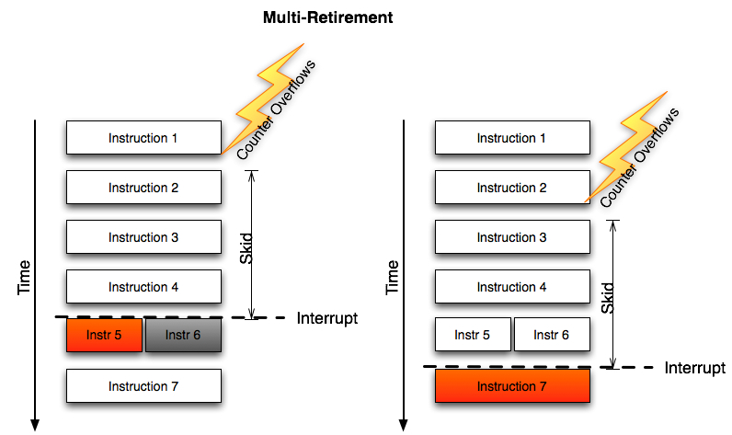
Accuracy Challenge

Slide 9
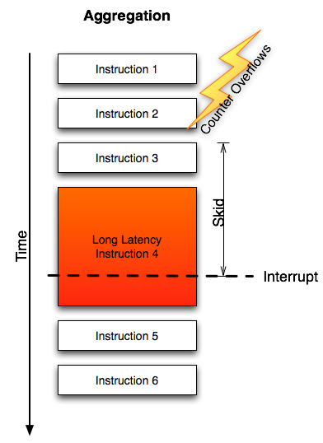
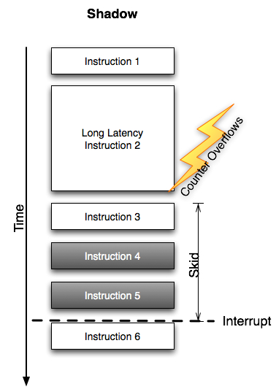
Accuracy Challenge

Slide 10
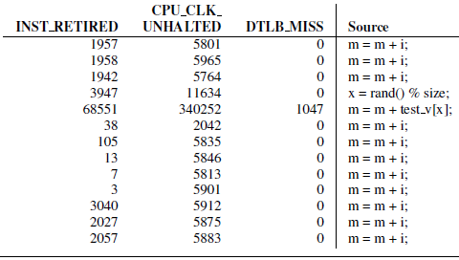
Accuracy Challenge

Slide 11
Improving the Accuracy
Flow Consistency
Use Minimum Cost Circulation Algorithm
Control flow → Network flow
Predict Aggregation/Shadow Effect
Sampling Multiple Events
Using the prediction to adjust the frequency

Slide 12
Source
Source
Branch: 7954
6873
6873
32
32
Taken: 7922
6905
6905
Join: 1049
6905
32
7954
7922
6873 + 32
1049
7922
0
7922
1049
Sink
Sink
[Levin et.al. Complementing Missing and Inaccurate Profiling using a Minimum Cost Circulation Algorithm. HIPEAC’08]

Slide 13
Use Prediction to Adjust Profile
Cost Function in MCC
Each basic block is attached by two edges
Forward (flow represents increasing the count)
Backward (flow represents decreasing the count)
Cost function for each edge
Larger cost means prevent changing in this direction
Using the prediction
Over-sampled: high cost on forward edge
Under-sampled: high cost on backward edge
BB1’
Forward Edge
Backward Edge
BB1’’

Slide 14
Predict Aggregation/Shadow
Model Aggregation Effects
Long latency instructions
Sample major long latency events
Branch Mispredict, Cache/DTLB Miss, etc
Estimate the stalls these events will cause
Skid has little influence on long latency events

Slide 15
Predict Aggregation/Shadow
Model Shadow Effects
CPU_CORE_CYCLES event
Time based sampling
Skid will only shift the profile
CPU_CYCLE – INST_RETIRED →Stalled Cycle (with skid)
Each stalled cycle will set a shadow area
Aggregation and Shadow co-exist
Heuristic to check which one dominates

Slide 16
Evaluation: Accuracy

Slide 17
Evaluation: Performance

Slide 18
Conclusion and Future Work
Sampling based FDO is promising
The artifacts in PMU data can be compensated for with appropriate understanding and heuristics, which improves the accuracy by 6%
Sample based Value Profiling
Future: Last Branch Register→More precise edge profile at binary level
Sample based LIPO

Slide 19
Questions?

