Slide 1
ZDDs for Dynamic Trace Analysis Graham Price Manish Vachharajani
Notes:
Intro

Slide 2

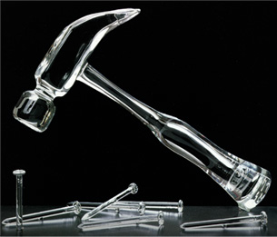
Motivation
Tools can be useful
ParaMeter
Are they useable?
Fabrel Studio
Representation take days to create!
Notes:
Shorten this slide

Slide 3
DIN vs. Ready Time
DIN
Instruction
Mem Addr
DIN
Ready Time
…
13
13
mov r3,r4
13
12
12
st 0(r1),r5
0xbee4
12
11
11
add r5,r3,r4
11
10
10
bnz r2, loop
10
9
9
addi r1,r1,4
9
8
8
addi r2,r2,-1
8
7
7
mov r4,r5
7
6
6
mov r3,r4
6
5
5
st 0(r1),r5
0xbee0
5
4
4
add r5,r3,r4
4
3
3
mov r3, 1
3
2
2
mov r4, 1
2
1
1
mov r2, 8
1
0
0
li r1, &fibarr
0
0
1
2
3
4
5
6
7
8
9
10
11
12
13
Notes:
Why is ParaMeter pretty. Fix numbers.

Slide 4

Video
Details: Price, Giacomoni, and Vachharajani PACT 2008

Slide 5
Trace BDD Construction
DIN
Ready Time
13
12
11
10
9
8
7
6
5
f_{d2} = (0,2)
4
3
2
f_{d1} = (0,1)
1
0
0
1
2
3
4
5
6
7
8
9
10
11
12
13
f_{d0} = (0,0)

Slide 6
Trace BDD Construction
Data Tuple
Binary Tuple
Boolean Function
(0,0)
(00,00)
(X’ * Y’ * Z’ * W’)
(0,1)
(00,01)
(X’ * Y’ * Z’ * W)
(0,2)
(00,10)
(X’ * Y’ * Z * W’)
{{X’ * Y’ * Z’ * W’}, {X’ * Y’ * Z’ * W}, {X’ * Y’ * Z’ * W}}
f_{trace} = (X’ * Y’ * Z’ * W’) + (X’ * Y’ * Z’ * W) + (X’ * Y’ * Z * W’)
Notes:
Use visual method to connect bits

Slide 7
The BDD Data Structure
False Arc
Inverting
False Arc
True Arc
F(X,Y,Z,W) = X*Y*Z*W
X
Y
Y
W
W
W
W
Z
Z
Z
Z
Z
Z
Z
Z
0
0
0
0
0
0
0
0
0
0
0
0
0
0
0
1
0

Slide 8
The BDD Data Structure
False Arc
Inverting
False Arc
True Arc
F(X,Y,Z,W) = X*Y*Z*W
X
Y
Y
W
W
W
W
Z
Z
Z
Z
Z
Z
Z
Z
Z
0
1

Slide 9
The BDD Data Structure
False Arc
Inverting
False Arc
True Arc
F(X,Y,Z,W) = X*Y*Z*W
X
Y
Y
W
W
W
W
W
Z
Z
0
1

Slide 10
The BDD Data Structure
False Arc
Inverting
False Arc
True Arc
F(X,Y,Z,W) = X*Y*Z*W
X
Y
Y
W
W
Z
Z
0
0
1

Slide 11
The BDD Data Structure
False Arc
Inverting
False Arc
True Arc
F(X,Y,Z,W) = X*Y*Z*W
X
X
Y
W
Y
Z
W
Z
0
1
1

Slide 12
Trace BDD Construction
X
X
X
Y
Y
Y
=
+
W
W
Z
Z
Z
1
1
1
f_{trace} = (X * Y * Z * W) + (X’ * Y’ * Z’ * W’)
f_{d0} = (X’ * Y’ * Z’ * W’)
f_{d1} = (X’ * Y’ * Z’ * W)
Notes:
Talk about strong canonisity, and this or operation takes polynomial time.

Slide 13

Trace BDD Construction Cont..
Unique Table
X
X
X
X
Compute Cache
Y
Y
Y
Y
W
W
W
1
=
1
+
Z
Z
Z
Z
Dead Nodes
I_{trace} = 0
1
1
1
1
f_{d1} = (X’ * Y’ * Z’ * W)
f_{trace} = (X’ * Y’ * Z’ * W’)
f_{d0} = (X’ * Y’ * Z’ * W’)
f_{trace} = (X’ * Y’ * Z’ * W’) + (X’ * Y’ * Z’ * W)

Slide 14
Trace BDD Construction Cont..
Unique Table
X
X
X
Compute Cache
Y
Y
Y
W
W
=
+
Z
Z
Z
Dead Nodes
1
1
1
f_{trace}
f_{d3} = (X’ * Y’ * Z * W’)

Slide 15
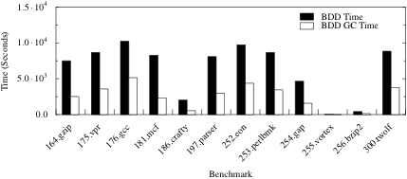
BDD Garbage Collection Time

Slide 16

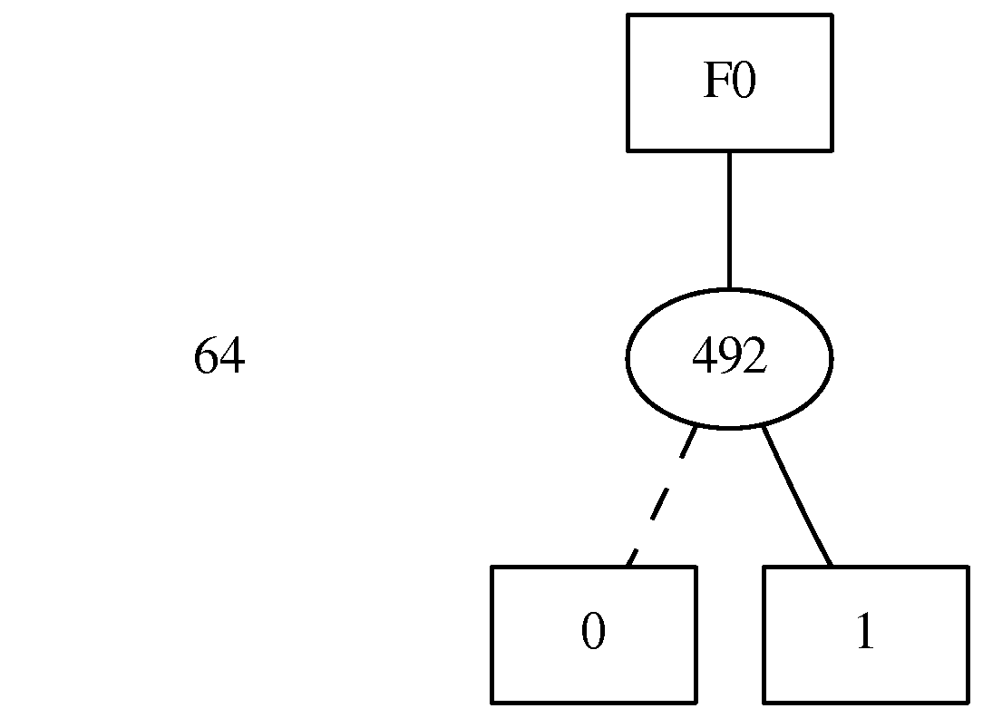
ZDDs
BDDs
Remove isomorpic graphs
Skip and remove nodes whose pointers point to the same child
ZDDs
Remove isomorpic graphs
Remove nodes whose “then” arc points to the constant 0

Slide 17
Trace ZDD Construction
Unique Table
f_{trace} = (X’ * Y’ * Z’ * W’) + (X’ * Y’ * Z’ * W)
Compute Cache
W
W
+
=
Dead Nodes
1
0
1
0
1
0
f_{d0} = (X’ * Y’ * Z’ * W’)
f_{d1} = (X’ * Y’ * Z’ * W)

Slide 18
Trace ZDD Construction
Unique Table
Compute Cache
Z
W
Z
+
=
W
Dead Nodes
1
0
1
0
1
0
f_{trace}
f_{d3} = (X’ * Y’ * Z * W’)
f_{trace (new)}

Slide 19
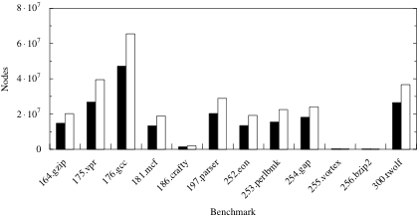
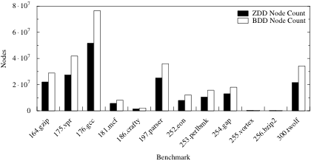
Trace ZDD Gains
~ 20% Reduction

Slide 20
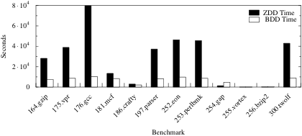
Trace ZDD Losses
3x Slower!

Slide 21
Trace ZDD Construction
Unique Table
Compute Cache
Z
W
Z
+
=
W
Death Row
1
0
1
0
1
0
f_{trace}
f_{d3} = (X’ * Y’ * Z * W’)
f_{trace (new)}

Slide 22
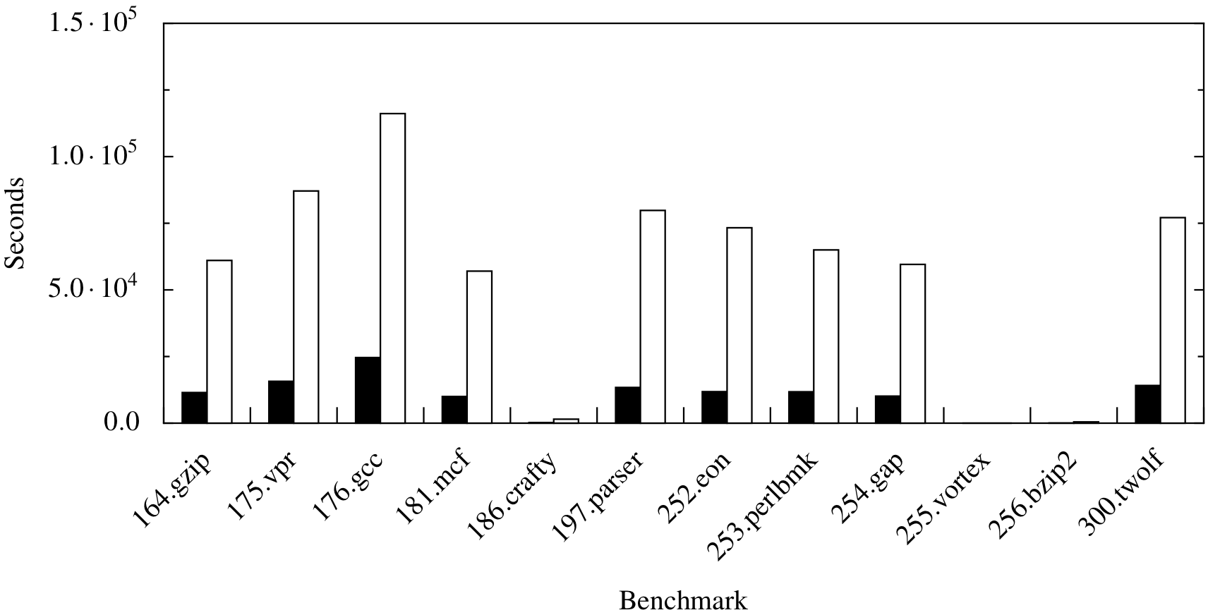
Trace ZDD Construction
DIN x RDY Tuples
Over 9 times faster!

Slide 23
Questions?

