Slide 1
An Adaptive Task Creation Strategy for Work-Stealing Scheduling
Lei Wang, Huimin Cui, Yuelu Duan, Fang Lu, Xiaobing Feng, Pen-Chung Yew
ICT, Chinese Academy of Sciences, China
University of Minnesota, U.S.A

Slide 2
Forecast
Adaptive task granularity
fine-grained parallelism
tasks
An adaptive task creation strategy
Work-stealing
Multi-cores
Notes:
In multi-threading programming, the programmer exposes the full parallelism in an application program and divides the work into fine-grained tasks. And then work-stealing scheduler maps and schedules these tasks into physical threads. There is a misunderstanding! The programmer doesn’t know how many cores can be used, and doesn’t know the workload situation, so he has to divide the work into fine-grained tasks. While the runtime system assumes that the programmer has already divided the work into appropriate task granularity, so it only considers how to get load balancing. We deal with the misunderstanding. We propose an adaptive task creation strategy to support work-stealing, the new strategy adaptively creates tasks to keep all threads busy and controls the task granularities.

Slide 3
Outline
An adaptive task creation strategy
A new data attribute -- taskprivate
Evaluations
Conclusions

Slide 4
Background
Cilk, Cilk++, X10, OpenMP3.0, TBB, TPL …
Parallel programming languages and libraries to support task-level parallelism
Programmer: dividing work into tasks instead of threads
Runtime system: mapping and scheduling tasks into physical threads
Key technique
Work-stealing scheduling

Slide 5
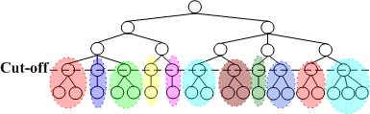
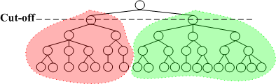
Granularity
too fine
➔
scheduling overhead dominates
cut-off = 3
too coarse
➔
lose potential parallelism,
cause starvation
cut-off = 1
Notes:
The task granularity problem is the tradeoff between the system overhead and the dynamic load balancing.
Now Cut-off strategy is used to control the task granularity, it specifies a depth of recursion in a computation tree beyond which no task could be created. But the big problem here is that when a cut is wrong, no task can be created and some threads are forced to be idle for lack of task to work on. In unbalanced computation trees, the problem is getting worse.

Slide 6
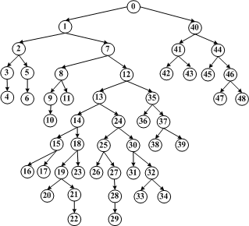
An unbalanced computation tree
P0 – red, P1 – blue, P2 – green, P3 – yellow.
Notes:
Assume there are four threads to execute nodes in the unbalanced computation tree.

Slide 7
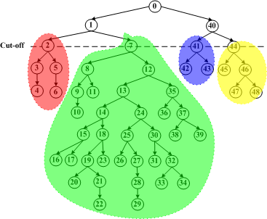
A cut-off strategy
Load imbalance
P0 – red, P1 – blue, P2 – green, P3 -- yellow

Slide 8
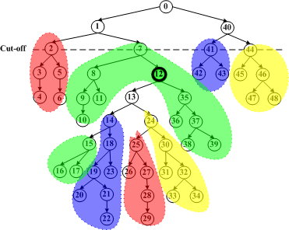
An adaptive task creation strategy -- AdaptiveTC
A special task
P0 – red, P1 – blue, P2 – green, P3 -- yellow
Notes:
In our strategy, a special task is introduced to switch a thread from a function call to a task, and further generate more child tasks for other threads to steal.
For example, when P2 is executing node12 in the green sub-tree, it could find that some other thread needs a task. P2 will create a special task 12 for node12, and then create child tasks for node 13 and 14 sequentially. Other threads can steal the descendant tasks. The whole system gets load balancing again.

Slide 9
AdaptiveTC
When executing a spawn statement
a task, a function call (a fake task), a special task
the task
the fake task
the special task
Adaptively switching between tasks and fake tasks to get a better performance
Cut-off
A special task
Keeping idle threads busy
Improving performance
Good load balancing
a task ➔ a fake task
a fake task ➔ a task

Slide 10
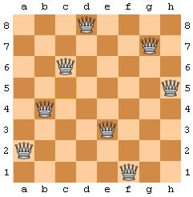
Which Cilk programs are correct?
N-queen problem
Notes:
The second issue.
N-queen problem is a typical backtracking search. The implementation needs to maintain a chessboard that indicates all current positions of the queens. As the chessboard variable could be accessed and modified by multiple tasks concurrently, in Cilk, the programmer needs to allocate memory space, and copy the value of the parent’s chessboard to each child task in order to assure correctness. This is called workspace copying.

Slide 11
A new data attribute -- taskprivate
Workspace copying
Not easy to program
Overhead is high
taskprivate
Introduced for workspace variables
Notes:
We propose a new data attribute taskprivate for workspace variables. The programmer only indicate that the parameter x is a taskprivate variable and what size it is. And then in AdaptiveTC, fake task and task handle taskprivate variable in different ways. In a fake task, the taskprivate keyword is ignored. But in a task, allocating and copying a new taskprivate variable for a child task is performed in order to assure correctness. In AdaptiveTC, as the number of tasks created is very small, taskprivate variables reduce the cost of workspace copying. So, the new attribute taskprivate improves the programmability and reduces workspace copying overhead to achieve a higher performance.

Slide 12
Test system, test cases
8 cores
2-processor quad core Intel Xeon E5520 (2.26GHz, 8G memory)
8 test cases
6 are backtracking search programs.
2 are divide and conquer programs.
Compared systems
Cilk-5.4.6, Tascell (PPoPP’09), AdaptiveTC
gcc -O3

Slide 13
Test case 1 -- performance
(Seconds) | 1 thread | 8 threads
C | 61 | 61
Cilk | 198 | 24.57
Cilk-SYNCHED | 184 | 22.41
Tascell | 85 | 14.24
AdaptiveTC | 66 | 8.27
Nqueen-array(16)
Notes:
The first test case is 16 nqueens problem, and uses an array to record whether conflicts occur.

Slide 14
Test case 1 -- analysis
Breakdown of overhead
Load balanced
overhead
The usage of cores with 8 threads
28.7% | 69.2% | 67% | 7.9%
Notes:
The task granularity problem is the tradeoff between the system overhead and the dynamic load balancing.
The ratio of the overhead to the total execution time shows how much the overhead impact the performance.
From these two figures, we can see that AdaptiveTC runs faster than Cilk. The major contributor is taskprivate variable, which reduces the workspace copying overhead. And it runs faster than Tascell for two reasons: less overhead and better dynamic load balancing.

Slide 15
Test case 2 -- performance
(Seconds) | 1 thread | 8 threads
C | 554 | 554
Cilk | 669 | 85
Cilk-SYNCHED | 661 | 88
Tascell | 627 | 114
AdaptiveTC | 612 | 77
Nqueen-compute(16)
Notes:
The second test case is also 16 Nqueens problem, but uses a different implementation. Instead of confliction array, it traverses the chessboard to find out whether conflicts occur, so it is more memory efficient, but spends more time in each task.

Slide 16
Test case 2 -- analysis
Breakdown of overhead
Load balanced
overhead
11.7% | 17.2% | 16.2% | 9.5%
The usage of cores with 8 threads
Notes:
In this test case, the system overhead in Cilk and Tascell is not as big as that in Test case1. Though AdaptiveTC still outperform, the improvement is not that big.
From load balancing analysis, AdaptiveTC and Cilk are better than Tascell. That’s why AdaptiveTC can outperform Tascell in this case, even they have similar overheads.

Slide 17
Experimental results

Slide 18
Experimental results (cont’d)
speedup
Cilk | 1
Cilk-SYNED | 1.07
Tascell | 1.5
AdaptiveTC | 2.24
Figure: Speedup with 8 threads, baseline is Cilk’s execution time
Notes:
With 8 threads, AdaptiveTC achieves 2.24 times average speedups over Cilk, and 1.6 times average speedups over Tascell.

Slide 19
Conclusions -- AdaptiveTC
An adaptive task creation strategy controls the tasks granularity.
Reducing the system overhead
Achieving a good load balancing
A new data attribute taskprivate is introduced for workspace variables.
Improving the programmability
Reducing the cost of workspace copying with an adaptive task creation strategy
Notes:
The contributions of this paper include two points.
Firstly, an adaptive task creation strategy is proposed to support work-stealing techniques for lower system overhead and better load balancing. AdaptiveTC is very suitable for many applications that have no definitive working sets or an unbalanced computation tree.
Secondly, a new data attribute taskprivate is introduced for workspace variables. It improves the programmability and further works with the controlled task granularities to reduce workspace copying overhead, and thus achieving a higher performance.

Slide 20
Thanks！

