Slide 1
Speculative Parallelization of
Partial Reduction Variables
Liang Han* Wei Liu⁺ James Tuck*
* Dept. of ECE, North Carolina State University
+ Intel Corp.

Slide 2
Parallelizing sequential codes
The abundance of irregular, serial code makes automatic parallelization important and hard
To be successful, strategies must:
  Avoid conservative assumptions for correctness
  Exploit the likely behavior of dependences at runtime
Notes:
Given the abundance of multi-core architectures and
the relatively few programs capable of exploiting parallel architectures effectively,
techniques for automatic and semi-automatic parallelization are increasingly important.

Slide 3
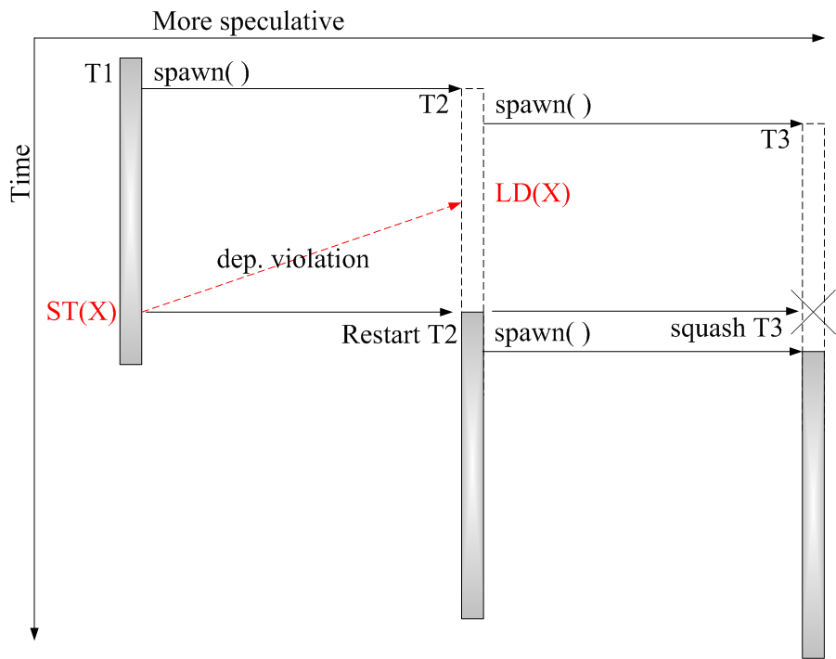
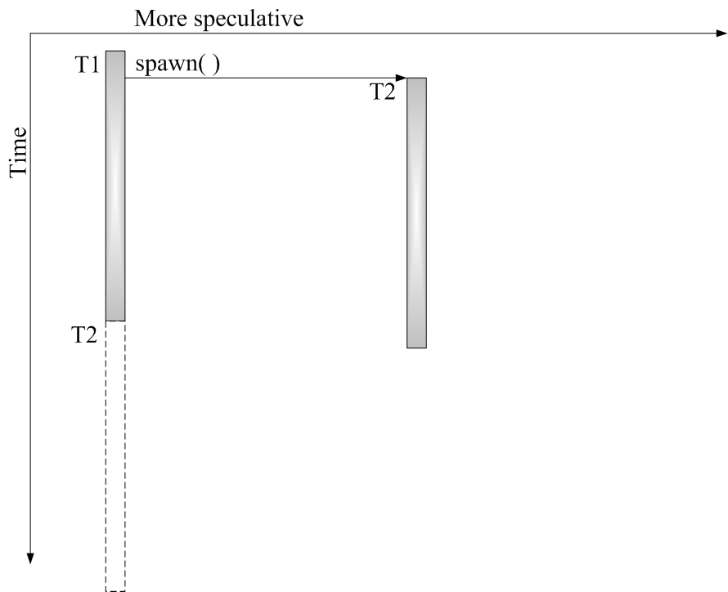
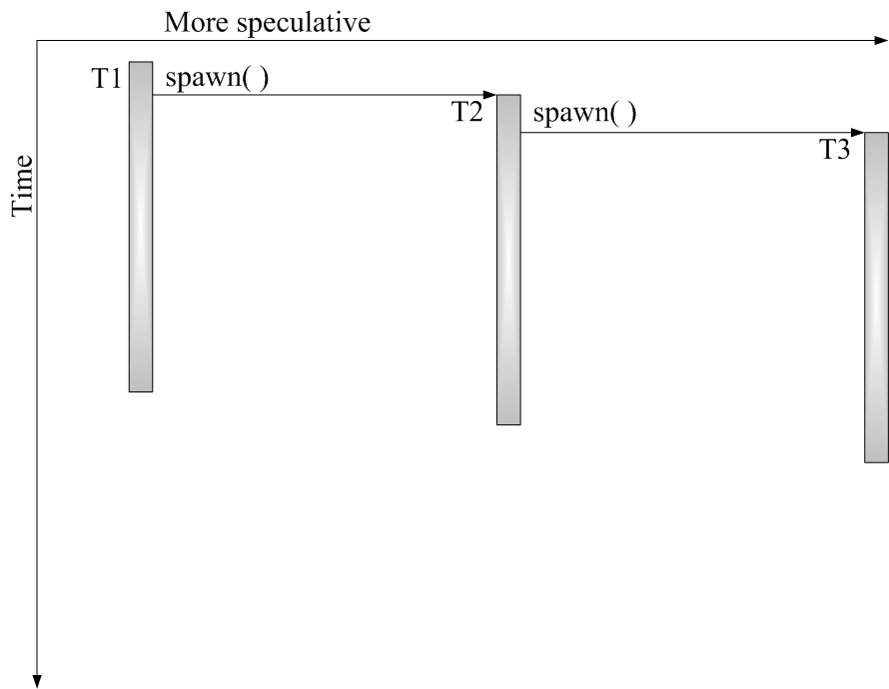
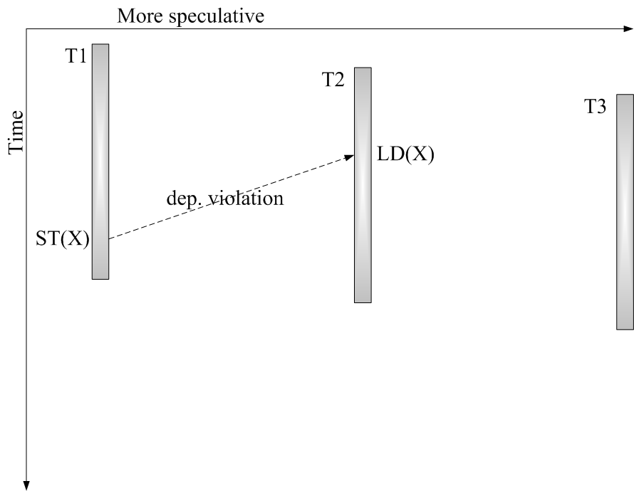
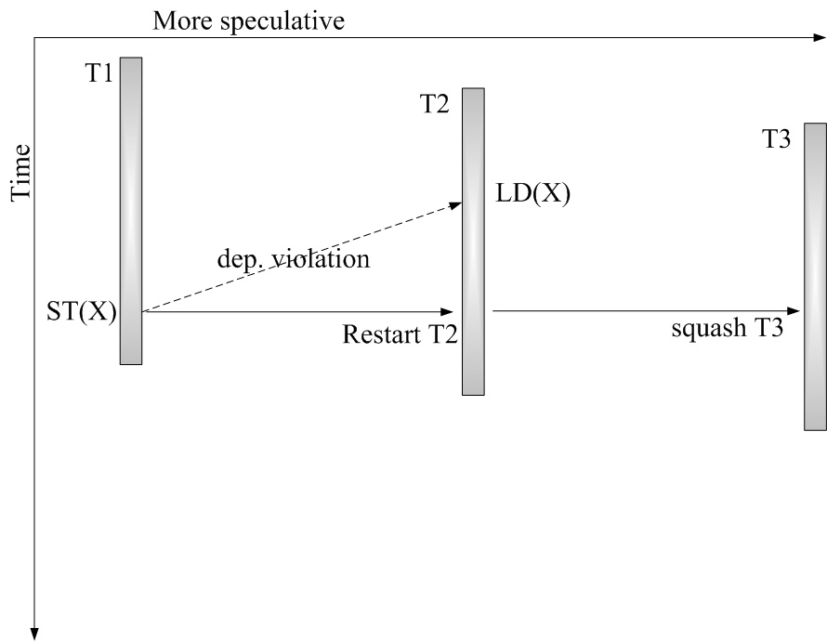
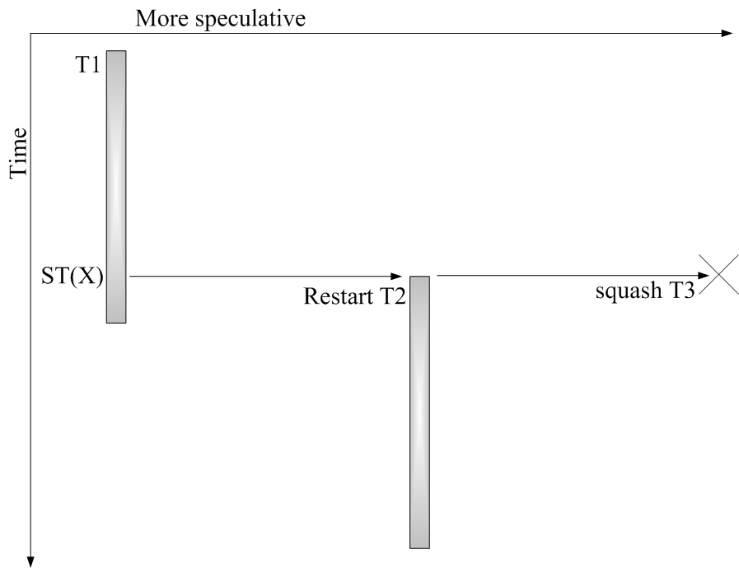
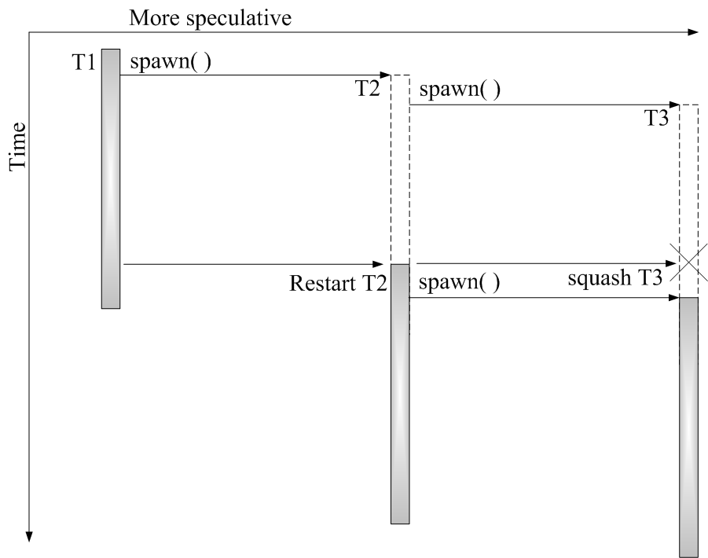
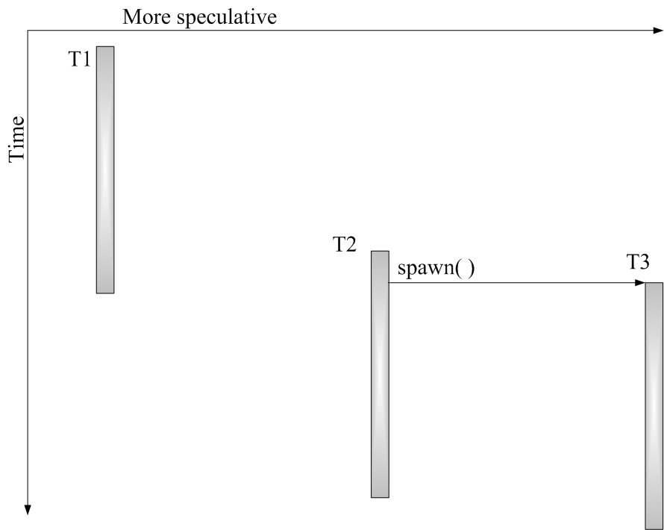
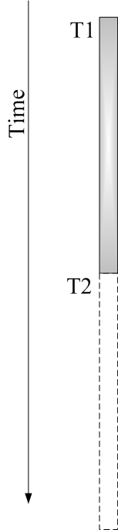

Thread Level Speculation (TLS)
A good way to parallelize sequential codes
Problem: squashes caused by mis-speculations
Reason: cross-thread dependences
Reduction variable (RV) is an important one
Notes:
How prog correctness guaranteed at runtime
Time proceed down the page
1. TLS:
-compiler doesn’t have to prove dependence – allow more parallelizing opportunities to be exploited at runtime.
-H/Ws track dependence violations at runtime and squash violated works on speculation failure.
2. Problem of TLS:
Current technologies have not done good jobs on this issue.
4. This study is targeted to parallelizing reduction behaviors on TLS systems.

Slide 4
Reduction Variables (RVs)
A reduction is a kind of loop recurrence
r = r (op) exp
  ‘exp’ is independent of ‘r’
  ‘r’ can not be read or written outside this update stmt
  ‘(op)’ has associativity and commutativity
RVs introduce loop-carried dependences
But, computation of RVs can be parallelized on a multi-core system via privatizing and synchronization
Notes:
With those restrictions on previous slide in place, the computation of RV, sum, can be parallelized by exploiting the associativity and commutativity of the recuction operator.
Via privatizing and synchronizing, the cross thread dependences on sum are removed or delayed to end of loop.
So,
- as long as we can detect a RV, we can handle it in this way so that the loop containing it can be parallelized.
- The more RVs we can detect, the more opportunity of parallelizing sequential codes we will have.

Slide 5
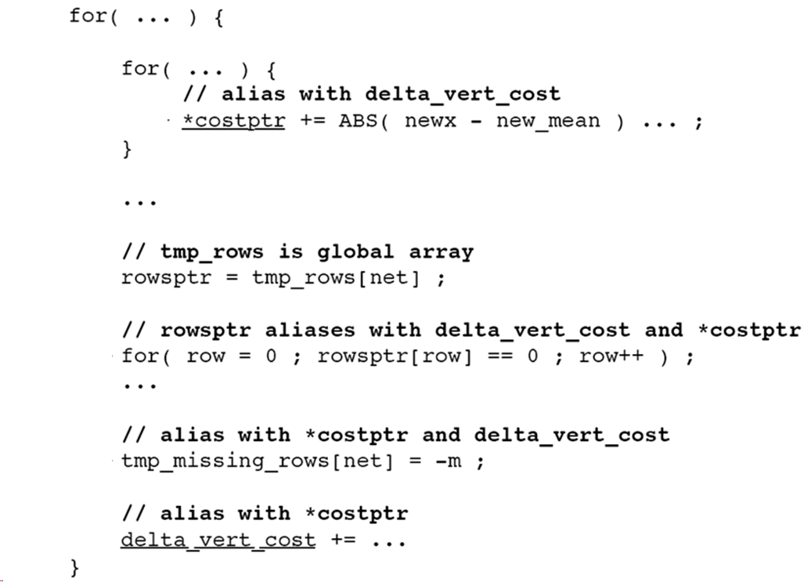
But…detecting RVs can be tough in irregular codes
In 300.twolf of SPECint2000
Potential accesses out of RV update statement
Notes:
The presence of either one is enough to disqualify both variables as RVs.

Slide 6
Runtime reduction behaviors
  Many variables behave like reduction dynamically
  But, few of them are detected by compiler
    Due to the limitation in conservative RV definition
      RVs cannot be accessed outside of update stmt
Due to conservative compiler analysis, run-time opportunities are lost in many cases
    May-alias references outside the RV update stmt may not alias at run-time
    RV references on seldom-taken branch could not happen at run-time
    Non-analyzable codes (e.g. external library calls) very likely never access the RV at run-time
We must exploit dynamic reduction behaviors!
Notes:
Case 1.Especially in a specific iteration at run-time
-For this case the variable behavior as a RV at runtime
Case 2.Is a RV along frequent path.
Case 3.Very likely the Update will not happen at runtime

Slide 7
Contributions
Define Partial Reduction Variables (PRVs) for static analysis:
  Our definition captures a wide variety of dynamic reduction behaviors
  PRVs appear 3 times more frequently than RVs
Describe a PRV detection algorithm
Propose S/W and H/W mechanisms that work synergistically to parallelize PRVs
Evaluated on SPEC CPU 2000
  Up to 46% and on average 10.7% performance gain
Notes:
PRV is a kind of shared variable that may behave like a RV at runtime
-performance gain against a state-of-the-art TLS system

Slide 8
Outline
Motivation
Definition and Detection of PRVs
S/W Parallelization of PRVs on a TLS System
Enhanced mechanisms with H/W Support
Evaluation and Conclusions
Notes:
Given the potential benefit of supporting PRVs, let’s see how to define it and detect them in compiler.

Slide 9


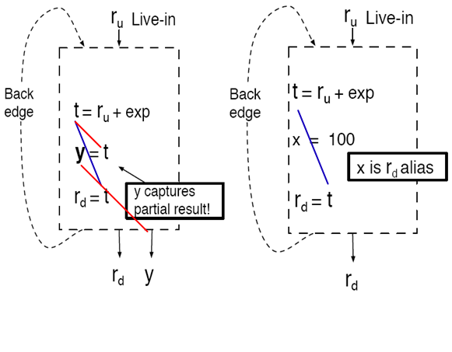
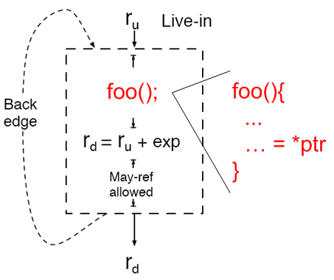
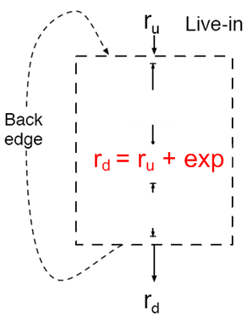
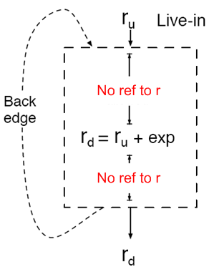
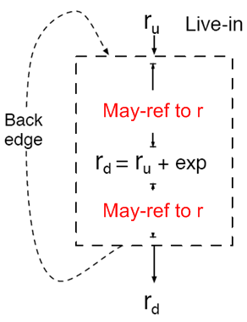
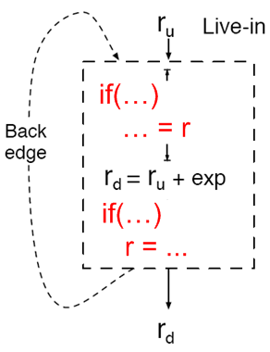
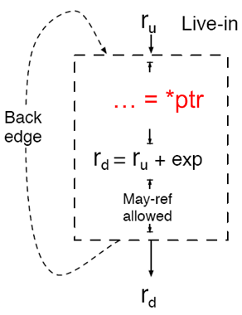
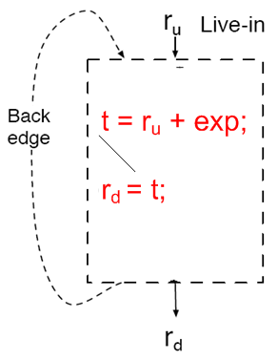

Partial Reduction Variables (PRVs)
Classic RVs require no access outside the update stmt
Permit R/W RVs out of the update stmt – May-ref to PRV
- Control flow
- Alias
- Cross-module / lib call
RV-update-chain cannot be interfered
- Rare cases
- Supporting them will complicate H/W and overall mechanisms
Notes:
Now, let’s see how we relaxed the definition of RVs to PRVs
Permit:
1.Single stmt, may ref allow
2.Multiple stmt,
3.PRV behavior on a path (hope freq at run-time)
4.Addr of r escapes to function call f()
Bad cases:
No PRV may-reference occurs in any RV-update-chain.
- t is propagated away by y
W to r could happen in mid. of the link
Although we could handle them in a tricky way,
They are rear cases
they complicated H/W and the overall mechanism a lot.
So, we just exclude these cases to keep H/W simple.
To sum up,
- Ref or may-ref are allowed outside of the RV-update-chain,
as long as they don’t break the RV-update-chain in the mid.
non-analyzable cross-module and lib call are allowed
RV-update-chain could be on a non-dom path.
? Could RV-update-chain in multi-BB.
As long as RV-update-chain is in a closed use-def chain (no live-in/live-out to it), it’s fine.

Slide 10
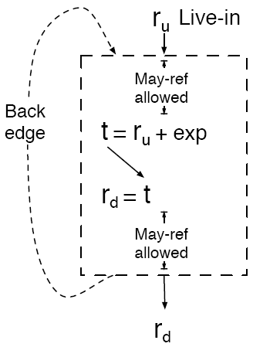


PRVs auto-detection algorithm
Based on detecting induction variables^{[12]} (IVs)
  Diff: ‘constant’ => ‘expr’
    Detect IV: iv = iv (op) constant
    Detect RV: rv = rv (op) expr
Steps:
  Detects a RV-cycle
  Searches for a RV-update-chain
  starting from an assignment
  Doesn’t stop searching on accesses out of the RV-update-chain
  Validation: no PRV may-ref occurs in RV-update-chain
[12] M. P. Gerlek, E. Stoltz, and M. Wolfe. Beyond Induction Variables:
Detecting and Classifying Sequences Using a Demand-Driven SSA Form.
ACM Trans. Program. Lang. Syst., 17(1):85–122, 1995.
Notes:
Our PRV detection algorithm is implemented in GCC 4.3 using the Tree-SSA intermediate representation.

Slide 11
Outline
Motivation
Definition and Detection of PRVs
S/W Parallelization of PRVs on a TLS System
Enhanced mechanisms with H/W Support
Evaluation and Conclusions

Slide 12
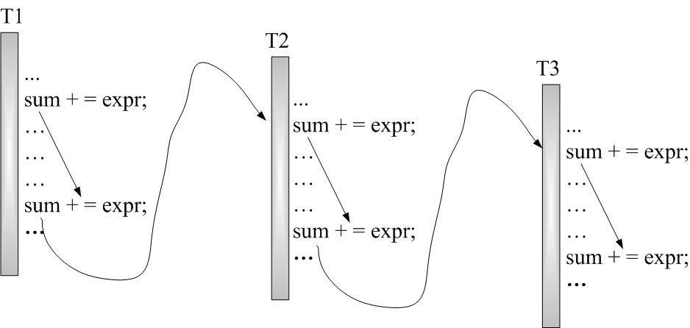
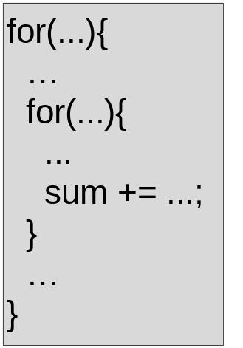
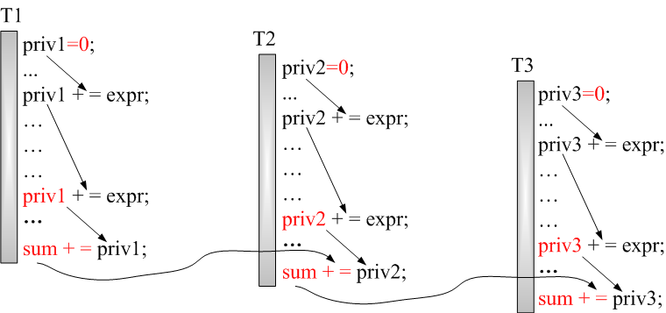
Requirements for parallelizing PRVs (1)
(1) When a PRV behaves like a classic RV
  Privatize PRV
    Initialize priv.
    PRV->priv.
  Synchronize
  Accumulate

Slide 13
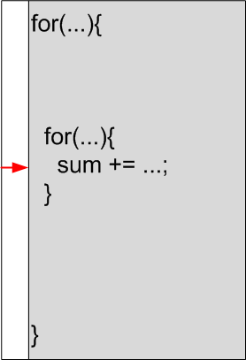
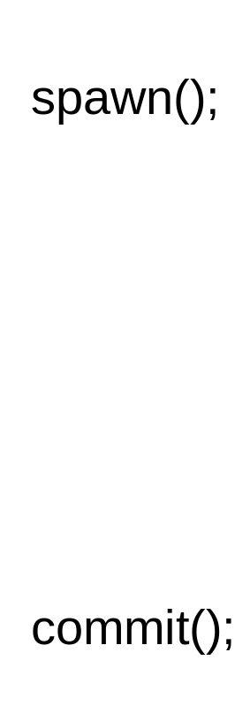
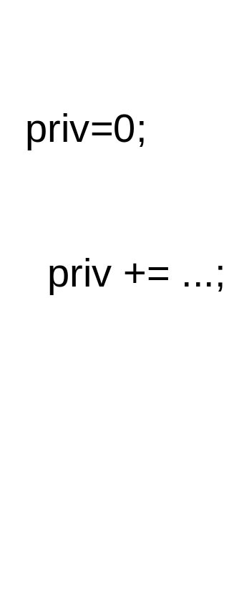
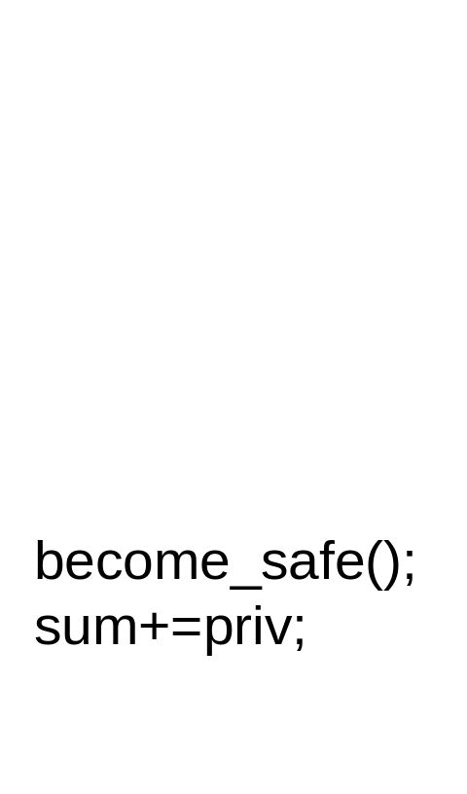
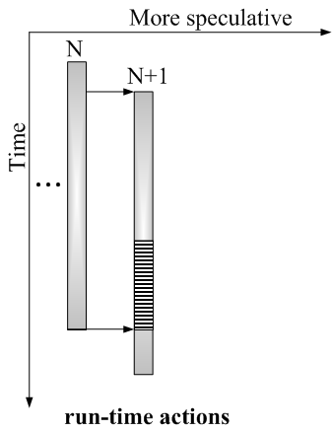
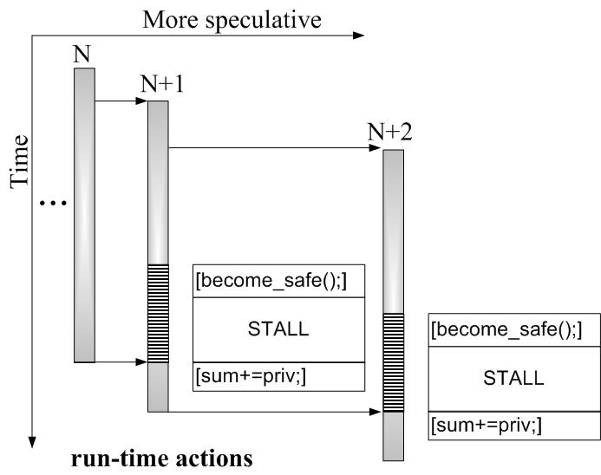

Parallelize PRVs on a TLS System (1)
(1) Classic RV
Privatize…
Synchronize…
Accumulate

Slide 14
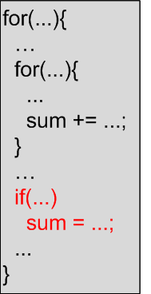
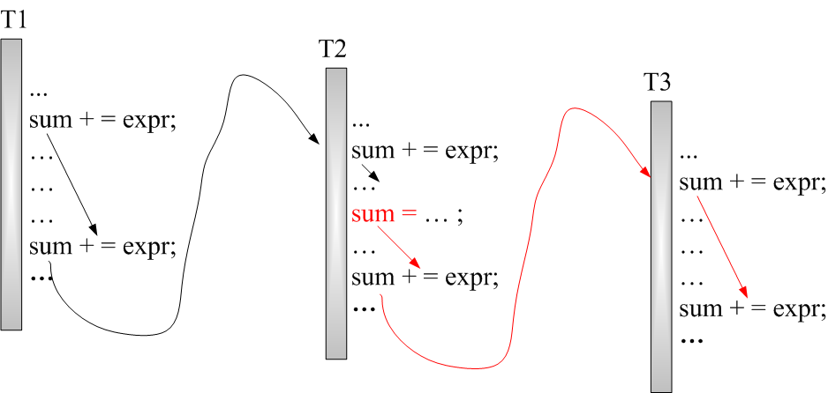
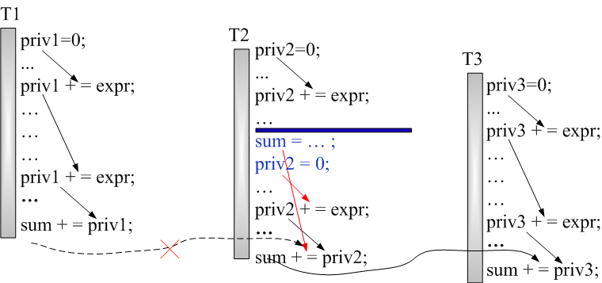
Requirements for parallelizing PRVs (2)
(2) Store to a PRV outside of RV-update-chain
Preserve the last store and order it with respect to all later iterations
Notes:
Store-only:
Have to ensure that the value of the PRV after executing the loop is equal to the last non-updating store accumulated with the private variable updates from all later iterations.

Slide 15
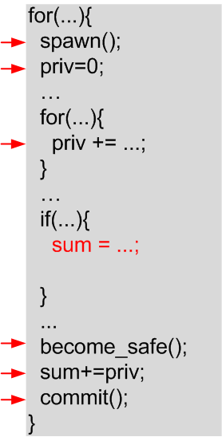
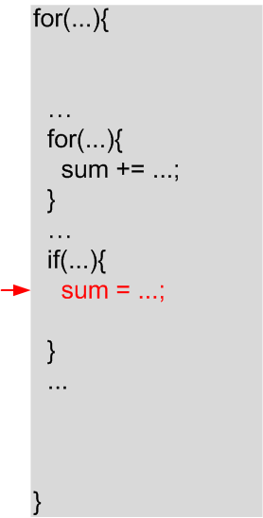
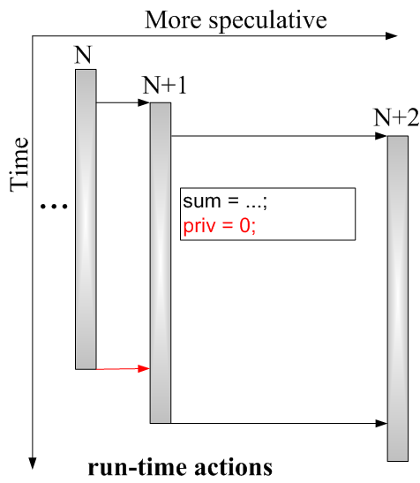
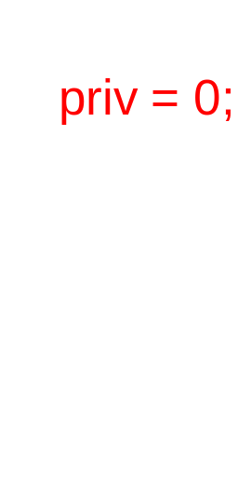
Parallelize PRVs on a TLS System (2)
(2) Store outside of update
Support classic RV
Store to PRV
Reset priv

Slide 16
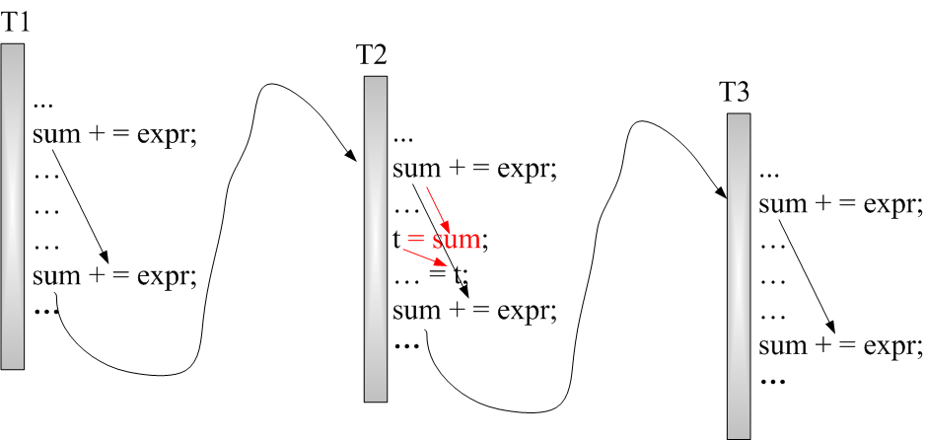
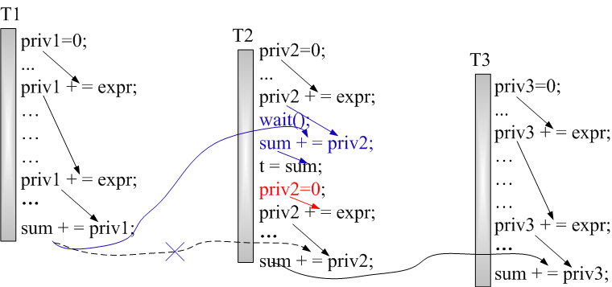
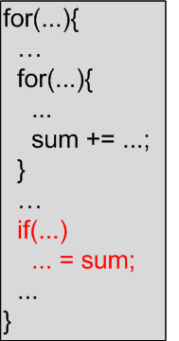
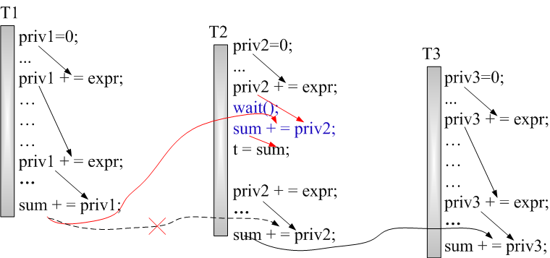
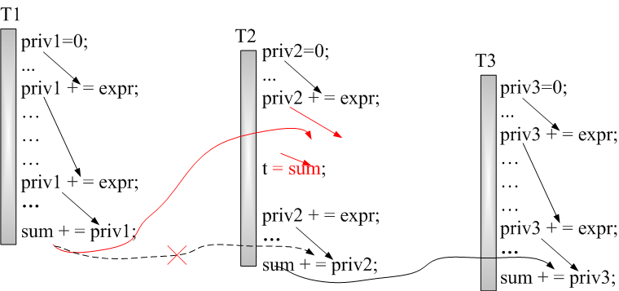
Requirements for parallelizing PRVs (3)
(3) Load from a PRV outside RV-update-chain
  The load must wait until PRV’s value is fixed
    All prior iterations complete the last update to their private variable
    Accumulate it to local private variable
  Reset private variable
Notes:
Load only:
all private values accumulated from prior iterations must be merged with the PRV to provide the correct value.
This requires that all prior iterations complete their last update to the private variable.
- If some of those iterations have not yet been scheduled, then the load must wait.

Slide 17
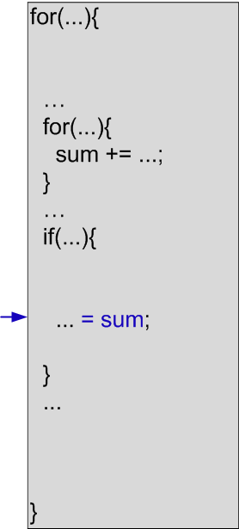
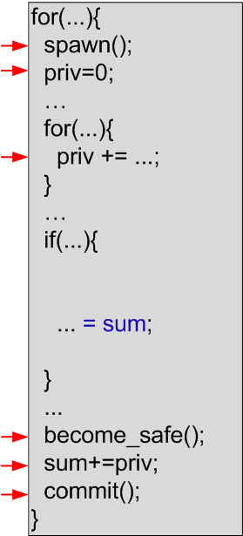
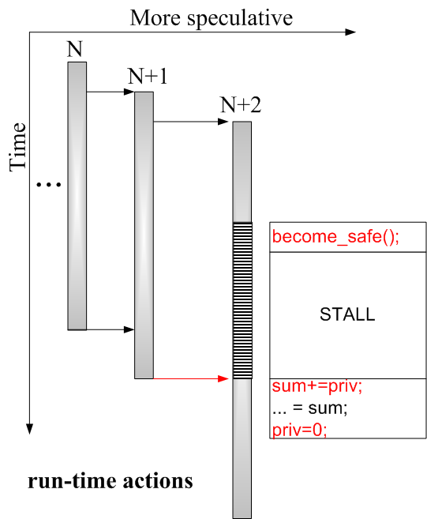
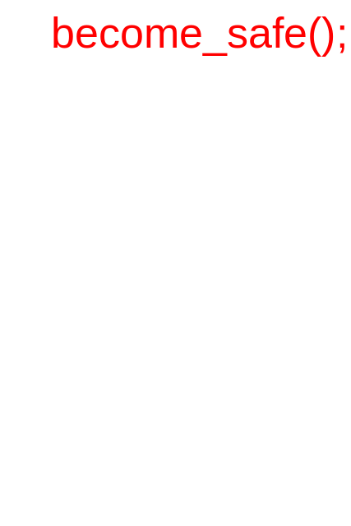
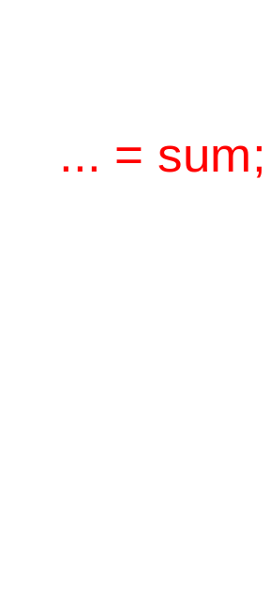
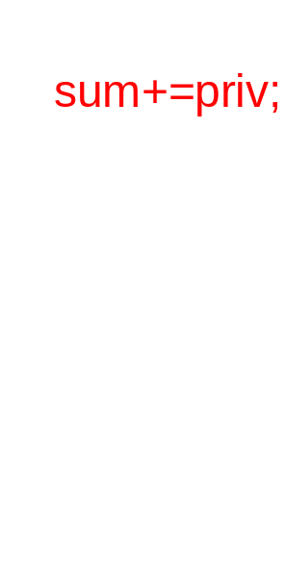
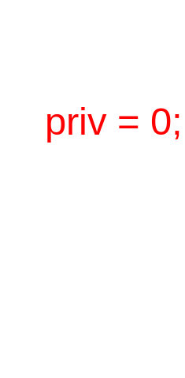

Parallelize PRVs on a TLS System
(3) Load outside of RV-update-chain
Support classic RV
Fix PRV value
Load PRV
Reset priv

Slide 18
Outline
Motivation
Definition and Detection of PRVs
S/W Parallelization of PRVs on a TLS System
Enhanced mechanisms with H/W Support
Evaluation and Conclusions

Slide 19
Support Implicit Accesses to PRVs
Implicit accesses to PRVs
  May-aliases
  Non-analyzable codes (cross-module or library calls)
  H/W is needed
We use a combined S/W and H/W approach
  Compiler:
    Inserts classic RV parallelization transformations
    Notifies H/W that there are implicit accesses
  Hardware:
    Monitors RV access and implicitly performs needed operations
Notes:
To this point all schemes we introduced are S/W techniques.
But we still need H/W support…

Slide 20
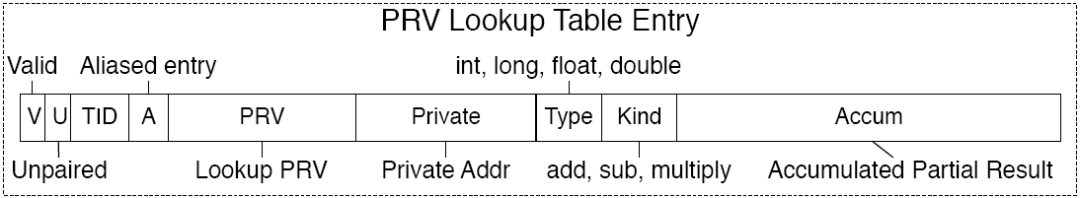
S/W-H/W Interfaces
When implicit accesses to PRVs is detected:
  Compiler: inserts pair(&PRV,&priv,+,int) / unpair()
      PRV Lookup Table (PLUT)
  H/W: will create an PRV entry in PLUT
Notes:
A bit: compiler may sel 2 PRVs in the same loop that may alias.
All priv R/W will be treated as PRV R/W, so that to guarantee correctness.
TID: commit, scan entries has this TID, bring PRV up-to-date.

Slide 21

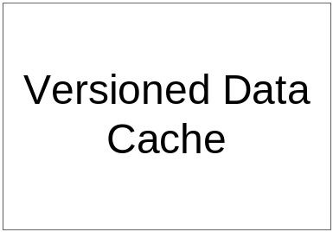
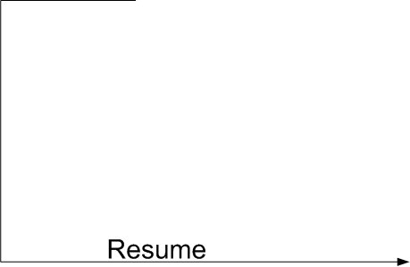





H/W Architecture and Run-Time Actions
Ld-St Queue and Versioned Cache: typical TLS
PLUT: PRV Lookup Table
Sig:
  Detect LD/ST address conflict against those in PLUT
  Signature is used for fast detection
Controller:
  Stall LSQ on hit
  Fix PRV status
  Resume LSQ
Notes:
The Load-Store Queue (LSQ) and Versioned Cache are assumed to be typical with no features specific to our scheme.
Versioned data cache:
is used to buffer speculative values in local thread.
across-thread communication is performed via cache coherence protocol
On PLUT hit, controller need stall LSQ and fix state.
Signature is used for fast detection of PLUT conflict.
[- (for 64-bit systems) A 32-bit bloom filter w/ single hash function derived from lower bits of address excluding the 2 least significant bits.]

Slide 22





Mechanisms to Support Implicit Access to PRVs
Compiler: SW/HW interface
Support classic RV (simplified)
No explicit fixing codes
H/W: detects access and updates PRV

Slide 23
Outline
Motivation
Definition and Detection of PRVs
S/W Parallelization of PRVs on a TLS System
Enhanced mechanisms with H/W Support
Evaluation and Conclusions

Slide 24
Methodology
Compiler: POSH ported to GCC 4.3
  Profiler weeds out ineffective tasks
  3 version of binaries (base / TLS / TLS+PRVs)
Simulator: SESC
  4-core CMP with TLS support
  3-issue core / 32KB private L1 / 2MB shared L2
  4-entry PLUT per core
Benchmark: SPEC CPU 2000
  Insert simulation markers in src codes
  Skip given number of markers (avr. 1-6 billion inst.)
  Run given number of markers (500 million to 1 billion inst)
Notes:
Our PRV detection algorithm is implemented in GCC 4.3 using the Tree-SSA intermediate representation.
a cycle-accurate execution-driven simulator models superscalar processors and memory subsystems in detail.
L1 buffer speculative data.
For diff binaries, simply timing a fixed number of inst is incorrect.

Slide 25




Performance & WastRate (normalized to base)
Overall 10.7%
Higher is better
15.82%
5.84%
Lower is better
WasteRate = # squashed inst (due to vio) / # of committed inst
Notes:
WasteRate: number of squashed inst(due to vio) out of the total number of committed inst.
The lower this ratio is, the less power will be wasted.
Since TLS+PRV removes some dep.
[? Didn’t show TLS+RV: same with TLS (except parser)]

Slide 26

PRV Characterization
ddd
Notes:
Final spec tasks sel by compiler infrastructure.
1.Main gain: Just A few PRVs have boosted performance and lowered power.

Slide 27
PRV Characterization
ddd
  Classic RVs
  but nearly no speedup
  Need our H/W support
  Need our S/W schemes
Notes:
Now, let’s see the PRVs distribution from another aspect…
L/P/G means…
This distribution shows how important it is to support PRVs. W/O our PRV support schemes, we would see nearly no benefit by merely supporting traditional RVs.
From another aspect, we can see the parallelization strategies could be tailored for each class of PRVs. This enables performance-cost trade-off on implementation.

Slide 28
Related work
Speculatively parallelization of hard-to-analyze reductions.
  LRPD test (Rauchwerger and Padua) [21]
  Instead of requiring complete static analysis, some disambiguation tests were delayed until runtime. (need insert dep. tracking & tests / cannot handle non-analyzable codes)
Hardware support for reductions
  PCLR (Garzaran et al.) [10]: accelerates the merging phase of the reduction after the parallel region. (focus on diff . issue / orthogonal to our mechanisms)
  UPAR (Zhang et al) [40]:
  (simple RVs/ scientific prog./ additional coherence protocol changes)
TLS systems have identified the need to effectively handle reduction variables
  Zhai et al.[39]: show the benefit of reductions for SPECint applications and shows modest gains. (auto. / RVs only)
  Prabhu et al.[19]: reductions is an important transformation to unlock the potential of key loops in vpr, mcf, and twolf. (manual)
Work by Zhai et al. on TLS targeting efficient synchronization of cross-thread dependences [37][38] is also relevant. (over-synchronized sometimes)
Notes:
1.- More recent work has identified the importance of employing speculation to extract more parallelism from hard-to-analyze reductions.
- LRPD…
Instead of requiring a complete static analysis, some disambiguation tests were delayed until runtime.
Refinements of the LRPD algorithm aim to increase coverage and reduce overhead of this approach.
-However,these mechanisms require full control-flow analysis of the
code being parallelized and identification of all loads and stores
that may participate in the reduction. Non-analyzable control flow
(e.g. into libraries) with unknown reads/updates cannot be treated
with this mechanism.
- Ours can cope with potentially unknown reads or writes to the reduction
variable at runtime.
2.
- Our definition of PRV shares many similarities with that described
by Zhang et al in UPAR[40].
- However, UPAR only evaluates certain kinds of PRV. Our approach broadens the definition;
it tolerates explicit accesses to the PRV, not just aliases.
- In addition, we search for PRVs in pointer-intensive integer codes, and
our approach is better suited to find a wide variety of PRVs in this domain.
3. Compilers and systems for Thread-Level Speculation have identified
the need to effectively handle reduction variables.

Slide 29
Conclusions
Define Partial Reduction Variables (PRVs) for static analysis:
  Our definition captures a wide variety of dynamic reduction behaviors
Describe a PRV detection algorithm
Propose S/W and H/W mechanisms that work synergistically to parallelize PRVs
Evaluated on SPEC CPU 2000
  Up to 46% and on average 10.7% performance gain
More benefit if combined with additional techniques targeting non-PRV dependences
Notes:
PRV is a kind of shared variable that may behave like a RV at runtime
More benefit if combined with other techniques
Loop unrolling for small loops
Additional tech targeting non-PRV dependences

Slide 30
Questions?

