Slide 1
LIPO: Feedback Directed Cross-Module Optimization
  davidxl@google.com
  raksit@google.com
  rhundt@google.com

Slide 2
Contents
Motivation
LIPO Overview
LIPO Implementation
LIPO Advantages
Future Directions

Slide 3
An Introductory Example
Problem:
  Optimization capability is limited by scope of the code compiler can see;
  Main optimization blocker: function boundaries, and artificial source boundaries
a.c:
int foo(int i, int j)‏
{
return bar (i,j) + bar (j,i);
}
b.c:
int bar(int i, int j)‏
{
return i - j;
}

Slide 4
Why is IPO Important ?
IPA : Performs analysis and transformations inter-procedurally – breaks function boundaries;
IPO : cross module IPA – breaks source boundaries
  Enables the most aggressive compiler optimizations by giving it the most freedom
  Allows the compiler to extend the optimization scope to functions in different modules via cross module inlining
  Whole program analysis reveals important function/variable properties (to enable optimization) not available otherwise

Slide 5
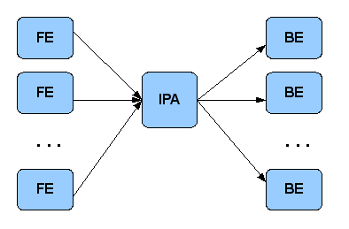
Traditional Link Time IPO
Very Powerful
  HP, Intel, Open64, etc follow this model

Slide 6
Problems With Link Time IPO
  Monolithic IPA phase: No build parallelism, compile time bottleneck
  IL object 4x larger – requiring large disk space, putting pressure on network bandwidth (distributed build)‏
  Dependence tracking and incremental build is hard
  Debugging support (depends on IL/compiler) problematic
  Hard to integrate with large scale build clusters
  To get the best potential out of IPO -- FDO is required! Further complicates build process

Slide 7
Problems With Link Time IPO
Usually hard for complex programs to provide whole program during build (shared libraries) – makes link time IPO even less attractive
Not practical -- software vendors are reluctant to use
As benchmarking tool by hardware/OS vendors

Slide 8
Contents
Motivation
LIPO Overview
LIPO Implementation
LIPO Advantages
Future Directions

Slide 9
Scalable IPO – Is it possible ?
The link step of traditional IPO is the bottleneck which makes it non scalable
Is the link step really needed?
First answer the question: what are the IPO transformations that have the most performance impact?

Slide 10
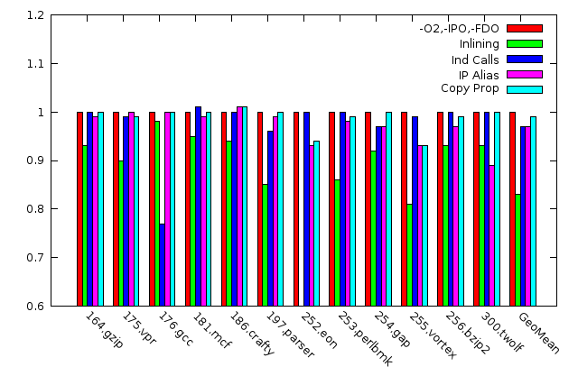
Effects of IPO Transformations

Slide 11
Scalable IPO – Is it possible?
Yes, it is possible if
  The compiler knows about what other source modules are needed for cross module inlining before the compilation starts
  Cross module analysis and preliminary inline decisions need to be performed early in order for this to happen

Slide 12
A Scalable IPO Scheme
In this scheme, CMI is enabled for compilation of a.c and d.c (assuming important calls are made to functions defined in b.c)‏

Slide 13
Feedback Directed Optimization
  Imposes a dual build model (FDO, PBO, PGO)‏
  2-Pass compilation with training run
    profile-gen compile, instrument binary
    training run, generate profile
    profile-use compile, use profile for best optimization
  FDO helps optimizing compilers:
    better optimization decisions (inlining, unrolling), value profiling and code specializations, data/code layout/cache optimizations etc.

Slide 14
LIPO is the solution !
  Leverage early steps in FDO process to make early decisions, no need to delay everything to IPA link!
  Integrate IPO with FDO, seamlessly!
  Move IP analysis (IPA) into the binary and execute it at the end of training run -- make global decisions earlier!
  Write IPA analysis results into profile
  During profile-use compilation,
    compile each file, as usual, with augmented profile
    read additional IPA results
    read in auxiliary modules to extend compilation scope

Slide 15
Contents
Motivation
LIPO Overview
LIPO Implementation
LIPO Advantages
Future Directions

Slide 16
Implementation
Three main blocks :
  LIPO runtime
  Support in language frontends
  Compiler middle end extensions

Slide 17
LIPO Runtime
  Linked into instrumented binary
  Invoked before program exit
  Performs IPA analysis
  Dumps IPA results into profile database
.

Slide 18
LIPO Runtime
  Currently only module affinity analysis for CMI
  Builds dynamic callgraph using indirect call counters and new direct call counters (used only for this purpose)‏
  Ideally module affinity analysis should be the same as inline heuristics (callsite hotness, callee hotness, callsite context propagation etc)‏
  Currently a greedy clustering algorithm is used.
.

Slide 19
LIPO-FE: Multiple Module Parsing
Requires language FEs to support parsing of multiple source modules:
  More than concatenating/combining sources together (i.e. -combine), fragile and error prone (decl conflict check)‏
  C++ name lookup rules are complicated
  Add support to allow parsing each module in isolation (name binding clearing)‏
  Shift symbol resolution and type unification to backend
  Easier to implement in compilers with separate front/ back-end, e.g. open64

Slide 20
LIPO-ME: Middle End Extensions
  In-core type unification for type based aliasing, cast removal
  In-core linking/merging of functions/global vars (inlining, aliasing)‏
  Handling of functions with special linkage (aux functions, comdat, function clone)‏
  Static promotion and global externalization
    static variables in aux modules
    static functions in aux modules
    global variables in aux modules
    statics in the primary module

Slide 21
Build System Integration
Full build in the local system
  Work as is, LIPO can find auxiliary modules and profile data. No additional changes are needed
Local incremental build
  Extra dependencies from primary module to aux modules need to be generated
  Makefile dependency can be generated by a tool reading profile data
Distributed build system
  Similar to local incremental build – primary module and all dependent files need to be sent across the network
  Integrated successfully with Google's Blaze system

Slide 22
More about LIPO
Option mismatch handling
  -D/-U/-I/-include/-imacro mismatches
  Other option mismatches
Mixed language module group is not supported
Not limited to usage with FDO – it supports grouping determined statically or from sample profiles.
Not limited to cross module inlining -- whole program runtime analysis is also possible.

Slide 23
Contents
Motivation
LIPO Overview
LIPO Implementation Details
LIPO Advantages
Future Directions

Slide 24
LIPO Advantages
  Works out of box – minimal extra effort on top of FDO
  Low overhead on build time
    Cross module calls are localized; form small clusters;
    No loss of build parallelism, easy integration with distributed build systems
    additional overhead in training run is low
  No IR read/write -- reduces pressure on network bandwidth
  Debug info maintained automatically
  Maximizing reuse of existing IP optimizations
  Reduce the need for source restructure,
    large header --> compile time

Slide 25
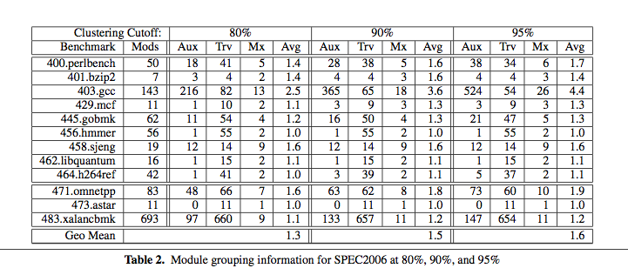
Module Grouping Data

Slide 26
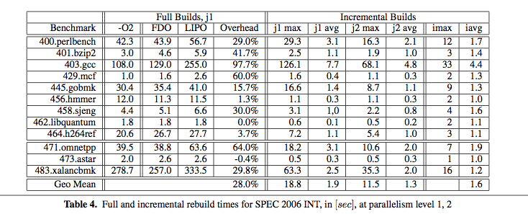
LIPO Build Time

Slide 27
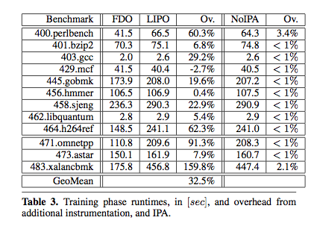
Training Overhead Data

Slide 28
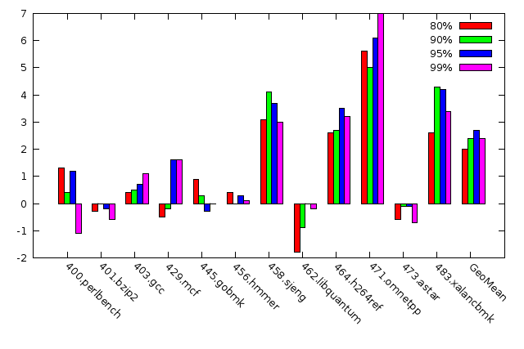
SPEC2006INT Performance

Slide 29
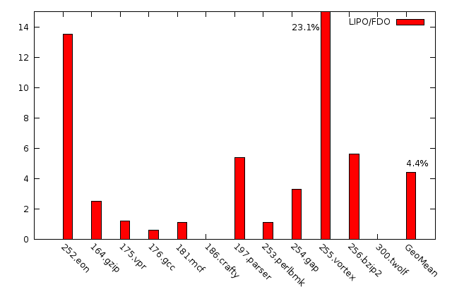
SPEC2000INT performance

Slide 30
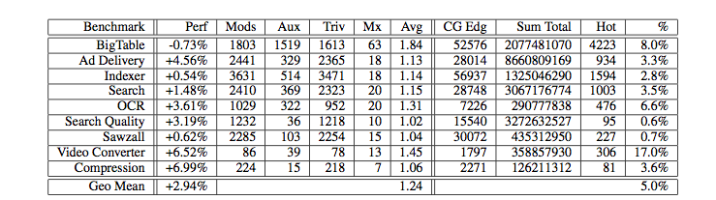
Real World Applications

Slide 31
Future work
  Better module affinity analysis (in consistent with CMI)‏
  Sampled FDO support
    Implemented and under testing !
  Support more language Front-ends than C/C++
  Infrastructure for Whole Program Analysis in LIPO and a whole fleet of WPAs

Slide 32
Questions ?

Slide 33
LIPO
  More powerful dynamic CMI analysis, considering more call context information and callee analysis
  More intelligent of threshold determination, e.g. adjusting threshold according to limit on parallelism, compile time constraint.
  Powerful whole program analysis implemented in LIPO
  Hook up with sampled FDO
  More advanced dyn-ipa with iterative training + zoom-in analysis
  Complete common FE support and add implementation for other important languages (fortran90)‏
  Cross language support, mixed option support

