Slide 1


On Improving Heap Memory Layout by Dynamic Pool Allocation
Zhenjiang Wang Chenggang Wu
Institute of Computing Technology, Chinese Adacemy of Sciences
Pen-Chung Yew
University of Minnesota

Slide 2
Outline
Introduction
Dynamic Pool Allocation
Evaluation
Conclusion

Slide 3
Dynamic Memory Allocation
Dynamic heap memory allocation is widely used in modern programs.
General-purpose heap allocators focus more on runtime overhead and memory utilization.
List 1
Nodes
List 2
Nodes
Tree
Nodes
Lea allocator (dlmalloc, in glibc)：

Slide 4

Pool Allocation
Pool allocation aggregates heap objects into separate memory pools at the time of their allocation.
List 1
Nodes
List 2
Nodes
Tree
Nodes
Pool Allocation:
Pool 1
Pool 2
Pool 3

Slide 5
Related Work
Garbage collector [Chilimbi, 1998] [Huang, 2004] [Serrano, 2009]
  GC can move objects at runtime
Compiler [Lattner, 2005]
  Data structure
Profiling [Seidl, 1998] [Barret, 1993] [Chilimbi, 2006] [Calder, 1998]
  Hot data stream, lifetime, etc
Runtime [Zhao, 2006]
  Call site based

Slide 6
Outline
Introduction
Dynamic Pool Allocation
Evaluation
Conclusion

Slide 7
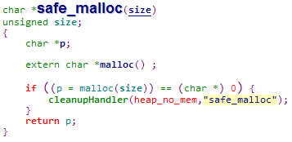

Allocation Site
Heap objects allocated from the same call instruction are often affinitive.
However, sometimes …

Slide 8
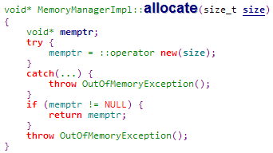

Allocation Site
Heap objects allocated from the same call instruction are often affinitive.
However, sometimes …

Slide 9
Allocation Site
Heap objects allocated from the same call instruction are often affinitive.
However, sometimes it could trick the call-site based scheme to aggregate all heap objects into one pool.

Slide 10
Example
main:
…
p = safe_malloc (16)
…
q = safe_malloc (28)
…
r = safe_malloc (40)
…
Pool 1
Pool 2
Pool 3
safe_malloc:
…
w = malloc (n)
…
Pool 1

Slide 11


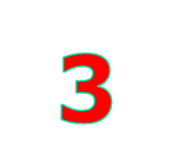
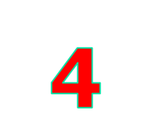

Full Call Chain
main
main
main
main
main
foo
foo
aaa
wrapper
ccc
foo
bar
bbb
wrapper
malloc
foo
wrapper
wrapper
malloc
foo
malloc
malloc
malloc

Slide 12


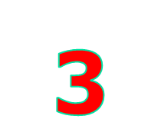
Fixed-length Call Chain
main
main
main
main
main
foo
foo
aaa
wrapper
ccc
foo
bar
bbb
wrapper
malloc
foo
wrapper
wrapper
malloc
foo
malloc
malloc
malloc

Slide 13
Adaptive Partial Call Chain
main
main
main
main
main
foo
foo
aaa
wrapper
ccc
foo
bar
bbb
wrapper
malloc
foo
wrapper
wrapper
malloc
foo
malloc
malloc
malloc

Slide 14




Need for Pool Merging
foo:
…
malloc(16)
…
bar:
…
malloc(16)
…
List
Nodes

Slide 15



Affinity
Same type
Objects are of type-I affinity if they are linked to form a data structure.
Objects are of type-II affinity if their pointers are saved in the same fields of type-I affinitive objects.
List
Nodes
Data 1
Data 2
Pool 1
Pool 2
Pool 3

Slide 16



Pool Merging Example
Suppose objects of Data 2 are allocated from two sites.
List
Nodes
Data 1
Data 2
Pool 1
Pool 2
Pool 3
Pool 4
Before merging

Slide 17
Pool Merging Example
Suppose objects of Data 2 are allocated from two sites.
List
Nodes
Data 1
Data 2
Pool 1
Pool 2
Pool 3
After merging

Slide 18
Data Structure
List
Nodes
DPA
Data structure based
Data 1
Data 2
Pool 1
Pool 2
Pool 3
Pool 1

Slide 19
Thresholds
A pool may not be beneficial if it has few objects, or the objects sizes are large.
A pool forwards its first 100 allocation requests to the system allocator. (object number threshold)
The sizes of these objects must be less than 128 bytes. (object size threshold)

Slide 20
Outline
Introduction
Dynamic Pool Allocation
Evaluation
Conclusion

Slide 21
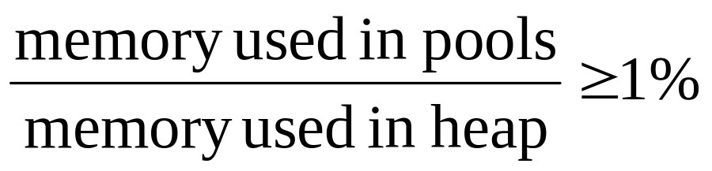
Platforms and Benchmarks
 | Platform #1 | Platform #2
CPU | Intel Pentium 4 | Intel Xeon
Family | Northwood | Harpertown
Frequency | 2.40GHz | 2.33GHz
L1I Cache | 32KB | 32KB
L1D Cache | 32KB | 32KB
L2 Cache | 512KB | 6144KB
Cache Line | 64B | 64B
Memory | 2GB | 16GB
OS | Linux 2.6.27 | Linux 2.6.26
12 SPEC 2000 and 2006 benchmarks

Slide 22
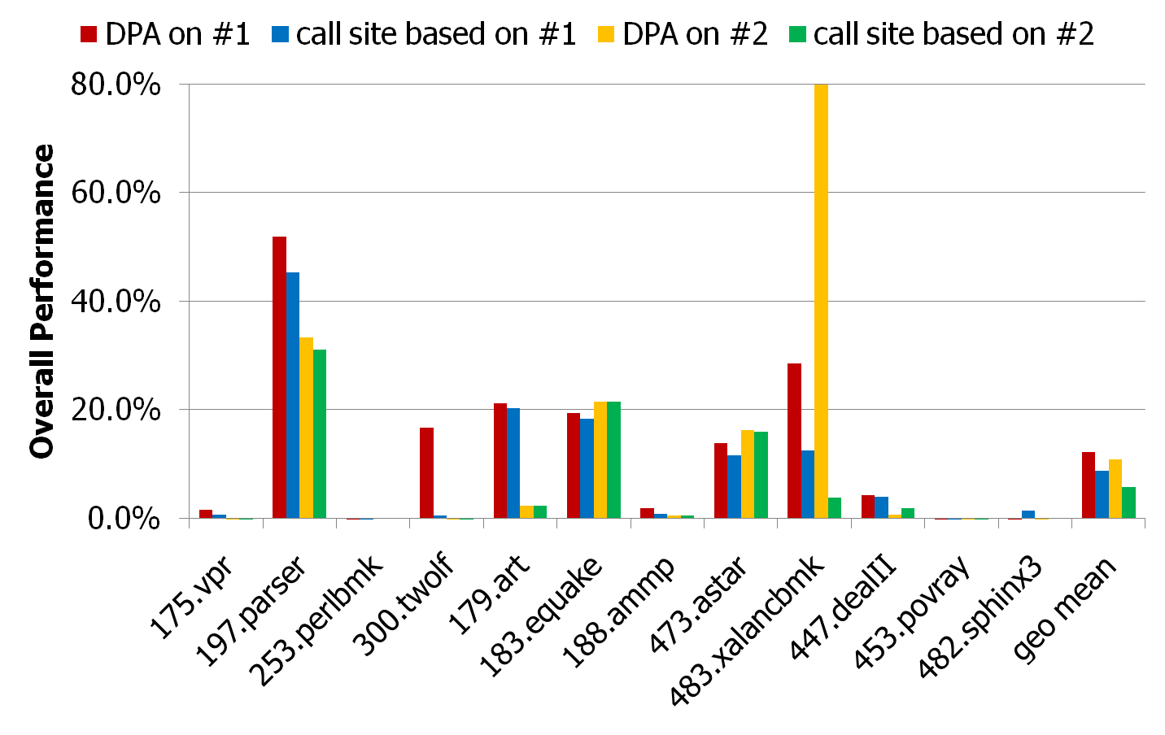
Overall Performance

Slide 23
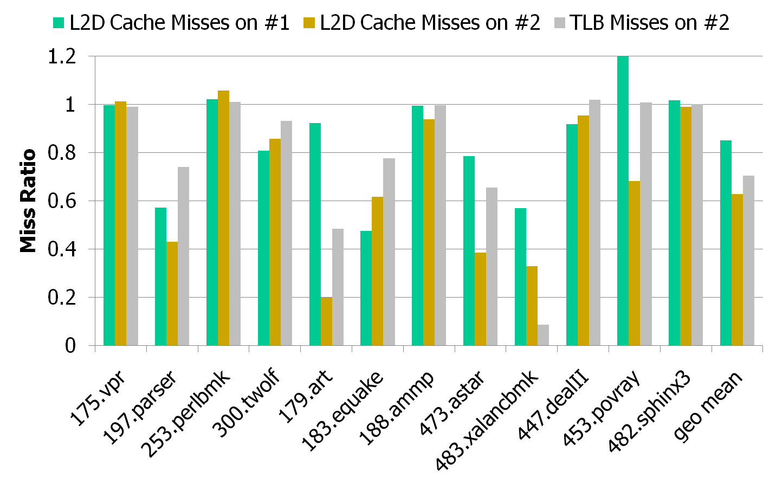
Cache and TLB Misses

Slide 24
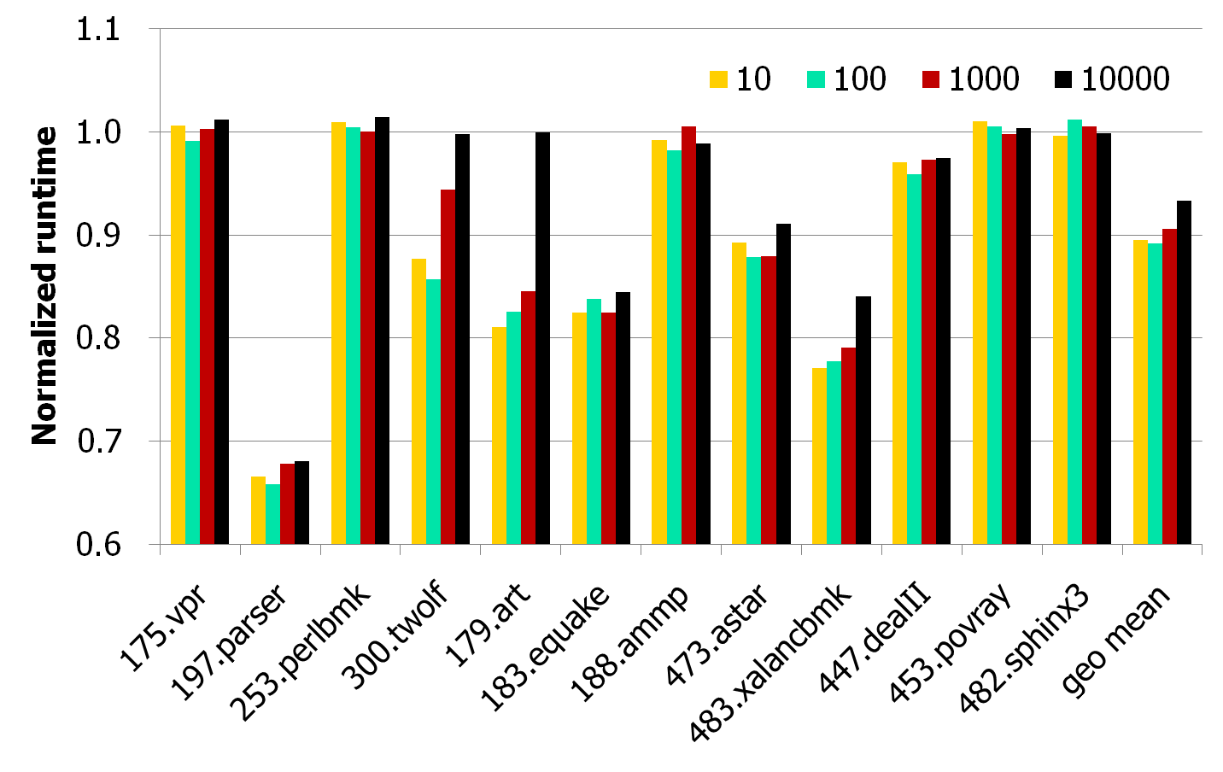
Object Number Threshold

Slide 25
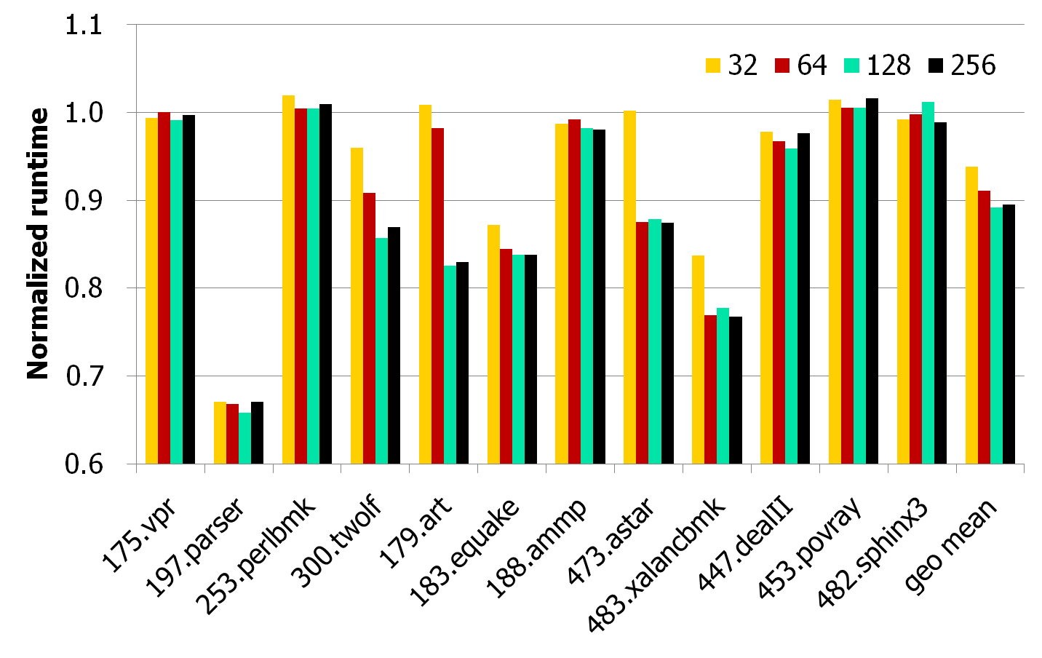
Object Size Threshold

Slide 26
Overhead
Time: less than 1% on average
  Stack unwinding and hash table looking up (for every allocation request, can be reduced by instrumentation)
  Wrapper recognition (for every function, amortized)
  SSG building and analysis (for every new call chain, amortized)
Space:
  Hash table (8K)
  IR (several times larger than code) and SSG (~10K)
  Metadata for pages in pools (20 bytes per page)

Slide 27
Outline
Introduction
Dynamic Pool Allocation
Evaluation
Conclusion

Slide 28
Conclusion
We proposed an approach to control the layout of heap data dynamically.
  adaptive partial call chain
  pool merging
We studied some factors that could affect the effectiveness of such layout.
We got an average speedup of 12.1% and 10.8% on two x86 machines.

Slide 29

The End
Thanks.
wangzhenjiang@ict.ac.cn
wucg@ict.ac.cn
yew@umn.edu

