Slide 1
Hybrid Java Compilation and Optimization for Digital TV
Dong-Heon Jung, Hyeong-Seok Oh,
Soo-Mook Moon
smoon@snu.ac.kr
School of EECS
Seoul National University, Korea

Slide 2
Accelerating DTV S/W Platform
DTV allows data-broadcasting
Sending data as well as picture/sound
Data-broadcasting platform is based on Java
Java xlets + Java middleware at the set-top box
Java is slow, so use just-in-time compilation (JITC)
Propose using ahead-of-time and idle-time compilation/optimization as well
Hybrid compilation and optimization

Slide 3

Executing xlet with JITC only

Slide 4

Executing xlet with Hybrid

Slide 5
Outline
Background on digital TV S/W platform
Xlet lifecycle
DTV acceleration
Hybrid Java Compilation and Optimization
JITC for xlet methods
AOTC for system/middleware methods
ITC and ITO for xlets
Experimental Results
Summary

Slide 6

Digital Television (DTV)
DTV sends digital signals instead of analog signals
Higher definition pictures and clearer sounds
Remaining bandwidth can be used for sending data
General information: traffic, weather, news, stock, …
Program-specific information (plot, cast, director,…)
Interaction using a return channel
T-commerce, T-banking,
T-government, …
Provides the data-broadcasting, interactive TV (iTV)

Slide 7
Java for Interactive TV
One key technology for iTV is Java
Many open standards are based on Java
DVB-MHP (satellite), OCAP (cable), ACAP (terrestrial)
Programmed using xlet applications
xlet classes + image/text files
Downloaded to the DTV set-top box
Interact with middleware/system classes at the set-top
xlet execution starts only when the user initiates it

Slide 8
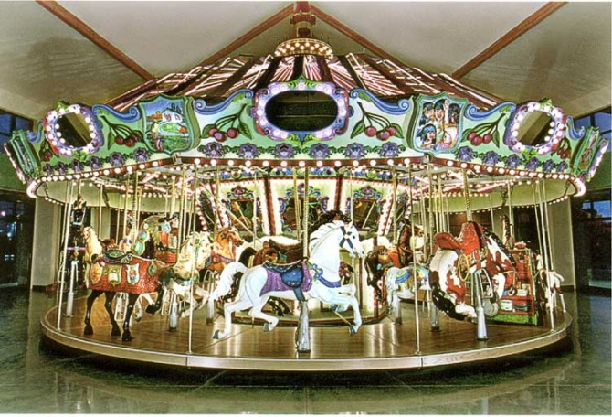
Sending and Receiving xlet App.
Xlet application is sent via carousel mechanism
Send a stream of xlet files
repeteatedly in a round-robin
Carousel file manager in the
set-top handles the receiving
When the DTV is turned on,
JVM starts and the application manager starts
Then xlet application for current channel start its lifecycle

Slide 9
The xlet Lifecycle
Not Loaded
When starting download of xlet application
Loaded
When loading xlet’s main class file
initXlet()
destroyXlet()
Paused
Destroyed
startXlet()
pauseXlet()
When switching to a different channel
Started
At Started state, a red-dot appears on the TV screen

Slide 10




An Example of xlet Execution
(a) Display Red-dot
(b) Display xlet Menu
(c) Select xlet menu
(d) Display Slected Menu

Slide 11
DTV Java Architecture
Two types of classes in DTV Java Platform
System/middleware classes statically installed at DTV
xlet classes dynamically downloaded from TV station
Similarities in other platforms
Mobile phone Java platform: MIDP middleware + midlet
Bluray disk Java platform: BD-J middleware + xlet
Both class types are getting more substantial
E.g., MIDP -> JTWI -> MSA
How to accelerate these substantial, dual-component Java platforms?

Slide 12
Hybrid Compilation and Optimization
Current wisdom of Java acceleration: JITC
Compile bytecode to machine code at runtime
In DTV, do JITC both xlets and system/middleware
Our proposal: hybrid compilation and optimization
Ahead-of-time compilation (AOTC) for system/middleware
Idle-time compilation (ITC) for xlets
Idle-time optimization (ITO) for images and text fonts

Slide 13
Hybrid Environment for DTV
XLET Applications
We actually built a hybrid environment for a DTV based on a PhoneME Advanced (CDC) VM
Set-top Box
Object Carousel File Manager
Phone Me Advanced
Middleware& system methods
Xlet methods
Xlet images and texts
AOTC
JITC/ITC
ITO
OS & Hardware
Persistent Storage

Slide 14
AOTC for System/Middleware
Employ AOT module in PhoneME Advanced VM
Compile pre-chosen methods using JITC and save in a file
When JVM starts officially, use the machine code directly
With no interpretation or compilation overhead
Two issues
Which methods to AOTC in system/middleware?
AOTC only those methods compiled at least once by JITC
Optimization
AOT-generated code is worse than JITC-generated code

Slide 15
AOT Enhancements
AOT inlining without runtime behavior
Implement inlining based on profile-feedback
No code patch optimization
Translated code for class initialization check, GC-check can be patched
Relocation prohibits some optimizations
Constant pointer optimization

Slide 16
Idle-Time Compilation (ITC) for xlet
Compile xlet methods in advance (idle-time)
Saves the JITC and interpretation overhead
Use our enhanced AOT
Assign a separate, lowest-priority thread for ITC to reduce the delay of the main thread (displaying red-dot)
OK even if user executes xlet in the middle of ITC

Slide 17
Idle-Time Optimization for Images
Loading/decoding of xlet images occur at runtime
Just-in-time when they are needed
Their overhead is substantial, taking much of running time
Propose pre-loading/decoding during idle-time
Two issues
When we start pre-loading/decoding in the xlet lifecycle
Started state or Not-loaded state: Do not work
Loaded state: good
How we perform pre-loading/decoding transparently
Use the ITC thread
Useful even when user executes xlets early and becomes idle

Slide 18
Just-in-Time Loading/Decoding
Run java code of selected menu
Start
Request Image Object
Initialize Xlet
Image is cached??
Start Xlet
Display red-dot
yes
no
User select the menu
Perform Image loading/decoding
Load image
from cache
Display selected menu
Save the image to image cache
Finish xlet
Get image object
End
Finish java code of selected menu

Slide 19
Pre-loading/decoding
Start
Start Image-preprocessing thread
Initialize Xlet
New file is received?
no
Terminate
the thread
Start Xlet
Display red-dot
yes
Get
each image file name
User select the menu
Display selected menu
Is pre-processed?
Finish xlet
yes
no
End
Perform Pre-loading/decoding
Save the image to cache

Slide 20
Idle-Time Optimization for Texts
Creating some font objects occur at runtime
Pre-creating of them at idle-time

Slide 21
Experimental Results
Experimented on a commercial DTV platform with real, on-air xlets broadcasted in Korea
Experimental Environment
DTV set-top box 333MHZ MIPS CPU with 128MB memory
Linux with kernel 2.6
Sun’s phoneMe Advanced MR2 version
Advanced common application platform (ACAP)

Slide 22
Benchmarks
xlets of three terrestrial TV stations in Korea
Designated by A, B, C
News, weather, traffic, and stock menu items
Interested in running time of each menu item
Size of xlet applications (KB)
 | class | image | text & etc. | Total
Station A | 276 | 1,348 | 344 | 1,968
Station B | 360 | 1,596 | 372 | 2,328
Station C | 448 | 1,280 | 288 | 2,016

Slide 23
Distribution of Method Calls

Slide 24
Distribution of JITCed Methods

Slide 25
Image Loading/Decoding Overhead

Slide 26
Running Time Impact of AOTC

Slide 27
Performance Impact of AOTC
Speedup

Slide 28
Impact of Pre-loading/decoding

Slide 29
Impact of Text Font Pre-creation
Running time (ms)

Slide 30
Overall Running Time of Hybrid
An average of 150% reduction
(15% by AOTC)

Slide 31
Impact on Transparency
Running time (ms)

Slide 32
Summary and Future Work
Proposed hybrid compilation/optimization for DTV
Just-in-time, ahead-of-time, and idle-time
Improves performance dramatically than JITC-only
With little change to other DTV behavior
Some ideas would work for other dual-component Java
Some future work
AOTC for system/middleware beyond AOT
By performing off-line AOTC with full optimizations enabled
The idea of pre-loading/decoding has been filed for patent application.

Slide 33
Thank you!

