Slide 1


SIMD Parallelization of Applications that Traverse Irregular Data Structures
Bin Ren, Gagan Agrawal, James R. Larus, Todd Mytkowicz, Tomi Poutanen,
Wolfram Schulte
Microsoft Research，Redmond
The Ohio State University

Slide 2
Contributions
Emulate a MIMD machine in SIMD to exploit fine-grained parallelism on irregular, pointer intensive data structures
Tree/Graph applications that traverse many independent data structures (e.g., regular expressions or random forests)
Challenges:
Poor Data Locality
Dynamic data-driven behavior from data dependencies and control dependencies

Slide 3
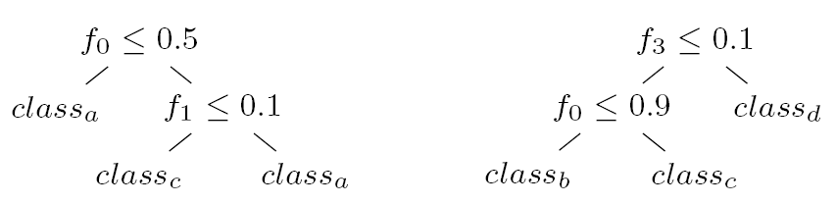
Exploit SIMD Hardware?
Example: Random Forests
Input feature vector: <f0 = 0.6, f1 = 0.7, f2 = 0.2, f3 = 0.2>
float Search(float features[]) {
float feature = features[this->featureIndex];
…
if (feature <= this->threshold)
return this->left->Search(features);
else
return this->right->Search(features);
…
}
Notes:
Irregular data structure;
Every node does the same operation, so there is great potential for parallelism; but it should be fine-grained

Slide 4
Imagine a simple machine
Two types of opcodes
T ops manage control flow (e.g., jmp, breq,…)
W ops manage data (e.g., loads, stores, increment,…)
Map opcodes to operations on irregular data structure
Emulate MIMD (T & W) in SIMD
Each SIMD lane traverses 1 irregular data structure
If opcodes are simple, we see speedups!
Opcodes are domain specific
Paper describes T’s and W’s in more detail

Slide 5
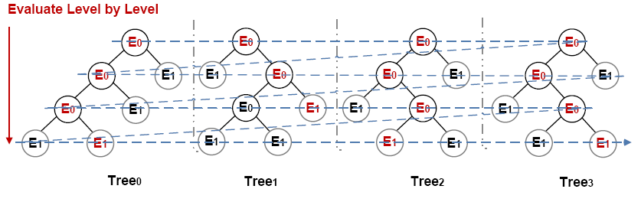
Overall Idea
Each SIMD lane traverses one irregular data structure
At internal nodes, n, we perform conditional traversal, T(n)
At leaf nodes, n’, we perform some evaluation W(n’)
“Compile” and “Interpret” each irregular data structure
“Compile” each node of the tree/graph into an opcode
Emulate MIMD machine (T and W opcodes) in SIMD

Slide 6
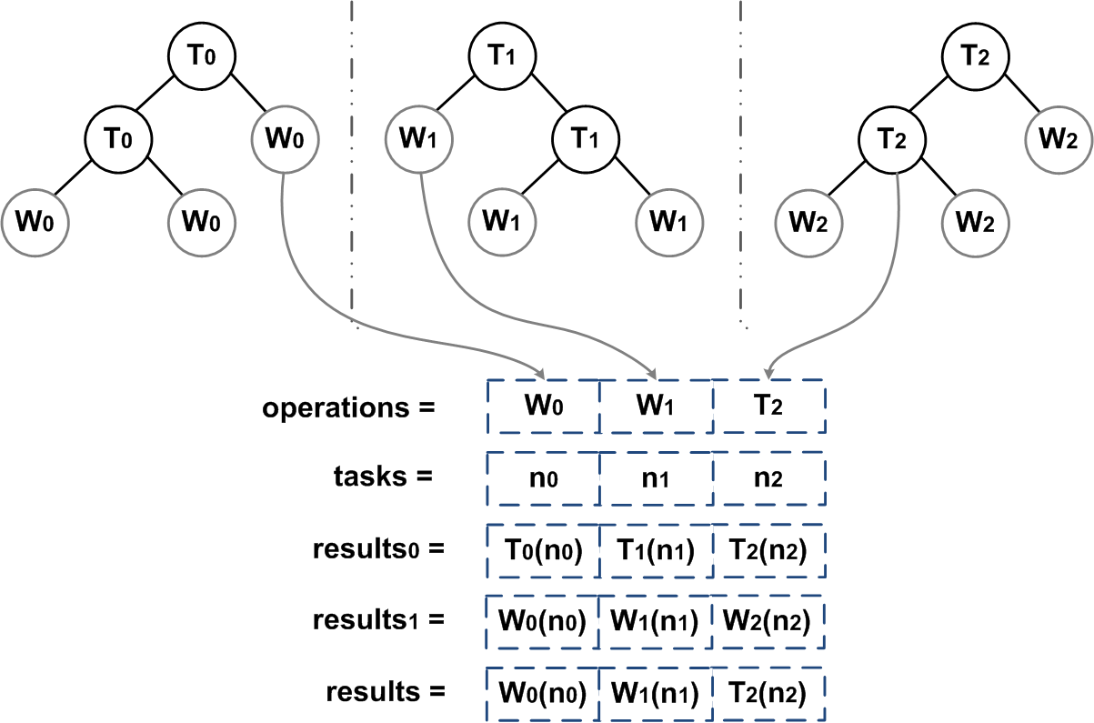
Challenges in SIMD Evaluation
Suppose we are executing 2nd level
Notes:
Mixed instructions that cannot be processed directly by SIMD unit

Slide 7
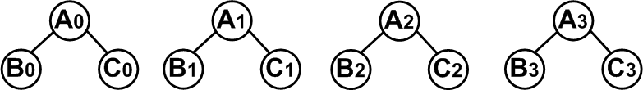
Challenges in SIMD Evaluation
Branch-less Addressing of Children
Branch operations slow SIMD
Control dependence is difficult to vectorize
Example:
if (cond0){ next0 = B0;} else {next0 = C0; }
if (cond1){ next1 = B1;} else {next1 = C1; }
if (cond2){ next2 = B2;} else {next2 = C2; }
if (cond3){ next3 = B3;} else {next3 = C3; }
Ci = Bi + 1
next0 = C0 – cond0;
next1 = C1 – cond1;
next2 = C2 – cond2;
next3 = C3 – cond3;
Vectorize by SSE
__m128i cond = _mm_cmple_ps(…);
__m128i next = Load (C0, C1, C2, C3);
next = _mm_add_epi32(next, cond);

Slide 8
Parallelism Optimizations
Task Removal– Light-weight Stream Compaction
To get rid of Control Flow Dependency, stream compaction operation is used (different from prefix-sum strategy)
Example:
TQ = [a, b, c, d, e, f, g, h]
Loop1:
Loop2:
Evaluate first 4 Tasks
Evaluate next 4 Tasks
get next buffer
get next buffer
R = [a, b, 0, d]
R = [0, 0, 0, h]
shuffle
shuffle
R = [a, b, d, 0]
R = [h, 0, 0, 0]
store
store
TQ = [a, b, d, 0, e, f, g, h]
TQ = [a, b, d, h, 0, 0, 0, 0]
Notes:
Fully utilize the benefit of SIMD lane

Slide 9
Parallelism Optimizations
Stream Compaction
nextEvalBuffer[num_trees] = {H0, H3, 0, 0, E4, D5, F6, D7}
nextEvalBuffer[num_trees] = {B0, B1, C2, B3, A4, A5, A6, A7}
nextEvalBuffer[num_trees] = {D0, E1, F2, D3, B4, B5, C6, B7}
nextEvalBuffer[num_trees] = {0, 0, 0, 0, 0, 0, 0, 0}
nextEvalBuffer[num_trees] = {B0, B1, C2, B3, B4, B5, C6, B7}
nextEvalBuffer[num_trees] = {H0, H3, H5, H7, 0, 0, 0, 0}
nextEvalBuffer[num_trees] = {D0, E1, F2, D3, E4, D5, F6, D7}
nextEvalBuffer[num_trees] = {A0, A1, A2, A3, A4, A5, A6, A7}
Notes:
A more concrete example

Slide 10
Parallelism Optimizations
Data Layout
Data locality is a key factor for parallel performance
A layouts generation process to organize data in the order they are likely to be accessed
Transparent to the interpreter because of the uniform interface

Slide 11
Parallelism Optimizations
Depth First and Breadth First Layout
Linearize data structure one by one

Slide 12
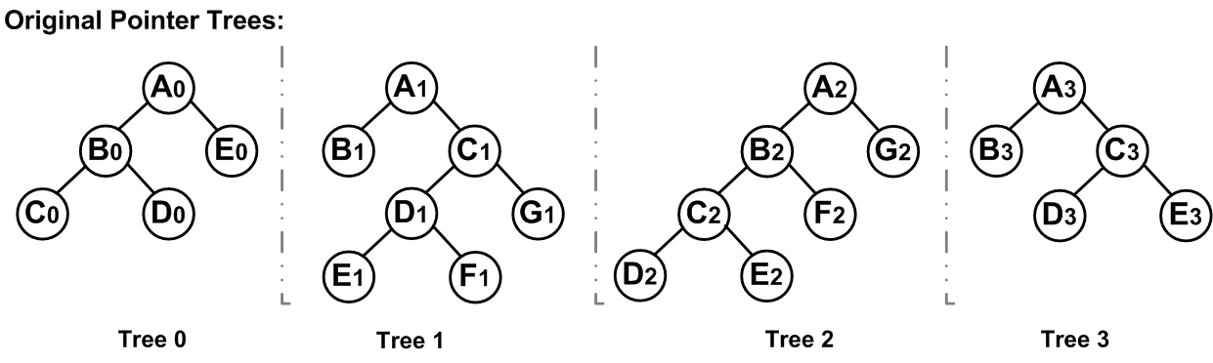
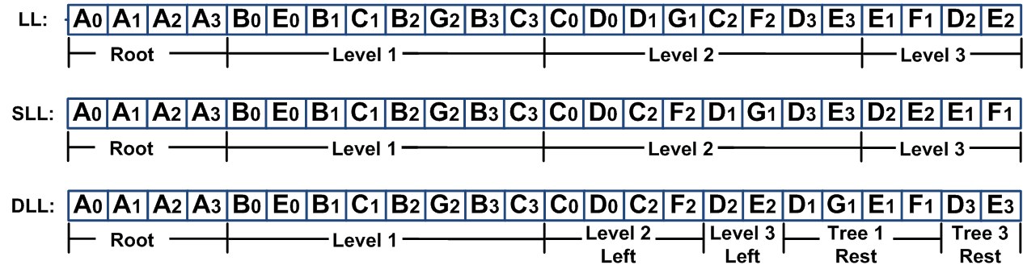
Parallelism Optimizations
Notes:
LL and SLL are more effective for relatively balanced access, and DLL is designed for severely biased access

Slide 13
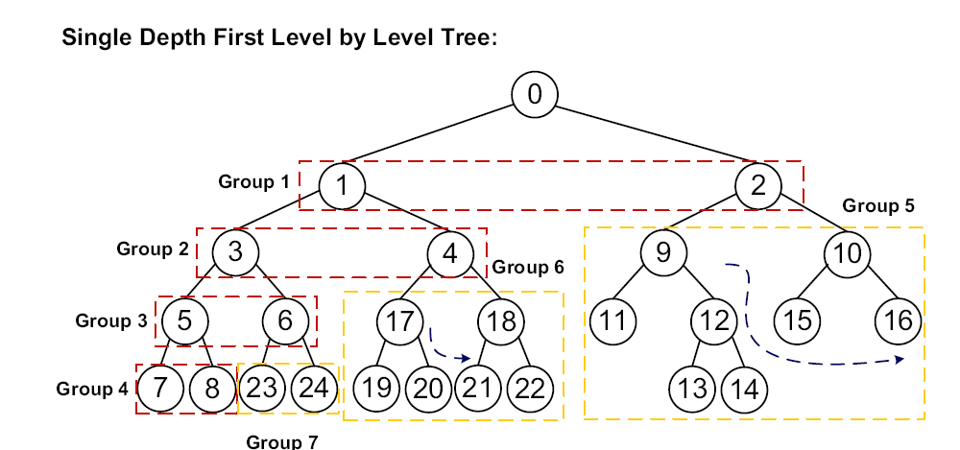
Parallelism Optimizations
For severe left bias
Notes:
For DLL layout, we first divide each tree into different groups as above, and put the partitions of all trees with the same group id next to each other. We put the left most part of all trees very dense, and the rest of trees relatively sparse.

Slide 14
Experimental Evaluation
Environment
Intel Xeon E5420 CPU (2.5GHz frequency) with SSE-4
Intel ICC compiler
Applications
Decision Tree Forest
Built from ALGLIB and Microsoft product
For ALGLIB experiments, using four data sets from UCI Machine Learning Repository – Poker, Shuttle, Abalone, and Satellite
Regular Expressions
NFA based regular expression engine with O(nm) complexity
Compare with GNU grep
Objectives of Evaluation
Overall Speedups from SIMD Parallelization
Benefits from Optimizations

Slide 15
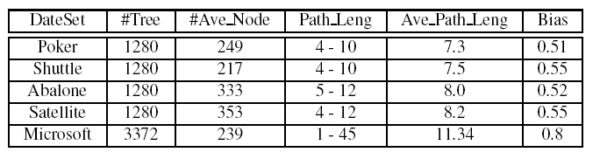
Experimental Evaluation
Decision Tree Forest
Summary of Evaluation Cases
Notes:
Porker and Abalone are very balance; Shuttle and Satellite are slightly left biased; and Microsoft is severely biased.

Slide 16
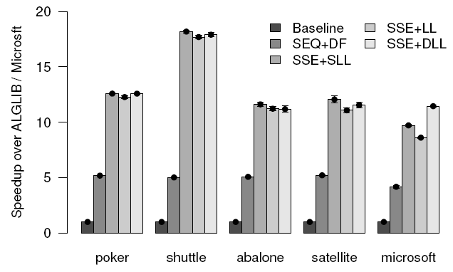
Overall Speedup from SIMD
Decision Tree Forest
Speedup over Baseline Implementations
Notes:
SLL is effective for balanced data set (Abalone), and DLL is for severely biased one (Microsoft).

Slide 17
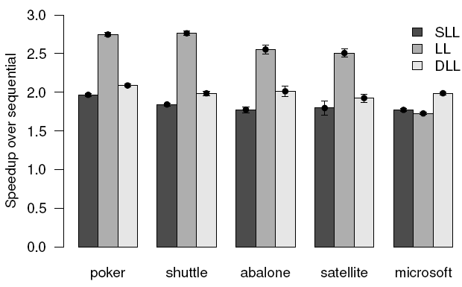
Overall Speedup from SIMD
Decision Tree Forest
Speedup over Different Data Layouts

Slide 18
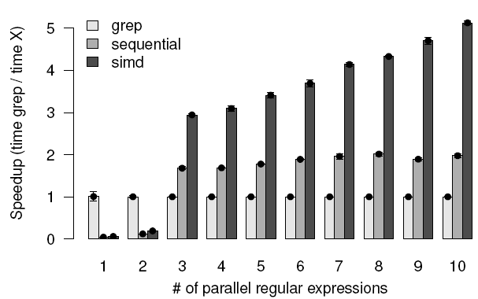
Overall Speedup from SIMD
Regular Expressions
Speedup of the SIMD interpreter over GNU grep

Slide 19
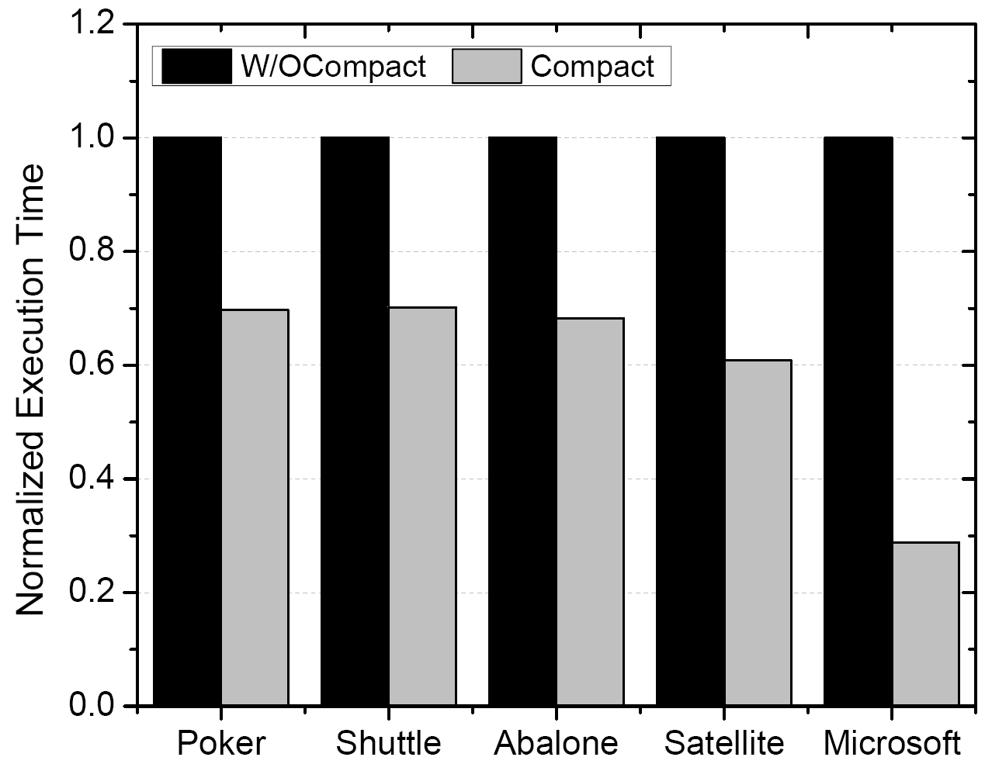
Benefits from Optimizations
Impact of Stream Compaction
30% speedup
70% speedup
Speedup Improvement from Stream Compaction

Slide 20
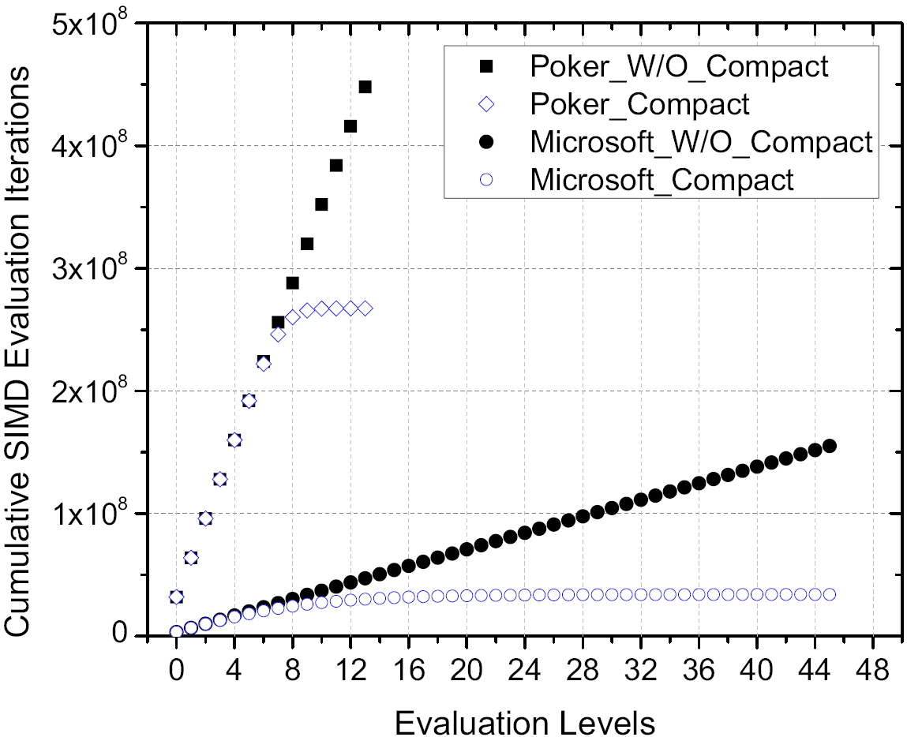
Benefits from Optimizations
Impact of Stream Compaction
40% Reduction
80% Reduction
Reduction in Workload from Stream Compaction
Notes:
From this figure and the figure in previous slide, we can infer that our stream compaction method incurs around 10% overhead.

Slide 21
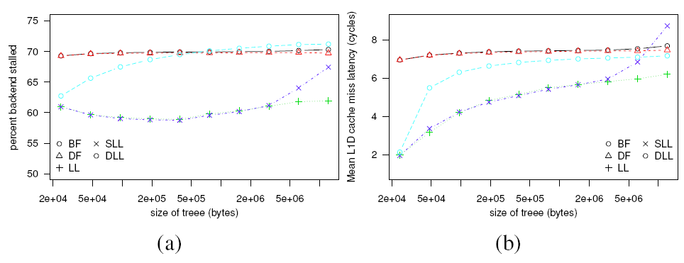
Benefits from Optimizations
Impact of Data Layout
Percent of time backend is stalled
Latency of L1 Data Cache Access
Notes:
We set up a balanced full tree forest experiment, and get the profiling result as above. It shows the benefit of using our intelligent data layouts.

Slide 22
Related Work
Compiler-based efforts to parallelize pointer-based structures
M. Kulkarni, M. Burtscher, R. Inkulu, K. Pingali, and C. Casc¸aval. How Much Parallelism is There in Irregular Applications? (PPoPP 2009)
Y. Jo and M. Kulkarni. Enhancing Locality for Recursive Traversals of Recursive Structures. (OOPSLA 2011)
Tree and graph traversal algorithms on SIMD architectures
P. Harish and P. Narayanan. Accelerating Large Graph Algorithms on the GPU using CUDA. (HiPC 2007)
T. Sharp. Implementing Decision Trees and Forests on a GPU. (ECCV 2008)
C. Kim, J. Chhugani, N. Satish, E. Sedlar, A.D. Nguyen, T. Kaldewey, V.W. Lee, S.A. Brandt, and P. Dubey. FAST: Fast Architecture Sensitive Tree Search on Modern CPUs and GPUs. (SIGMOD 2010)
Emulating MIMD with SIMD
G.E. Blelloch, S. Chatterjee, J.C. Hardwick, J. Sipelstein, and M. Zagha. Implementation of a Portable Nested Data-Parallel Language. (JPDC 1994)
Notes:
Very related:
Jo and Kulkarni built an automated compiler that traverses multiple irregular data structures in parallel. Their approach transforms an irregular data structure into one that exploits spatial locality in the tree traversal. We see our approach as similar---we are manual, however, we exploit SIMD.
Kulkarni et al. (first paper) demonstrate how to exploit coarse-grained parallelism (e.g., threads on multicore) in irregular data structures. We see our approach as complimentary as we focus on fine-grained (e.g., SIMD) parallelism.
We are not the first to discuss emulating a MIMD machine in SIMD: e.g., Blelloch work investigated emulating MIMD in SIMD however, their approach was more theoretical and based on NESL, their data parallel language. In contrast, we exploit features found in modern hardware and tried to make our approach work under those constraints for a few interesting applications on modern hardware.

Slide 23
Conclusion
Approach to traverse and compute on multiple, independent, irregular data structures in parallel using SSE
Design multiple optimizations to exploit features found on modern hardware
Implement two case studies to demonstrate the utility of our approach and show significant single-core speedups

Slide 24
Thanks for Your Attention!
Any Questions?

Slide 25
Backup Slides

Slide 26
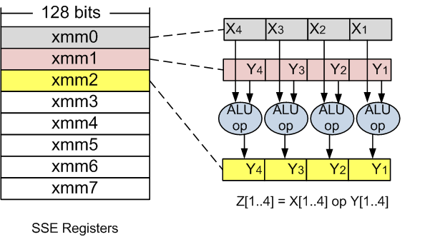
Background
Illustration of SSE
Notes:
(GPUs can be used for both Coarse-grained and Fine-grained parallelism because of its hierarchical structure)

Slide 27
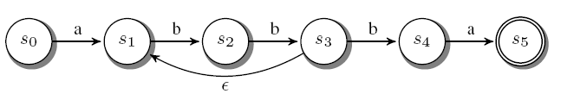
Background
Regular Expressions Matching
Regular Expression
a(bb)+ba
nondeterministic finite automata (NFA)
T0
T2
T1
Challenge I: How to exploit parallelism?
Input String: abbbbba
Challenge II: How to get good memory locality?
Notes:
Irregular data structure;
Every node does the same operation, so there is great potential for parallelism; but it should be fine-grained

Slide 28
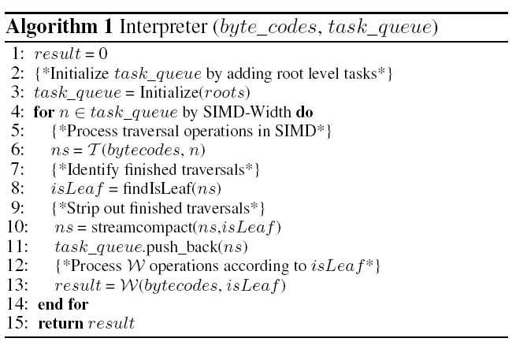
Challenges in SIMD Evaluation
General representation of Interpreter (Tasks Scheduler)
Notes:
By linearization method, we can get rid of the pointers.

Slide 29


Challenges in SIMD Evaluation
An Interpreter for Random Forest
Compilation: Instruction Format
T Instruction (compare):
long: 8 bytes
short: 2 bytes short: 2 bytes float: 4 bytes
W Instruction (output):
Notes:
The instruction one represents to the internal node and … leaf node

Slide 30
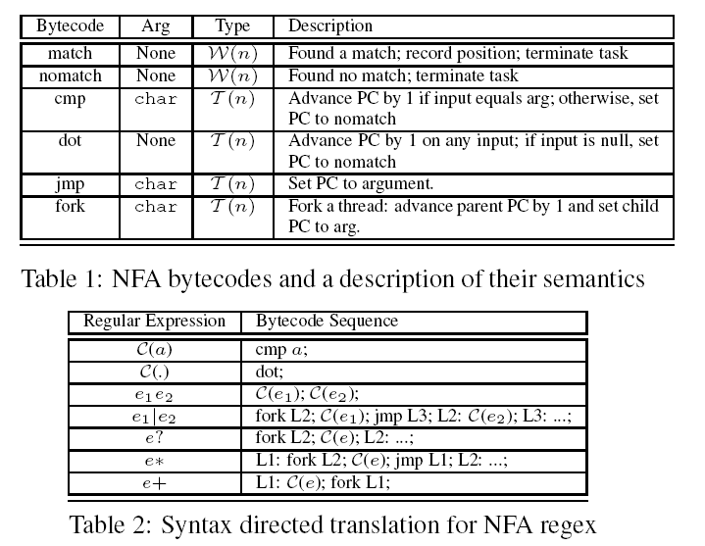
Challenges in SIMD Evaluation
An Interpreter for Regular Expression Matching
Compilation: Instruction Format (similar to Cox’s NFA engine)
Notes:
The instruction one represents to the internal node and … leaf node

Slide 31
Parallelism Optimizations
Tiling trees into smaller bags
Observation: Only a small number of trees are processed at the same time
Total number of trees is N, and the number of trees in each bag is n, then within each bag, we linearize n trees by LL/SLL/DLL layout
Tiling can improve the locality of deep levels of trees, especially for SLL and DLL layout

Slide 32
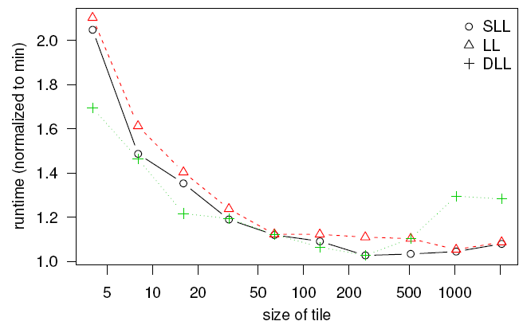
Benefits from Optimizations
Impact of Tiling
The Impact of Tiling on Our Approach
Notes:
By tiling, we can get good speedup especially for DLL layout.

Slide 33
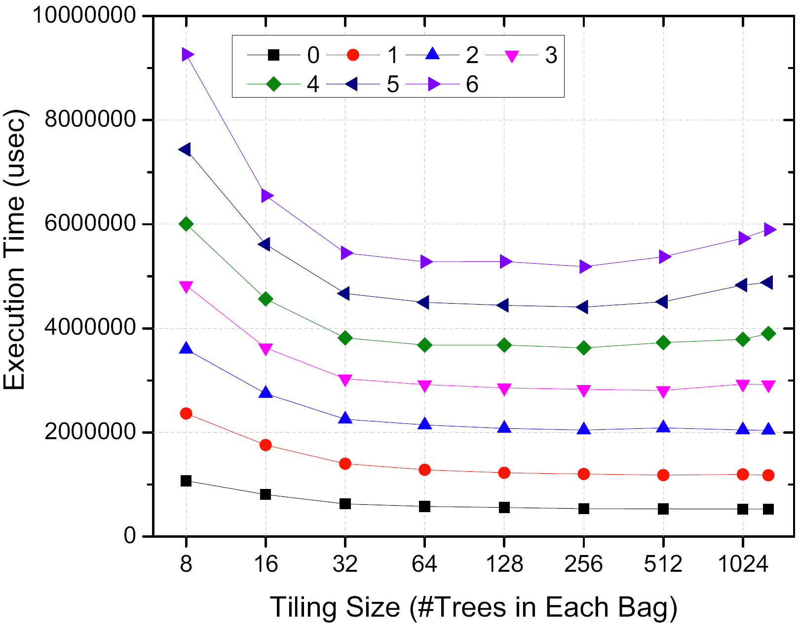
Benefits from Optimizations
Tiling gives us benefits for the deeper evaluation levels
Execution Time with Changing Evaluation Levels and Tiling Size
Notes:
Our tiling benefit is coming from the deeper level evaluations.

