Slide 1
DrDebug: Deterministic Replay based Cyclic Debugging with Dynamic Slicing
Yan Wang*, Harish Patil**, Cristiano Pereira**, Gregory Lueck**, Rajiv Gupta*, and Iulian Neamtiu*
*University of California Riverside
**Intel Corporation

Slide 2

Cyclic Debugging for Multi-threaded Programs
Root cause of the bug?
ver. 1.9.1
Mozilla
developer
Bug report
Id: 515403
Program
binary + input
Fast-forward to the buggy region
Data race on variable rt->scriptFilenameTable
main thread
Observe program state
Fast Forward
worker threads
T1
T2
Long wait while fast-forwarding (88%)
Buggy region (12%) still large:
~1M instructions
➔ Difficult to locate the bug
buggy
Region

Slide 3
Key Contributions of DrDebug
Execution Region and Execution Slice
User Selects Execution Region
Only capture execution of buggy region
Avoid fast forwarding
User Examines Execution Slice
Only capture bug related execution
Work for multi-threaded programs
Single-step slice in a live debugging session
T1
T2
Region
Results:
Buggy region: <15% of total execution for bugs in 3 real-world programs
Execution slice: < 48% of buggy region, < 7% of total execution for bugs in 3 real-world programs

Slide 4
PinPlay in DrDebug
PinPlay [Patil et. al., CGO’10, http://www.pinplay.org] is a record/replay system, using the Pin dynamic instrumentation system.
Program binary + input
Logger
region
pinball
Captures the non-deterministic events of the execution of a (buggy) region
region
pinball
Replayer
Program
Output
Deterministically repeat the captured execution
region
pinball
Relogger
pinball
Relog execution—exclude the execution of some code regions

Slide 5
Execution Region
T1
T2
Record on
Root Cause
Region
region
pinball
Record off
Failure Point

Slide 6
Dynamic Slicing
Dynamic slice: executed statements that played a role in the computation of the value.
T1
T2
region
pinball
Root Cause
compute
slice
Failure Point

Slide 7
Dynamic Slicing
Dynamic slice: executed statements that played a role in the computation of the value.
T1
T2
region
pinball
Root Cause
compute
slice
compute
slice
slice
pinball
Failure Point
Excluded Code Region

Slide 8

Replaying Execution Slice
T1
T2
Prior work on slicing:
post-mortem analysis
slice
pinball
Inject value
Inject value
Failure Point

Slide 9
Usage model of DrDebug
record on/off
DrDebug
Program binary + input
compute
slice
slice
pinball
Only Capture Bug Related
Program Execution
Root cause of the bug?
Cyclic Debugging
Based on Replay of
Execution Slice
Observe program state

Slide 10
Other Contributions
Improve Precision of Dynamic Slice
Dynamic Data Dependence Precision
Filter out spurious register dependences due to save/restore pairs at the entry/exit of each function
Dynamic Control Dependence Precision
Presence of Indirect jumps → Inaccurate CFG
→ Missing Control Dependence
Refine CFG with dynamically collected jump targets
Integration with Maple [Yu et al. OOPSLA’12]
Capture exposed buggy execution into pinball
Debug exposed concurrency bug with DrDebug

Slide 11
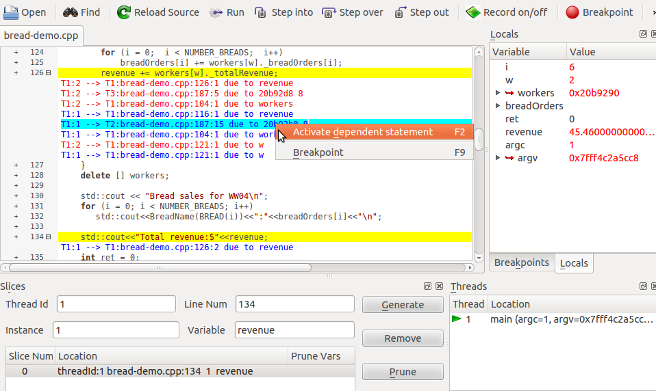
DrDebug GUI Showing a Dynamic Slice
Slice Criterion

Slide 12
Data Race bugs used in our Case Studies
Program Name | Bug Description
pbzip2-0.9.4 | A data race on variable fifo → mut between main thread and the compressor threads
Aget-0.57 | A data race on variable bwritten between downloader threads and the signal handler thread
Mozilla-1.9.1 | A data race on variable rt→scriptFilenameTable. One thread destroys a hash table, and another thread crashes in js_SweepScriptFilenames when accessing this hash table
Quantify the buggy execution region size for real bugs.
Time and space overhead of DrDebug are reasonable for real bugs.

Slide 13

Time and Space Overheads for Data Race Bugs with Buggy Execution Region
Program Name | #ins(%ins in region vs. total) | #ins in slice pinball (%ins in slice vs. region pinball) | Logging Overhead |  | Replay Time (sec) | Slicing Time (sec)
 |  |  | Time (sec) | Space (MB)
Pbzip2 (0.9.4) | 11,186 (0.04%) | 1,065 (9.5%) | 5.7 | 0.7 | 1.5 | 0.01
Aget (0.57) | 108,695 (14.3%) | 51,278(47.2%) | 8.4 | 0.6 | 3.9 | 0.02
Mozilla (1.9.1) | 999,997 (12.2%) | 100 (0.01%) | 9.9 | 1.1 | 3.6 | 1.2
Buggy region size ~ 1M
Buggy Region: <15% of total execution
Execution Slice: <48% of buggy region, <7% of total execution

Slide 14
Logging Time Overheads
with native input

Slide 15
Replay Time Overheads
The buggy regions up to a billion instructions can still be collected/replayed in reasonable time(~2 min).
with native input

Slide 16
Execution Slice: replay time
36%
with native input

Slide 17
Contributions
Support for recording: execution regions and dynamic slices
Execution of dynamic slices for improved bug localization and replay efficiency
Backward navigation of a dynamic slice along dependence edges with Kdbg based GUI
Results: Buggy region: <15% of total execution; Execution slice: <48% of buggy region, <7% of total execution for bugs in 3 real-world programs
Replay-based debugging and slicing is practical
if we focus on a buggy region

Slide 18
Q&A?

Slide 19
Backup

Slide 20
Cyclic Debugging with DrDebug
Logger
(w/ fast forward)
Program binary + input
Replayer
pinball
Capture Buggy Region
Pin’s Debugger
Interface (PinADX)
Form/Refine a hypothesis about the cause of the bug
Replay-based Cyclic Debugging
Observe program state/ reach failure

Slide 21
Dynamic Slicing in DrDebug when Integrated with PinPlay
Pin
Program binary + input
logger
region
pinball
(a) Capture buggy region.
Pin
slice
region
pinball
Dynamic Slicing
Remote
Debugging
Protocol
GDB
KDbg
Replayer
(b) Replay buggy Region and Compute Dynamic Slices.

Slide 22
Dynamic Slicing in DrDebug when Integrated with PinPlay
Pin
slice
+
Relogger
slice
pinball
region pinball
(c) Generate Slice Pinball from Region Pinball.
Pin
Remote
Debugging
Protocol
GDB
KDbg
slice
pinball
Replayer
(d) Replay Execution Slice and Debug by Examining State.

Slide 23
Computing Dynamic Slicing for Multi-threaded Programs
Collect Per Thread Local Execution Traces
Construct the Combined Global Trace
Shared Memory Access Order
Topological Order
Compute Dynamic Slice by Backwards Traversing the Global Trace
Adopted Limited Preprocessing (LP) algorithm [Zhang et al., ICSE’03] to speed up the traversal of the trace

Slide 24
Dynamic Slicing a Multithreaded Program
Def-Use Trace for T1
Def-Use Trace for T2
1₁ {x} {}
7₁ {y} {}
int x, y, z;
y
2₁ {z} {x}
8₁ {j} {y}
T1
T2
x=5;
2 z=x;
3 int w=y;
4 w=w-2;
5 int m=3*x;
6 x=m+2;
7 y=2;
8 int j=y + 1;
9 j=z + j;
10 int k=4*y;
if (k>x){
12 k=k-x;
assert(k>0);
}
3₁ {w} {y}
z
9₁ {j} {z,j}
4₁ {w}{w}
10₁ {k} {y}
x
5₁ {m} {x}
11₁ {k,x} {}
x
x
6₁ {x} {m}
12₁ {k}{k,x}
wrongly assumed atomic region
program order
x
shared memory
access order fox x
13₁ {k} {}
Example Code
Per Thread Traces and Shared Memory Access Order

Slide 25
Dynamic Slicing a Multithreaded Program
1₁ {x} {}
2₁ {z} {x}
x
T1
1₁ x=5
x
5₁ m=3*x
7₁ {y} {}
8₁ {j} {y}
9₁ {j} {z,j}
10₁ {k} {y}
11₁ {k,x} {}
7₁ y=2
m
y
T2
6₁ x=m+2
10₁ k=4*y
x
root cause
k
CD
3₁ {w} {y}
4₁ {w} {w}
5₁ {m} {x}
6₁ {x} {m}
11₁ if(k>x)
12₁ k=k-x
T1
k
13₁ assert(k>0)
12₁ {k} {k,x}
13₁ {k} {}
CD
T2
should read (depend on) the same definition of x
slice criterion
Slice for k at 13₁
Global Trace

Slide 26
Execution Slice Example
Prior works-- postmortem analysis
Execution Slice – single-stepping/examining slice in a live debugging session
T1
T2
T1
T2
1₁ x=5
7₁ y=2
1₁ x=5
7₁ y=2
Only Bug Related Executions (e.g., root cause, failure point) are Replayed and Examined to Understand and Locate bugs.
8₁ j=y + 1
9₁ j=z + j
inject
2₁ z=x
3₁ w=y
4₁ w=w-2
inject
z=5
w=0
j=8
10₁ k=4*y
11₁ if (k>x)
12₁ k=k-x
13₁ assert(k>0)
5₁ m=3*x
6₁ x=m+2
10₁ k=4*y
11₁ if (k>x)
12₁ k=k-x
13₁ assert(k>0)
5₁ m=3*x
6₁ x=m+2
Code Exclusion Regions
Injecting Values During Replay

Slide 27
Control Dependences in the Presence of indirect jump
call fgetc
mov %al,- 0x9(%ebp)
...
mov 0x8048708(,%eax,4),%eax
jmp *%eax
6 mov 0xc(%ebp),%eax
add $0x2,%eax
mov %eax,-0x10(%ebp)
7 jmp 80485c88 ...
P(FILE* fin, int d){
int w;
char c=fgetc(fin);
switch(c){
case 'a': /* slice criterion */
w = d + 2;
break;
…
11}
Inaccurate CFG Causing
Missed Control Dependence
C Code
Assembly Code
3₁: c=fgetc(fin)
‘a’
6₁: w=d+2
c
Capture Missing
Control Dependence
due to indirect jump
4₁: switch(c)
Imprecise Slice for w at line 6₁
CD
6₁: w=d+2
Notes:
For accurately capturing dynamic control dependence in the presence of recursive functions and irregular control flow, we use the online algorithm by [Xin et al. ISSTA’07]. However, using this algorithm in the context of a dynamic binary instrumentation framework poses a major challenge.
It assumes the availability of precomputed static immediate post-dominator information for each basic block. Due to the presence of indirect jumps, accurate static construction of the control flow graph is not possible. As a result, the post-dominator information precomputed statically is imprecise and the dynamic control dependences computed are
imprecise as well.
In prior works, this problem is addressed by restricting the applicability of the slicing tool
to binaries generated using a specific compiler which limits the applicability of the tool.

Slide 28
Improve Dynamic Control Dependence Precision
Implement a static analyzer based on Pin's static code discovery library -- this allows DrDebug to work with any x86 or Intel64 binary.
We construct an approximate static CFG and as the program executes, we collect the dynamic jump targets for the indirect jumps and refine the CFG by adding the missing edges.
The refined CFG is used to compute the immediate post-dominator for each basic block

Slide 29
Spurious Dependences Example
3 call fgetc
mov %al,-0x9(%ebp)
4 mov 0xc(%ebp),%eax
add %eax,%eax
5 cmpb $0x74,-0x9(%ebp)
jne 804852d
6 call Q 804852d
7 mov %eax,-0x10(%ebp)
9 Q()
10 push %eax
...
12 pop %eax
P(FILE* fin, int d){
int w, e;
char c=fgetc(fin);
e= d + d;
if(c=='t')
Q();
w=e; /* slice criterion */
}
Q()
10 {
...
12 }
save/restore pair
C Code
Assembly Code
save/restore pair
Spurious Data/Control Dependence

Slide 30
Spurious Dependences Example
True Definition of eax
Bypass data dependences
caused by save/restore pairs
4₁: e = d+d
add %eax, %eax
‘t’
3₁: c=fgetc(fin)
e
c
10₁: push %eax
CD
eax
5₁: if(c==‘t’)
4₁: e = d+d
add %eax, %eax
121: pop %eax
e
CD
eax
7₁: w = e
mov %eax, -0x10(%ebp)
7₁: w = e
mov %eax, -0x10(%ebp)
Imprecise Slice for w at line 7₁
Refined Slice

Slide 31
Improved Dynamic Dependence Precision
Dynamic Control Dependence Precision
Indirect jump (switch-case statement):
Inaccurate CFG → missing Control Dependence
Refine CFG with dynamically collected jump targets
Dynamic Data Dependence Precision
Spurious dependence caused by save/restore pairs at the entry/exit of each function
Identify save/restore pairs and bypass data dependences

Slide 32
Integration with Maple
Maple [Yu et al. OOPSLA’12] is a thread interleaving coverage-driven testing tool. Maple exposes untested thread interleaving as much as possible.
We changed Maple to optionally do PinPlay-based logging of the buggy execution it exposes.
We have successfully recorded multiple buggy executions and replayed them using DrDebug.

Slide 33
Slicing Time Overhead
10 slices for the last 10 different read instructions, spread across five threads, for region length 1M (main thread)
Average dynamic information tracing time: 51 seconds
Average size of slice: 218K dynamic instructions
Average slicing time: 585 seconds

Slide 34
Dynamic Slicer Implementation
Immediate Post Dominators
Pin
Control Dependence Detection
Global Trace Construction
Slice
+
Shared Memory Access Order
Slicer & Code Exclusion Regions Builder

Slide 35
Time and Space Overheads for Data Race Bugs with Whole Execution Region
Program Name | #executed ins | #ins in slice pinball (%ins in slice pinball) | Logging Overhead |  | Replay Time (sec) | Slicing Time (sec)
 |  |  | Time (sec) | Space (MB)
pbzip2 | 30,260,300 | 11,152 (0.04%) | 12.5 | 1.3 | 8.2 | 1.6
Aget | 761,592 | 79,794 (10.5%) | 10.5 | 1.0 | 10.1 | 52.6
Mozilla | 8,180,858 | 813,496 (9.9%) | 21.0 | 2.1 | 19.6 | 3,200.4

Slide 36
Logging Time Overheads

Slide 37
Replay Time Overheads

Slide 38
Removal of Spurious Dependences: slice sizes

