Slide 1
Fix the code. Don’t tweak the hardware: A new compiler approach to Voltage - Frequency scaling
Sweden
Alexandra Jimborean
Konstantinos Koukos
Vasileios Spiliopoulos
David Black-Schaffer
Stefanos Kaxiras
Notes:
Present self + team
Previous decades: Time is money → Performance
Current decade: Power is money → Energy
This work improves energy efficiency without damaging performance.

Slide 2

Goal
Keep PERFORMANCE!

Slide 3
Motivation & Background
DVFS: Dynamic Voltage Frequency Scaling
DFVS → power management …
Quadratic power improvement (f, V²) at most linear performance slowdown (f )
Dennard scaling problem
DVFS is dead! Long live DVFS!
Must make DVFS much more efficient
Optimize the software to match the hardware
P≈C_{eff} f V²
Background
Automatically tune the code at compile time!

Slide 4
Coupled Execution
Optimal f - Coupled Execution
Max f - Coupled Execution
f_{opt}
f_{opt}
f_{max}
f_{max}
f_{opt}
f_{max}
f_{opt}
f_{max}
f_{opt}
f_{max}
f_{max}
f_{opt}
f_{max}
f_{opt}
Energy waste
Performance loss
_{Memory bound}
_{Compute bound}
Background
Koukos et.al. Decoupled Access-Execute –ICS 2013-

Slide 5
Decoupled Execution
Ideal DVFS (f_{min} - f_{max}) - Coupled Execution
f_{max}
f_{max}
f_{min}
f_{max}
f_{max}
f_{min}
f_{max}
f_{max}
f_{min}
f_{max}
Decouple the compute (execute) and memory (access)
Access: prefetches the data to the L1 cache
Execute: using the data from the L1 cache
Access at low frequency and Execute at high frequency
Background
Access (prefetch)
Execute (compute)
Decoupled Execution (DAE)
f_{min}
f_{max}
Koukos et.al. Decoupled Access-Execute –ICS 2013-

Slide 6

Code generation and optimization for DVFS
Contributions
Automatically generated access
phase by the compiler !

Slide 7
How do we implement DAE?
Input: Task-based parallel workloads
Why?
Schedule tasks independently
Control task size
Easy to DAE automatically!
LLVM IR code transformations
Output: Split each task
Access phase → prefetch data
Execute phase → compute
Contributions

Slide 8
How do we implement DAE?
Size the tasks to fit in the private cache (e.g.,L1)
Access phase: prefetches the data
Remove arithmetic computation
Keep (replicate) address calculation
Turn loads into prefetches
Remove stores to globals (no side effects)
Execute phase: original (unmodified) task
Scheduled to run on same core right after Access
DVFS Access and Execute independently
f_{Low}
Contributions
Save energy
f_{High}
Compute fast

Slide 9
DAE Compilation
Access phase - created automatically by the compiler must:
Be lean (not too many instructions)
Prefetch the right amount of data
Derive the access patterns from the execute code and optimize their prefetch
1. Affine → polyhedral model
2. Non-affine (complex control flow codes) → skeleton with optimizations
Contributions

Slide 10
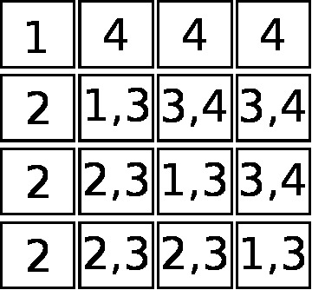
1. Affine codes: Polyhedral model
for ( i = 0; i < N; i++)
for ( j = i+1; j < N; j++){
A[j][i]₂ /= A[i][i]₁;
for ( k = i+1; k < N; k++)
A[j][k]₃ -= A[j][i]₂ * A[i][k]₄;
}
Contributions
Efficient prefetching!
for ( i = 0; i < N; i++)
for ( j = 0; j < N; j++)
prefetch A[i][j]

Slide 11
Polyhedral algorithm
Compute linear functions for load instructions
Compute the set of accessed memory locations per instruction
Compute the convex union of these sets
Contributions

Slide 12
Polyhedral algorithm
Compute linear functions for load instructions
Compute the set of accessed memory locations per instruction
Compute the convex union of these sets
Generate the loop nest of minimum depth prefetching them
Contributions
Highly
efficient
prefetching!
Restricted to
affine codes.
~30% of loops in
our benchmarks

Slide 13
2. Non-affine codes, complex CFG
Clone the original task
Keep only instructions involved in:
Memory address computation
CFG
Replace load with prefetch instructions
Discard store instructions to globals
Apply optimizations → lightweight access code
Contributions

Slide 14
Optimizations: CFG
Problem:
complex CFG → heavy access phase.
Execute :
for ( i = 0; i < N; i++)
for ( j = i+1; j < N; j++){
if (cond)
A[j][i] += A[i][j];
A[i][j] -= N;
}
Execute :
for ( i = 0; i < N; i++)
for ( j = i+1; j < N; j++){
if (cond)
A[j][i] += A[i][j];
A[i][j] -= N;
}
Solution:
only prefetch addresses guaranteed to be accessed.
Contributions
Access :
for ( i = 0; i < N; i++)
for ( j = i+1; j < N; j++)
prefetch A[i][j];
Improvements: profile & prefetch the hot path.

Slide 15
Optimizations: address computation
Problem: address computation requires memory accesses.
Execute :
for ( i = 0; i < N; i++) A[B[i]] -= ...;
Solution: access memory and prefetch only the last indirection.
Access :
for ( i = 0; i < N; i++)
prefetch B[i];
Access :
for ( i = 0; i < N; i++){ prefetch B[i];
x = load B[i];
prefetch A[x];
}
Contributions
Improvements: profile → address comp. overhead vs. prefetching benefits.

Slide 16
Contributions in a nutshell
2 methods to generate the access phase:
Polyhedral – affine codes
Analyze access pattern
Generate minimal-depth loop
Optimized skeleton – non-affine codes
Create clone
Add prefetch, remove stores
Optimize → lightweight access version
Contributions

Slide 17
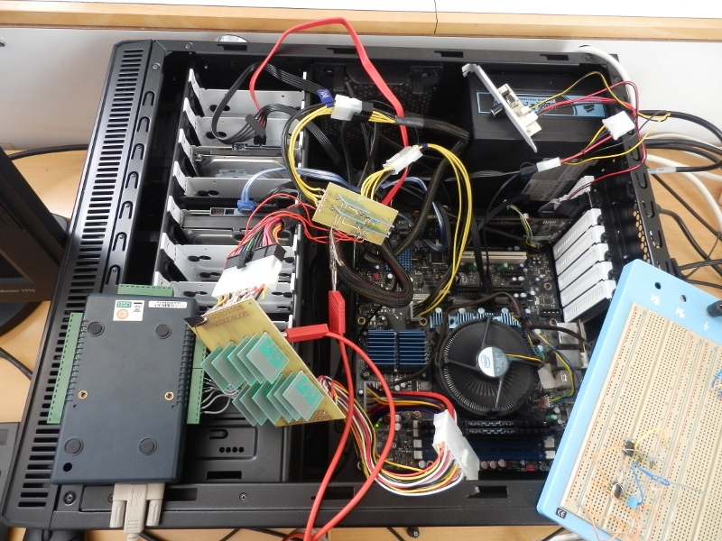
Methodology
Methodology

Slide 18
Overcoming HW limitations
Current hardware does not support:
Per-core DVFS
Low-overhead DVFS
But getting there …
Model the benefits of per-core DVFS
for future hardware !
Methodology
Performance: Measured on real HW
Energy: Modeled & verified on real HW
Spiliopoulos et.al. Green Governors –IGCC 2011

Slide 19
Evaluation
Evaluation

Slide 20
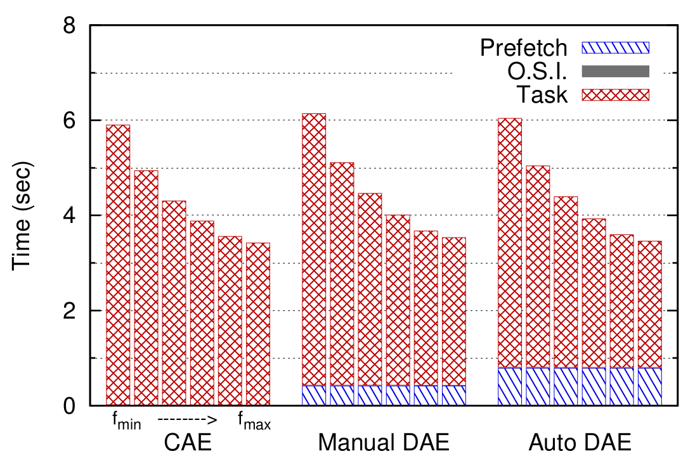
Coupled execution
FFT RunTime Profile – 4 threads
FFT RunTime Profile – 4 threads
Evaluation
f_{min} → f_{max}

Slide 21
Coupled execution
FFT RunTime Profile – 4 threads
Evaluation
f_{min} → f_{max}

Slide 22
Coupled execution
FFT RunTime Profile – 4 threads
Evaluation
f_{min} → f_{max}

Slide 23
Coupled execution
FFT RunTime Profile – 4 threads
Evaluation
f_{min} → f_{max}

Slide 24
Coupled execution
FFT RunTime Profile – 4 threads
Evaluation
f_{min} → f_{max}

Slide 25
Coupled execution
FFT RunTime Profile – 4 threads
Evaluation
f_{min} → f_{max}

Slide 26
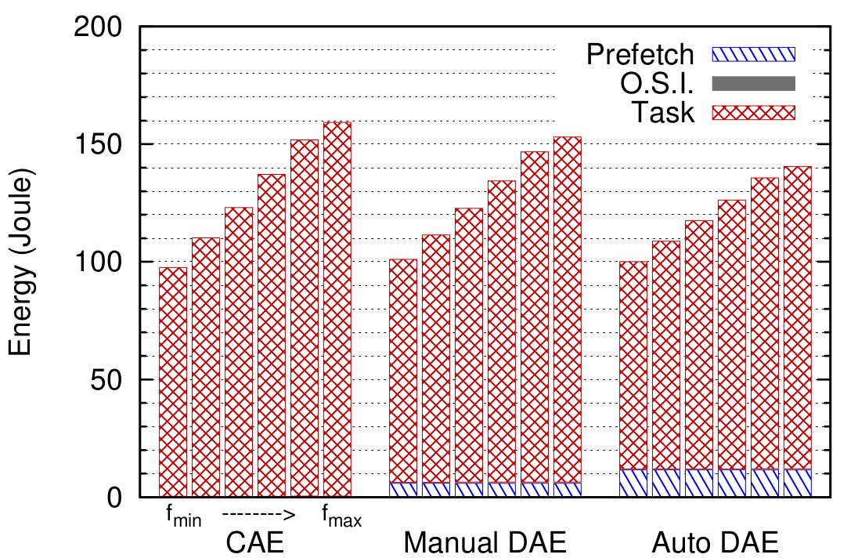
Coupled execution
FFT RunTime Profile – 4 threads
FFT EnergyProfile – 4 threads
Evaluation
f_{min} → f_{max}

Slide 27
Coupled execution
FFT RunTime Profile – 4 threads
FFT EnergyProfile – 4 threads
Evaluation
f_{min} → f_{max}

Slide 28
Coupled execution
FFT RunTime Profile – 4 threads
FFT EnergyProfile – 4 threads
Evaluation
f_{min} → f_{max}

Slide 29
Coupled execution
FFT RunTime Profile – 4 threads
FFT EnergyProfile – 4 threads
Evaluation
f_{min} → f_{max}

Slide 30
Coupled execution
FFT RunTime Profile – 4 threads
FFT EnergyProfile – 4 threads
Evaluation
f_{min} → f_{max}

Slide 31
Coupled execution
FFT RunTime Profile – 4 threads
FFT EnergyProfile – 4 threads
Evaluation
f_{min} → f_{max}

Slide 32
Coupled vs Manual DAE
Performance “unaffected”
FFT RunTime Profile – 4 threads
FFT EnergyProfile – 4 threads
Evaluation
f_{min} → f_{max}
Access: f_{min}
Execute: f_{min} → f_{max}

Slide 33
Coupled vs Manual DAE
Performance “unaffected”
FFT RunTime Profile – 4 threads
FFT EnergyProfile – 4 threads
Evaluation
f_{min} → f_{max}
Access: f_{min}
Execute: f_{min} → f_{max}

Slide 34
Coupled vs Manual DAE
Performance “unaffected”
FFT RunTime Profile – 4 threads
FFT EnergyProfile – 4 threads
Evaluation
f_{min} → f_{max}
Access: f_{min}
Execute: f_{min} → f_{max}

Slide 35
Coupled vs Manual DAE
Performance “unaffected”
FFT RunTime Profile – 4 threads
FFT EnergyProfile – 4 threads
Evaluation
f_{min} → f_{max}
Access: f_{min}
Execute: f_{min} → f_{max}

Slide 36
Coupled vs Manual DAE
Performance “unaffected”
FFT RunTime Profile – 4 threads
FFT EnergyProfile – 4 threads
Evaluation
f_{min} → f_{max}
Access: f_{min}
Execute: f_{min} → f_{max}

Slide 37
Coupled vs Manual DAE
Performance “unaffected”
FFT RunTime Profile – 4 threads
FFT EnergyProfile – 4 threads
Evaluation
f_{min} → f_{max}
Access: f_{min}
Execute: f_{min} → f_{max}

Slide 38
Coupled vs Manual DAE
Performance “unaffected”
FFT RunTime Profile – 4 threads
FFT EnergyProfile – 4 threads
Evaluation
f_{min} → f_{max}
Access: f_{min}
Execute: f_{min} → f_{max}

Slide 39
Coupled vs Manual DAE
Performance “unaffected”
Energy savings
FFT RunTime Profile – 4 threads
FFT EnergyProfile – 4 threads
Evaluation
f_{min} → f_{max}
Access: f_{min}
Execute: f_{min} → f_{max}

Slide 40
Coupled vs Manual DAE
Performance “unaffected”
Energy savings
FFT RunTime Profile – 4 threads
FFT EnergyProfile – 4 threads
Evaluation
f_{min} → f_{max}
Access: f_{min}
Execute: f_{min} → f_{max}

Slide 41
Coupled vs Manual DAE
Performance “unaffected”
Energy savings
FFT RunTime Profile – 4 threads
FFT EnergyProfile – 4 threads
Evaluation
f_{min} → f_{max}
Access: f_{min}
Execute: f_{min} → f_{max}

Slide 42
Coupled vs Manual DAE
Performance “unaffected”
Energy savings
FFT RunTime Profile – 4 threads
FFT EnergyProfile – 4 threads
Evaluation
f_{min} → f_{max}
Access: f_{min}
Execute: f_{min} → f_{max}

Slide 43
Coupled vs Manual DAE
Performance “unaffected”
Energy savings
FFT RunTime Profile – 4 threads
FFT EnergyProfile – 4 threads
Evaluation
f_{min} → f_{max}
Access: f_{min}
Execute: f_{min} → f_{max}

Slide 44
Coupled vs Manual DAE
Performance “unaffected”
Energy savings
FFT RunTime Profile – 4 threads
FFT EnergyProfile – 4 threads
Evaluation
f_{min} → f_{max}
Access: f_{min}
Execute: f_{min} → f_{max}

Slide 45
CAE vs M-DAE vs Auto DAE
AutoDAE access phase prefetches more data at f_{min}
compared to ManualDAE
Performance “unaffected”
Energy savings
FFT RunTime Profile – 4 threads
FFT EnergyProfile – 4 threads
Evaluation
f_{min} → f_{max}
Access: f_{min}
Execute: f_{min} → f_{max}

Slide 46
CAE vs M-DAE vs Auto DAE
AutoDAE access phase prefetches more data at f_{min}
compared to ManualDAE
Performance “unaffected”
Energy savings
FFT RunTime Profile – 4 threads
FFT EnergyProfile – 4 threads
Evaluation
f_{min} → f_{max}
Access: f_{min}
Execute: f_{min} → f_{max}

Slide 47
CAE vs M-DAE vs Auto DAE
AutoDAE access phase prefetches more data at f_{min}
compared to ManualDAE
Performance “unaffected”
Energy savings
FFT RunTime Profile – 4 threads
FFT EnergyProfile – 4 threads
Evaluation
f_{min} → f_{max}
Access: f_{min}
Execute: f_{min} → f_{max}

Slide 48
CAE vs M-DAE vs Auto DAE
AutoDAE access phase prefetches more data at f_{min}
compared to ManualDAE
Performance “unaffected”
Energy savings
FFT RunTime Profile – 4 threads
FFT EnergyProfile – 4 threads
Evaluation
f_{min} → f_{max}
Access: f_{min}
Execute: f_{min} → f_{max}

Slide 49
CAE vs M-DAE vs Auto DAE
AutoDAE access phase prefetches more data at f_{min}
compared to ManualDAE
Performance “unaffected”
Energy savings
FFT RunTime Profile – 4 threads
FFT EnergyProfile – 4 threads
Evaluation
f_{min} → f_{max}
Access: f_{min}
Execute: f_{min} → f_{max}

Slide 50
CAE vs M-DAE vs Auto DAE
AutoDAE access phase prefetches more data at f_{min}
compared to ManualDAE
Performance “unaffected”
Energy savings
FFT RunTime Profile – 4 threads
FFT EnergyProfile – 4 threads
Evaluation
f_{min} → f_{max}
Access: f_{min}
Execute: f_{min} → f_{max}

Slide 51
CAE vs M-DAE vs Auto DAE
AutoDAE access phase prefetches more data at f_{min}
compared to ManualDAE
Performance “unaffected”
Energy savings
FFT RunTime Profile – 4 threads
FFT EnergyProfile – 4 threads
Evaluation
f_{min} → f_{max}
Access: f_{min}
Execute: f_{min} → f_{max}

Slide 52
CAE vs M-DAE vs Auto DAE
AutoDAE access phase prefetches more data at f_{min}
compared to ManualDAE
Performance “unaffected”
Energy savings
FFT RunTime Profile – 4 threads
FFT EnergyProfile – 4 threads
Evaluation
f_{min} → f_{max}
Access: f_{min}
Execute: f_{min} → f_{max}

Slide 53
CAE vs M-DAE vs Auto DAE
AutoDAE access phase prefetches more data at f_{min}
compared to ManualDAE
Performance “unaffected”
Energy savings
FFT RunTime Profile – 4 threads
FFT EnergyProfile – 4 threads
Evaluation
f_{min} → f_{max}
Access: f_{min}
Execute: f_{min} → f_{max}

Slide 54
CAE vs M-DAE vs Auto DAE
AutoDAE access phase prefetches more data at f_{min}
compared to ManualDAE
Performance “unaffected”
Energy savings
FFT RunTime Profile – 4 threads
FFT EnergyProfile – 4 threads
Evaluation
f_{min} → f_{max}
Access: f_{min}
Execute: f_{min} → f_{max}

Slide 55
CAE vs M-DAE vs Auto DAE
AutoDAE access phase prefetches more data at f_{min}
compared to ManualDAE
Performance “unaffected”
Energy savings
FFT RunTime Profile – 4 threads
FFT EnergyProfile – 4 threads
Evaluation
f_{min} → f_{max}
Access: f_{min}
Execute: f_{min} → f_{max}

Slide 56
CAE vs M-DAE vs Auto DAE
AutoDAE access phase prefetches more data at f_{min}
compared to ManualDAE
Performance “unaffected”
Energy savings
FFT RunTime Profile – 4 threads
FFT EnergyProfile – 4 threads
Evaluation
f_{min} → f_{max}
Access: f_{min}
Execute: f_{min} → f_{max}

Slide 57
CAE vs M-DAE vs Auto DAE
AutoDAE access phase prefetches more data at f_{min}
compared to ManualDAE
AutoDAE
competitive with
hand crafted codes
Performance “unaffected”
Energy savings
FFT RunTime Profile – 4 threads
FFT EnergyProfile – 4 threads
Evaluation
f_{min} → f_{max}
Access: f_{min}
Execute: f_{min} → f_{max}

Slide 58
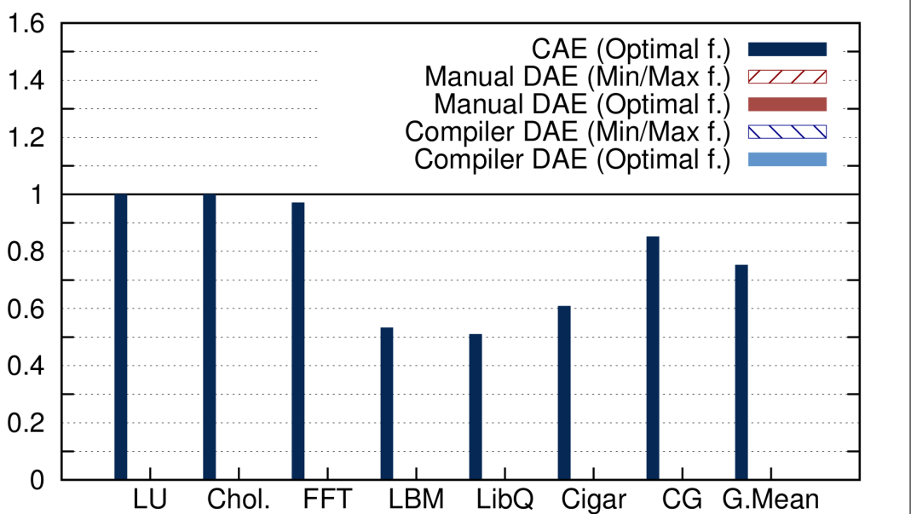
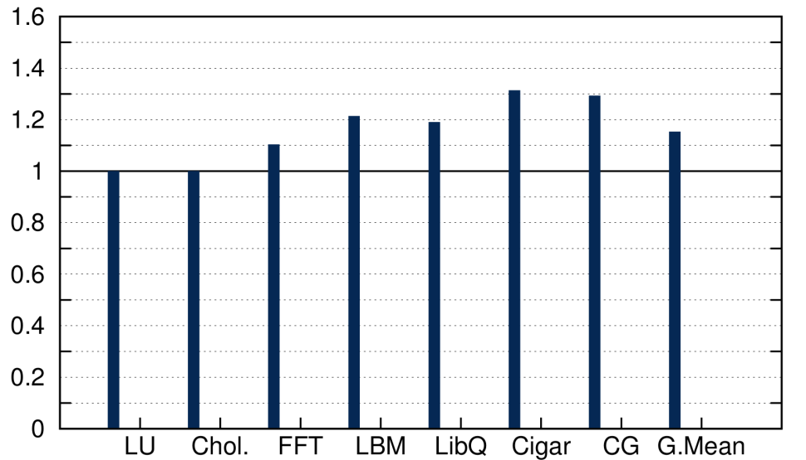
Putting it all together
EDP (normalized to original at f_{max})
CAE: 26% EDP improvement
CAE:15% Performance degradation
Evaluation
Runtime (normalized to original at f_{max})
The lower the better!

Slide 59
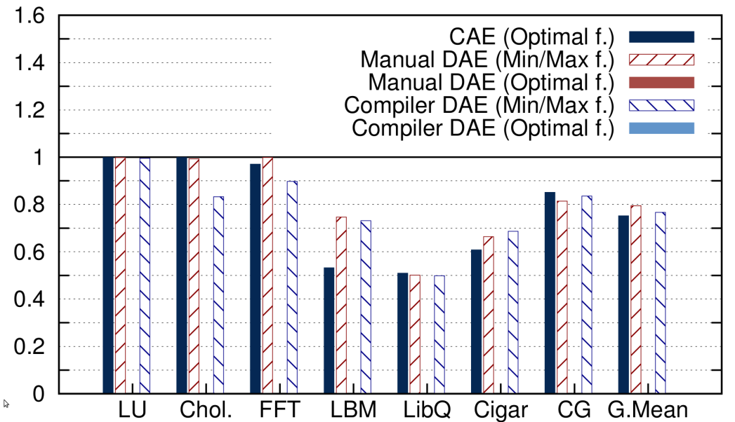
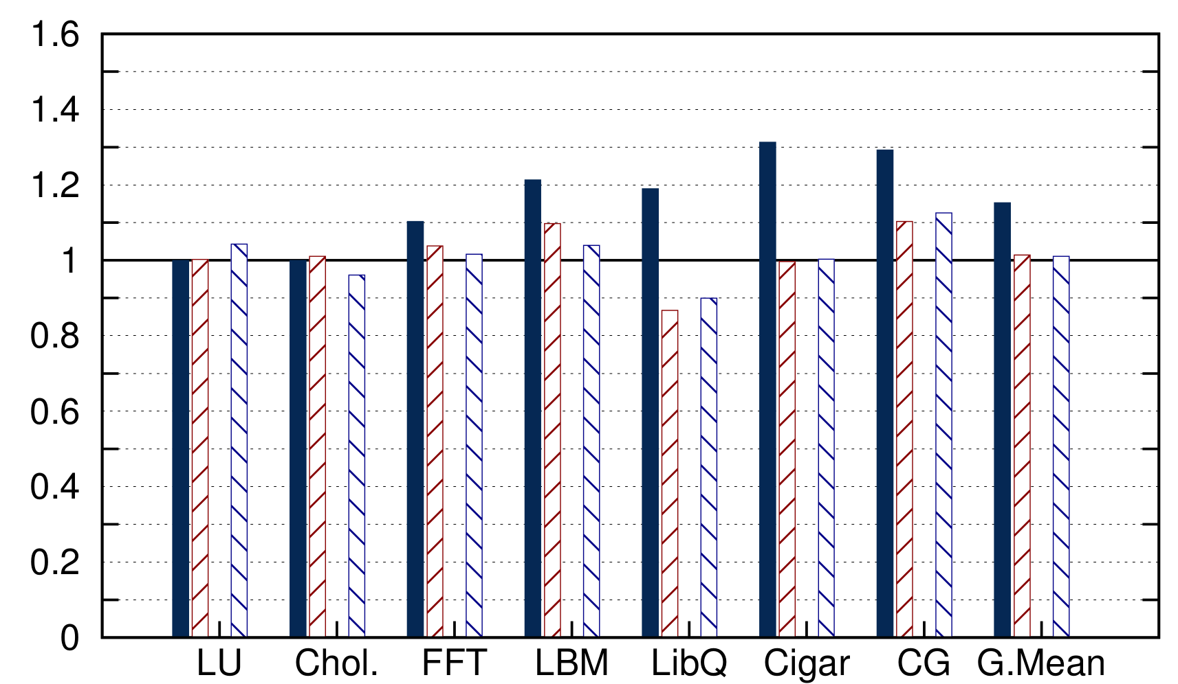
Putting it all together
EDP (normalized to original at f_{max})
CAE: 26% EDP improvement
M-DAE: 20% EDP improvement
A-DAE: 22% EDP improvement
CAE: 15% Perf. degradation
M-DAE: <1% Perf. degradation
A-DAE: <1% Perf. degradation
Evaluation
Runtime (normalized to original at f_{max})
500ns latency, per-core DVFS
The lower the better!

Slide 60
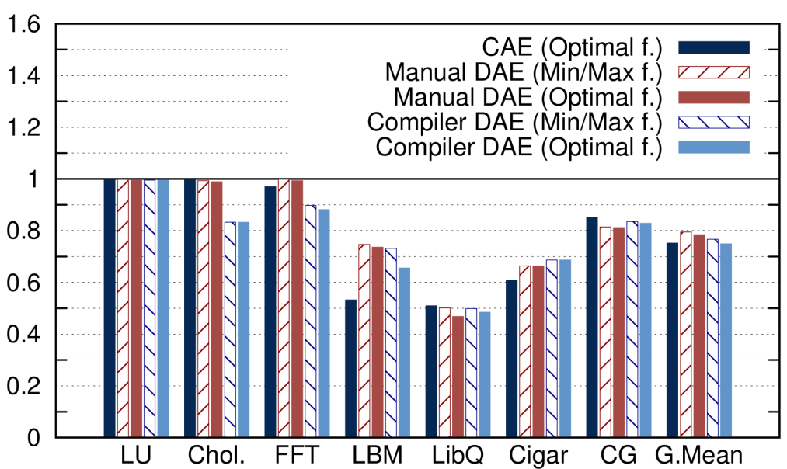
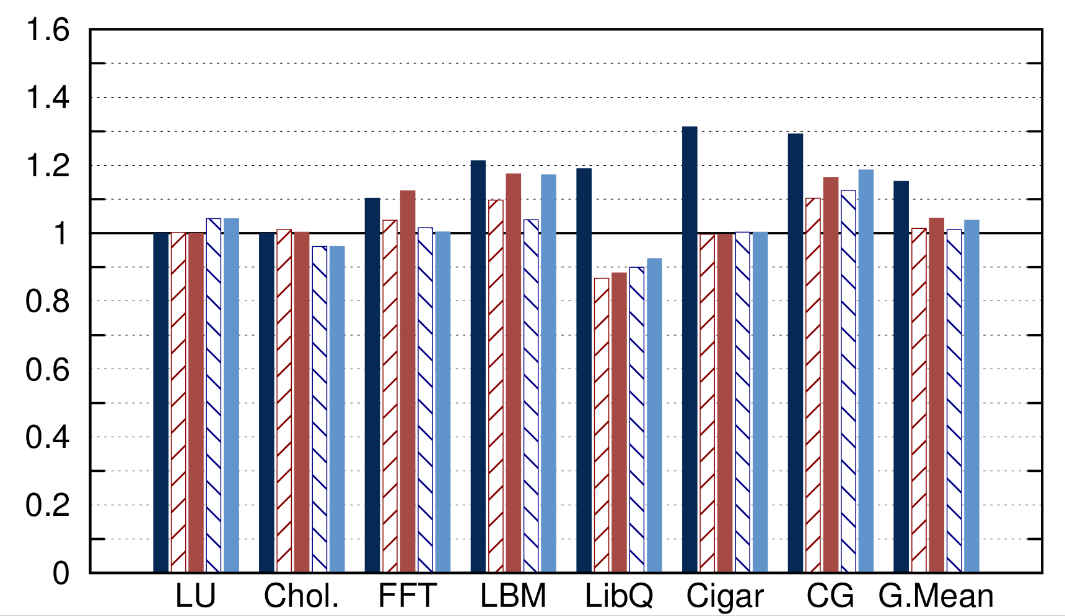
Putting it all together
EDP (normalized to original at f_{max})
CAE: 26% EDP improvement
M-DAE: 23% EDP improvement
A-DAE: 25% EDP improvement
CAE: 15% Per. degradation
M-DAE: <4% Perf. degradation
A-DAE: <4% Perf. degradation
Evaluation
Runtime (normalized to original at f_{max})
500ns latency, per-core DVFS
Auto-DAE outperforms
the manually crafted
codes since the compiler
derives the access
phase from an internally
optimized task version.

Slide 61
Putting it all together
EDP (normalized to original at f_{max})
CAE: 26% EDP improvement
M-DAE: 22% EDP improvement
A-DAE: 25% EDP improvement
CAE: 15% Per. degradation
M-DAE: <4% Perf. degradation
A-DAE: <4% Perf. degradation
Evaluation
Runtime (normalized to original at f_{max})
500ns latency, per-core DVFS
Coupled execution provides
optimal EDP of 26% with 15%
performance degradation!
Automatic DAE provides close to
optimal EDP of 25% with
less than 4%
performance degradation!

Slide 62
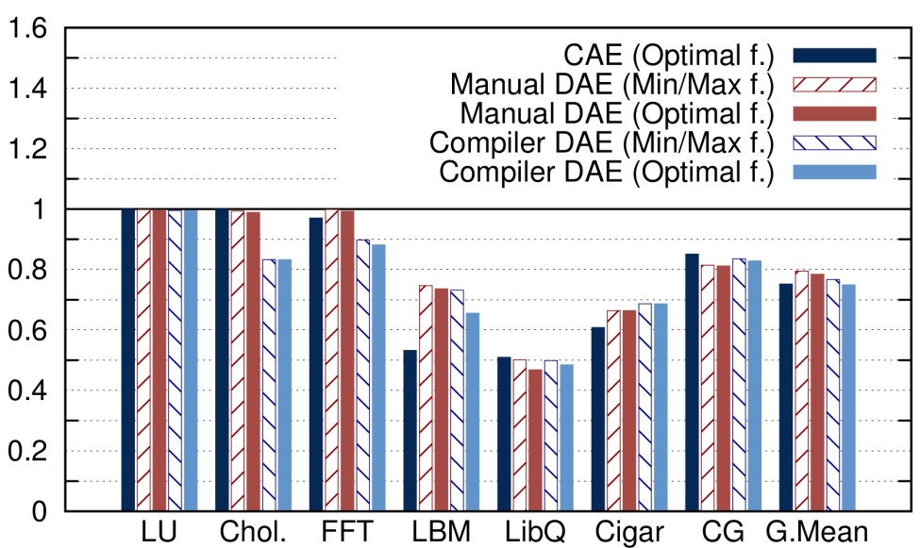
Statistics
Slowdown
Polyhedral method →
-5% to 1%
Skeleton method →
-10% to 18%
Runtime(normalized to original at f_{max})
Skeleton instead of polyhedral method: 75% overhead
EDP (normalized to original at f_{max})
Evaluation

Slide 63
Take-away message
Goal: Save energy, keep performance
Tool: DVFS
Problem: Fine granularity of memory- and compute-bound phases → impossible to adjust f at this rate
Solution: Decoupled Access Execute
Contribution: Automatic DAE (compiler)
Results: Equivalent to hand crafted code
(25% EDP improvement compared to original)
Conclusions

Slide 64
Fix the code. Don’t tweak the hardware: A new compiler approach to Voltage - Frequency scaling
Sweden
Alexandra Jimborean
Konstantinos Koukos
Vasileios Spiliopoulos
David Black-Schaffer
Stefanos Kaxiras
Notes:
Present self + team
Previous decades: Time is money → Performance
Current decade: Power is money → Energy
This work improves energy efficiency without damaging performance.

Slide 65
Statistics
# of loops that are detected to be affine:
6 out of 22 loops
2 out of 7 analyzed benchmarks
# of tasks per benchmark
highly varying 45K - 50M
1-4 loops per benchmark
granularity: 5-320 usec for the execute and 2-30 for the access phase
% of TA: 1.8%(LU, cholesky), 19% FFT, 42-49%

Slide 66
Evaluation: Optimizing DAE
For some applications we can choose better frequencies !
Access phase: Complex calculations
Slightly higher f than min is optimal
Execute phase: Too many / irregular writes
Slightly lower f than max is optimal
Optimal → “OptEDP” policy
Use power and performance models to predict f,V that has the optimal EDP and set this at runtime
“Spiliopoulos et.al., Green governors: A framework for continuously adaptive DVFS.”

Slide 67
Understanding DVFS
Memory Bound
Compute Bound
Maximum Frequency
Maximum Frequency
X
Stall (MEM)
Miss penalty
Energy waste
Performance Loss
Low Frequency
Low Frequency
Miss penalty
Background
Real programs
f_{max}
f_{min}
f_{max}
f_{min}
f_{max}
f_{min}
f_{max}
Impossible to DVFS this fast
How do we solve this problem ?

Slide 68

Methodology
Profile:
on real HW
for each f
Estimate
Access / Execute
Energy
for each f,V
Estimate Power
Model Accuracy
Time
IPC
Power
Model
Verify
Methodology
Now we can model the benefits of per-core DVFS
on real hardware !
Performance: Measured on real HW
Energy: Modeled & verified on real HW
Spiliopoulos et.al. Green Governors –IGCC 2011

