Slide 1

Fluidic Kernels: Cooperative Execution of OpenCL Programs on Multiple Heterogeneous Devices
Prasanna Pandit
R. Govindarajan
Supercomputer Education and Research Centre
Indian Institute of Science, Bangalore
CGO—2014

Slide 2
Outline
Introduction
The Problem
The FluidiCL Runtime
Optimizations
Results
Conclusion

Slide 3
introduction

Slide 4
Introduction
Heterogeneous devices are common in today’s systems such as multicore CPUs and GPUs
Different programming models:
OpenMP, CUDA, MPI, OpenCL
How can a single parallel program
Choose the right device
Utilize all devices if possible
Heterogeneous programming models like OpenCL need manual effort from the programmer
Notes:
Heterogeneous devices like CPUs and GPUs have become common in today’s computing systems.
There are different programming models for each of them.
Programming models like OpenCL are still manual in nature
How can we have a single parallel program which can effectively use all available devices?

Slide 5
OpenCL
An open standard for heterogeneous computing
Support for different devices: CPU, GPU, Accelerators, FPGA...
Program portability
as long as the device vendor supports it
Programmer selects the device to use

Slide 6
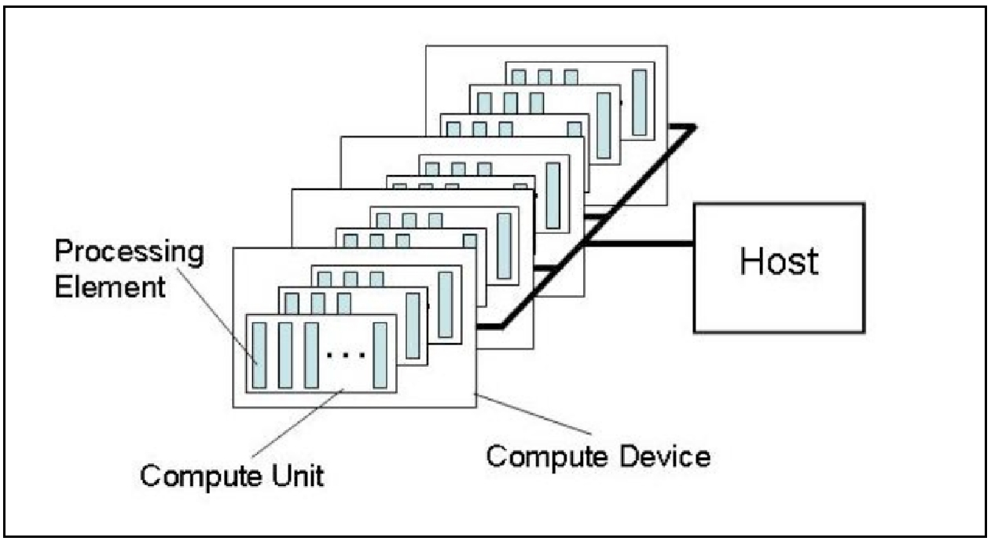
OpenCL Host and Device
Source: Khronos Group
Notes:
The diagram shows openCL device model
There is a separate host program and device program. The device program is called a kernel.
The diagram also shows the logical entities in a device – compute unit and processing elements.
These are where work-groups and work-items will run. I will explain them shortly.

Slide 7
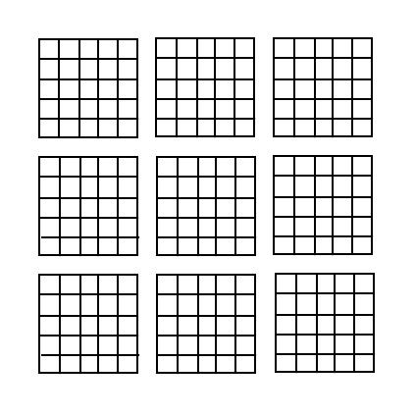
OpenCL
Expects the programmer to specify parallelism
Work-group
Work-item
OpenCL memory consistency model does not guarantee that writes by a work-item will be visible to work-items of other work-groups
A work-group can be used as a unit of scheduling across devices

Slide 8
OpenCL
Expects the programmer to specify parallelism

Slide 9
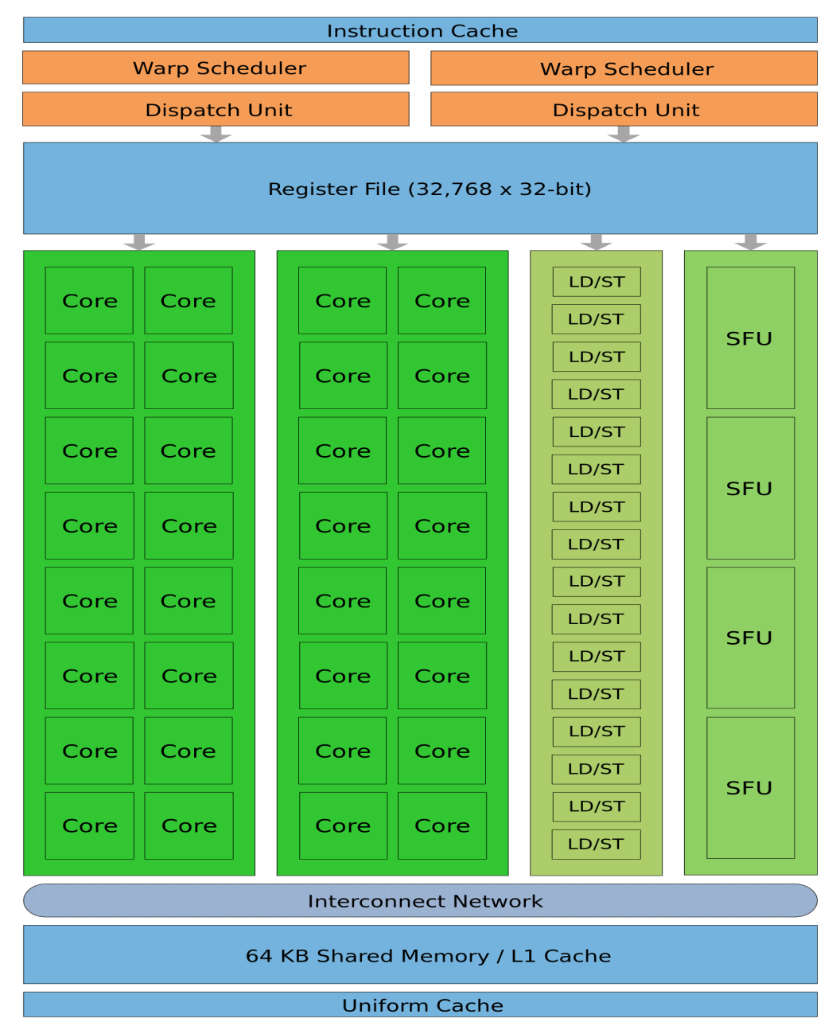
GPU Architecture
Source: NVIDIA
Notes:
Let’s look at the GPU architecture.
A Streaming multiprocessor is what’s shown here. A GPU has tens of such SMs.
Each SM has many Streaming Processors – shown as Cores in green
There is a large register file that can be used to maintain the context of thousands of in-flight threads
A small Shared Memory and L1 cache is present
High-end GPUs typically have discrete memory which means data has to be moved to the device before the computation

Slide 10
The problem

Slide 11
The Problem
CPUs and GPUs:
Different architectures, varying performance
CPUs have fewer cores, large caches, give good single thread performance
GPUs emphasize high throughput over single thread performance
Data transfer overheads for discrete GPUs
How do I run every OpenCL kernel across both CPU and GPU to get the best possible performance?

Slide 12
The Problem
Which device should my OpenCL program run on?
Different applications run better on different devices
ATAX
SYR2K

Slide 13
The Problem
Which device should my OpenCL program run on?
Same application runs differently on different inputs
SYRK (1100)
SYRK (2048)

Slide 14
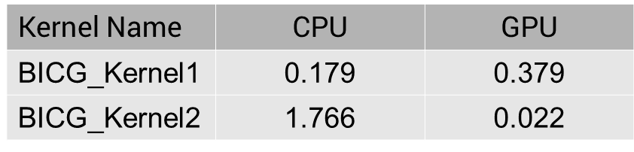
The Problem
What if my program has multiple kernels, and each likes a different device?
Where the data resides is important!

Slide 15
Solution
It is desired to have a framework which can:
identify the best performing work allocation
dynamically adapt to different input sizes
factor in data transfer costs
transparently handle data merging
support multiple kernels
without requiring prior training or profiling or programmer annotations

Slide 16
The fluidicl runtime
Notes:
7 mins

Slide 17
Overview
Application
OpenCL
Device
Runtime
Device

Slide 18
Overview
Application
FluidiCL
OpenCL
CPU
Runtime
OpenCL
GPU
Runtime
CPU
GPU

Slide 19
Kernel Execution
Data transfers to both devices
Two additional buffers on the GPU: one for data coming from the CPU, one to hold an original copy
CPU
Host
GPU
GPUData
Twin
CPUData

Slide 20
Modified Kernels
CPU Kernel
GPU Kernel
Start
Start
Is
work-group
within
range?
Has
work-group
finished
on
CPU
?
No
Yes
Yes
No
Execute Kernel Code
Execute Kernel Code
Exit
Exit

Slide 21
Kernel Execution
CPU
GPU
Subkernel1 (450-499)
0 – 99
Data+Status
100 – 199
CPU subkernel considered complete only if data reaches the GPU
Duplicate execution of work-groups legal as long as results are chosen carefully
Subkernel2 (400-449)
Data+Status
200 – 299
Subkernel3 (350-399)
Data+Status
300 – 349
Subkernel4 (300-349)
Data Merge
Data

Slide 22
Kernel Execution
CPU
GPU
Subkernel1 (450-499)
0 – 99
Data+Status
100 – 199
Subkernel2 (400-449)
Data+Status
200 – 299
Subkernel3 (350-399)
Data+Status
300 – 349
Subkernel4 (300-349)

Slide 23
Data Merging
CPUData
GPUData
Twin

Slide 24
Optimizations

Slide 25
GPU Work-group Aborts
Work-group aborts in loops necessary to reduce duplicate execution
Code to check CPU status inserted inside innermost loops
__kernel void someKernel (__global int *A, int n)
{
int i;
bool done = checkCPUExecutionStatus ();
if (done == true)
return;
for (i = 0; i < n; i ++)
{
//...
}
}

Slide 26
Loop Unrolling
Inserting checks inside loops can inhibit loop unrolling optimization by the GPU compiler
Restructure the loop to perform unrolling
keeps pipelined ALUs in GPU occupied
int i;
for(i=0; i< n; i+=(1+UNROLL_FACTOR))
{
int k1, ur = UNROLL_FACTOR;
bool done = checkCPUExecutionStatus ();
if (done == true)
return;
if ((i+ur) > n)
ur = (n-1)-i;
for (k1 = i; k1 <= (i+ur); k1++)
{
//Expression where i is replaced
//with k1
}
}

Slide 27
Other Optimizations
Buffer Management:
Maintain a pool of buffers for additional FluidiCL data
Create a new buffer only if one big enough is not found
Reclaim older buffers
Data Location tracking:
Where is the up-to-date data?
If CPU has it, no transfer is required when the host requests it.
if CPU executed the entire grid
if device-to-host transfers have completed

Slide 28
results
Notes:
14 mins

Slide 29
Experimental Setup
CPU | Intel Xeon W3550 (4 cores, 8 threads)
GPU | NVIDIA Tesla C2070 (Fermi)
System Memory | 16GB
GPU Memory | 5GB
OpenCL CPU Runtime | AMD APP 2.7
OpenCL GPU Runtime | NVIDIA CUDA 4.2

Slide 30
Benchmarks
Benchmarks from the Polybench GPU suite
Benchmark | Input Size | No. of kernels | No. of work-groups
ATAX | (28672, 28672) | 2 | 896, 896
BICG | (24576, 24576) | 2 | 96, 96
CORR | (2048, 2048) | 4 | 8, 8, 16384, 8
GESUMMV | (20480) | 1 | 80
SYR2K | (1000, 1000) | 1 | 4000
SYRK | (2500, 2500) | 1 | 24727

Slide 31
Overall Results
All optimizations enabled
64% faster than running on GPU only and 88% faster than running only on CPU

Slide 32
Different Input Sizes
SYRK benchmark: Close to 2x faster than the best of CPU and GPU on average across different input sizes

Slide 33
Work-group Abort inside Loops
Increases performance by 27% on average

Slide 34
Effect of Loop unrolling
Aborts inside loops included but without unrolling
Performance would suffer by upto 2x if loop unrolling was not done

Slide 35
Comparison to SOCL (StarPU)
FluidiCL performs 26% faster than the profiled StarPU DMDA scheduler of SOCL.

Slide 36
Related Work
Achieving a single compute device image in opencl for multiple gpus, Kim et al. [PPoPP 2011]
Considers multiple identical GPUs
Performs buffer range analysis to identify partitioning
Works for regular programs
A static task partitioning approach for heterogeneous systems using opencl, Grewe et al. [CC 2011]
Uses a machine learning model
Decides at a kernel level
StarPU Extension for OpenCL, Sylvain Henry
Adds OpenCL support for StarPU
Requires profiling for each application
Compiler and Runtime Support for Enabling Generalized Reduction Computations on Heterogeneous Parallel Conﬁgurations, VT Ravi et al. [ICS 2010]
Work sharing approach for generalized reduction applications

Slide 37
Conclusion
A heterogeneous OpenCL runtime called FluidiCL which performs runtime work distribution and data management
A scheme that does not require prior profiling/training
Can adapt to different inputs
CPU + Fermi GPU:
outperforms the single best device by 14% overall

Slide 38
Future Work
Using compiler analysis to reduce data transfer
Explore the scheduling idea further
on integrated CPU—GPU platforms
on multiple accelerators

Slide 39
questions?
Thank you!

