Slide 2


Simplifying Scalable Graph Processing with a
Domain-Specific Language
Sungpack Hong (Oracle Labs)
Semih Salihoglu (Stanford University)
Jennifer Widom (Stanford University)
Kunle Olukotun (Stanford University)

Slide 3


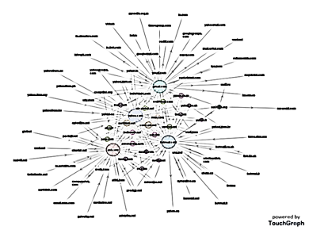
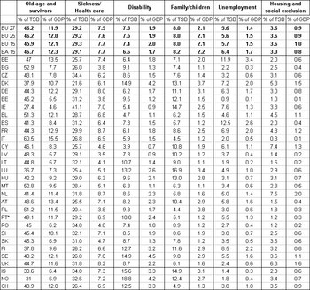

Graph Analysis
What is graph analysis?
  Represent your data as a graph
  Analyze the graph to discover useful information or insights about your data
Why graph representation?
  A graph captures relationship between data entities
  Discover indirect relationships between data entities (e.g. path-finding)
  Consider the impact of local relationships in a global context (e.g. Pagerank)
  Identify patterns and groups in the data set (e.g. community detection)
Ideas about the data
Discoveries on the data
Data Entities
Graph Representation
Run Graph
Analysis
Data Scientist

Slide 4
Challenges in Graph Analysis
Intuitive Program in DSL
Implementation
Overhead
compile
Our Approach:
Domain Specific Language
(Green-Marl)
Data scientists: trained for graph algorithms, not necessarily for distributed programming
Make worse
Special Programming Model
Performance
Parallelization + Latency hiding
Graph Analysis: a lot of random data access (communications)
Data Size
Special Frameworks for
Distributed Graph Processing
(e.g. Pregel)
Huge graphs: 100s of billions of edges

Slide 5
Pregel
A Scalable Distributed Graph Processing Framework
Target framework: Pregel
  A distributed graph processing framework originated from Google [SIGMOD 2010]
    Shown to be very scalable
  Open-source implementations: Giraph (Apache), GPS (Stanford), …
  Special Programming Model:
    Evolved from Map-Reduce
    Vertex-local state + Bulk-synchronous message passing

Slide 6
Pregel’s Programming Model
Pregel Program:
To describe the behavior of each vertex
Local State:
Each vertex maintains its own local state.
The state can be modified via local computation.
Graph Distribution:
Vertices of the graph are distributed over multiple machines
VertexCompute(int vid, int timestep) {
process_rcvd_msgs(); //rcvd at step N+1
do_local_computation()
send_msgs(); //send at step N
}
V₁
V₂
V₃
V_{n-2}
V_{n-1}
V_{n}
Machine #1
Machine #K
……
Time Step n
Time Step n + 1
V_{n-2}
V_{n-1}
V_{n}
V₁
V₂
V₃
Time-Step:
The execution is time-stepped.
At one time step, all the vertices are computed in parallel
The same compute() method is invoked at every time step
Bulk-Synchronous Message Passing:
A vertex can send messages to other vertices
All the messages are bulk-delivered at the beginning of next time step

Slide 7
Issue: Pregel’s Programming Model
Pregel’s Programming Model
  Vertex-centric, Message-Passing, Bulk-Synchronous
  Designed for engineering reasons
    Enforces Parallelism
    Enables buffering up small messages into big packets
    Trades-off latency vs. bandwidth
Natural way to design graph algorithms
  Imperative
  Random-access memory
Gap

Slide 8
Example
“In a social network, compute the average number of teenage followers among those who themselves are more than K years old?”
(i.e. How cool is your daddy?)
Time-stepped:
Need a finite state machine
Vertex-Centric:
Behavior of each vertex
class vertex extends … {
……
public void compute(…){
if (step == 1) {
if (this.age >= 13 && this.age < 20)
sendNeighbors (new IntMessage(1));
}
else if (step == 2) {
this.teenCount = 0;
for(r: getReceived())
this.teenCount += r.IntValue();
}
else if (step == 3) {
if (this.age > K) {
…. // compute global average
// Count number of teen followers
// for each node the graph
Foreach(n: G.Nodes) {
n.teenCount =
Count(t:n.InNbrs)(t.age>=13&&t.age<20);
}
// Compute average number of
// teen-followers of people older than K
Float avgTeenFollowers =
Avg(n:G.Nodes)(n.age>K){n.teenCnt};
Compilation?
Algorithm Description in Green-Marl
Imperative &&
Random memory accessing (Read)
Pregel Implementation
Message-Passing:
Random memory access becomes message passing (pushing)
Bulk-Synchronous:
Messages are bulk-delivered at the next time-step

Slide 9
Compilation By Example (1/9)
Expanding Syntax Sugar
Expand into explicit loops
Procedure teenCnt (G: Graph,
teenCnt, age: Node_Prop<Int>,
K: Int) :Float
{
Foreach(n: G.Nodes)
n.teenCnt =
Count(t:n.InNbrs)
(t.age>=10 && t.age<20);
Float avg_val =
Avg(n:G.Nodes)(n.age>K)
{n.teenCnt};
Return avg_val;
}
...
Foreach(n: G.Nodes) {
Int _S1 = 0;
Foreach (t: n.InNbrs) {
If (t.age>=10 && t.age<20)
_S1 += 1;
}
n.teenCnt = _S1;
}
Int _S2 = 0;
Int _C3 = 0;
Foreach(n: G.Nodes) {
If (n.age > K) {
_S2 += n.teenCnt;
_C3 += 1;
} }
Float avg_val = (_C3 == 0) ?
0 : _S2 / (Double) _C3;
...

Slide 10
Compilation By Example (2/9)
State Machine :
State is managed by the master class
Extracting State Machine
Vertex Parallel Computation
@override
public void compute(…) {
switch(_state) {
case 1:do_state_1(); break;
case 2:do_state_2(); break;
case 3:do_state_3(); break;
…
}}
private void do_state_1(…) {
is_parallel = true;
_state_nxt = 2;
…
}
private void do_state_2(…) { …
is_parallel = false;
_S2 = 0;
_C3 = 0;
}
…
...
Foreach(n: G.Nodes) {
Int _S1 = 0;
Foreach (t: n.InNbrs) {
If (t.age>=10 && t.age<20)
_S1 += 1;
}
n.teenCnt = _S1;
}
Int _S2 = 0;
Int _C3 = 0;
Foreach(n: G.Nodes) {
If (n.age > K) {
_S2 += n.teenCnt;
_C3 += 1;
} }
Float avg_val = (_C3 == 0) ?
0 : _S2 / (Double) _C3;
...
Init
state 1
state 2
state 3
state 4
(Master class)*
Master class:
A special class for sequential execution between vertex-parallel steps
Original feature of GPS (and now of Giraph as well)
Fin
Sequential Computation
Identifies sequential execution region vs. parallel execution region.
Create State machine

Slide 11
Compilation By Example (3/9)
Global Variables :
Scalar variables are global (i.e. visible to all nodes)
Globals are managed by master
Global Variables and Vertex-Local States
public class teenCntMaster extends … {
// global variables
private int K;
private int _S2;
private int _C3;
private float avg_val;
Procedure teenCnt (G: Graph,
teenCnt, age: Node_Prop<Int>,
K: Int) :Float
{
...
Int _S2 = 0;
Int _C3 = 0;
Foreach(n: G.Nodes) {
If (n.age > K) {
_S2 += n.teenCnt;
_C3 += 1;
} }
Float avg_val = (_C3 == 0) ?
0 : _S2 / (Double) _C3;
...
Master Class
public class teenCntVertex extends … {
// vertex-private variables
private int age;
private int teenCnt;
...
Vertex-local State:
Vertex properties compose vertex-local state
Vertex Class

Slide 12
Compilation By Example (4/9)
Global Variable: Reference and Reduction
public class teenCntMaster extends … {
// global variables
private int K; …
private void do_state_3(…) { …
Global.put(“K”, new IntVal(K));
}
private void do_state_4(…) { …
_S2+=Global.get(“_S2”).intValue();
…
avg_val = (_C3 == 0) ? 0 : _S2 / _C3 …
}
}
Procedure teenCnt (G: Graph,
teenCnt, age: Node_Prop<Int>,
K: Int) :Float
{
...
Int _S2 = 0;
Int _C3 = 0;
Foreach(n: G.Nodes) {
If (n.age > K) {
_S2 += n.teenCnt;
_C3 += 1;
} }
Float avg_val = (_C3 == 0) ?
0 : _S2 / (Double) _C3;
...
Broadcast:
Global variables are broadcast from the master at the beginning of the state where they are referred
Broadcast
Master Class
state 3
public class teenCntVertex extends … {
private void do_state_3(…) {
int K=Global.get(“K”).intValue();
if (this.age > K) {
Global.put(“_S2”,
new IntSum(this.teenCnt);
…
}
}
state 4
Reduction:
Vertex class can perform reduction to scalar variables
Reduction
Vertex Class

Slide 13
Compilation By Example (5/9)
Neighborhood Communication Pattern (Remote-Write)
class vertex extends ..{
…
private void do_state_n() {
sendNbrs(new IntMessage(this.Val));
}
private void do_state_n_1() {
for(m: getRcvdMsgs()) {
this.foo += m.getIntValue();
}
}
Foreach(n: G.Nodes) {
Foreach (t: n.Nbrs) {
t.Foo += n.Val;
} }
n1
n2
val
val
val
val
t1
t2
t3
foo+=…
Remote write to neighbors:
Naturally maps with Pregel’s message pushing
Every node n sends out its val to its neighbor t; t sums up those val into its foo.

Slide 14
Compilation By Example (6/9)
Neighborhood Communication Pattern (Remote-Read)
Edge-Flipping Transformation:
Compiler applies re-writing
Reserves-edge creation code is also added in the init() phase.
Foreach(n: G.Nodes) {
Foreach (t: n.Nbrs) {
n.Foo += t.Val;
} }
Re-written by the compiler
Foreach(t: G.Nodes) {
Foreach (n: t.InNbrs) {
n.Foo += t.Val;
} }
foo+=…
n1
n2
foo+=…
val
val
Solution
n1
n2
val
val
val
t1
val
t3
val
t2
t1
val
t3
t2
Now, n is “reading” values from nbr t.
Instead, let t sends values to n using reverse edges
Pregel only allows pushing messages, not pulling
!

Slide 15
Compilation By Example (7/9)
Replace local scalar with temporary property
Loop Dissection
Message Pulling Pattern
Cannot apply edge-flipping, because of other statements in outer loop
...
Foreach(n: G.Nodes) {
Int _S1 = 0;
Foreach (t: n.InNbrs) {
If (t.age>=10 && t.age<20)
_S1 += 1;
}
n.teenCnt = _S1;
}
...
...
Node_Prop<Int> _tmpS;
Foreach(n: G.Nodes) {
n._tmpS = 0;
Foreach (t: n.InNbrs) {
If (t.age>=10 && t.age<20)
n._tmpS += 1;
}
n.teenCnt = n._tmpS;
}
...
...
Node_Prop<Int> _tmpS;
Foreach(n: G.Nodes) {
n._tmpS = 0;
}
Foreach(t: G.Nodes) {
If (t.age>=10 && t.age<20) {
Foreach (n: t.OutNbrs) {
n._tmpS += 1;
}}}
Foreach(n: G.Nodes) {
n.teenCnt = n.tmpS;
}
...
...
Node_Prop<Int> _tmpS;
Foreach(n: G.Nodes) {
n._tmpS = 0;
}
Foreach(n: G.Nodes) {
Foreach (t: n.InNbrs) {
If (t.age>=10 && t.age<20)
n._tmpS += 1;
}
}
Foreach(n: G.Nodes) {
n.teenCnt = n.tmpS;
}
...
Split loops
Apply edge-flipping

Slide 16
Compilation By Example (8/9)
Loop-Merge:
Re-order Loops and Merges them
Loop Merging
{
Node_Prop<Int> _tmpS;
Foreach(n: G.Nodes) {
n._tmpS = 0;
}
Foreach(t: G.Nodes) {
If (t.age>=10 && t.age<20)
Foreach (n: t.OutNbrs)
n._tmpS += 1;
}
}
Foreach(n: G.Nodes) {
n.teenCnt = n.tmpS;
}
Int _S2 = 0;
Int _C3 = 0;
Foreach(n: G.Nodes) {
If (n.age > K) {
_S2 += n.teenCnt;
_C3 += 1;
} }
Float avg_val = (_C3 == 0) ?
0 : _S2 / (Double) _C3;
Return avg_val;
}
{
Node_Prop<Int> _tmpS;
Int _S2 = 0;
Int _C3 = 0;
Foreach(n: G.Nodes) {
n._tmpS = 0;
}
Foreach(t: G.Nodes) {
If (t.age>=10 && t.age<20) {
Foreach (n: t.OutNbrs)
n._tmpS += 1;
}
}
Foreach(n: G.Nodes) {
n.teenCnt = n.tmpS;
If (n.age > K) {
_S2 += n.teenCnt;
_C3 += 1;
}
}
Float avg_val = (_C3 == 0) ?
0 : _S2 / (Double) _C3;
Return avg_val;
}
These two loops are merged

Slide 17
Compilation By Example (9/9)
State-Merge:
Merge parallel states
State Merging
Init
{
Node_Prop<Int> _tmpS;
Int _S2 = 0;
Int _C3 = 0;
Foreach(n: G.Nodes) {
n._tmpS = 0;
}
Foreach(t: G.Nodes) {
If (t.age>=10 && t.age<20)
Foreach (n: t.OutNbrs) {
n._tmpS += 1;
}
}
Foreach(n: G.Nodes) {
n.teenCnt = n.tmpS;
If (n.age > K) {
_S2 += n.teenCnt;
_C3 += 1;
}
}
Float avg_val = (_C3 == 0) ?
0 : _S2 / (Double) _C3;
Return avg_val;
}
_S2 = 0; _C3 = 0;
this._tmpS = 0;
If (this.age >= 10 …)
sendMessage ()
for (Messge m: getRcvd())
this._tmpS += 1;
this.teenCnt = this._tmpS;
If (this.age > K) {
…
}
Code
Generation
avg_val = …
Finalize
States might be safely merged even with certain RAW dependency
Communicating loops are implemented as two states

Slide 18
Another Example: Pagerank (1/2)
Procedure pagerank(G: Graph, … )
{
Int iter = 0;
Double diff = 0;
Double N = (Double) G.numNodes();
G.PR = 1 / N;
Do {
diff = 0;
iter++;
Foreach(n: G.Nodes) {
Double val = (1-d) / N +
d*Sum(w: n.InNbrs){w.PR/w.Degree())};
diff += |w.PR – val|;
w.PR <= val @ n;
}
} While ((diff>e) && (iter<max));
}
Syntax Expansion
Loop Dissection
Edge Flipping
Loop Merging
State Extraction
State Merging

Slide 19
Another Example: Pagerank (2/2)
Intra-loop State Merge
Compiler ensures safety of re-ordering
Init
_is First ←false
Iter = 0; N = 1 / numNodes();
If (!_isFirst)
diff = 0; Iter ++;
this.PR = 1 / N;
If (!_isFirst)
{
for (Message m: getRcvd())
this._tmpS += m.doubleVal;
val = (1 – d) / N + d * _tmpS;
diff = d.PR – val;
Global.put (“diff”, DoubleSum(diff));
…
}
this._tmpS = 0;
sentMsg( this.PR / getDegree());
Do
diff = 0; Iter ++;
this._tmpS = 0;
sentMsg( this.PR / getDegree());
for (Message m: getRcvd())
this._tmpS += m.doubleVal;
val = (1 – d) / N + d * _tmpS;
diff = d.PR – val;
Global.put (“diff”, DoubleSum(diff));
…
_ is First?
Yes
while (…)
Intra-Loop State Merge:
Merge states across loop boundary
while (…)
Finalize

Slide 20
Other Issues
There are other issues to be taken care of by the compiler
  Vertex-local data access from Master
  Write to arbitrary (random) vertex
  Message generation and message tagging
  Reverse edge creation
  Data loading
  Boilerplate code generation
  …

Slide 21
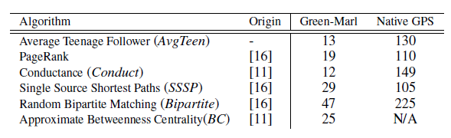
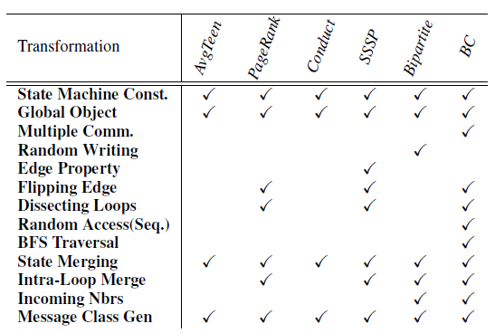
Experimental Results
Compilation
Fact: Less # of lines
Claim: More intuitive code (check our paper)
Comparison of Algorithms (Line of Codes)
Compilation steps are shared across for different algorithms

Slide 22
Yet Another Example: Betwenness Centrality
Algorithm is complicated;
Challenging for manual Pregel implementation
Procedure approx_bc(…) {
G.BC = 0; // Initialize BC as 9
Int k = 0;
While (k < K) { // Pick K random starting point//
Node s = G.PickRandom();
Node_Prop<Float> sigma; // two temporary prop
Node_Prop<Float> delta;
G.sigma = 0; // Initialize Signma
s.sigma = 1;
// Traverse graph in BFS order from s
InBFS(v: G.Nodes From s) {
v.sigma = Sum (w: v.UpNbrs) {w.sigma};
}
InReverse {// Traverse reverse order to s
v.delta = Sum (w: v.DownNbrs) {
v.sigma / w.sigma * (1+ w.delta)
};
v.BC += v.delta; // accumulate
}
k++;
}
}
The compiler expands BFS into do-while and Foreachs (l.e. level-synchronous BFS)
Loops are dissected and merged
Intra-loop state merging is applied
Compiler takes care of different messages and state machines
Pregel Program Compiled:
9 States
4 Message Types

Slide 23
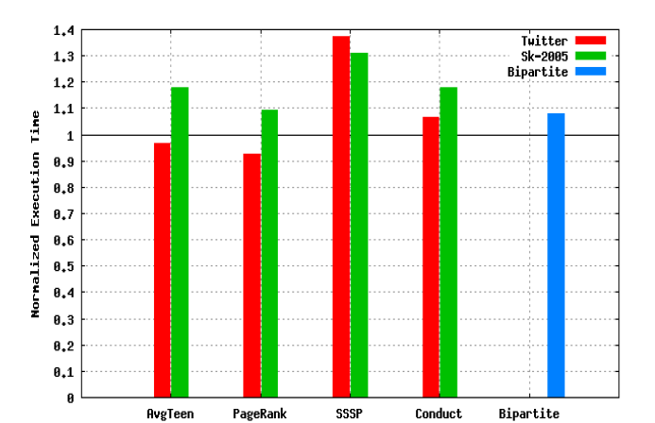
Experimental Results
Performance
Comparing performance of compiler-generated program vs hand-coded program
  Amazon Cluster: 20 Machines. GPS.
Same number of states and messages
-10% ~ + 18%
Different Graph Instances
Hand-coded
GPS
Performance
(Lower is Better)
Different Graph Algorithms
Compiler did not utilized certain API() (voteToHalt)
Can be supported with more analysis

Slide 24

Future Works (1/2)
We showed that it is possible to compile Green-Marl programs into a very different programming model
We also have a version that compiles into In-memory parallel runtime [ASPLOS’12] and Giraph [GRADES’13]
… which means we have portability
Observation
  In-memory implementation is much faster, as long as
  the graph fits in memory
Green-Marl
Program
G-M
Compiler
In-Memory
Parallel
Implementation
Distributed
Implementation

Slide 25
Future Works (2/2)
A consolidated graph processing system
  Currently, a lab project.
  Hoping to put some artifacts for public preview, soon
Green-Marl +
Built-in Operations
User Analysis Algorithm
(Flexibility)
In-memory
Graph Processing
Engine
Distributed
Graph Processing
Engine
Fast Graph Processing (Analytics)
On-line, Interactive
Scalable Graph Processing (Analytics)
Off-line, Batch
Graph
Snapshot
Graph
Snapshot (large)
Data Management (Transactions)
Oracle
DB

Slide 26
Disclaimer
"THE CONTENTS IN THIS SLIDE DECK IS INTENDED TO OUTLINE OUR GENERAL DIRECTION. IT IS INTENDED FOR INFORMATION PURPOSES ONLY, AND MAY NOT BE INCORPORATED INTO ANY CONTRACT. IT IS NOT A COMMITMENT TO DELIVER ANY MATERIAL, CODE, OR FUNCTIONALITY, AND SHOULD NOT BE RELIED UPON IN MAKING PURCHASING DECISION. THE DEVELOPMENT, RELEASE, AND TIMING OF ANY FEATURES OR FUNCTIONALITY DESCRIBED FOR ORACLE'S PRODUCTS REMAINS AT THE SOLE DISCRETION OF ORACLE."

Slide 27
Summary
Compiles Green-Marl programs into Pregel (GPS) framework.
  Address productivity issue in large graph processing
Big difference between Green-Marl programming model vs. Pregel programming model
  Imperative, share-memory vs. message-passing, vertex-centric, bulk-synchronous
Compiler exploited high-level semantic information of the DSL

Slide 30
Completeness Issue
Current automatic Transformation (Set C)
In theory, set A == set B?
Pregel-Compatible Set (Set B)
Mechanical Transformation
what is the practical boundary of set B?
Pregel-Canonical Set
Pregel
Programs
When becomes set C == set B?
Equivalent?
There exists an equivalent program re-writing
Green-Marl Programs (Set A)

