Slide 1


Warm-Up Methodology for HW/SW Co-Designed Processors
A. Brankovic, K. Stavrou, E. Gibert, A. Gonzalez

Slide 2

Scope
HW/SW co-designed processors (Transmeta-like processors)
Staged Compilation
Interpretation, Basic Block Translation, Super-Block Optimization
I$
Guest ISA
(CISC - x86)
Transparent Optimization
Layer
CODE CACHE
TOL
Host ISA
(RISC)
HW

Slide 3
Scope
Q: How to warm-up the µA state of a HW/SW co-designed processors?
Translation & Optimization
Overhead
TOL
L2$ miss
Correct TOL state + Correct HW state
AUTHORITATIVE EXECUTION
collect
Warm-Up TOL state + Warm-Up HW state
WARM-UP
collect
Restore
Architectural Point
L2$ miss ~ 100 cycles
TOL
~ 10K cycles
TOL overhead creates
2-3 orders of magnitude bigger simulation error
time
Requirements
LOW ERROR
LOW SIMULATION COST
(3) GENERALY APPLICABLE (tolerant to different TOL and HW setups)

Slide 4
Scope
Contributions
We solved the problem of the warm-up in HW/SW co-designed processors
Our solution is based on Downscaling Promotion Thresholds (TH)
Simulation Error: 0.75%, Simulation Cost Reduction: 65X
Agenda
Proposed Solution: Downscaling Promotion Thresholds
Simulation methodology
Experimental Results
Conclusions

Slide 5
Existing solutions
Correct TOL state (Transparent Optimization Layer) + Correct HW state
Beginning of application
(AS) Authoritative Simulation
- very costly
X
Authoritative simulation
collect
Warm-Up HW state
X
(FASS) Fast Authoritative Simulation - costly
TOL authoritative
HW warm-up (wu)
collect
Warm-Up TOL state
X
NAÏVE – bad error/cost trade-off
Short warm-up -> 100% error
TOL wu
HW wu
collect
Restore x86 State
(CP) Compilation Plan
- Not generally applicable Depends on Transparent Optimization Layer -TOL
X
TOL wu
HW wu
collect
Restore x86 State + profiling info & compilation plan
More details in the paper
time

Slide 6
Downscaling Promotion Thresholds (TH)
During the warm-up, the promotion thresholds are downscaled
in order to promote faster the code regions to the right compilation stage

>Threshold1
>Threshold2
Low Error
Low Simulation Cost
Generally Applicable
L1
L2
L3
Interpretation
BB translation
SB optimization
Restore x86 State
Warm-Up Length (L_{WU})
TOL wu
HW wu
collect
lower threshold(TH_{WU1})
L_{WU1}
Original Threshold
collect
Which pair is better ?
(TH_{WU1} ,L_{WU1}) or (TH_{WU2} ,L_{WU2})
collect
TH_{WU2}
(TH_{WU2}> TH_{WU1})
L_{WU2}
(L_{WU2} > L_{WU1})
time

Slide 7
Outline
Contributions
We solved the problem of the warm-up in HW/SW co-designed processors
Our solution is based on Downscaling Promotion Thresholds (TH)
Simulation Error: 0.75%, Simulation Cost Reduction: 65X
Agenda
Proposed Solution: Downscaling Promotion Thresholds
Simulation methodology
Experimental Results
Conclusions

Slide 8
Simulation Methodology
DARCO infrastructure¹
Transparent Optimization Level - TOL (x86 -> PowerPC)
Compilation stages: Interpretation, BB translation, SB optimization
Threshold _{INT->BB}=5, Threshold _{BB->SB}=10K
Hardware (PowerPC-like)
2-way issue, in-order, 3 levels memory hierarchy
Suites: SPECint2006 and SPECfp2006
Simulate first 5B x86 instructions
5 samples per application (at 1B, 2B, 3B, 4B, 5B x86 instructions)
[1M,10M, 100M, 500M,1B]
10M
TOL
HW
collect
1M
¹ DARCO: Infrastructure for Research on HW/SW co-designed Virtual Machines. In AMAS-BT'11,, San Jose, June 4, 2011.

Slide 9
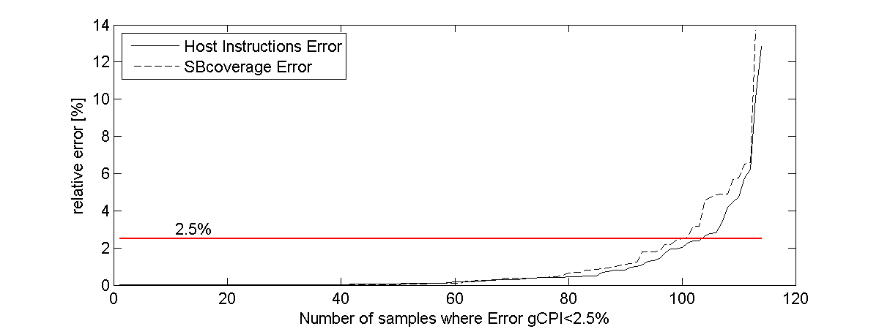
Warm-Up Error Definition
gCPI (guest CPI) error is not enough to be measured
Other statistics are important: Number of host instructions, SuperBlock coverage, etc.
In order to guide the researchers
error = max(gCPI error, SuperBlock coverage error, #host instruction error)
There are examples where: gCPI error - accurate
SB coverage – inaccurate
#host instructions – inaccurate

Slide 10
Outline
Contributions
We solved the problem of the warm-up in HW/SW co-designed processors
Our solution is based on Downscaling Promotion Thresholds (TH)
Simulation Error: 0.75%, Simulation Cost Reduction: 65X
Agenda
Proposed Solution: Downscaling Promotion Thresholds
Simulation methodology
Experimental Results
Conclusions

Slide 11
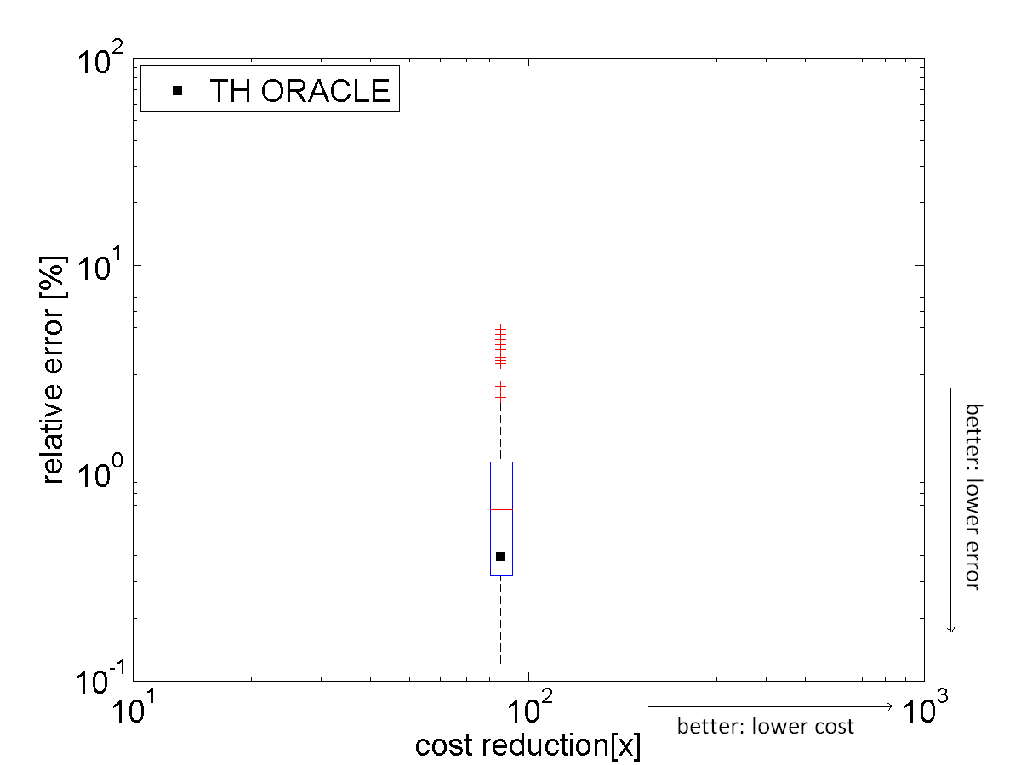
Downscaling Promotion Thresholds (TH) - ORACLE
Exploring 50 configurations (10 thresholds x 5 warm-up lengths)
TH_{WU}: [10, 20, 50, 100, 200, 500,1000, 2000, 5000,10K]
L_{WU}: [1M,10M, 100M, 500M,1B]
TH ORACLE chooses off-line the best pair
Warm-Up Length (L_{WU})
collect
TH_{WU}
collect
Relative error wrt authoritative simulation [%]
collect
TH - ORACLE avg 0.4%
Max 4.8%
Cost Red.: 90X
L_{WU1}
IDEAL SCENARIO
(0% error)
(∞ cost reduction)
Lower Threshold
(TH_{WU1})
Original Threshold
Cost reduction wrt authoritative simulation [X]
LOW ERROR, LOW SIMULATION COST

Slide 12
Downscaling Promotion Thresholds (TH) - Prediction Model
Predict warm-up threshold and warm-up length based on high-level statistics
Scaled warmed-up execution - similar behavior like authoritative execution
Based on execution distribution of PCs
Algorithm:
record execution distribution exec(PCx) during WU1 - for each PC in collect
find scaling factor - scales the best warm-up to authoritative distribution
scaling factor = TH_{DEF}/TH_{WU}
find the best warm-up period (WU1 or WU2) - scaling error is minimal
WU1 is better than WU2
exec(PCx)=N
Exec. Counter
exec(PCx)=N1
collect
exec(PCx)=N2
AUTH.
0
N
WU2
TH
WU1
WU1
N1
N2
WU2
AUTHORITHATIVE
PCx
PCs

Slide 13
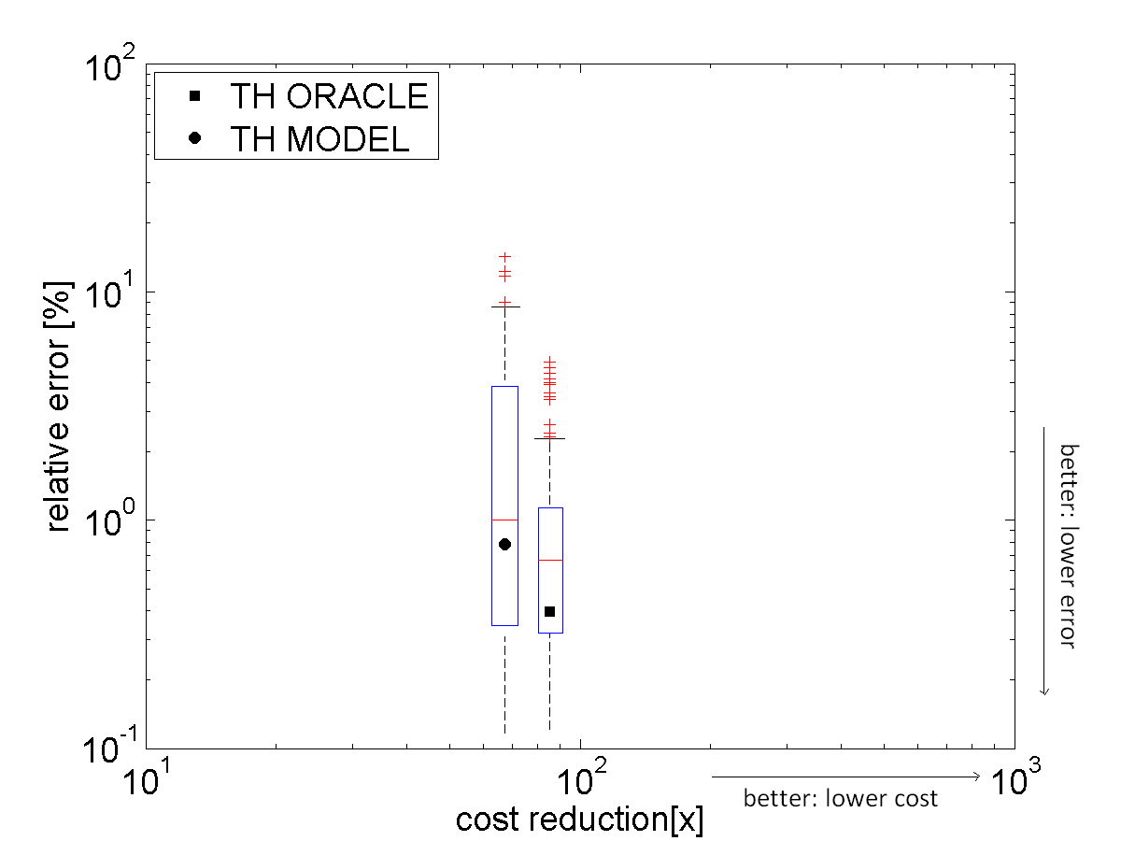
Downscaling Promotion Thresholds (TH) – MODEL vs. ORACLE
Exploring 50 configurations (10 thresholds x 5 warm-up lengths)
TH_{WU}: [10, 20, 50, 100, 200, 500,1000, 2000, 5000,10K]
L_{WU}: [1M,10M, 100M, 500M,1B]
TH ORACLE chose off-line the best pair
TH MODEL when the algorithm is applied
Relative error wrt authoritative simulation [%]
TH - MODEL avg 0.75%
Max 16%
Cost Red.: 65X
IDEAL SCENARIO
(0% error)
(∞ cost reduction)
Cost reduction wrt authoritative simulation [X]
TH MODEL similar to TH ORACLE

Slide 14
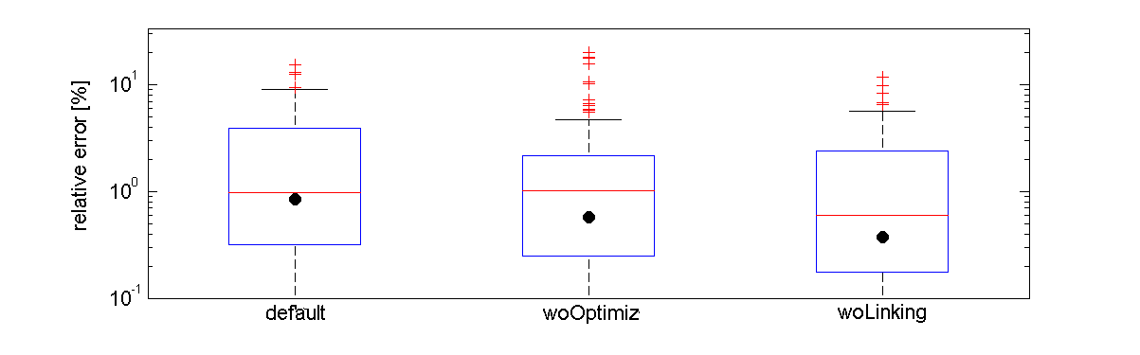
Downscaling Promotion Thresholds (TH) - Different Configurations
Different Transparent Optimization Layers (TOL) configurations:
without Optimizations
without Linking
Similar for different HW parameters:
L1D$: 2X smaller, 2X bigger
L2U$: 2X smaller, 2X bigger
Model behaves similar for other TOLs

Slide 15
Outline
Contributions
We solved the problem of the warm-up in HW/SW co-designed processors
Our solution is based on Downscaling Promotion Thresholds (TH)
Simulation Error: 0.75%, Simulation Cost Reduction: 65X
Agenda
Proposed Solution: Downscaling Promotion Thresholds
Simulation methodology
Experimental Results
Conclusions

Slide 16
Conclusions
Conclusions
We proved that traditional warm-up cannot be applied for HW/SW co-designed processors
More details in the paper
We showed that the error of the warm-up cannot be based on gCPI
We proposed the novel warm-up approach – Downscaling Promotion Thresholds
We proposed the model to predict the optimal warm-up setup for Downscaling Promotion Thresholds technique
Average Simulation Error : 0.75%
Average Simulation Cost Reduction: 65X

Slide 17

Questions
Thanks!
?
Aleksandar Brankovic
abrankov@ac.upc.edu
?
?
?
?
?
?
?
?
?

Slide 18
Backup Slides

Slide 19
Compilation Plan - Issues
Compilation plan: save the plan of the region formation
Issues: cases when the region formation depends on µA execution
Control speculation Transparent Optimization Layer (TOL): coverts biased braches into asserts
Converting depends on how other regions are built in the code cache
Software controlled power gating
Software prefetcher
Code Cache contents 1
BB1
YES
Biased Branch?
SuperBlock
BB2
NO
Code Cache contents 2
BB3

Slide 20
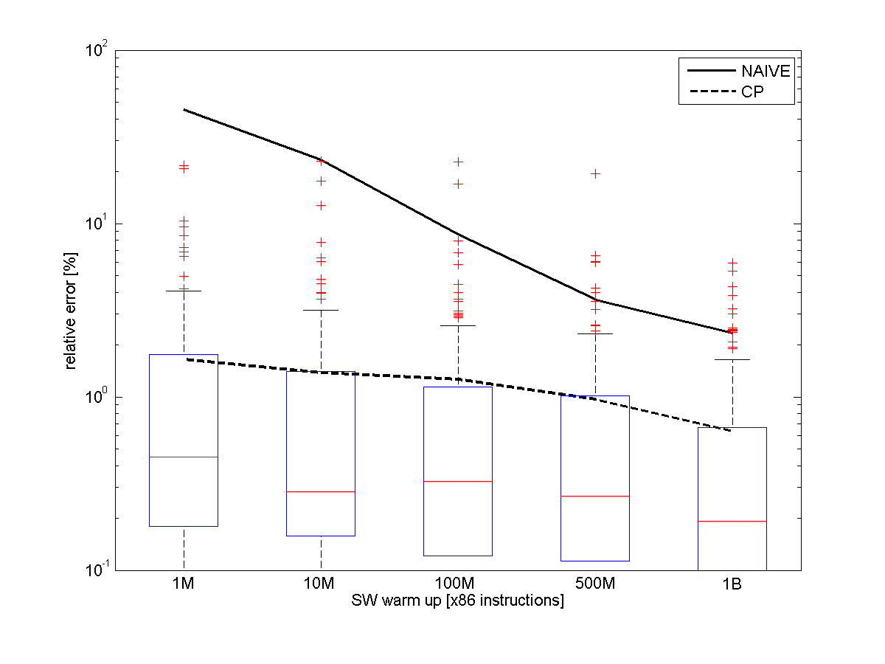
Results: CP (CP vs NAIVE)
CP.
Maximum error
20%
NAIVE.
Reduction in error 10-100x!!
Limitations. Depends on SW layers
CP
Average error
Average Relative Errors, collect period 10M

Slide 21
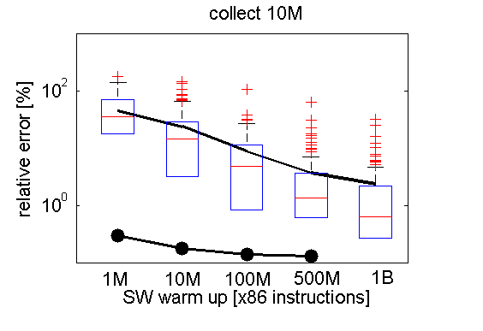
Results: FASS vs NAIVE
FASS
TOL
HW
coll
NAIVE.
SW error ≠ 0
HW error ≠ 0
FEASIBLE
Maximum error
high
NAIVE
TOL
HW
coll
0
end
FASS
SW error = 0
HW error ≠ 0
NOT FEASIBLE
New technique needed!

