Slide 1
DRONE INVADERS
Project For Augmented Reality
by
Ambroz Luin and Chris Godnic

Slide 2
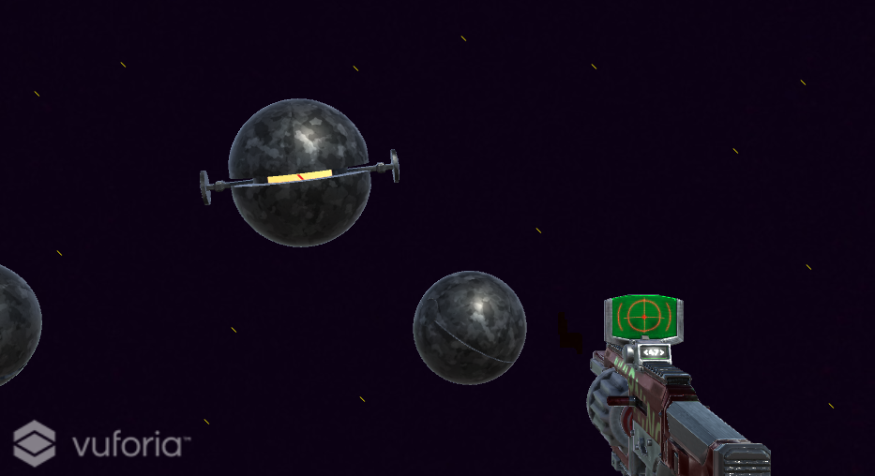
PROTOTYPE

Slide 3





Technologies you plan to use
Unity
Vuforia
C#
Android SDK
Unity Asset Store

Slide 4

What was or is expected to be the most difficult part?

Slide 5
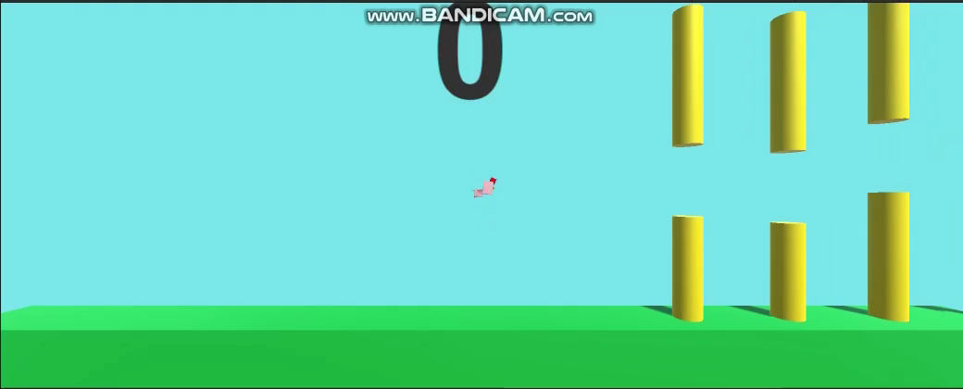
Who did or will do what on the project?
Working together on one computer
Solving problems and making updates together

Slide 6


