Slide 1
Project1

Slide 2
Body

Slide 3
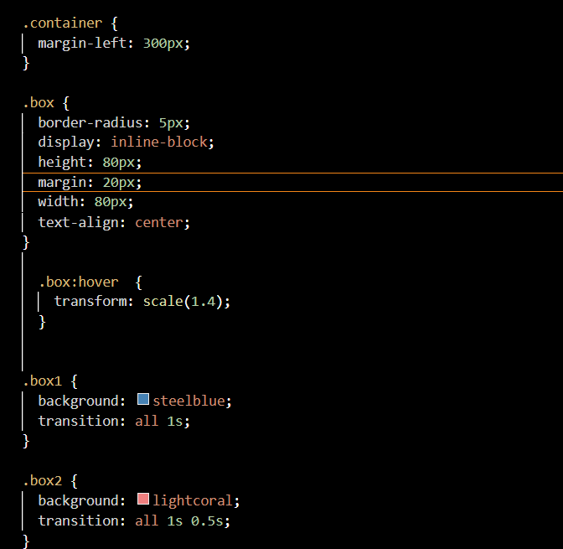
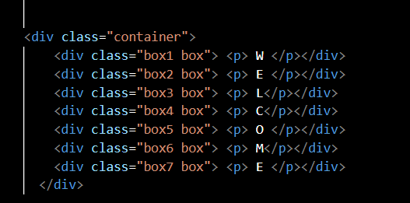

HTML and Outlook
CSS
Notes:
The transition-delay property allows you to specify when the transform will start. By default, the transition starts as soon as it is triggered (e.g., on mouse hover). However, if you want to transition to start after it is triggered you can use the transition delay property.
This gave the welcome sign I cool effect when u run your mouse thur it

Slide 4
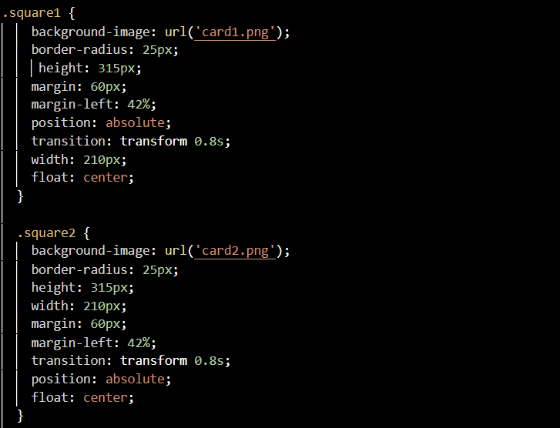

outlook
css
Notes:
The translate value moves an element left/right and up/down. The movement is based on the parameters given for the X (horizontal) Y (vertical) axes.
A positive X value moves the element to the right, while a negative X moves the element to the left. A positive Y value moves the element downwards and a negative Y value, upwards.
Used this theory to show the illusion on card on top of another.

