Slide 1
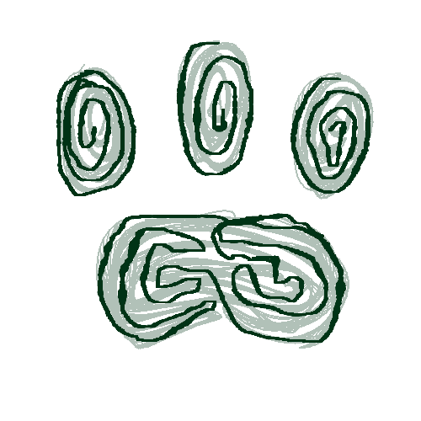








PawPrints
The Pet Database

Slide 2
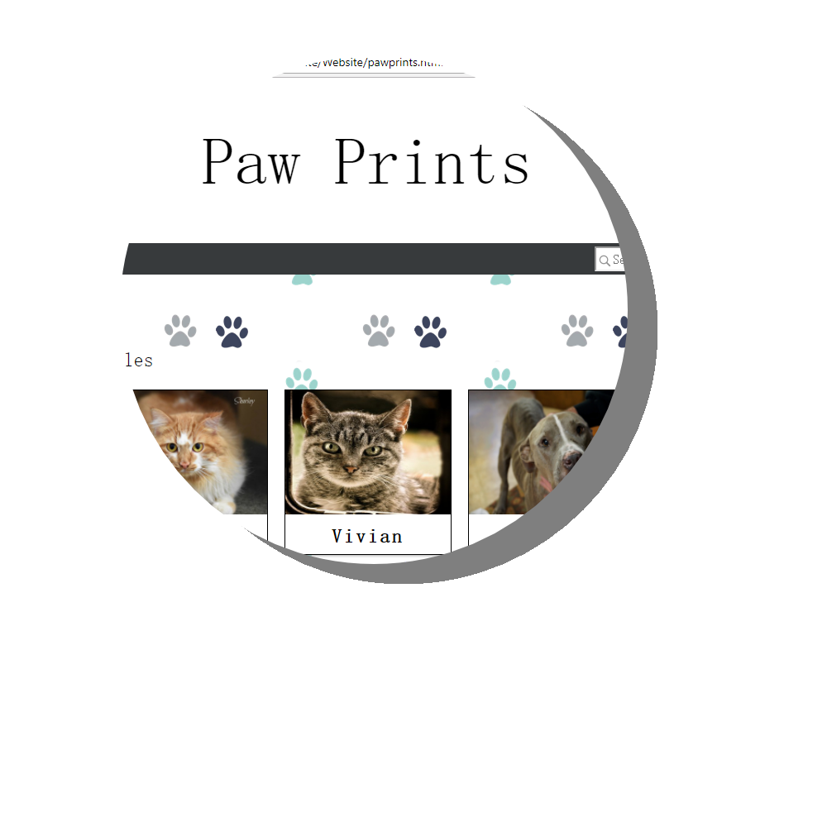
The Website
Perhaps a gif of it working here

Slide 3
The Desktop

Slide 4
The Database

Slide 5
