Slide 1
Evaluating the Forecasting Performance of Sales in the Restaurant Industry
Carl J Loucius
Colorado State University Global
MIS581: Capstone – Business Intelligence and Data Analytics
Dr. Osama Morad
08/04/2024
Notes:
The title of this presentation is “Evaluating the Forecasting Performance of Sales in the Restaurant Industry.” This presentation is based on the results of my Capstone Project.

Slide 2

The Structure of the Presentation
Discuss the nature of the research project
Discuss the research questions and hypotheses.
Discuss the methodology of the project.
Summary statistics analysis and time series plots
Development of ARIMA and Simple ANN Models
Discuss Results & Provide Recommendations
Figure 1
A Simple Formula for Sales Forecast in the Restaurant Industry
Note. From A Detailed Guide to Restaurant Sales Forecasting, by Tabelin Team, 2023, Tablein (https://www.tablein.com/blog/restaurant-sales-forecasting).
Notes:
This presentation will cover the results of my research project, which focused on evaluating the forecasting performance of sales using an ARIMA time series statistical model and a Simple Artificial Neural Network, or the Simple ANN, model. The purpose of this slide is to cover the overall structure of the presentation. This presentation will first cover the nature of the research project by discussing the reasoning behind my choice to tackle this research project, the dataset that will be used, and the research questions and hypothesis of the project. Then, this presentation will talk about the methodology of the project. I will cover the methods used to analyze the dataset, such as summary statistics and time series plots. Furthermore, I will discuss the methods used to answer the research questions, such as how the ARIMA and Simple ANN models will be constructed. Lastly, I will discuss the project's results and provide recommendations based on these findings.

Slide 3
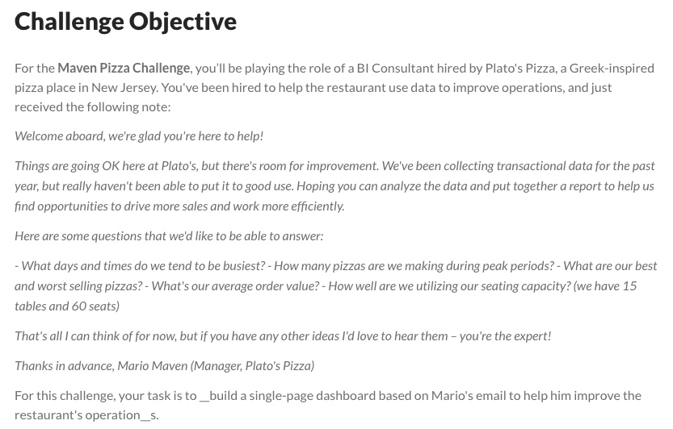
Forecasting Performance of Sales – The Problem
The lack of academic articles on data analytics in the restaurant industry illustrates a need to publish studies in the field.
Dataset: 2015 Transactional Data for a Pizza Restaurant
RQ 1: Is the time series data stationary?
RQ 2: Is an ARIMA model or a Simple ANN more effective at forecasting?
Figure 2
The Original Maven Pizza Challenge Description
Note. From Introducing the maven pizza challenge, by E. Ruiz, 2022, Maven Analytics (https://www.mavenanalytics.io/blog/maven-pizza-challenge).
Notes:
One of the most significant issues about studying data analytics in the restaurant industry is the need for more academic articles on how data analytics is used in this industry. According to Roy et al. (2020), their searches using the Web of Science database to find articles on data analytics in the restaurant industry yielded a few hits. For instance, the database produced 212 publications using “restaurant* analytic*” as their search keyword (Roy et al., 2020). However, when they used “restaurant” as the keyword, it produced 11,958 publications. However, only 1,610 of these publications were published in the business and management categories, the usual category for search for analytics applications (Roy et al., 2020). The number of publications in the business and management categories represents less than 10% of the research articles using the keyword “restaurant.” From my personal experience, I could not find articles about sales forecasting in the restaurant industry. Still, I found more articles on this subject and its application to other sectors, such as the automotive and retail industries. Hence, there is a need to fill a gap in the application of data analytics to the restaurant industry. The performance of sales forecasting models is one way to fill this gap since forecasting allows “efficient resource allocation, cost reduction, and demand planning” (Chaudhuri, 2023).
I used a dataset shared on the Maven Analytics platform to study the performance of sales forecasting models in the restaurant industry. This dataset is a transactional time series data containing information about the 2015 transactional sales for a pizza restaurant. This dataset includes 11 features and approximately 50,000 transactional observations on pizza sales throughout 2015. For my project, I had to repurpose the dataset by creating three user-generated variables for this study. The user-generated variables that were made are “Total Sales”, “Total Orders”, and “Total Pizzas Sold and they were created by observing as a daily value versus a transactional one.
For my project, there are two research questions. The first question focuses on whether the data exhibits stationary behavior. This is important to determine since nonstationary data can negatively impact time series statistical models. The null hypothesis for this research question is “The time series data is nonstationary,” while the alternative hypothesis is “The time series data is stationary.” The second research question is the main topic of this project, which is “whether an ARIMA model or a Simple ANN is more effective at sales forecasting?” The null hypothesis for this research question is “The forecast accuracy of the ARIMA time series model and the Simple ANN model is not significantly different.” In contrast, the alternative hypothesis is "The forecast accuracy of the ARIMA time series model and the Simple ANN model is significantly different.”

Slide 4
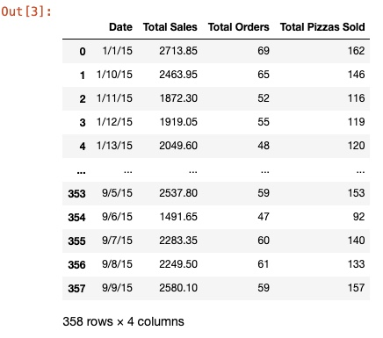
Project’s Methodology – Part 1
Analyze the descriptive statistics, time series plots, and correlations among the variables.
Determine whether the time series data is stationary using the Augmented Dickey-Fuller Test (ADT Test).
Determine the optimal ARIMA and Simple ANN Models
Perform Grid Search to find optimal hyperparameter values.
Figure 3
Output for Dataset
Notes:
Now that I have discussed the problem this research is trying to address, I will discuss the methodology used. First, the study will use Python to analyze the descriptive statistics, time series plots, and correlations among the variables. This analysis aims to gain a basic understanding of whether the time series data is exhibiting stationary behavior. The information revealed by this analysis is not the de facto method to determine this. Still, it provides a good starting point for this analysis. Afterward, the study will determine whether the time series data is stationary using the Augmented Dickey-Fuller Test, also known as the ADT Test. This statistical test will determine whether a unit root exists, which will imply that the data is nonstationary (Nielsen, 2020). If the data is nonstationary, it must undergo a transformation method and retested (Nielsen, 2020). Otherwise, it is stationary, and we can continue to the next part, which is determining the optimal ARIMA and Simple models. These models will be chosen using Grid Search to find the optimal values for the designated hyperparameters. For instance, the “order” hyperparameter will be optimized for the ARIMA model. In contrast, the “optimizer”, “activation”, “epochs”, and “batch_size” hyperparameters were optimized for the Simple ANN model. The model's optimal hyperparameter values will be chosen based on the minimization or maximization of some criteria.

Slide 5
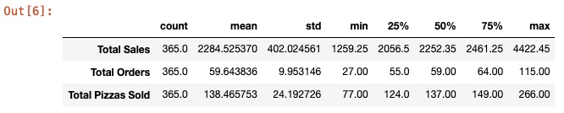
Project’s Methodology – Part 2
Construct optimal ARIMA and Simple ANN models using training data.
Perform forecasts on the training and testing partitions of the data using each model.
Calculate the training and testing RMSE scores to compare the models' forecasting performance.
Analyze time series plot of data for the December 2015 predictions vs actual sales for further analysis.
Figure 4
Descriptive Statistics of Data
Notes:
After determining the optimal hyperparameter values for each model, the optimal ARIMA and Simple ANN will be constructed using the training data. Both models will be used to build forecasts on the training and testing partitions of the data. This is done to make the training and testing root mean square error (RMSE) scores, which is the evaluation metric that will be used to determine whether the models performed significantly differently or not. The choice to use the RMSE as the evaluation metric for comparison rests on the fact that the RMSE is one of the more popular error measures in usage in various domains (Shcherbakov et al., 2013). The model that produces the lower test RMSE score will be considered more effective in sales forecasting, which will answer the second research question. However, the time series plots of each model’s predictions vs actual sales must also be analyzed for further analysis.

Slide 6
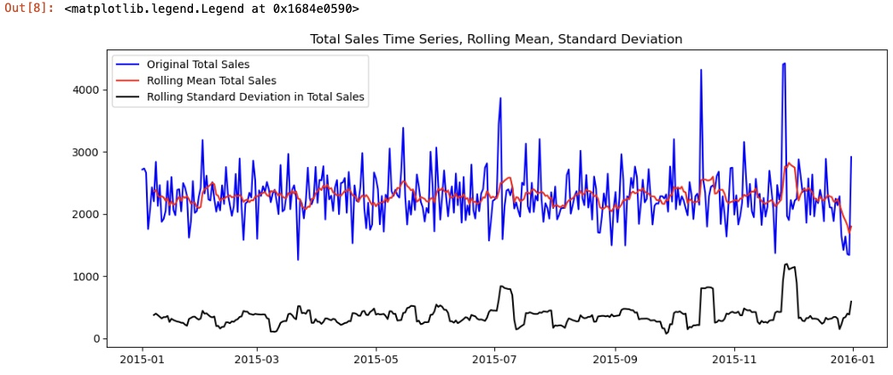
Stationarity: Using Descriptive Statistics and Time Series Plots
Descriptive statistics indicates the mean for each variable does not deviate far from the median.
Indicating potentially normal data.
Time Series Plots:
No clear trend or seasonality
No clear patterns
Rolling mean and standard deviation plots are roughly balanced
More than likely, the data is stationary
Only the “Total Sales” variable will be used for the remainder of the analysis.
Figure 5
Time Series Plot for Total Sales, Rolling Mean, and Standard Deviation
Notes:
The descriptive statistics indicate that the mean for each variable does not deviate far from the median. This is important since it suggests that the data distribution is approximately normal, indicating that it is more than likely stationary. The time series plots for each variable indicate the same conclusion about the data. If you look at Figure 5, which is currently displayed on the screen, there are no patterns to indicate any trend or seasonality for the “Total Sales” variable. Furthermore, the rolling weekly mean and standard deviation plots are roughly balanced, indicating that the data is stationary. These same observations can be made for the time series plots for the other two variables, “Total Orders” and “Total Pizzas Sold”, which will be seen in the next slide. It is important to note that “Total Orders” and “Total Pizzas Sold” were dropped from the remainder of the analysis since the variables are strongly correlated with “Total Sales.”

Slide 7
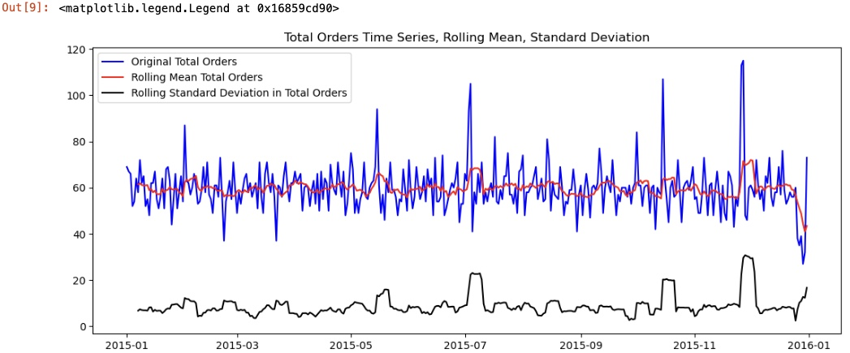
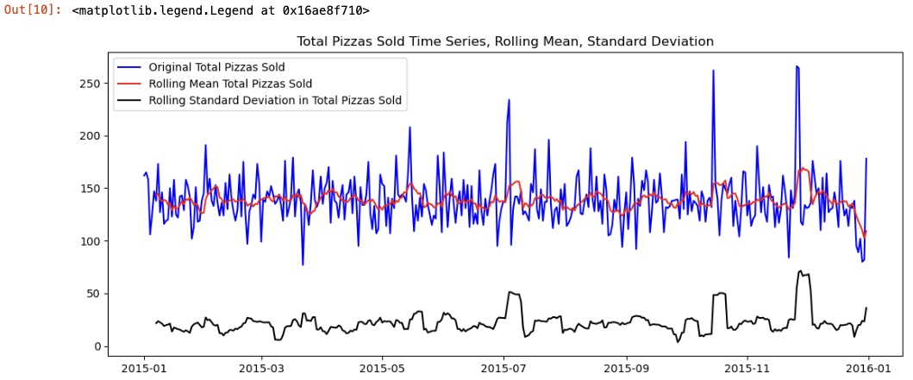
Stationarity: Using Descriptive Statistics and Time Series Plots
Figure 6
Time Series Plot for Total Orders, Rolling Mean, and Standard Deviation
Figure 7
Time Series Plot for Total Pizzas Sold, Rolling Mean, and Standard Deviation
Notes:
Figures 6 and 7 show the time series plots for the “Total Orders” and “Total Pizzas Sold” variables. These plots follow the same patterns as the “Total Sales” time series plots. Hence, the same observations applies to these plots.

Slide 8
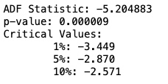
Is the data stationary? Using the ADF Test
The Augmented Dickey-Fuller (ADF) test is a statistical test that measures stationary data.
It tests whether the data has a unit root.
If a unit root exists, then the data is non-stationary.
P-value (0.000009) is highly statistically significant since it is far below the significance level of 5%
Data is stationary.
Figure 8
ADF Statistical Test Results
Notes:
Although the descriptive statistics and time series plots suggest that the “Total Sales” variable is stationary, it should not be considered the de facto method to determine stationary. As mentioned previously, the ADF test is used to test stationary. This test aims to test whether the data has a unit root. If a unit root exists, then the data is nonstationary. According to the results shown in Figure 8, the p-value is highly significant. Hence, the null hypothesis about the nonstationary data can be rejected, implying that we do not have to worry about applying any transformations to the data before creating a statistical time series model.

Slide 9
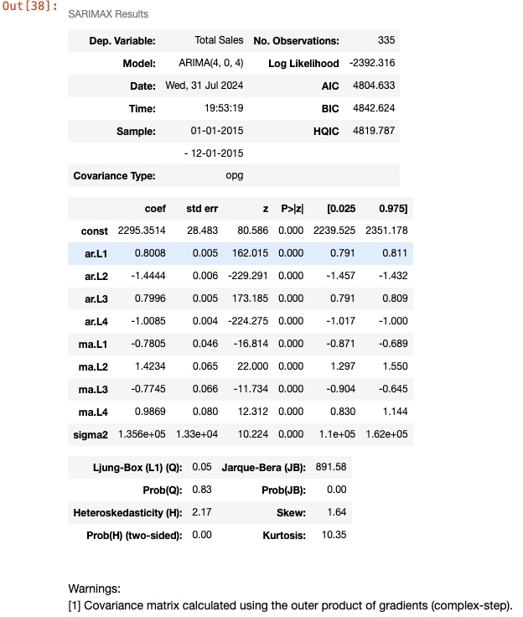
Optimal ARIMA and Simple ANN Model
Figure 9
ARIMA Model Summary Results
Optimal ARIMA Model:
Hyperparameter Tested: Order
Optimal Order: (4,0,4)
AIC of 4804.633
Optimal Simple ANN Model:
Hyperparameters Tested: Optimizer, Activation function, Number of epochs, and Batch size
Optimal value set: {adam, relu, 100, 1)
Model RMSE error: $392.29
Notes:
The order hyperparameter was tested for the ARIMA model. The tuple (x,y,z) had the option of choosing one of the following values for x, y, and z: 0, 1, 2, 3, and 4. The Grid Search determined the optimal values for the tuple by minimizing the AIC value. According to the search procedure, the tuple (4,0,4) is the optimal choice for order since it produced the lowest AIC value of 4804.633. Figure 9, displayed on the screen, shows the summary statistics for this model.
On the other hand, the Simple ANN model had more hyperparameters optimized. The hyperparameters tested for optimization included the optimizer, the activation function, the number of epochs, and the batch size. The Grid Search procedure determined the optimal value set to be {adam, relu, 100, 1} since it had the lowest RMSE score of $392.29. After selecting the optimal models, I proceeded to the next step: test the accuracy of the model's predictions to determine whether one performed better than the other.

Slide 10
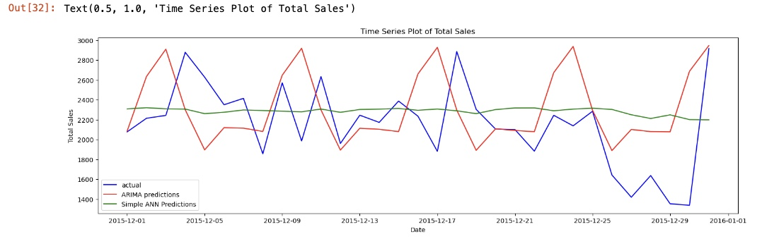
Forecasting Performance
The forecast of the Simple ANN model performed better than the ARIMA model.
ARIMA Test Set RMSE: $524.48
Simple ANN Test Set RMSE: $421.60
Visualization shows a different story:
ARIMA model captures and demonstrates the noise patterns significantly better than Simple ANN
Actual Errors of Forecasts vs Actual:
ARIMA vs Actual: +7.39%
Simple ANN vs Actual: +5.77%
Figure 10
Time Series Plot of ARIMA and Simple ANN Sales Predictions vs Actuals
Notes:
According to the RMSE score for the test set, the forecast of the Simple ANN model performed better than the ARIMA model. The ARIMA test set RMSE score was $524.48, while the test set RMSE score for the Simple ANN model was $421.60. The Simple ANN model performed significantly better since its RMSE score for the test set is 24.40% smaller than the value for the ARIMA model. This is a big difference. Thus, the Simple ANN performs better according to the chosen evaluation metric, implying that the forecasts of each model are significantly different.
Although the Simple ANN performed better according to the RMSE score, I examined the time series plots for the models' predictions vs. actual sales to visually explore the forecasts' performance. According to Figure 10, the time series plot for the Simple ANN model, which is represented as a green line, has a slight variation in its sales. According to the plot, roughly the same sales figures are predicted daily. On the other hand, the ARIMA model, represented by the red line, captures and demonstrates the noise patterns significantly better than the Simple ANN model. The ARIMA model has the peaks and valleys that should be found in these plots. According to Figure 10, I would have expected the ARIMA model to have performed better, but it did not. The reason is that the ARIMA’s model predictions had a percent error of +7.39% with respect to the actual sales. The Simple ANN model had a percent error of +5.77%. Thus, the ARIMA model overpredicted more than the Simple ANN model, which also explains the higher RMSE score.

Slide 11

Forecasting Performance: A Conclusion
Figure 11
End of Presentation
Simple ANN model created a more accurate monthly forecast
ARIMA model captured more noise to accurately model its daily peaks and valleys but performed worse regarding the monthly prediction.
Future Research: How does the performance of these models change when:
Additional observations are added.
The effect of trend and seasonality
The effect of weather patterns
Note. Image from Microsoft Word 365.
Notes:
In summary, the Simple ANN model created a more accurate monthly forecast than the ARIMA model for December 2015. Even though it produced a model with a lower RMSE score, the time series plots of predictions vs. actuals reveal that the ARIMA model captured more noise to accurately model its daily peaks and valleys. The Simple ANN model did not capture this noise, as reflected in its plot.
Other researchers can expand the academic literature on this subject by taking the findings of this project and expanding upon them. The central route they can take is adding observations to the dataset. These observations can be more time observations (e.g., increasing the number of observations to include observations beyond 2015) or additional variables that can add meaningful information to the model. Adding more time observations can allow the researchers to study how trends and seasonality impact the sales forecasting model’s performance. Additionally, the researchers can add variables such as socioeconomic factors, demographics of the area, weather patterns, and more to determine if any of these variables can add meaningful information to the model. By performing more comprehensive analyses of restaurant data, we can expand our understanding of how restaurants can maintain a competitive edge.
Thank you for your time and attention to this important research.

Slide 12
References
Chaudhuri, S. (2023, October 25). Assessment of accuracy metrics for time series forecasting. Medium. https://medium.com/analytics-Vidhya/assessment-of-accuracy-metrics-for-time-series-forecasting-bc115b655705
Nielsen, A. (2020). Practical time series analysis: Prediction with statistics & machine learning. O’Reilly.
Roy, D., Spiliotopoulou, E., & de Vries, J. (2022). Restaurant analytics: Emerging practice and research opportunities. Production and Operations Management, 31(10), 3687-3709. https://doi.org/10.1111/poms.13809
Ruiz, E. (2022, September 21). Introducing the maven pizza challenge. Maven Analytics. https://www.mavenanalytics.io/blog/maven-pizza-challenge
Shcherbakov, M. V., Brebels, A., Shcherbakova, N. L., Tyukov, A. P., Janovsky, T. A., & Kamaev, V. A. (2013). A survey of forecast error measures. World Applied Sciences Journal, 24(2013), 171-176. https://doi.org/10.5829/idosi.wasj.2013.24.itmies.80032
Tabelin Team. (2023, April 25). A detailed guide to restaurant sales forecasting. Tablein. https://www.tablein.com/blog/restaurant-sales-forecasting

