Slide 1
Final Project: Dice-Rolling Simulator
Christian Edison Gonzalez

Slide 2
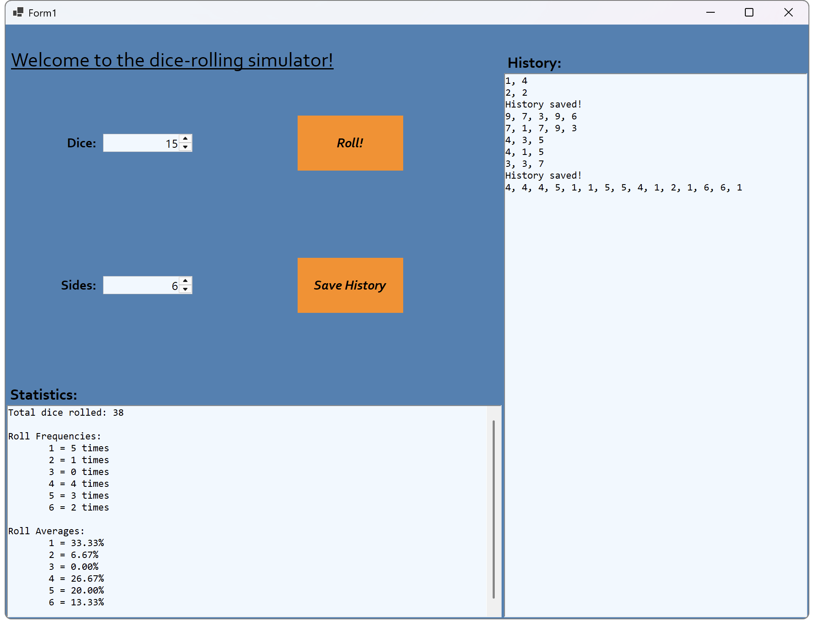
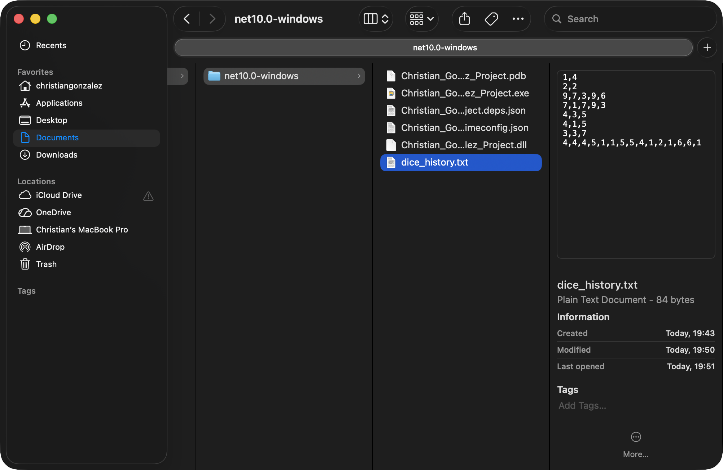
Introduction
Project idea: dice-rolling simulator
allow users to select the number of dice to roll together
allow users to select the number of sides per die
roll the dice and display a history of results
track statistics after every roll: display the total rolls, number of times each side was rolled, average chance of rolling a certain side
save roll history to a comma-separated log file

Slide 3
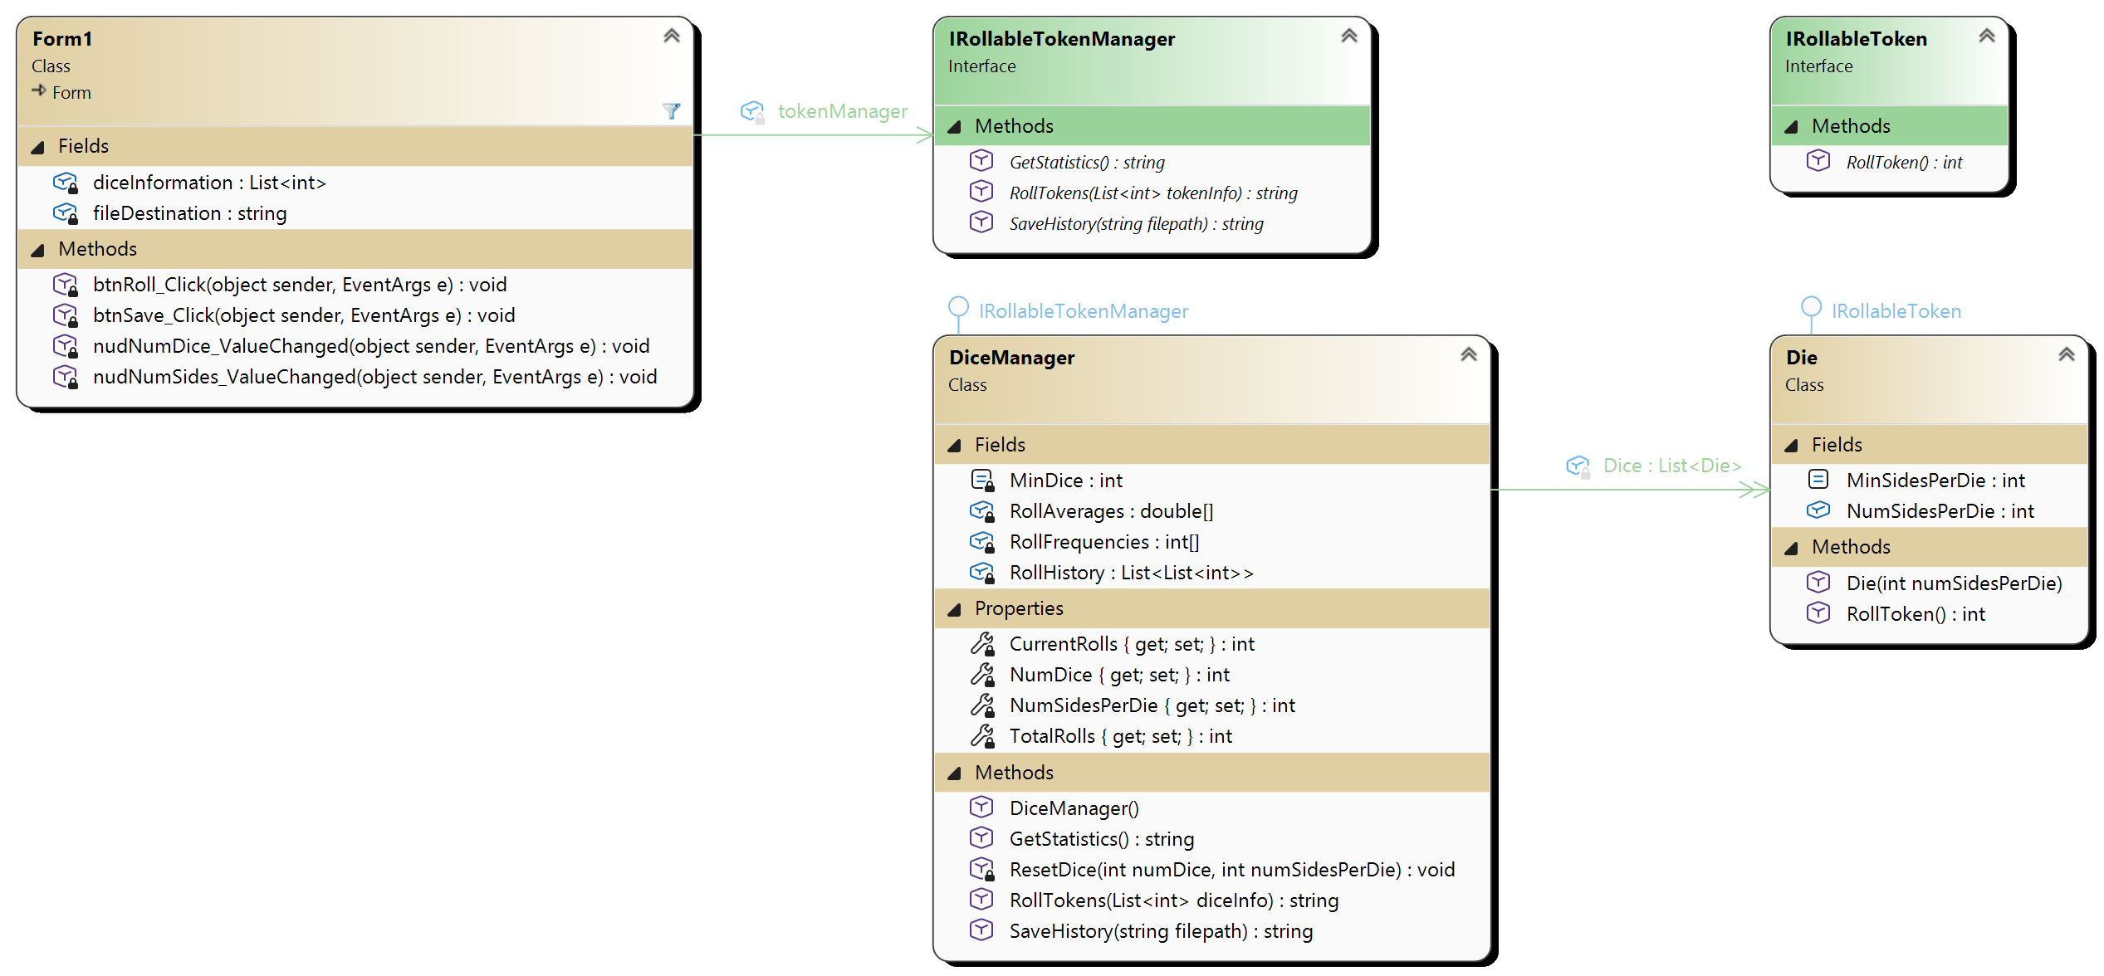
Implementation: UML Diagram
Emphasis on abstraction and polymorphism
Software principles like SOLID, GRASP:
Liskov substitution principle
separation of concerns
Easily maintainable, highly extendable:
flipping coins
shuffling cards
etc.

Slide 4
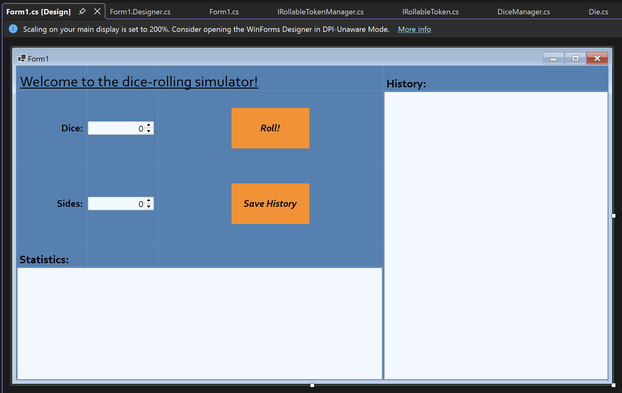
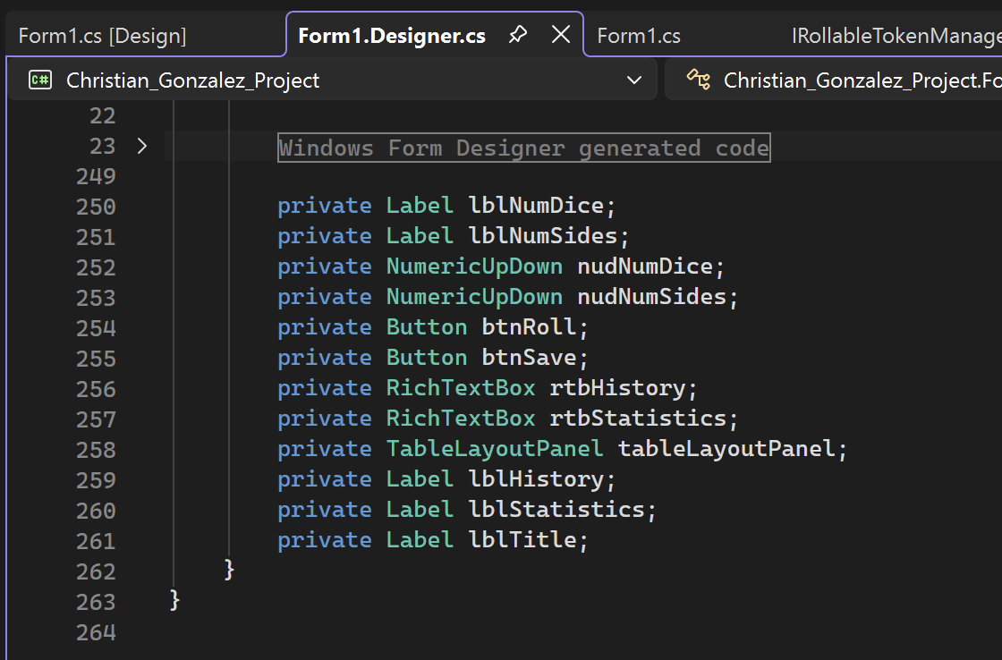
Implementation: WinForms Controls
Specific controls can be changed as needed
No changes to underlying logic required for Roll, Save History, History, or Statistics controls

Slide 5
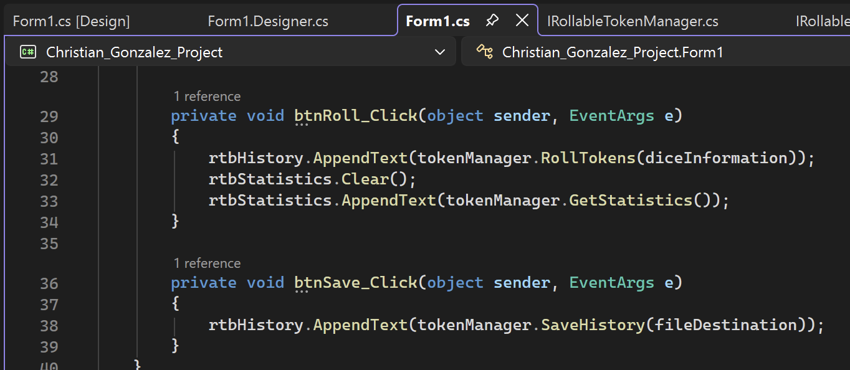
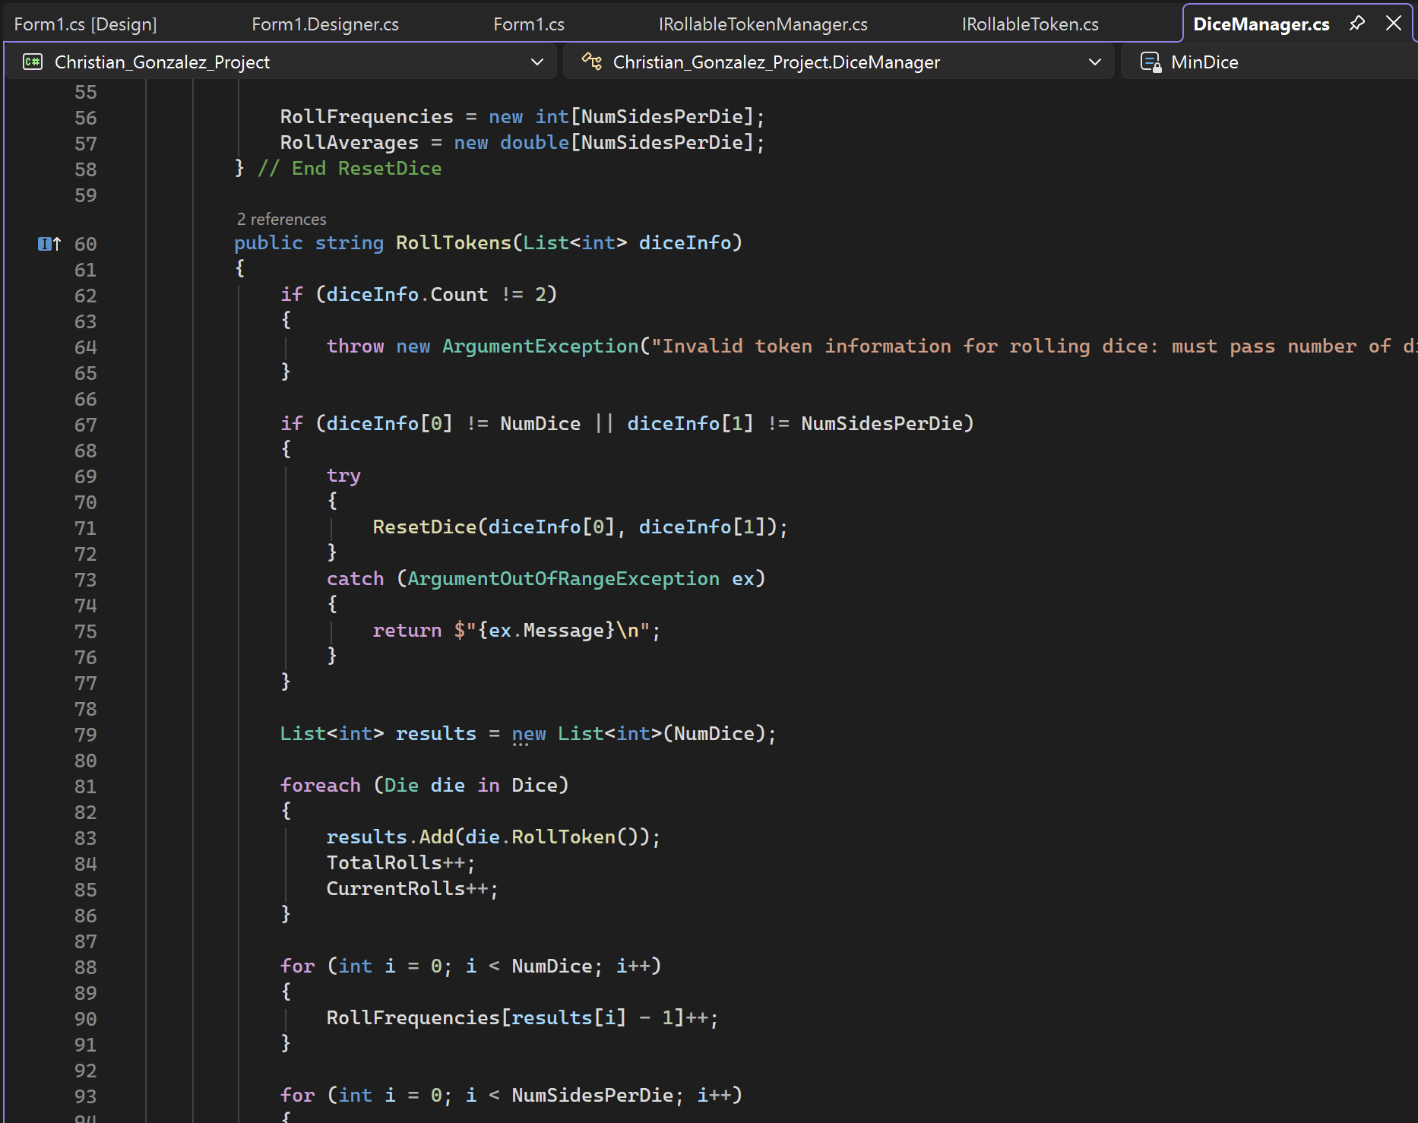
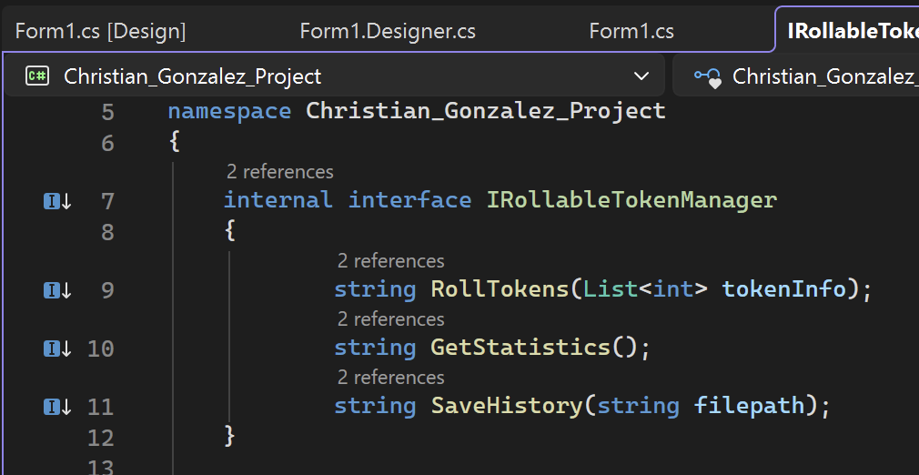
Demo: Code and App!

Slide 6
Takeaways from the Experience
Planning the object-oriented was the hardest part:
much more familiar with procedural programming
some parts aren’t needed or don’t make sense (IRollableToken is never used)
Much room for optimization:
saving history rewrites the entire file instead of appending
use async programming to save history and keep UI responsive
Visual Studio class designer:
cool!
but extensive compatibility issues, took several hours to troubleshoot

Slide 7
Thank you! Questions?

