Slide 1
Remote Repository
Push
Pull
Local Repository

Slide 2
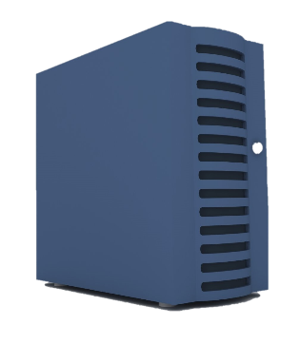

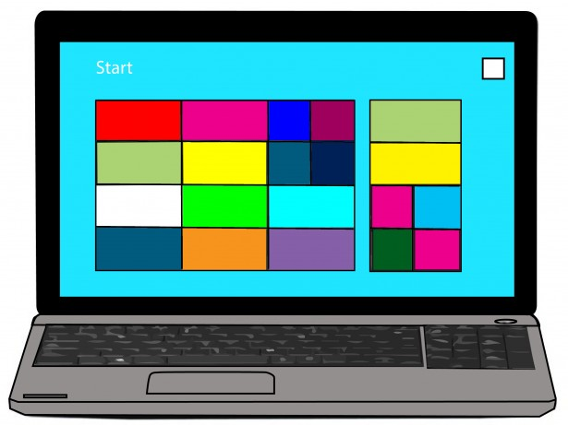
GitHub
(origin)
Pull
Push
Pull
Push

Slide 3
Team Member A

Slide 4
Team Member B

Slide 5


Slide 6
REPOSITORY
master
make_gui_blue
add_x_icon
remove_title_bar

Slide 7

GitHub
(origin)

Slide 8
GitHub
(origin)

Slide 9
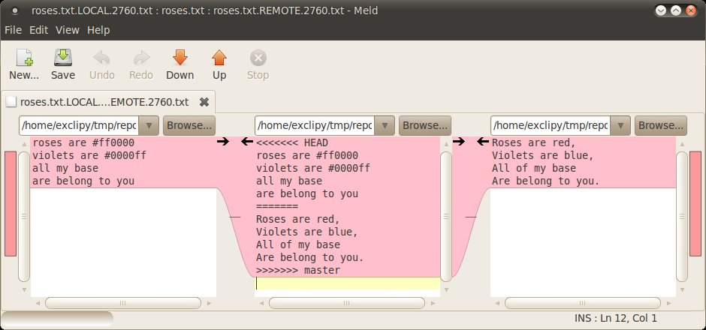
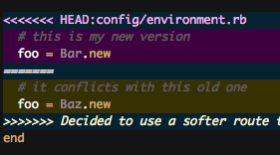

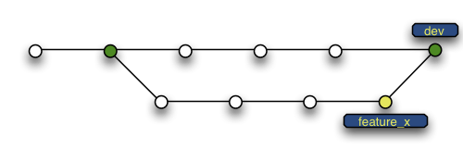

Slide 10

Track Changes
Version Control
Rollback
Integrate
Work Together

Slide 11
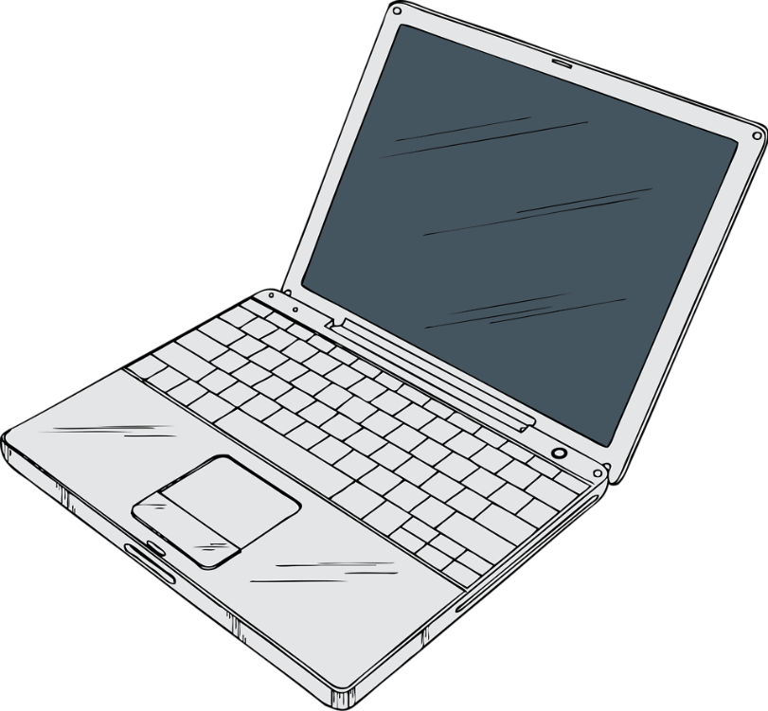





Slide 12


Slide 13


Slide 14


Slide 15


Slide 16







