Slide 1

Parkify
Félix Iñiguez
Diego Camargo
Salvador Ahedo
Fernando Rubio
Juan Tamayo
Jairo Rubio
Diego Toledo
Eduardo Tostado
Monserrat Sánchez
Carlos Pedraza
Ricardo Palma
Víctor Najar
“Stop looking for it, we found it.”

Slide 2
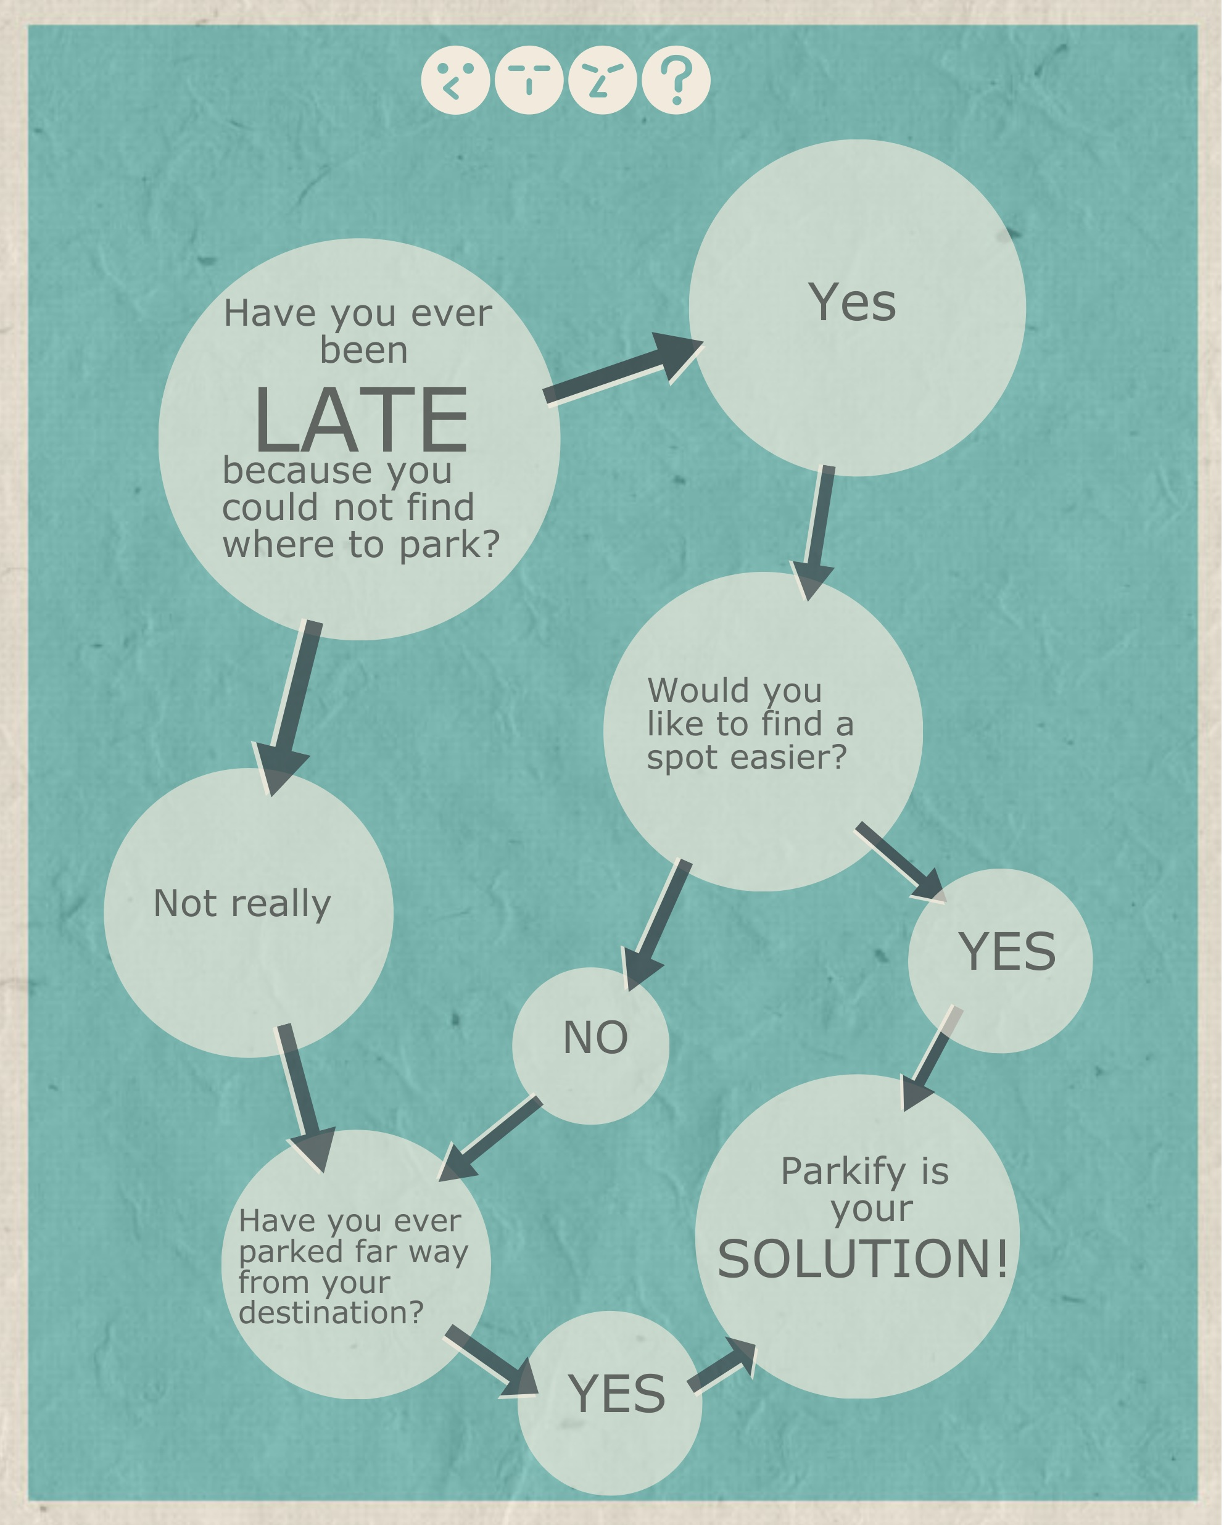
Problems & Solutions
Parkify is able to:
Find the closest parking area available.
Prioritize parking areas near the most common destinations.
Count how many parking spots are available at the moment.
Tell if a parking zone is completely or half full.

Slide 3

Were can you find it?
It is available on ANDROID starting from software versión Lollipop onwards.
Visiting our web site at http://10.43.51.167:5000/

Slide 4
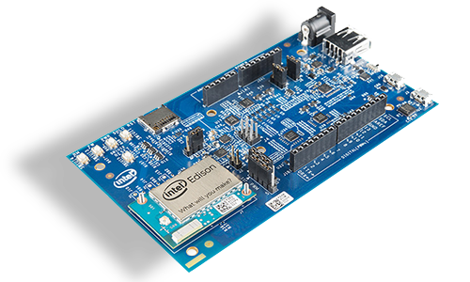
How was it designed?
Using Intel Edison Board.
Written in Python 3 language.
Simulating a parking enviroment through sensors.
Marking the entry and exit of cars.
SSH protocol to the Edison Database.

Slide 5
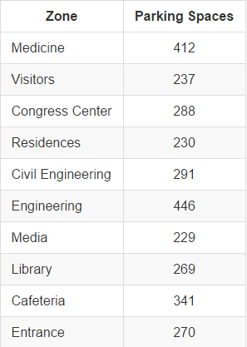
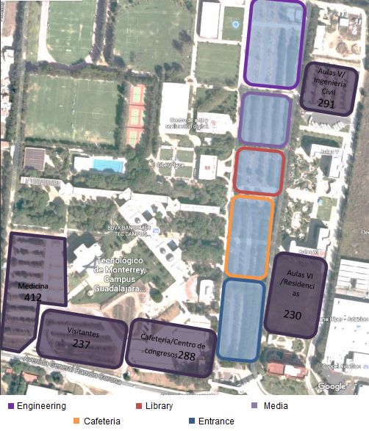
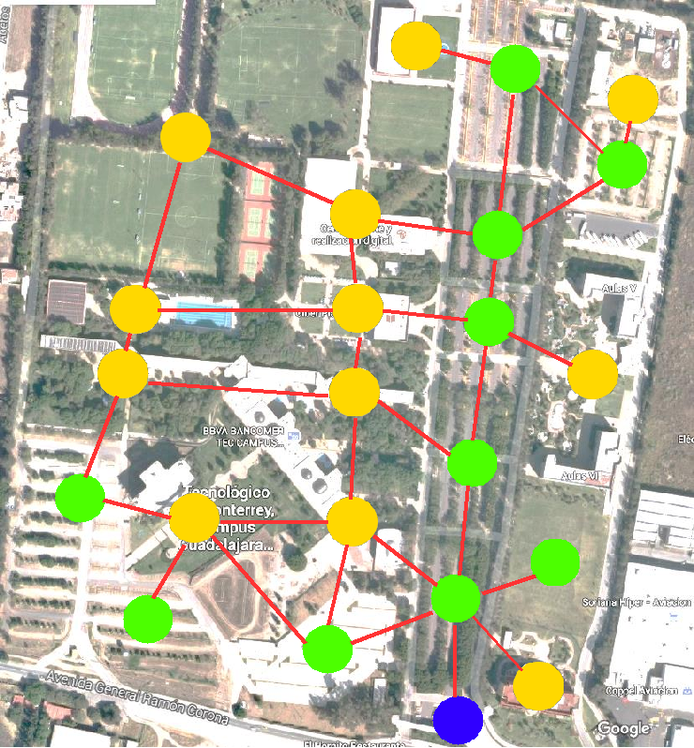
Prototype design
Base information Algorithm

Slide 6
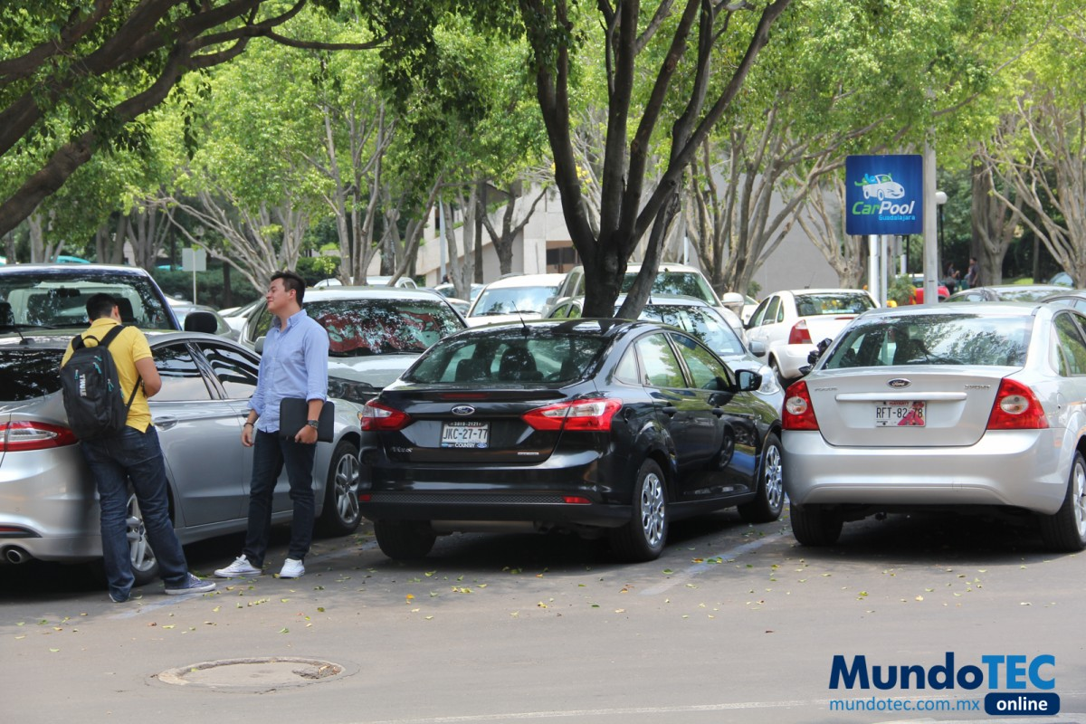
How does it works?
Sensor countdown that, depending of the spaces available, make the LCD screen charge from green to yellow, from yellow to red and vice versa.
Invalid requests are posible.
Functions are defined to find entrances, sections, closest parking section to the user as well for the sections surrounding that section.

Slide 7
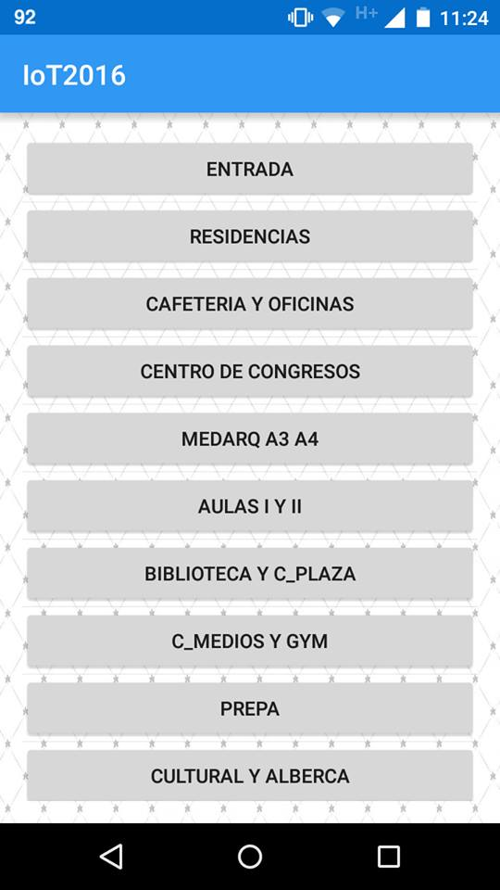
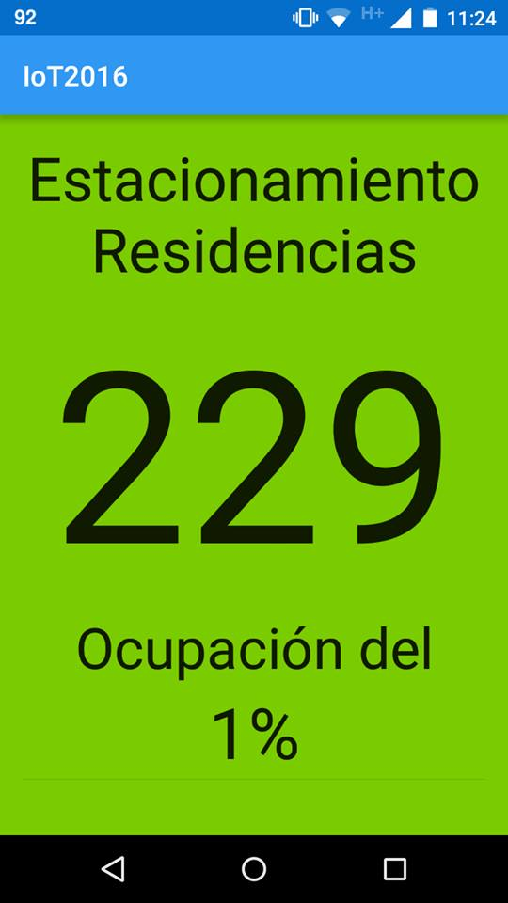
How does it works for the user?
At first, when the user enters the parking lot, Parkify will request the area where the user is heading.
Then, Parkify will display the information about such area.

Slide 8
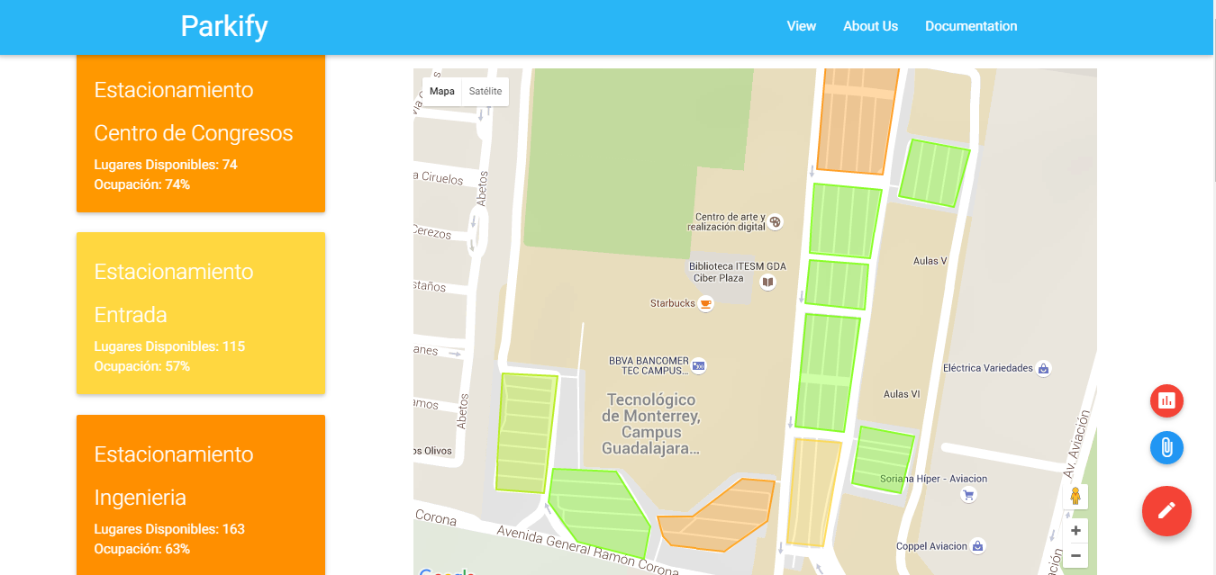
How does it works for the admin?
The counter inside the webpage lets the admin supervise the status of the database information.
In case of a glitch inside the counter, the admin is able to restart or change it.
The information updates each 2 seconds.

