Slide 1
A “Super” Analysis
Delving Into Data About America’s Biggest Football Game

Slide 2
Questions To Examine
What are the best Super Bowl Squares to get in your pool?
Can we use data to bet the over/under for the game?
Has scoring increased in the more recent Super Bowls?
Do higher scoring games lead to higher TV ratings?
Can advertising costs be represented by a particular distribution?

Slide 3
Our Data
winning_pts: The number of points scored by the winning team
losing_pts: The number of points scored by the losing team
combined_pts: The number of total points scored
winning_pts_2: The value of the Super Bowl square for the winning team
losing_pts_2: The value of the Super Bowl square for the losing team
ad_cost: The cost of a 30 second TV ad during the game
rating_household: The Nielsen TV rating for the game
super_bowl: The number of a given Super Bowl (started with Super Bowl 1, have now gone up to Super Bowl 54)

Slide 4
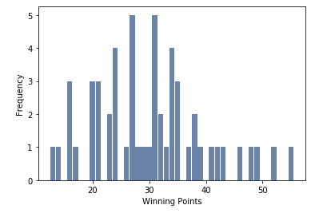
winning_pts
Mean: 30.1
Variance: 95.4
Standard Deviation: 9.8
Mode: 27, 31
Outliers: There are of course a few games where teams scored a lot of points, which is to be expected from winning teams. However, there were also some teams that scored very little and still won. For example, the losing point total for a winning team was 13, scored by the New England Patriots in Super Bowl 53. These outliers are still relevant to our data because the games happened, but it is interesting to point out how there is a wide spread of ways to win these games.
Histogram of the data:

Slide 5
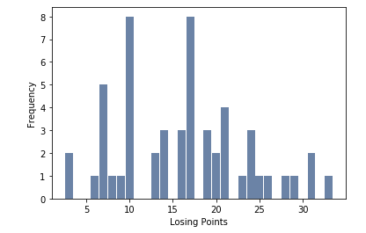
losing_pts
Mean = 16.2
Variance = 55.0
Standard Deviation = 7.4
Mode: 10, 17
Outliers: There are some very low point totals, but similarly to winning_pts this is to be expected from teams that lose the game. The more interesting outliers are the high scores, as you typically do not see a losing team scoring a lot of points. The highest score from a losing team is 33 points, scored again by the New England Patriots in Super Bowl 52. We will keep these outliers in our data set because they are still relevant, but once again it is important to note that there are a variety of ways to lose a football game.
Histogram of the data

Slide 6
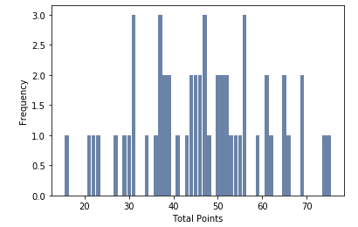
combined_pts
Mean: 46.3
Variance: 194.3
Standard Deviation: 13.9
Mode: 31, 37, 47, and 56
The outliers for this are interesting, and goes to show how different football games can be. The lowest scoring game was Super Bowl 53, with the Patriots beating the LA Rams 13-3. The highest scoring game was Super Bowl 29, with the San Francisco 49ers defeating the San Diego Chargers 49-26. They are relevant to our data and we will keep them in for analysis.
Histogram of data:

Slide 7
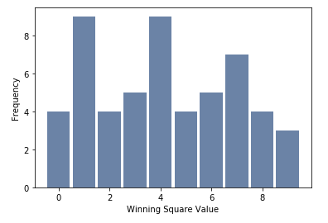
winning_pts_2
The summary statistics for this variable are not very helpful, since there are only 10 options. I did however include the mode.
Mode: 1, 4
Histogram of the data:

Slide 8
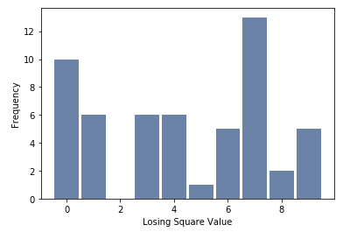
losing_pts_2
The summary statistics for this variable are not very helpful, since there are only 10 options. I did however include the mode.
Mode: 7
Histogram of the data:

Slide 9
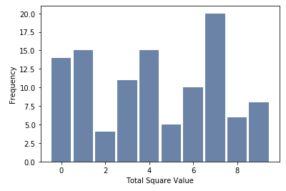
Combination of winning_pts_2 and losing_pts_2
I think the more helpful histogram for this data would be a combined one. This way, we get a better overall view of Super Bowl squares during the history of the game.
From this graph, one could conclude that the numbers you want to see in your Super Bowl square are 0, 1, 4, and 7. The numbers you definitely don’t want to see are 2, 5, and 8. This conclusion is not super surprising, as “common” football scores do end in 0, 1, 4, and 7. It would be interesting to find a dataset that has scores after each quarter, so one could see if maybe 2 is only useless as a final score winner. Next semester!
Histogram of data:

Slide 10
ad_cost
Mean: 1659919.40
Variance: 2732508040774.13
Standard deviation: 1653029.96
Mode: 2200000, 5000000
Because of the large spread of these values, I don’t think a histogram is useful. We will examine different plots for these advertising costs later in our analysis.

Slide 11
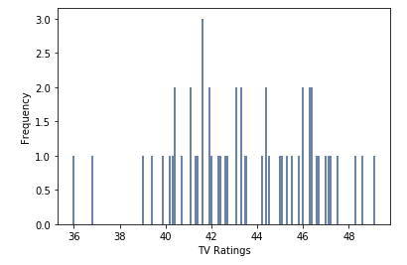
rating_household
Mean: 43.5
Variance: 8.9
Standard deviation: 3.0
Mode: 41.6
Outliers: The earlier Super Bowls did not have the ratings that the current ones do. As you can see from our Histogram, there are two occurrences of Super Bowls with ratings less than 38. These are Super Bowls 2 and 3. We also see there are 3 values greater than 48. These are Super Bowls 16, 17, and 20 which occurred in the 1980s. I would have to do some digging into why there was a spike in this time. Famous teams? Famous players? Rise of TV in general? In any rate we will keep all of these outliers in for analysis.
Histogram of data:

Slide 12
Scores over the years
One of my hypotheses is that scores have increased over the years. One way to look into this is via a PMF comparison graph. We can calculating PMFs for combined points for games from Super Bowls 1-27 and 28-54, and see if there is any discernible difference in the graphs

Slide 13
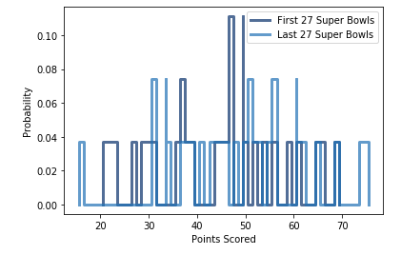
Scores over the years
Combined PMF
As you can see from this graph, the score probabilities are rather similar for both groups of games. There is quite a bit of overlap, and no real discernible difference in the probabilities for the two.

Slide 14
Scores over the years
Another way to check if there is an increase in scores is to perform a difference in means hypothesis test. By doing this, we can test if there is a significant difference between the mean score of the first 27 Super Bowls versus the mean score of the last 27 Super Bowls
Using the code in the accompanying .ipynb file, when we run the difference in means test we get a p-value of 0.176. This means we expect to see a difference as big as the observed effect about 17.6% of the time. This effect is therefore not statistically significant. Based on this and the PMF, I would conclude that my hypothesis is false, and there really has not been a major change in scoring over the lifetime of the Super Bowl.

Slide 15
Betting the Over/Under
We are currently in the rise of sports betting. States all across the country are beginning to legalize it, and the vernacular is becoming a part of society.
One of these terms is “over/under”. For those unfamiliar, Vegas predicts the number of combined points that will be scored. As a bettor, you have to decide if there will be more (over) or less (under) points scored in the actual game
This got me thinking, can we use past Super Bowl data to get a leg up on this bet? For Super Bowl 54, the over/under was set at 54 points. Let’s take a look at our data and see what we can find. We will create a CDF of the combined_pts variable.

Slide 16
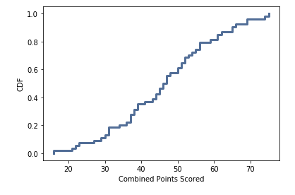
Betting the Over/Under
CDF of combined points:
Using this CDF, we can obtain the probability that less than 54 points were scored in a Super Bowl. This value is .72, or 72%.
Based solely on the history of the game, one could bet the under thinking 72% is a pretty large chunk of games.
In this specific scenario, you would have won the bet, as the Chiefs won 31-20 (51 combined points)

Slide 17
Higher Scores = Higher Ratings?
Another one of my Super Bowl hypotheses is that higher scoring games lead to higher ratings. My reasoning is that as the buzz picks up that a lot of points are being scored, someone who may have been indifferent about the game may be more likely to turn it on.
To evaluate this hypothesis, we will produce a scatter plot of the data

Slide 18
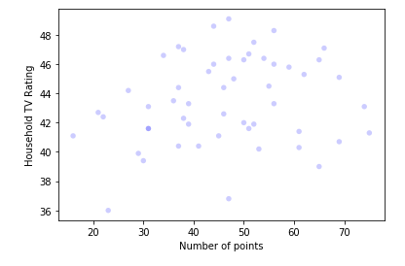
Higher Scores = Higher Ratings?
Scatter plot:
From this scatter plot, I start to get the feeling that my hypothesis is incorrect. There doesn’t seem to really be a strong correlation between the two. The points are relatively scattered throughout without a discernible pattern. Just to cover all of our bases, we will also run a regression analysis.

Slide 19
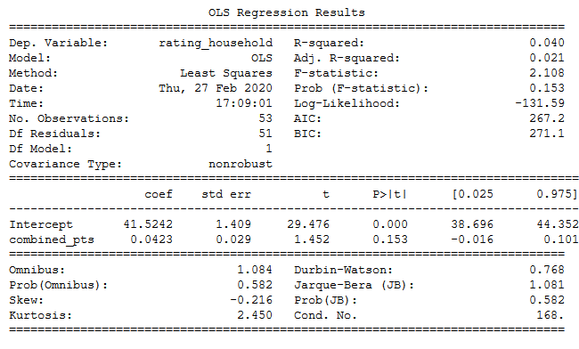
Higher Scores = Higher Ratings?
Regression results:
This data further cements my feelings that the hypothesis was false. With such low values for R-squared and F-statistic, we can see that there is really no correlation between these two variables.
Why was this hypothesis false? I think there is one key factor and that is that the Super Bowl is going to have a fantastic rating regardless of the score. Some people may only tune in for a high scoring game, but they are in the vast minority.

Slide 20
Advertising Costs
Something I was just generally curious about was the progression of advertising costs over time. You hear the astronomical numbers and think “Is the company really getting their money’s worth?” and “Have they always been this outrageous?”
We will produce a scatter plot of advertising cost over the course of the Super Bowls and see what we can find

Slide 21
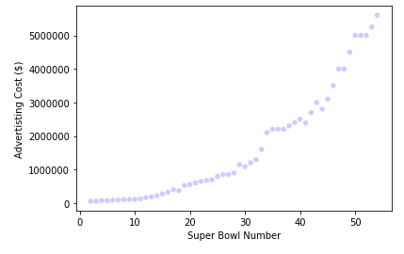
Advertising Costs
Scatter Plot
If we evaluate this scatter plot, we can see that there was a rather gradual increase in ad cost for about the first 30 Super Bowls, and then ever since then there has been a steep incline.
This graph looks like it could possibly be represented by an exponential distribution. Let’s dig into that a little further!

Slide 22
Advertising Costs
If a distribution is exponential, that means the log of the values should be represented by a straight line. Let us convert our data to log(advertising cost), and produce another plot.

Slide 23
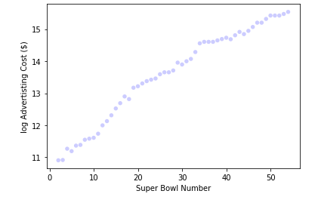
Advertising Costs
Plot of log values:
This plot definitely looks linear to me. There is a pretty steady slope for the entirety of the trajectory from Super Bowl 1 to Super Bowl 54.
Another good way to view its linearity would be to fit a best-fit line to this data

Slide 24
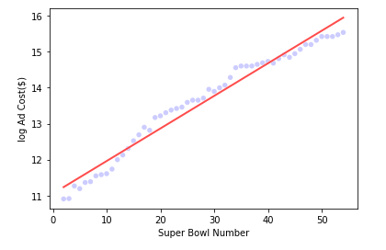
Advertising Costs
Best-fit line
This line is an incredible fit for our data, with some data points actually intersecting it, and all data lying very close to it. There are no real outliers here.
If we calculate the coefficient of determination of this line, we get a value of 0.97. This value measures the goodness of fit of this linear model. This would indicate there is a strong linear relationship between these two variables.

Slide 25
Advertising Costs
All signs point to advertising costs having an exponential distribution. Another way to examine is to look at the CDF and CCDF, and see if they look like the examples from Page 50 of our textbook.

Slide 26
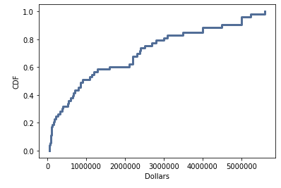
Advertising Costs
CDF:
From viewing this CDF, we see that it definitely mimics the examples Downey gave us in Chapter 5.
Next step is to look at the complementary CDF. For an exponential distribution, this will be a straight line.

Slide 27
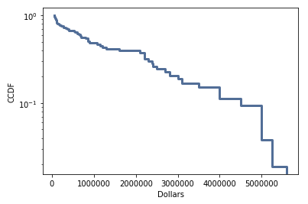
Advertising Costs
CCDF
Now this graph is definitely not a perfect straight line, which indicates the exponential distribution is not a perfect fit for our data.
Nevertheless, based on everything presented here, I definitely think it is reasonable to model this data with an exponential distribution.

Slide 28
Conclusions
What are the best Super Bowl Squares to get in your pool?
Based on our analysis here, I would say you should definitely be hoping to get a square that contains a 0, 1, 4, or 7. If you get one that contains a 2, 5, or 8 well... best of luck!

Slide 29
Conclusions
Can we use data to bet the over/under for the game?
Based on the CDF of combined points scored in Super Bowl history, we can definitely make an educated guess on how many points will be scored. For this last Super Bowl, the over/under was set at 54 points. If we plug that into our CDF, we can see that over 72% of all Super Bowls have scored below 54 points. With a final score of 31-20, you would have won your bet if you followed the percentage and bet the under.
While these games are independent of one another, it is definitely interesting to think about them as a whole, and use the past to help predict the future.

Slide 30
Conclusions
Has scoring increased in the more recent Super Bowls?
Based on our PMF and Hypothesis Test analyses, I would conclude that no, scoring has not increased or decreased in more recent Super Bowls. The difference in means between the first 27 and last 27 combined scores is statistically insignificant.

Slide 31
Conclusions
Do higher scoring games lead to higher TV ratings?
Once again, based on our scatter plot and linear regression analysis, it seems as those TV ratings and combined score have little to do with one another. With a pattern-less scatter plot, and such low R-squared values, one could say there is really no correlation between the two.

Slide 32
Conclusions
Can advertising costs be represented by a particular distribution?
It appears we finally have a yes! Based on scatter plot and CDF analysis, it looks like advertising costs can be very well modeled using an exponential distribution. When we saw the linearity of the log values, and the shape of the CDF, we could conclude than an exponential distribution would be a good fit for this data.

Slide 33
Thanks for tuning in!
All of my code can be found in Goodwin_final.ipynb
The original dataset can be found here: https://www.kaggle.com/achyutbabu/tv-halftime-shows-and-the-big-game

