Slide 1






About me
Catherine Gosmeyer
cgosmeyer
Studied Astrophysics, Journalism & Comp Sci (2013)
Instrument Analyst for Hubble and James Webb Space Telescopes (2013-2017)
Scientific Software Developer for NASA’s ICESat-2 mission (2017+)
Part-time graduate student in Geospatial Information Sciences (2018+)
Editor for Astrophysics Source Code Library (2019+)

Slide 2
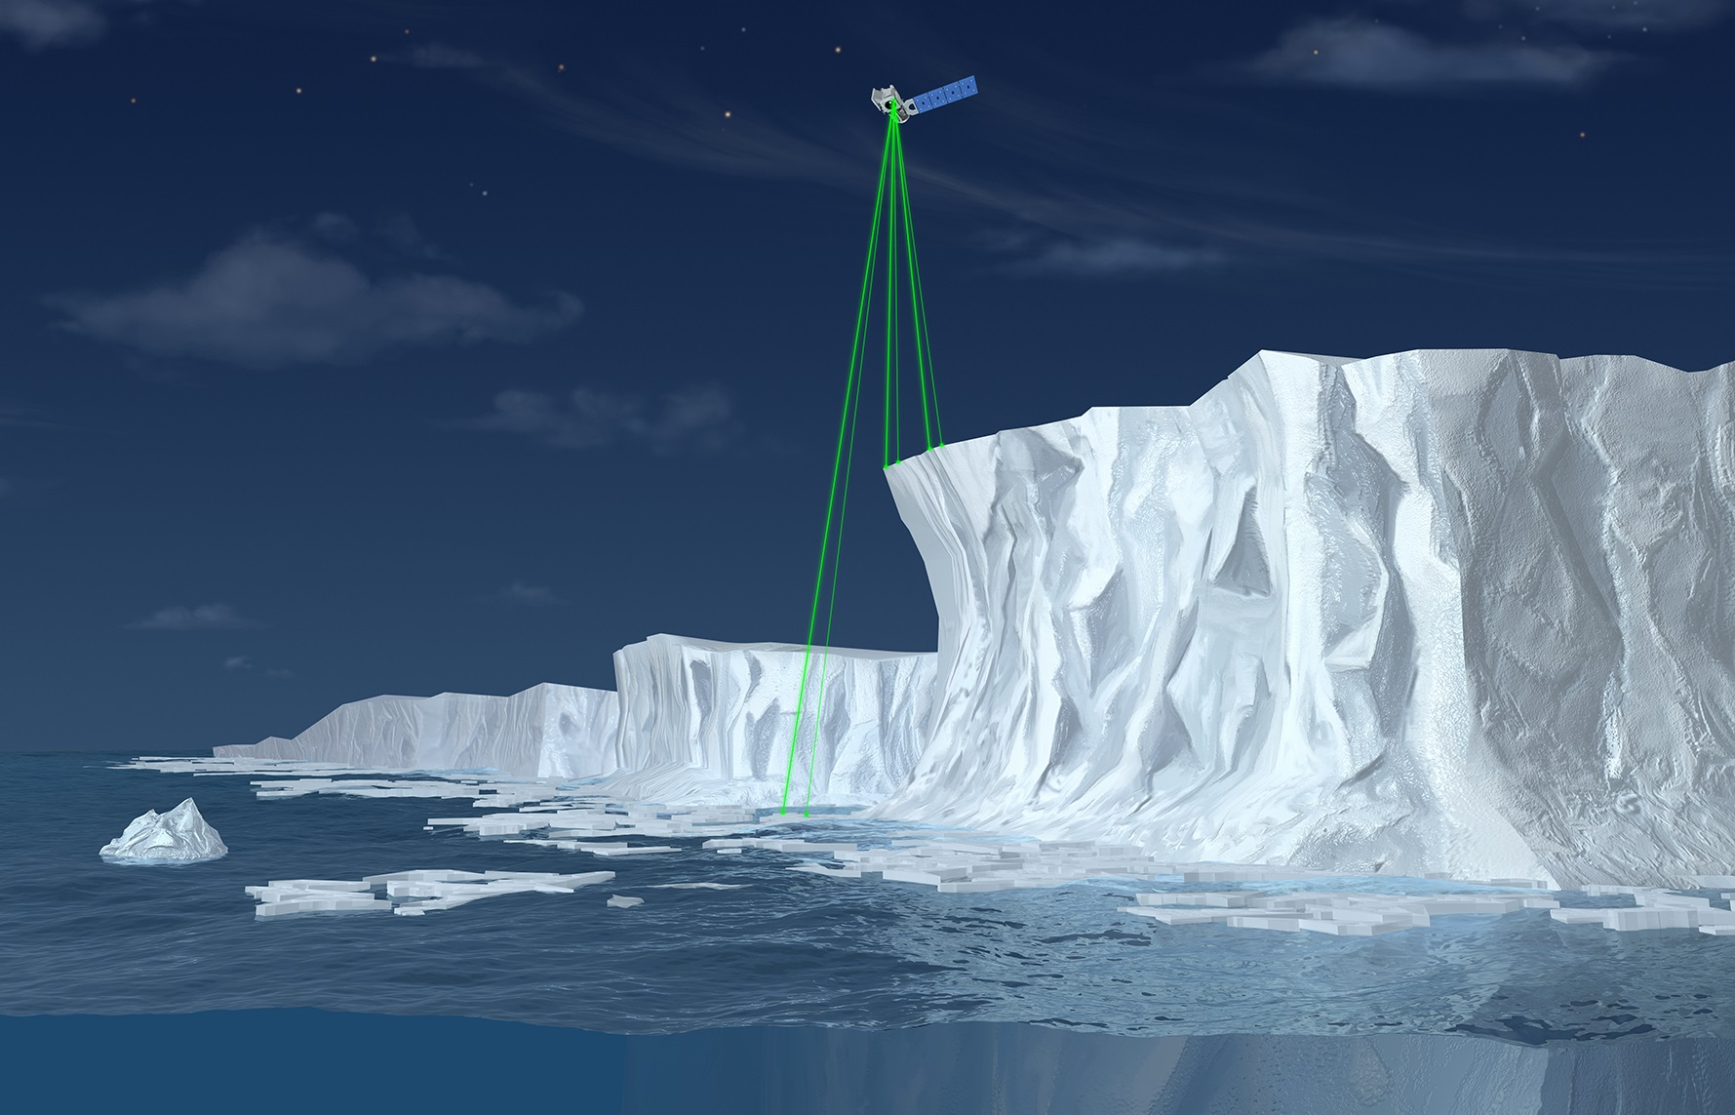

Speed of light finite:
If measure round-trip time
can derive altitude
cgosmeyer
NASA Goddard Space Flight Center/ADNET Systems
Notes:
Since we need cm-level precision, need measure in picoseconds! Verifying the calculation very important!

Slide 3
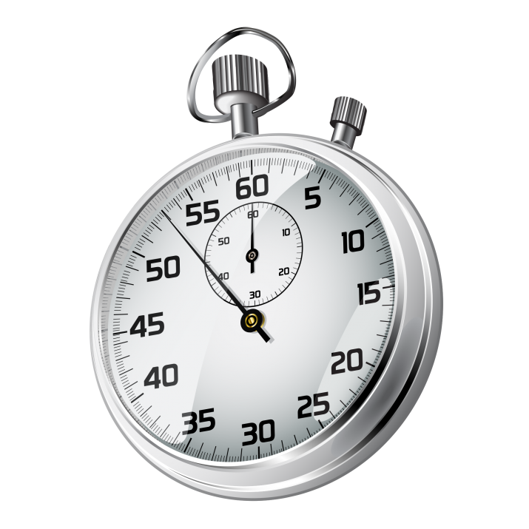
Speed of light finite:
If measure round-trip time
can derive altitude
cgosmeyer
NASA Goddard Space Flight Center/ADNET Systems
Notes:
Since we need cm-level precision, need measure in picoseconds! Verifying the calculation very important!

Slide 4


Fortran
Time of Flight Recipes
+
Raw Data
=
HDF5 of 1384 fields
Problem:
Were the algorithms correctly implemented?
cgosmeyer
NASA Goddard Space Flight Center/ADNET Systems

Slide 5
Fortran
Time of Flight Recipes
+
Raw Data
=
HDF5 of 1384 fields
Problem:
Were the algorithms correctly implemented?
Python
Solution:
Re-implement in Python! But forget H5 - use pickles!
Pickle...
of each calculation object
Time of Flight Recipes
+
Raw Data
=
cgosmeyer
NASA Goddard Space Flight Center/ADNET Systems

Slide 6
Why pickle?
import pickle
pickle.dump(obj, open(”mypickle.pkl", "wb"))
Retains types
All my variables, calibration selections, equations for intermediate calculations are already attributes – I don’t know what I’ll need to write out beforehand and I don’t need to
Minimizes read/write errors – I know any errors must be in the computation code
Save intermediate stages of the long computations – I can test changes quickly
cgosmeyer
NASA Goddard Space Flight Center/ADNET Systems
Notes:
I’m already familiar with my class’s structure and I don’t need be burdened by inventing a structure for an output file that only I am using.
H5 was great for the final results. But when you see a discrepancy in the two arrays in your verification tests you don’t want to see just the final results!

Slide 7
Why pickle?
import pickle
pickle.dump(obj, open(”mypickle.pkl", "wb"))
Great for:
Testing / quick looking
Saving intermediate stages
Not for:
Storing long-term
Sharing
cgosmeyer
NASA Goddard Space Flight Center/ADNET Systems
Notes:
What stackoverflow does not tell you

Slide 8

Astrophysics Source Code Library
Makes astrophysics (+ planetary!) codes used in published research citable and discoverable
In 20 years, over 2000 codes indexed
Indexed by the SAO/NASA Astrophysics Data System (ADS) and Web of Science's Data Citation Index
ascl.net/submissions
Random code of the day: @asclnet
cgosmeyer
NASA Goddard Space Flight Center/ADNET Systems
Notes:
Same founders as Astronomy Picture of the Day. Find me later for swag!

