Slide 1

COV warm electronic model
COV TCB meeting – 6th February
Chloé Goupy

Slide 2
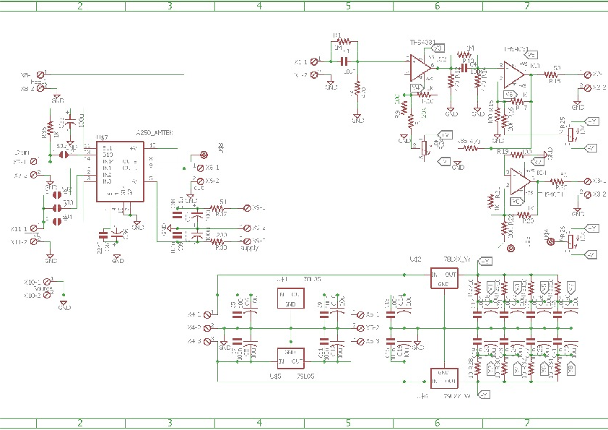
Electronic schemes
Provided by Riccardo
https://twiki.cern.ch/twiki/pub/NUCLEUS/CryogenicOuterVeto/COV_Analog_ShapingAmplifier_Diagram.pdf
https://twiki.cern.ch/twiki/pub/NUCLEUS/CryogenicOuterVeto/COV_Analog_LinearAmplifier_Diagram.pdf
Available amplifiers at TUM:
≈20 us shaper
≈120 us shaper
Linear amplifier (no shaper)
shaper
Not sure of what are those:
Hyp: readout outputs?
2

Slide 3
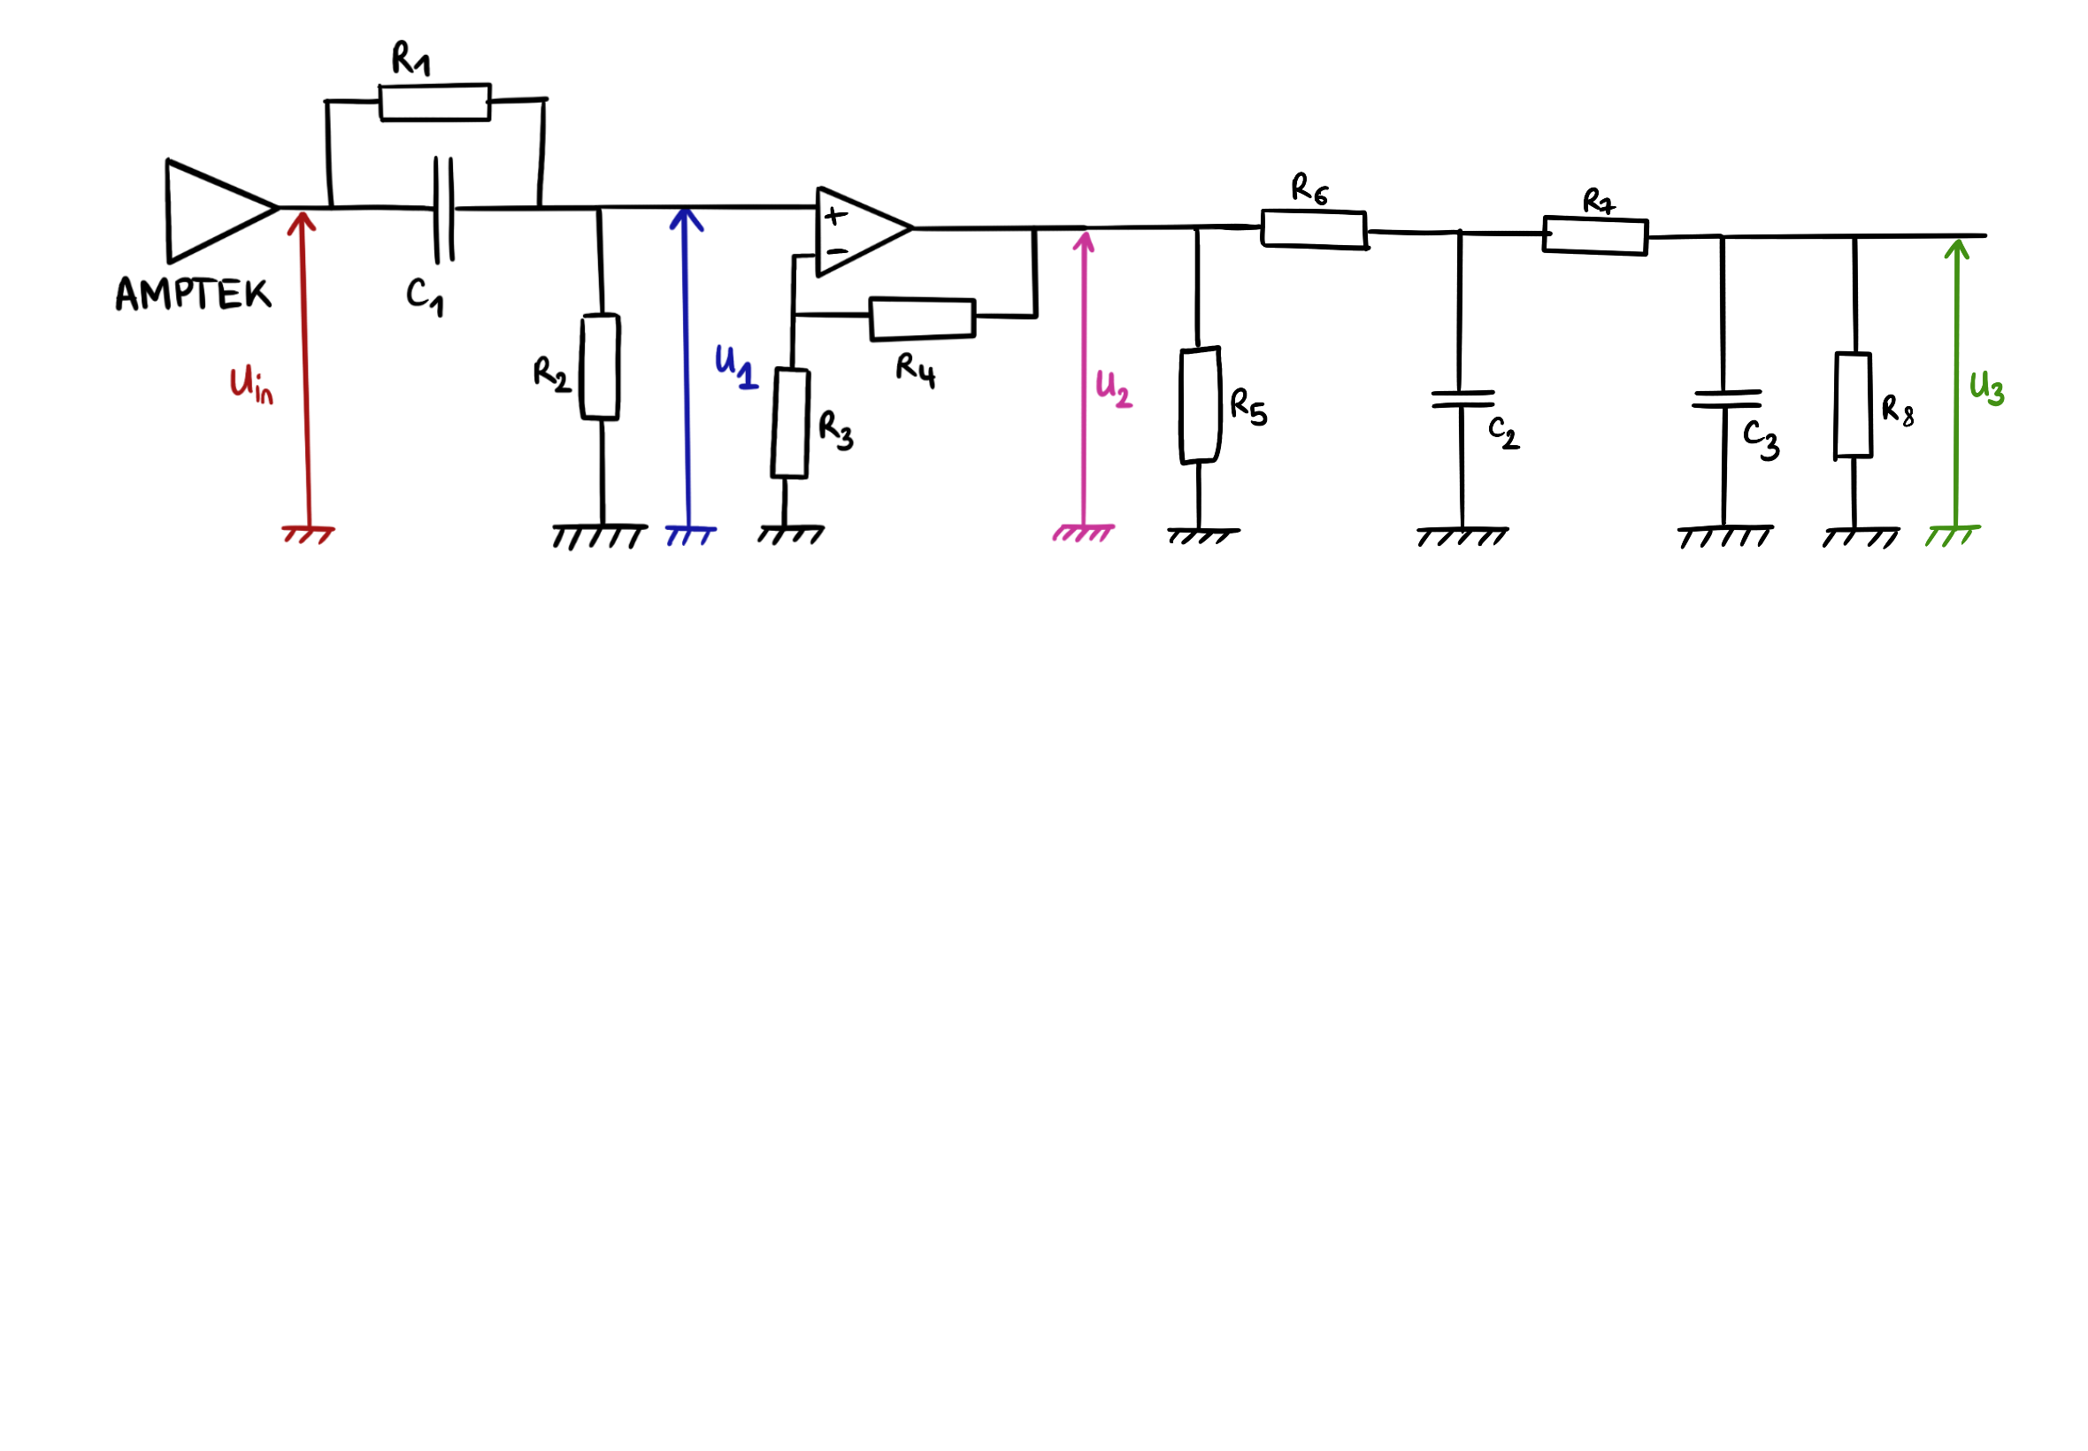
Shaper
Compute the transfer function step by step
3

Slide 4
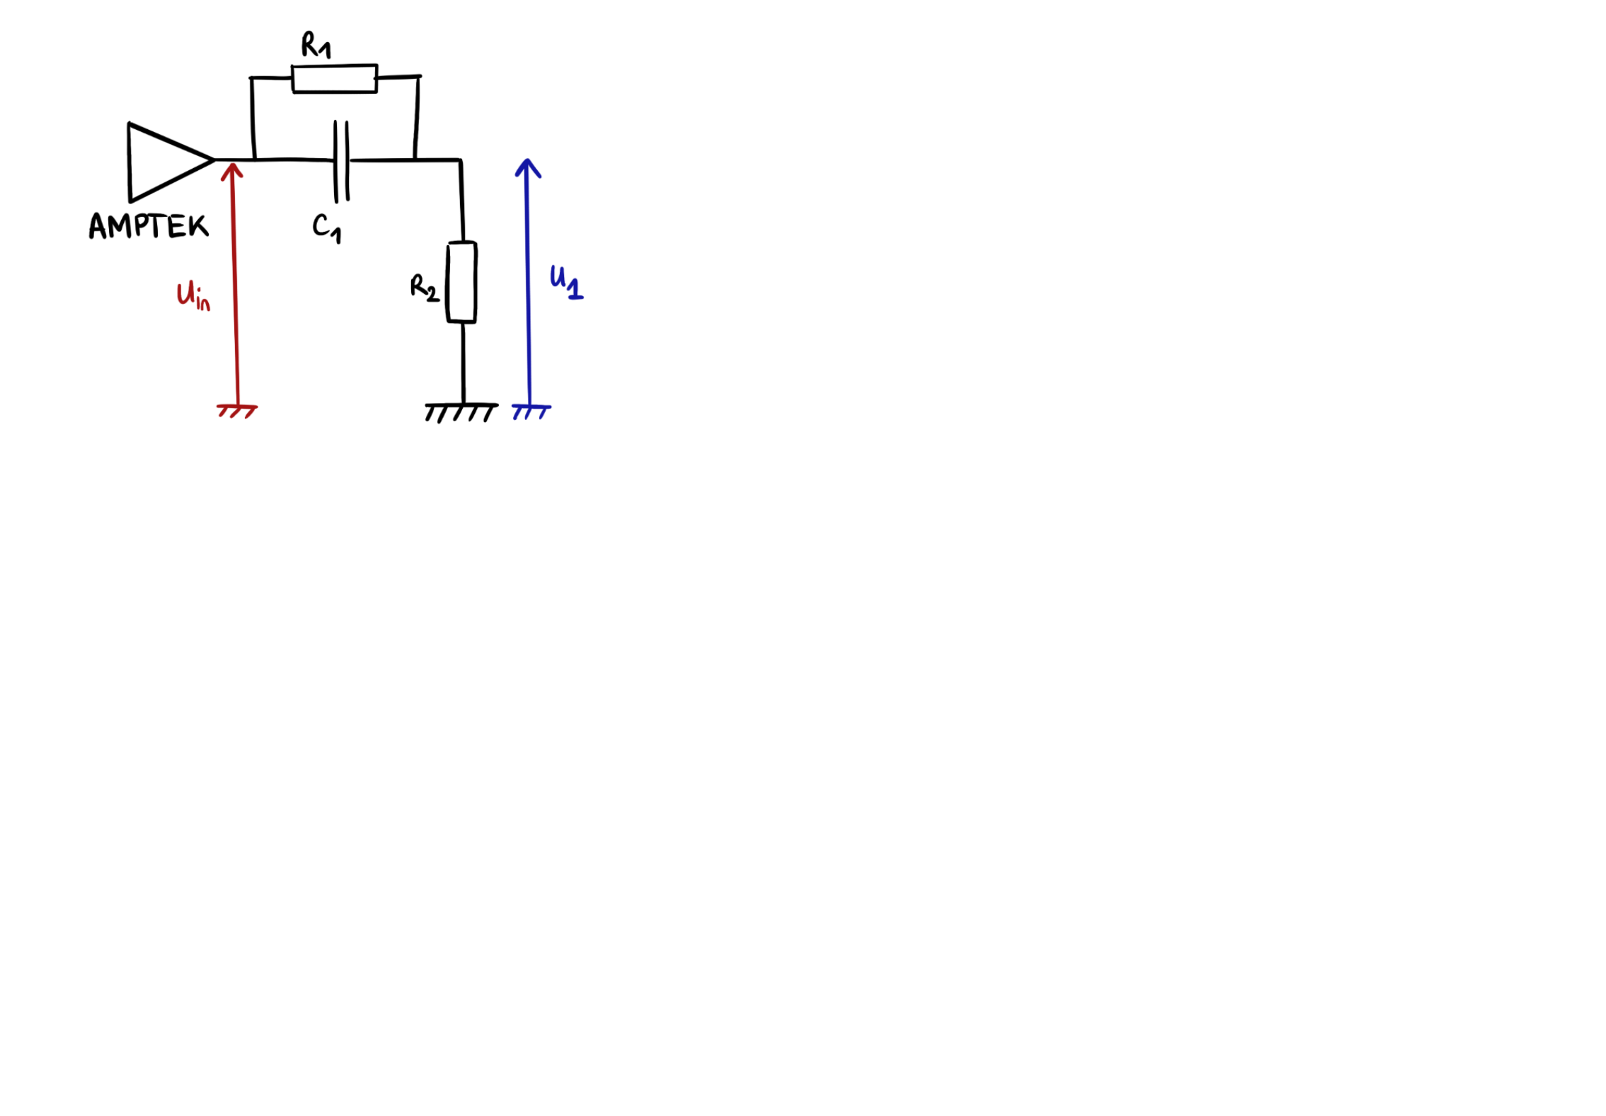
Shaper
Compute the transfer function step by step
High-pass
Shaper: R1 = 1 M
C1 = 22 nF
R2 = 470
cut_freq = 97 x 1e6 rad/s = 15 kHz
No Shaper: R1 = 1 M
C1 = 10 uF
R2 = 470
cut_freq = 213 rad/s = 34 Hz
4

Slide 5
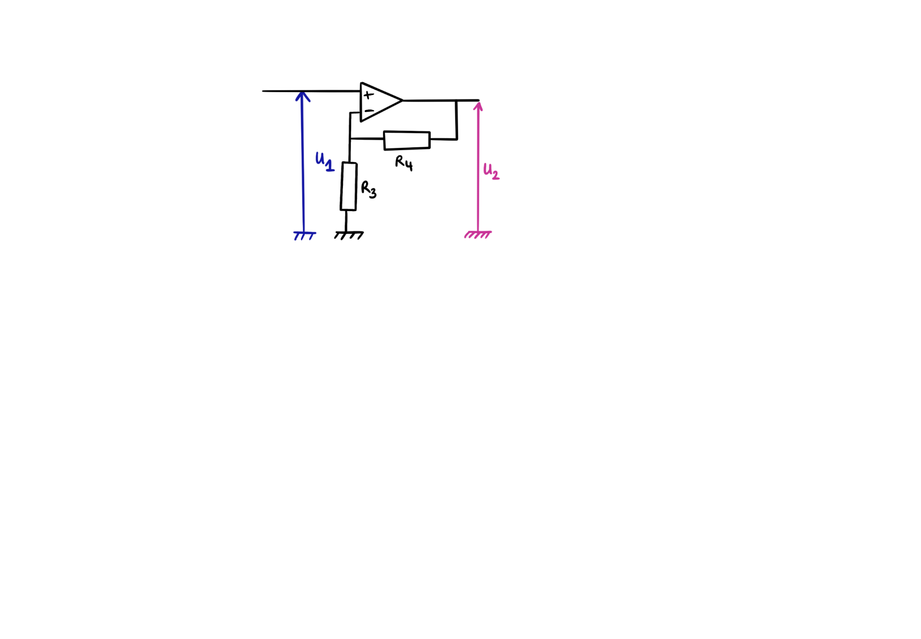
Shaper
Compute the transfer function step by step
“Follower” amplifier
Shaper: R3 = 470
R4 = 1 K
gain = 3.12
5

Slide 6
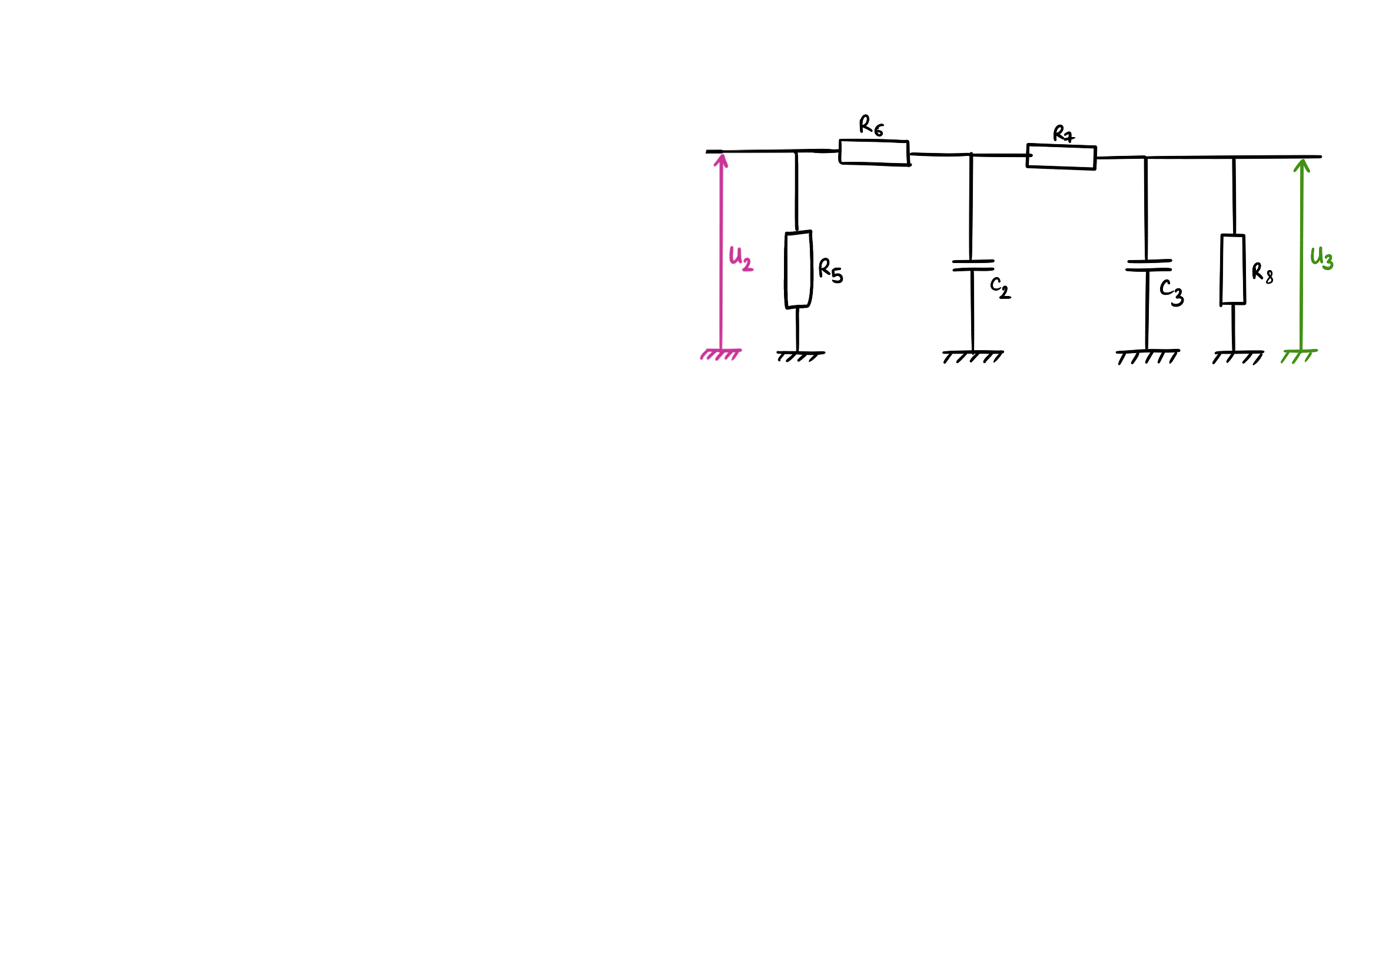
Shaper
Compute the transfer function step by step
2nd order low-pass ⇒ shaper
Shaper: R7 = R6 = 2.2 K
C3 = C2 = 1 nF
R8 = 470
freq1 = 931 rad/s = 296 Hz
freq2 = 45e6 rad/s = 7.12 MHz
6

Slide 7
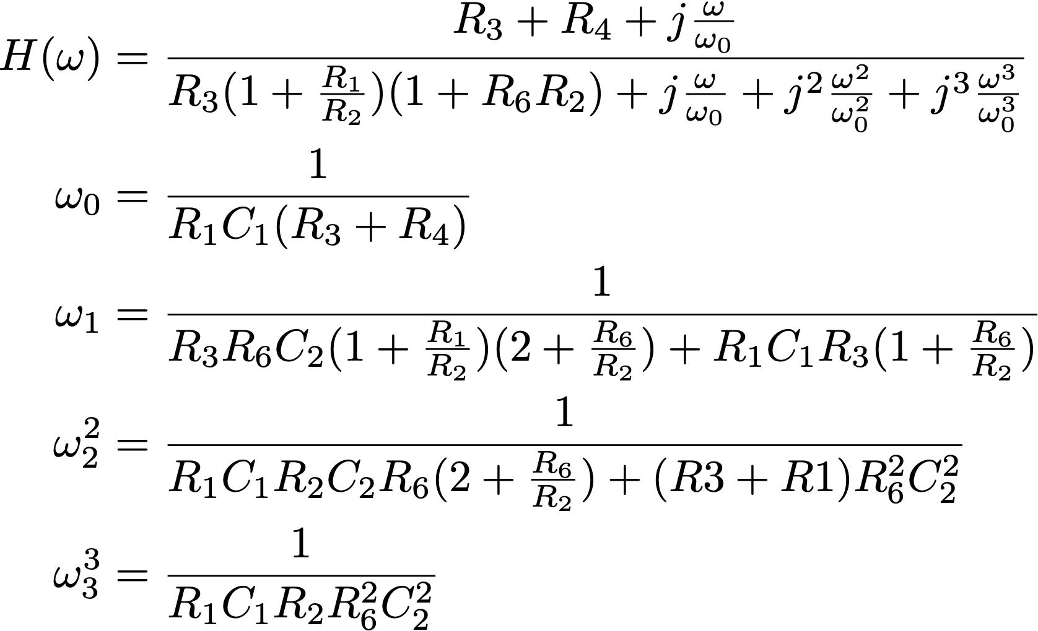
Shaper
Compute the transfer function step by step
7

Slide 8
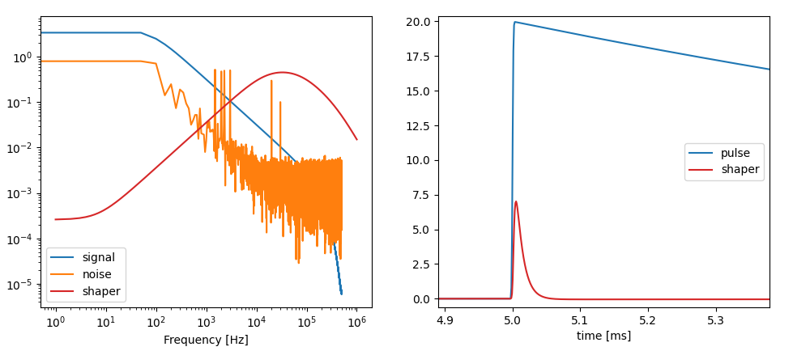
Shaper
Model
⚠️ Noise is arbitrary, inspired by shaped noise
time scale make sense
Where is the undershoot?
8

Slide 9
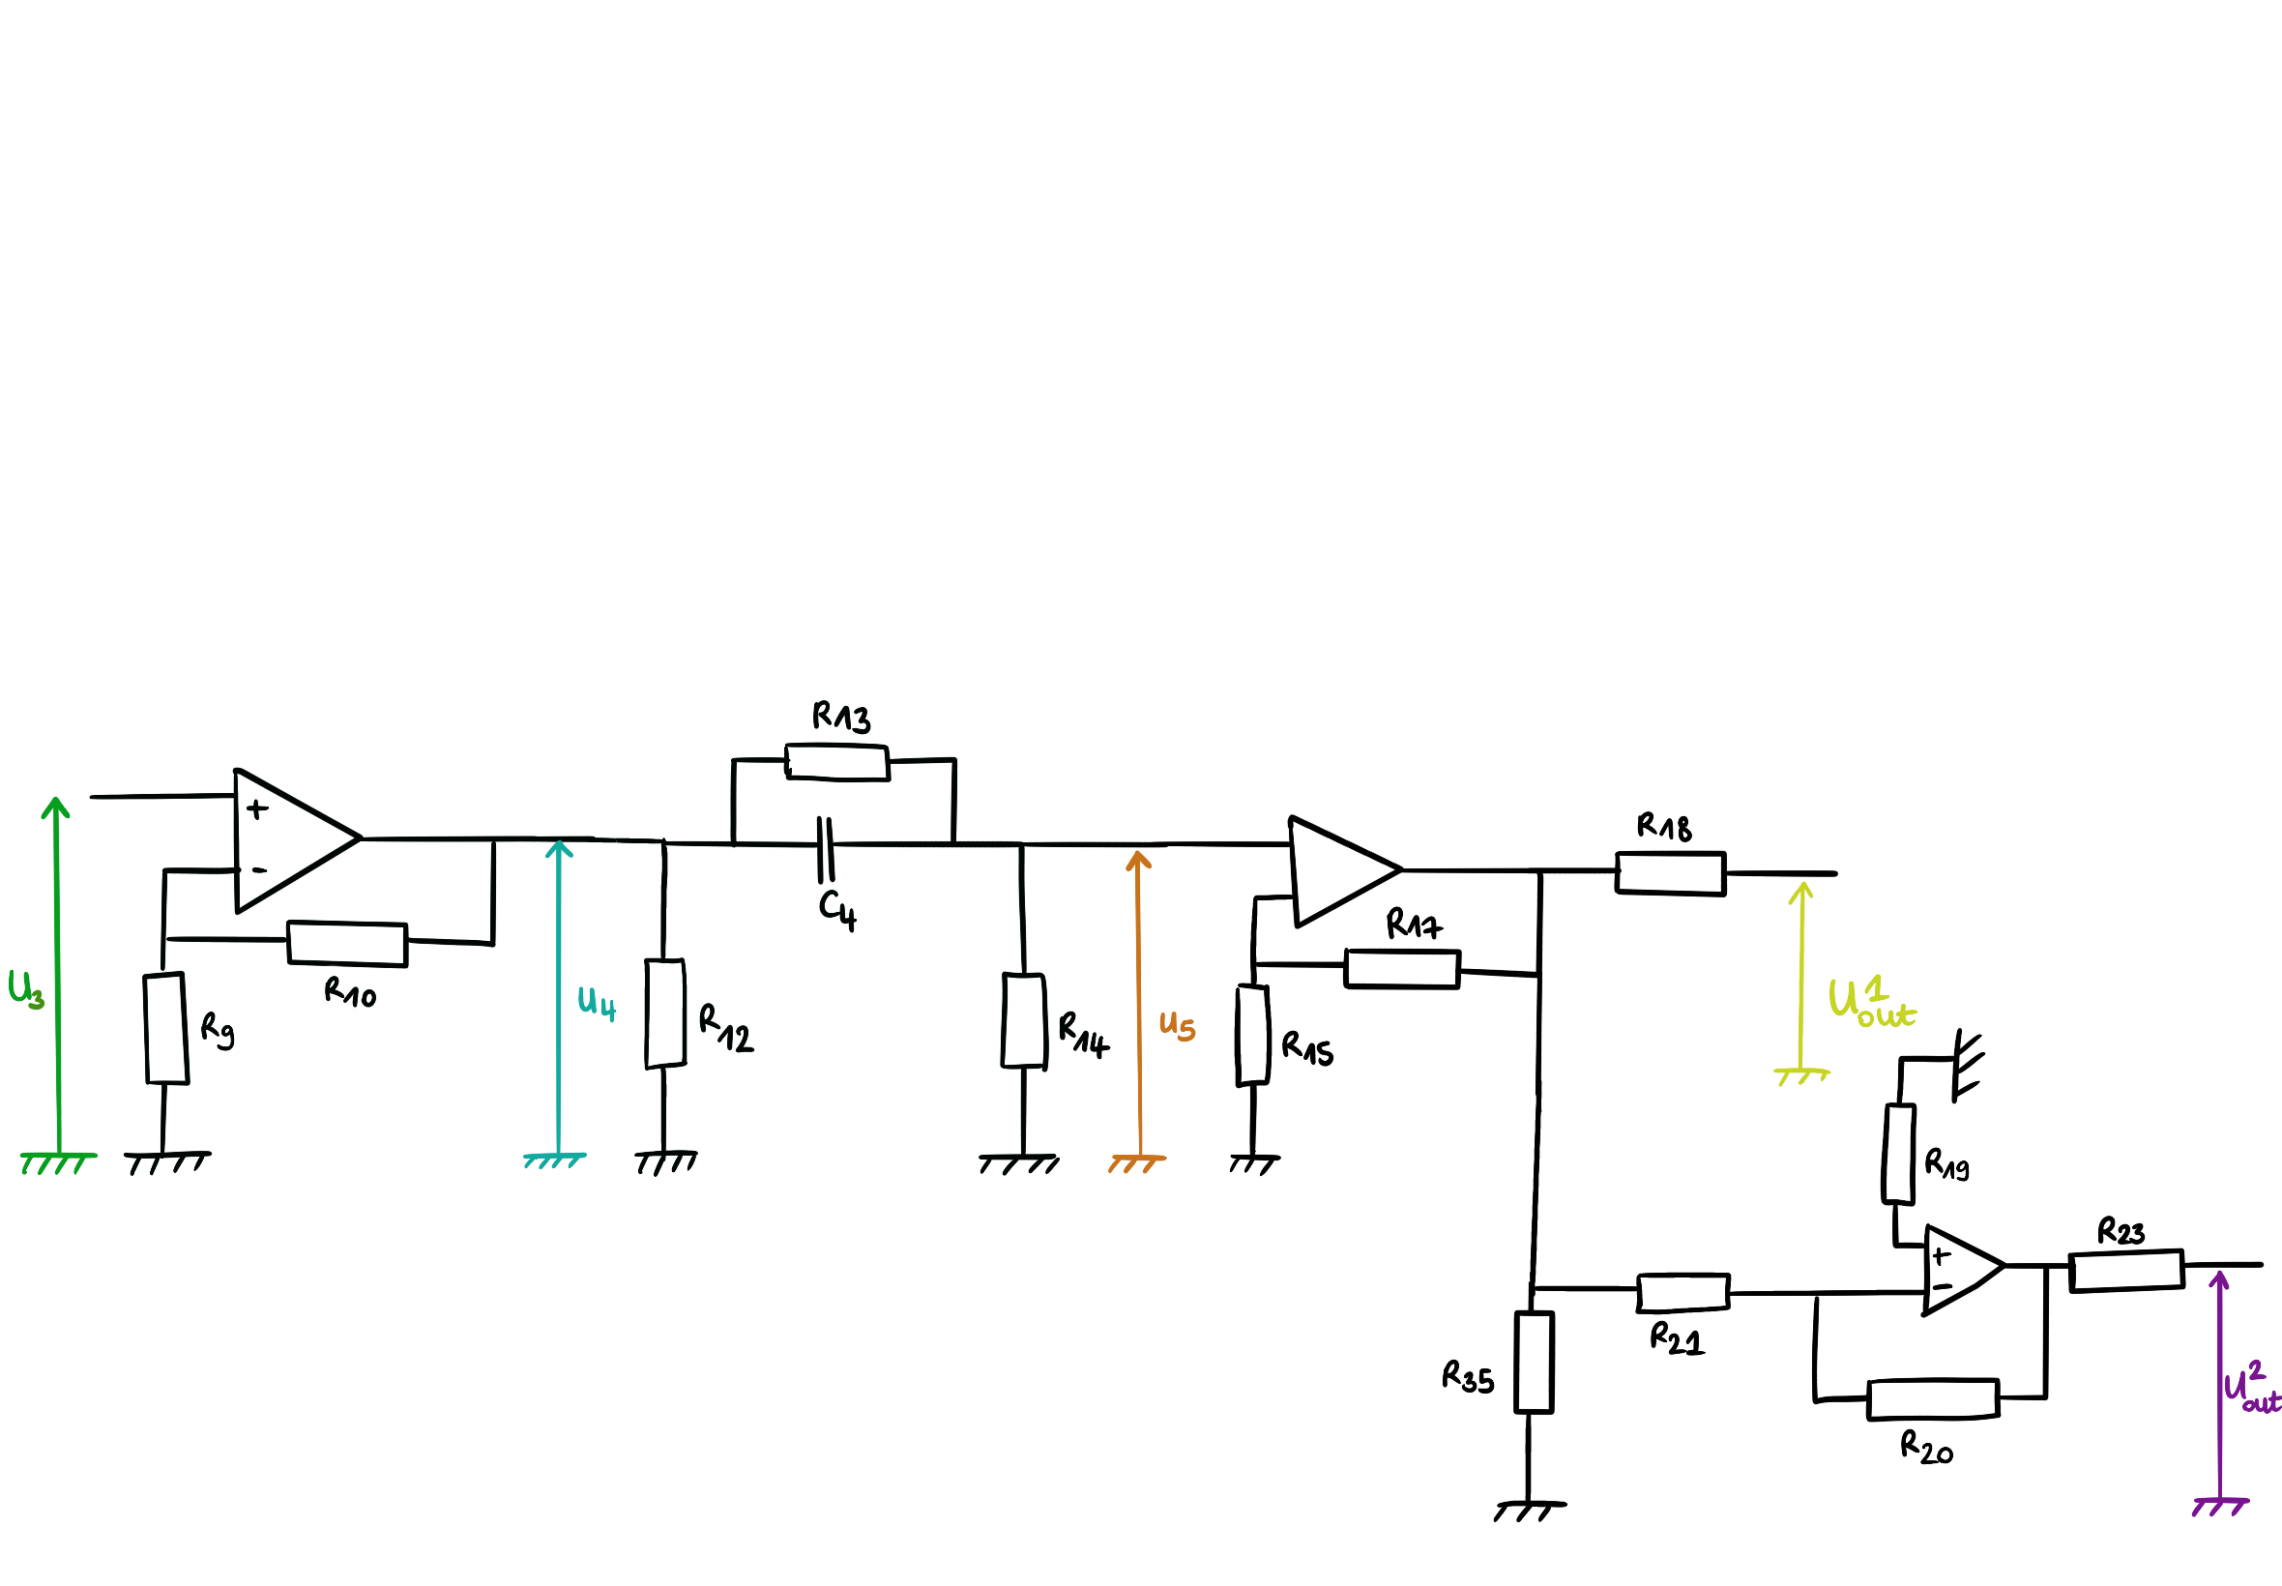
Amplifiers
Compute the transfer function step by step
9

Slide 10
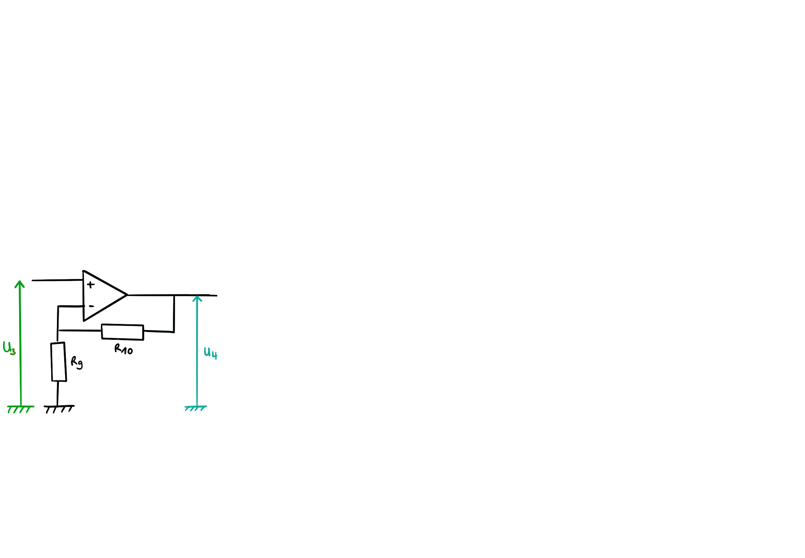
Amplifiers
Compute the transfer function step by step
“Follower” amplifier
Shaper: R9 = 470
R10 = 1 K
gain = 3.12
No shaper: R9 = 100
R10 = 1 K
gain = 11
10

Slide 11
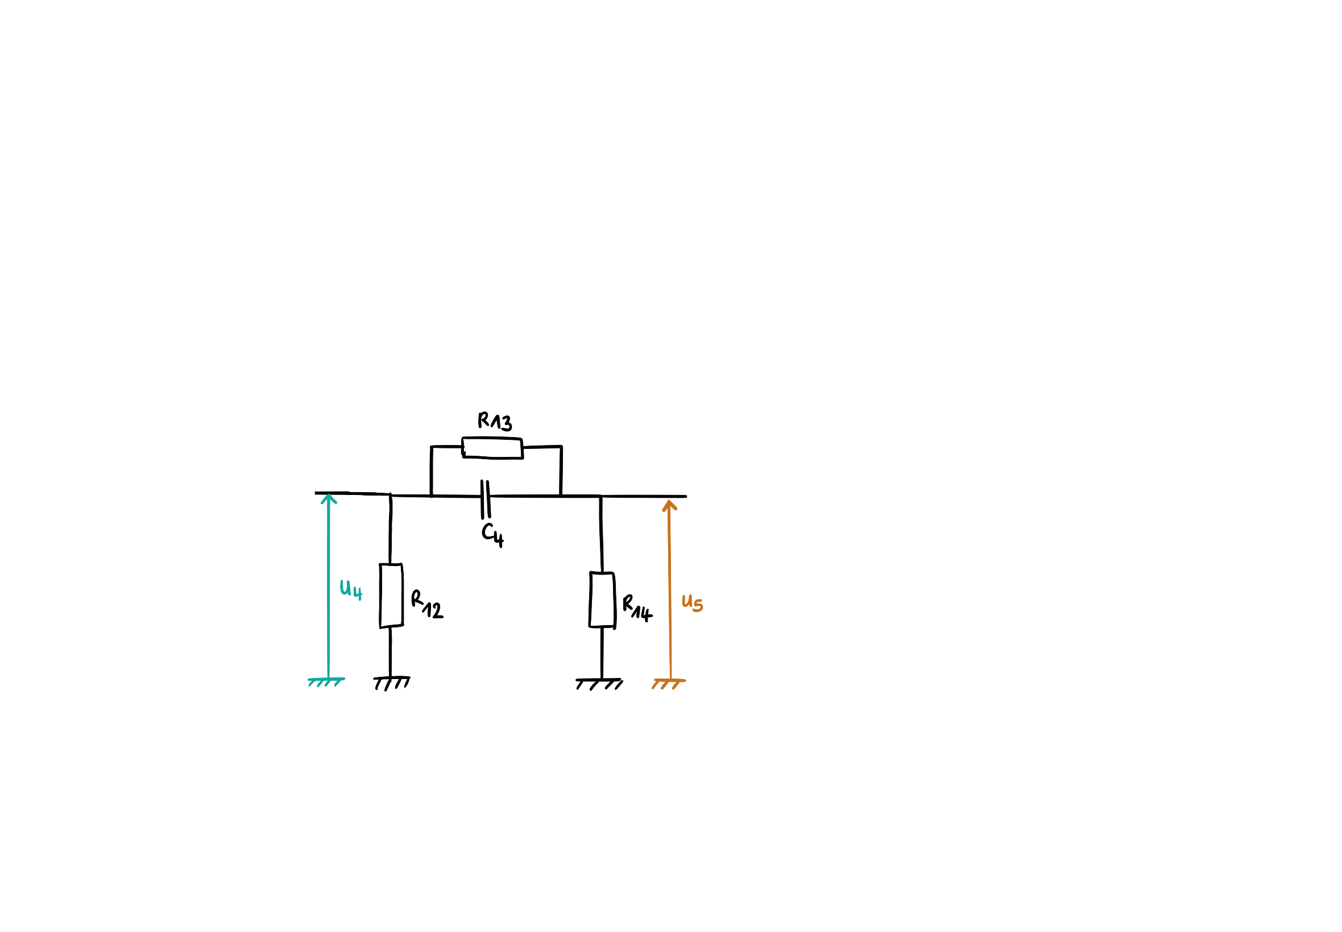
Amplifiers
Compute the transfer function step by step
High pass
Shaper: R13 = 1 M
C4 = 100 nF
R14 = 470
cut_freq = 21 x 1e3 rad/s = 3 kHz
No Shaper: R13 = 1 M
C4 = 100 nF
R14 = 470
cut_freq = 21 x 1e3 rad/s = 3 kHz!!
11

Slide 12
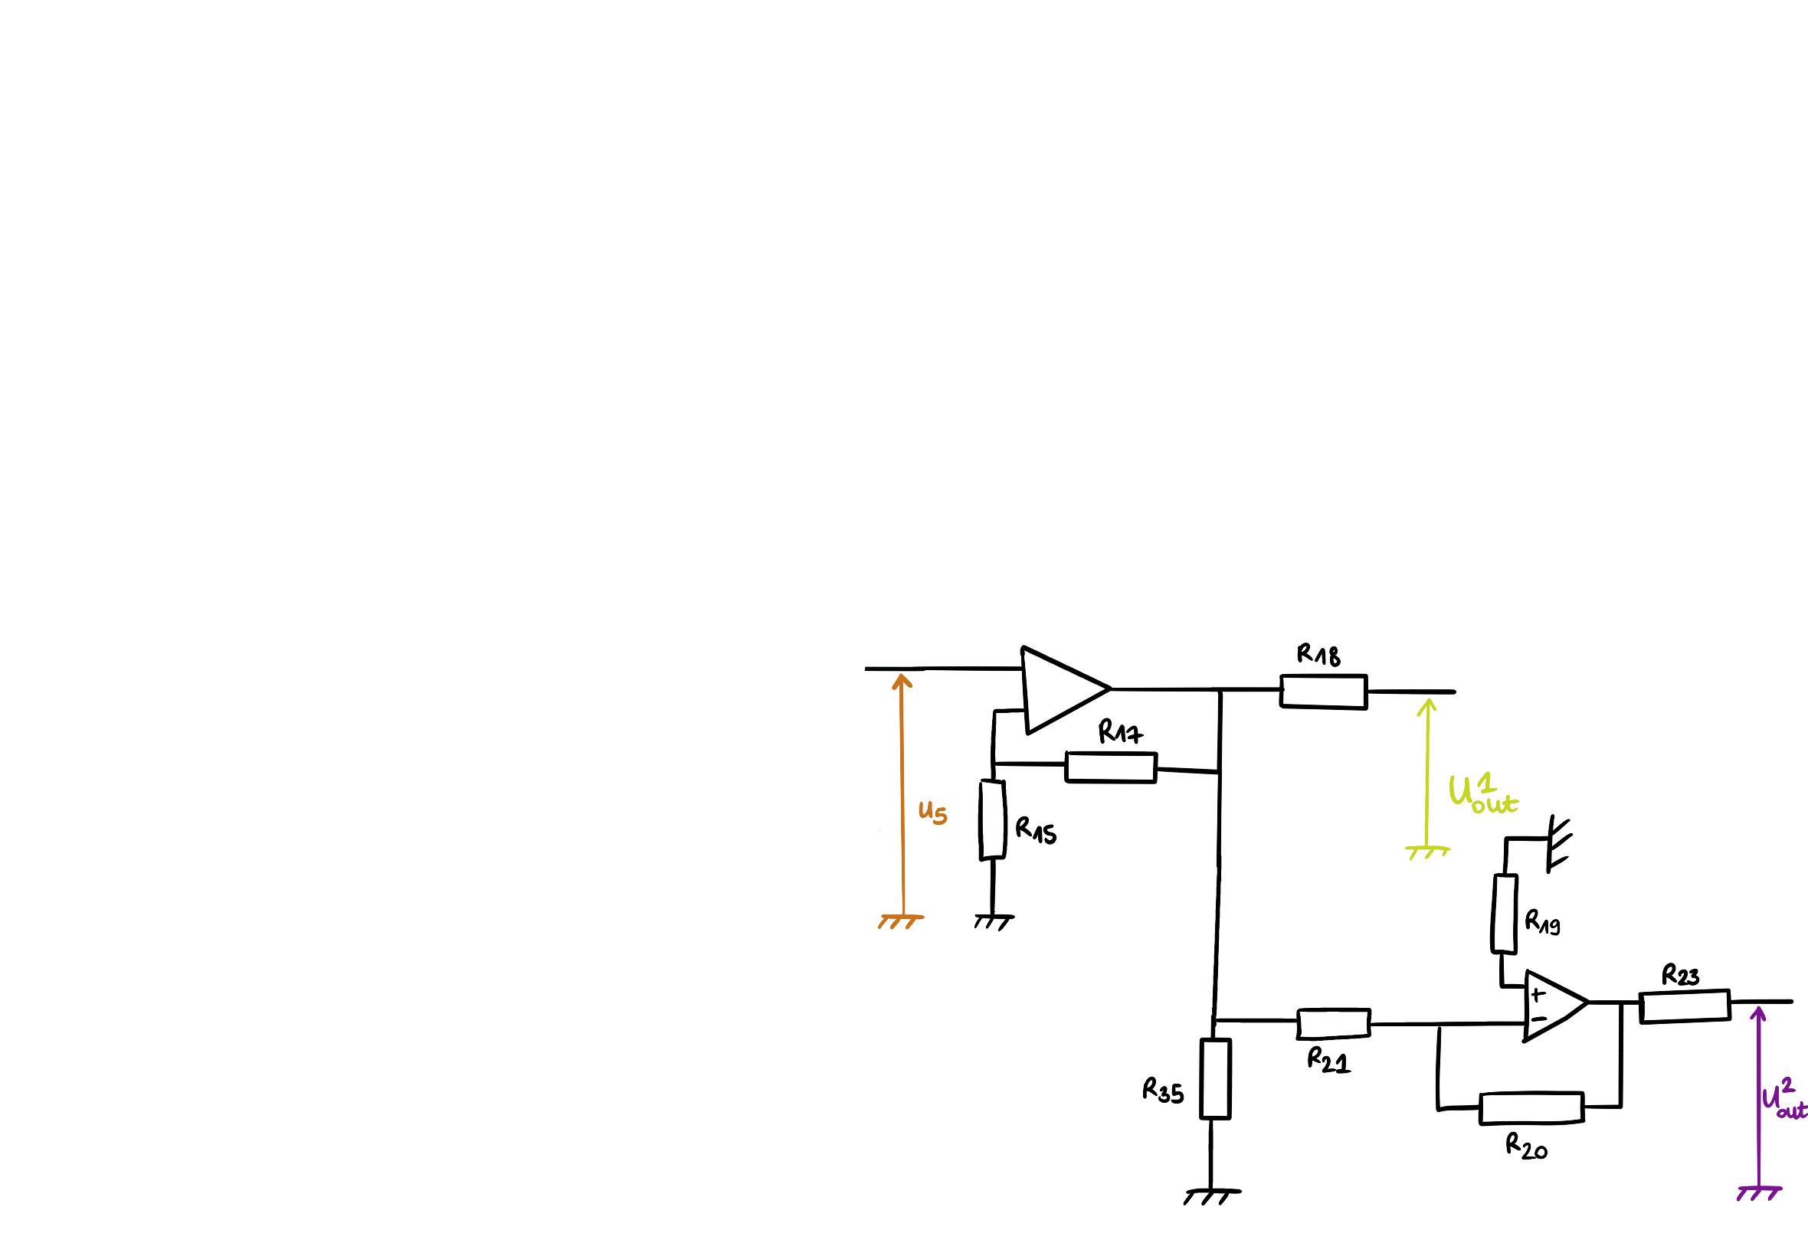
Amplifiers
Compute the transfer function step by step
Amplifiers
G = 10.88
G = -11.05
Signs are matching but not the gain!!
⇒ maybe an error in the calculation…
12

Slide 13
Amplifiers
Compute the transfer function step by step
13

Slide 14
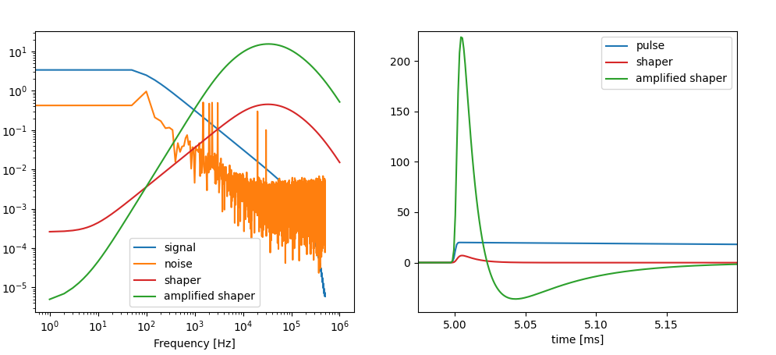
Amplified shaper
Model
⚠️ Noise is arbitrary, inspired by shaped noise
Time scale make sense
Undershoot also
Gain = 223/20 = 11.15 (measured: 62)
14

Slide 15
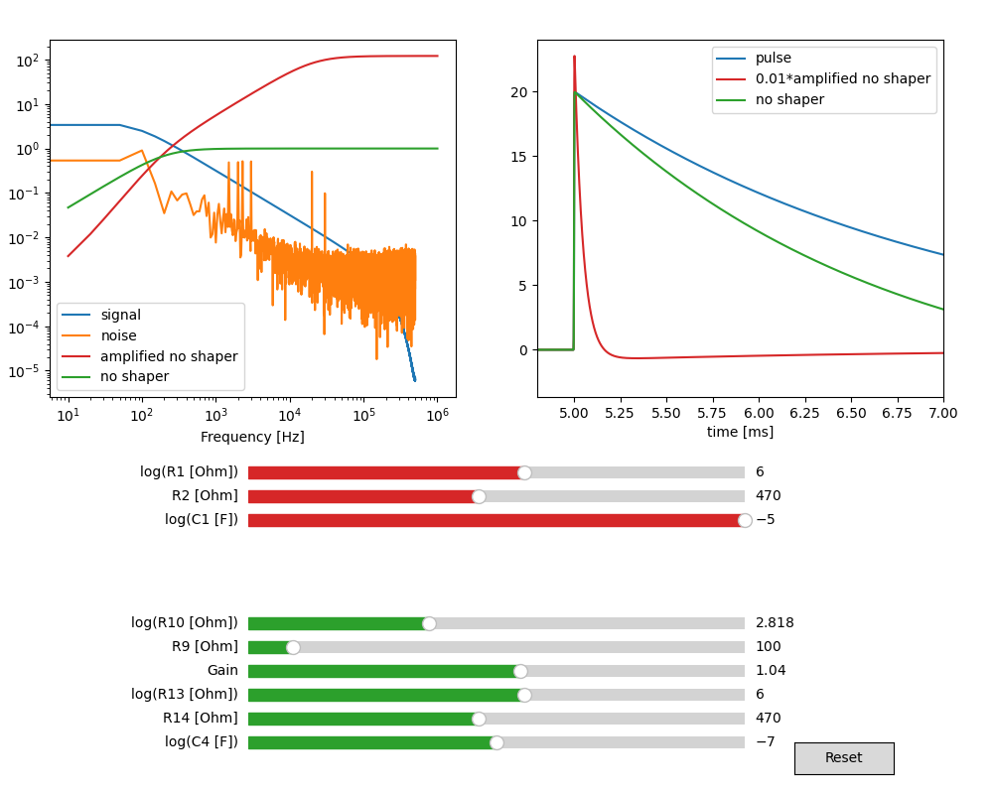
No shaper
Model
⚠️ Noise is arbitrary, inspired by shaped noise
Must be an error in values of ampli
Green shape is not surprising
Gain = 110 (measured: 135)
Gain of ampli only : ≈ 2200/20 = 110
15

Slide 16
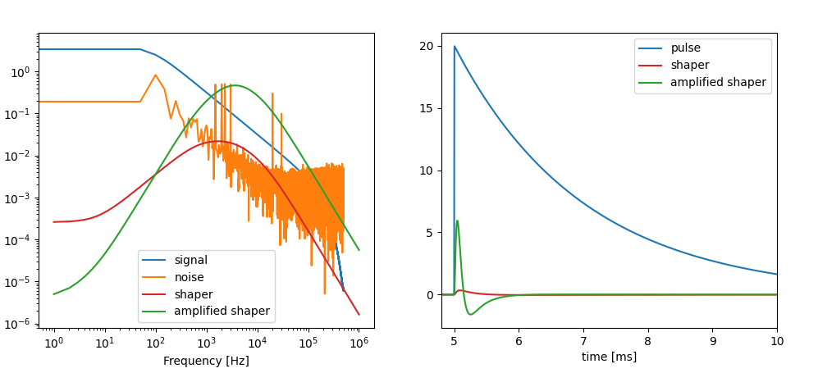
Longer decay shaper
Model
Only change mentioned: C2 and C3 = 100nF ⇒ change shaper time constant (2nd order low-pass)
⇒ freq1 = 931 rad/s = 296 Hz
⇒ freq2 = 454 rad/s = 72 Hz
time scale make sense
Undershoot also
Gain = 5/20 = 0.3 (measured: 4)
16

Slide 17
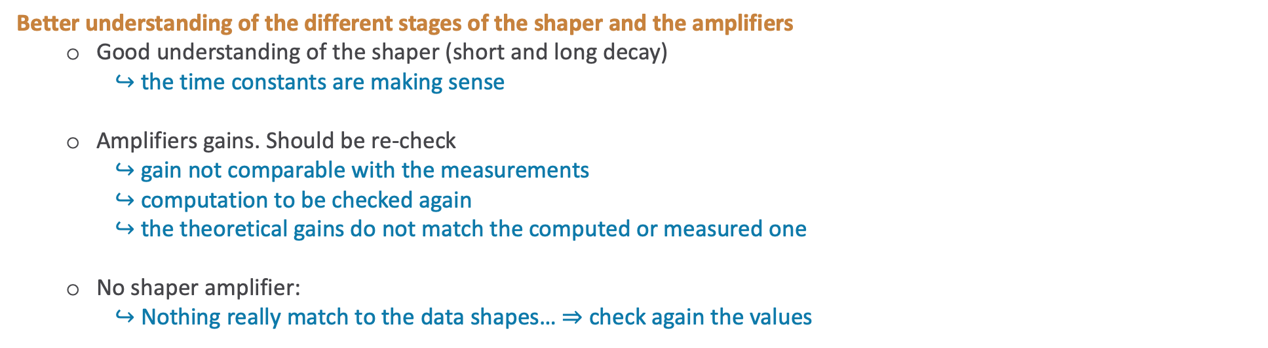
Conclusions
Better understanding of the different stages of the shaper and the amplifiers
Good understanding of the shaper (short and long decay)
$↪$ the time constants are making sense
Amplifiers gains. Should be re-check
$↪$ gain not comparable with the measurements
$↪$ computation to be checked again
$↪$ the theoretical gains do not match the computed or measured one
No shaper amplifier:
$↪$ Nothing really match to the data shapes… ⇒ check again the values
17

Slide 18
A few comments about run 5

Slide 19
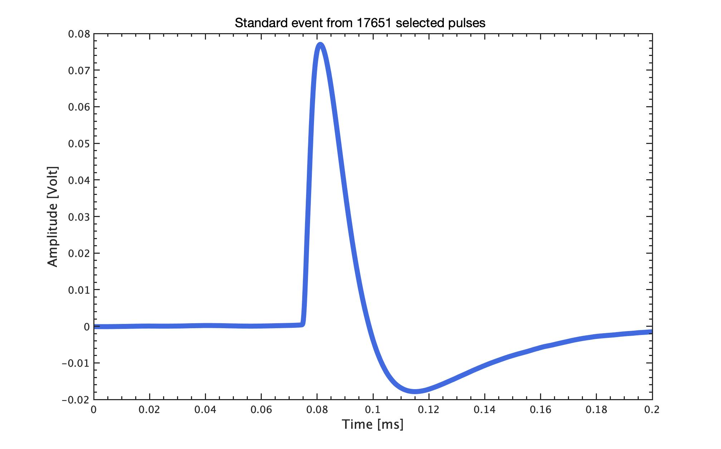
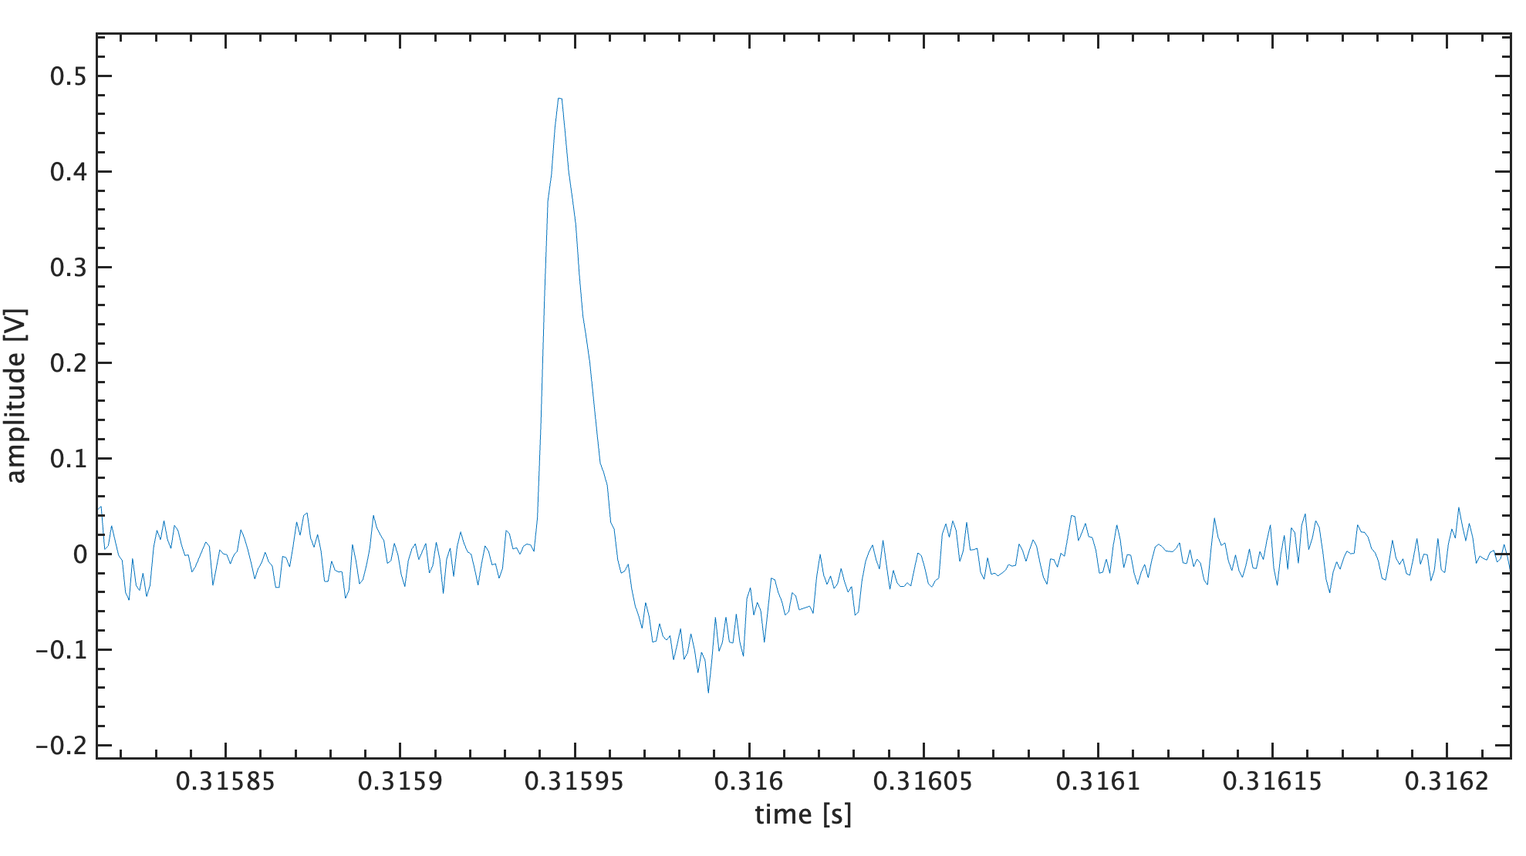
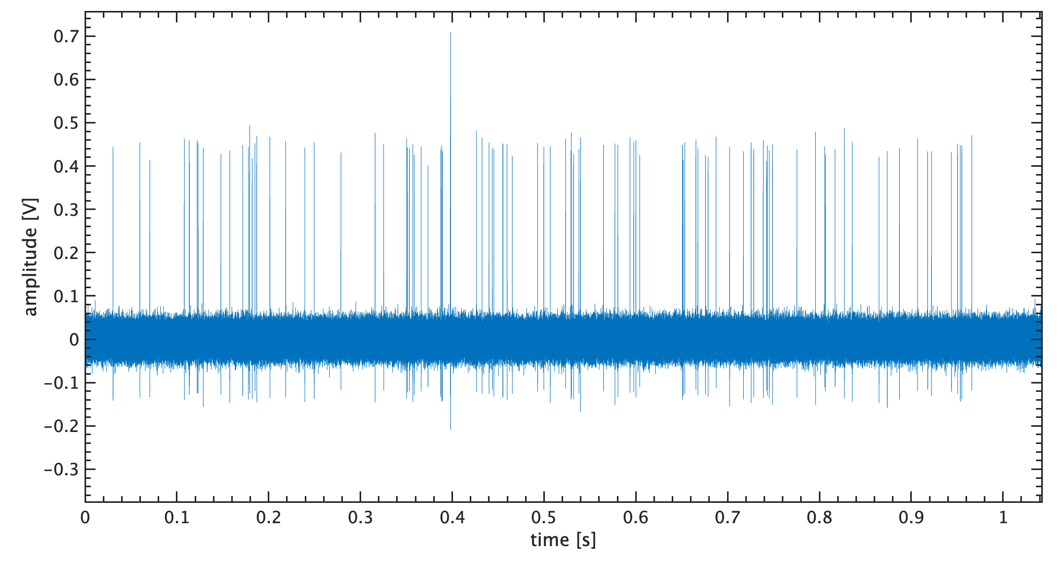
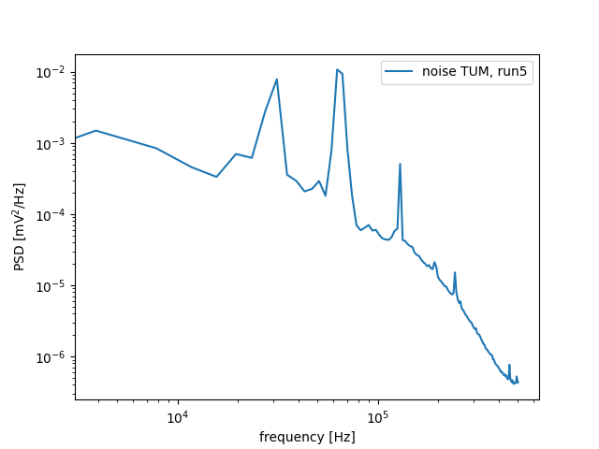
COV trigger efficiency
1- Generate a simulation of the COV data (VDAQ binary files) with CryoLab
simulated data stream with pulses of a given energy, at a given rate
Standard events ⇒ average of selected pulses in run 5 data
Noise power spectrum from run5
19

Slide 20
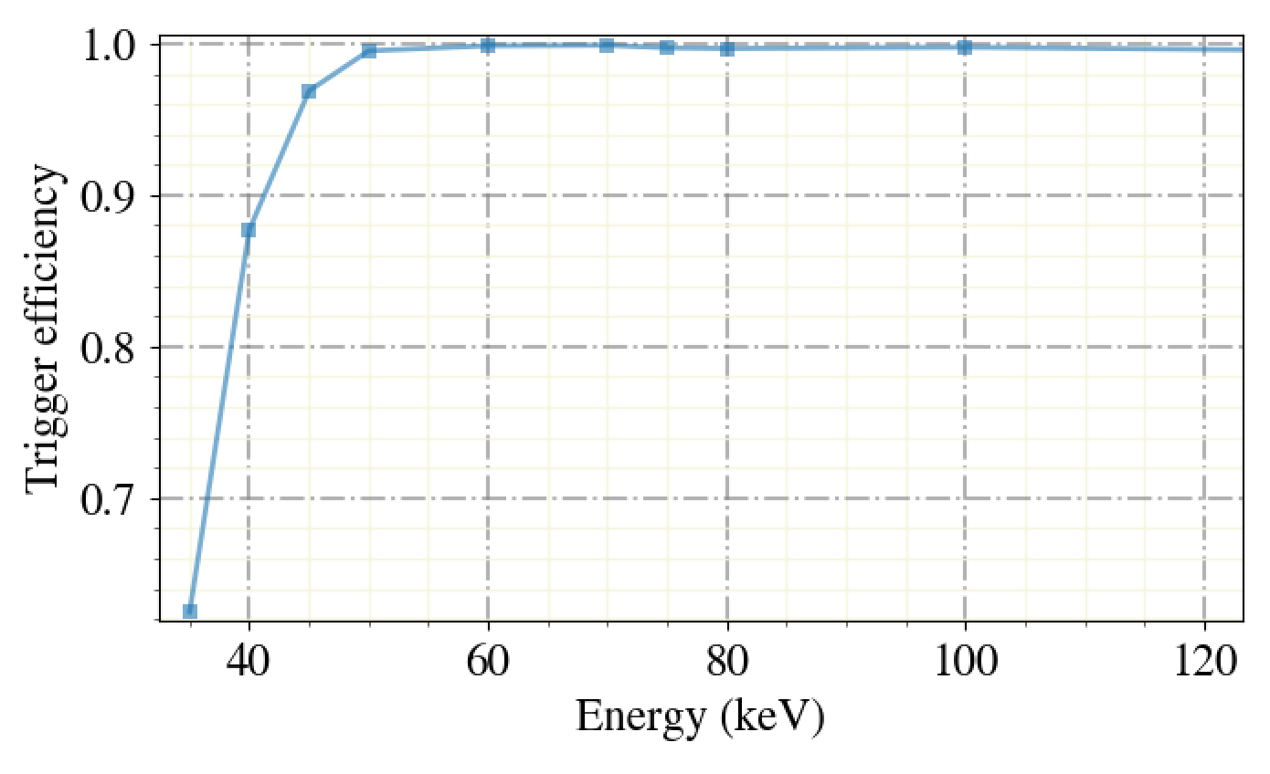
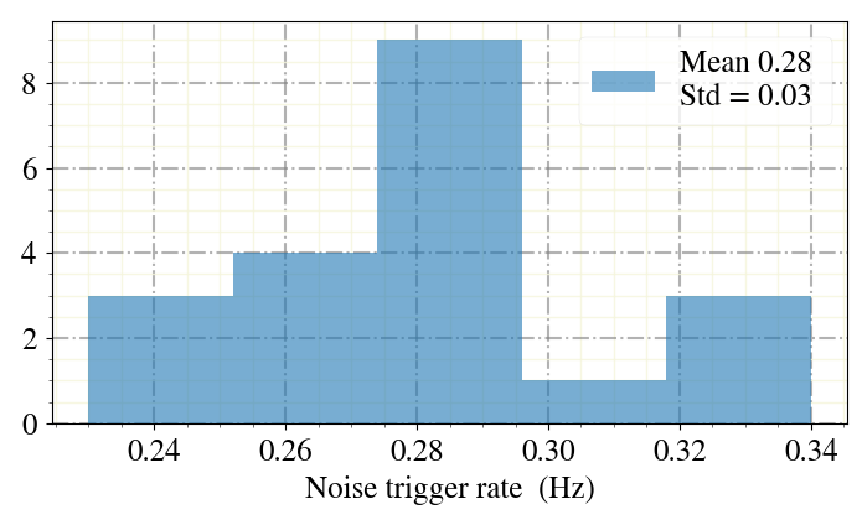
COV trigger efficiency
2- Trigger with CAIT and compute efficiency (Elisabetta)
Trigger efficiency with OF
But some noise triggers:
20

Slide 21
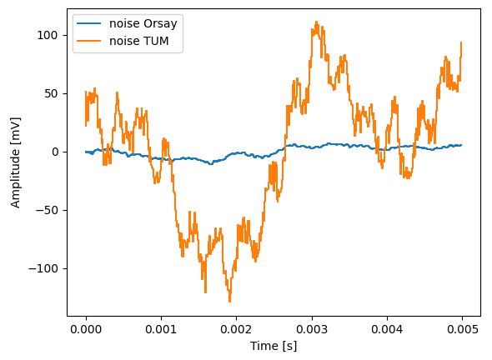
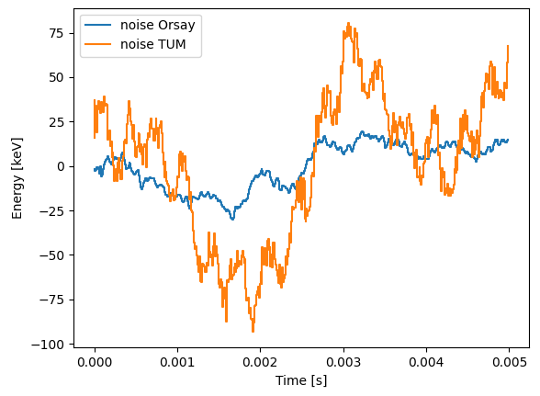
Run5 noise
⇒ scaling by (rough) gain
21

Slide 22
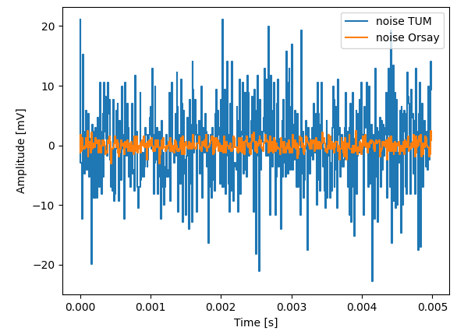
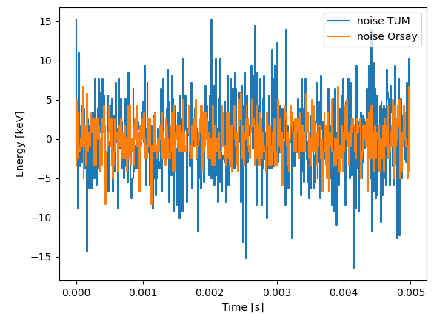
Run5 noise
Bin to bin method
⇒ scaling by (rough) gain
22

Slide 23
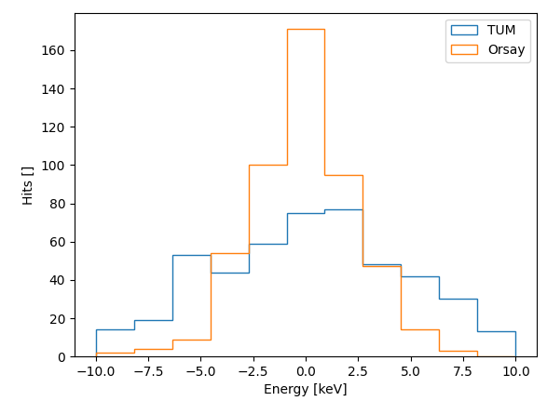
Run5 noise
Bin to bin method
⇒ scaling by (rough) gain
23

