Slide 1
Causal Inference Test and measurement error
A causal pathway of Q -> X -> Y was simulated, and an imperfect proxy for X (X_{p}) was used to test causal inference of X_{p} -> Y or Y -> X_{p}
The CIT statistic (y axis) leads to erroneous causal inference with even modest levels measurement error
Notes:
Background: The CIT makes causal inference about an exposure and an outcome by treating the exposure as a mediator between a SNP and the outcome. A major problem with mediation analysis is that measurement error in the mediator can fail to completely abrogate an association between SNP and outcome. Here we show how measurement error (measured as the correlation between the exposure X and its measured proxy X_{p}) influences the CIT’s test statistic for some known causal relationship.
Simulation details: Exposure and outcome were simulated with a SNP influencing each. Proxies were simulated either by introducing noise or by introducing bias, or by introducing both. Either bias or noise were sufficient to cause a reduction in correlation between true X and proxy X, and both bias and noise have the same effect on CIT, so only cor(X, X_{p}) is shown here. The CIT was performed on the simulated variables to test either the correct model of X -> Y using X’s SNP or the incorrect model of Y -> X using Y’s SNP. The p-value that CIT generates is plotted on the y axis

Slide 2
Bi-Directional MR
Measurement error does not lead to erroneous causal inference in MR
Notes:
The same simulation was performed as in the CIT simulation, i.e. X -> Y with a SNP for X and a SNP for Y. Bi-directional MR was performed 100 times for each point and the result was either that it made the correct inference, the incorrect inference, or was underpowered to make a conclusive answer. The proportion of the calls is on the y-axis, i.e. when cor(X,X_{p}) is > 0.25 the correct inference is almost always made, but when < 0.25 the power reduces and the rate of inconclusive answers increases.

Slide 3
Increased error with increased sample size
Notes:
The same CIT test with measurement error simulation, but with different sample sizes. Here only showing the p values for the incorrect causal model, and only when the measurement error is relatively small (x axis scale 0.75-1). The CIT makes estimates of incorrect causal inference with greater certainty as sample size increases.

Slide 4
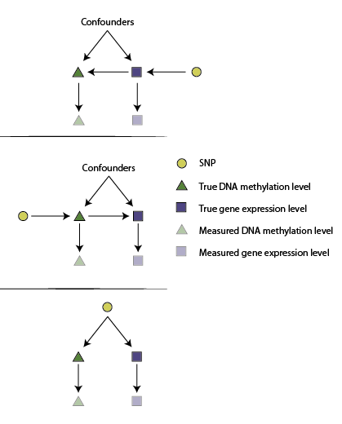
MR Steiger test
Under no measurement error we can try to specify the underlying model
R²(g,y) > R²(g,x)
R²(g,y) < R²(g,x)
Requires multiple
instruments to
distinguish from the
above
What proportion of possible measurement error values would support the empirical result?
Notes:
Left – possible models, Steiger test just tests if the Rsq_gx is larger than Rsq_gy, and if it is then that is evidence of the SNP influencing x first.
Right – important to evaluate how sensitive this is to measurement error. The proportion of the blue surface above the red plane represents measurement error values in X and Y that would lead to the empirical result being wrong. The blue surface below shows the measurement error values which would not give the wrong direction.

