Slide 1

Canadian Bioinformatics Workshops
www.bioinformatics.ca

Slide 2

In collaboration with
Cold Spring Harbor Laboratory
&
New York Genome Center

Slide 3

Module #: Title of Module
3

Slide 4
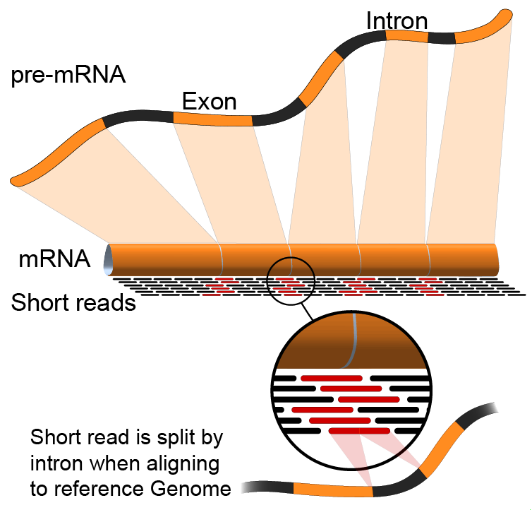
Module 2 RNA-seq alignment and visualization (tutorial)
Malachi Griffith & Obi Griffith
High-throughput Biology: From Sequence to Networks
April 27-May 3, 2015

Slide 5
Learning Objectives of Tutorial
Run Bowtie2/TopHat2 (or STAR) with parameters suitable for gene expression analysis
Use samtools to demonstrate the features of the SAM/BAM format and basic manipulation of these alignment files (view, sort, index, filter)
Use IGV to visualize RNA-seq alignments, view a variant position, etc.
Determine BAM-read counts at a variant position
Use samtools flagstat, samstat, FastQC to assess quality of alignments

Slide 6
3-i. Align reads with tophat
Align all reads in the 6 libraries of the test data
6 libraries with two files each (one for each read1 and read2 of the paired-end reads)
Use tophat for the alignment
Supply the gene GTF file obtained in step 3
Supply the bowtie indexed genome obtained in step 4
The ‘-G’ option tells tophat to look for the exon-exon junctions of known transcripts. It will still look for novel exon-exon junctions as well
Since there are 6 libraries in the test data set, 6 alignment commands are run
On a test system, each of these alignments took ~1.5 minutes using 8 CPUs
Each alignment job outputs a SAM/BAM file
http://samtools.sourceforge.net/SAM1.pdf

Slide 7
3-i. Align reads with STAR
Again, align all reads in the 6 libraries of the test data, now with STAR
Supply the same gene GTF file obtained in step 3
Supply the STAR indexed genome obtained in step 4
The ‘-outSAMstrandField intronMotif’is needed so that STAR produces an alignment compatible with cufflinks
How long did the alignment take compared to tophat?
What additional steps are needed?

Slide 8
3-ii. Post-alignment visualization
Create indexed versions of bam files
These are needed by IGV for efficient loading of alignments
Visualize spliced alignments
Identify exon-exon junction supporting reads
Identify differentially expressed genes
Compare tophat and STAR alignments
Try to find variant positions
Create a pileup from bam file
Determine read counts at a specific position

Slide 9
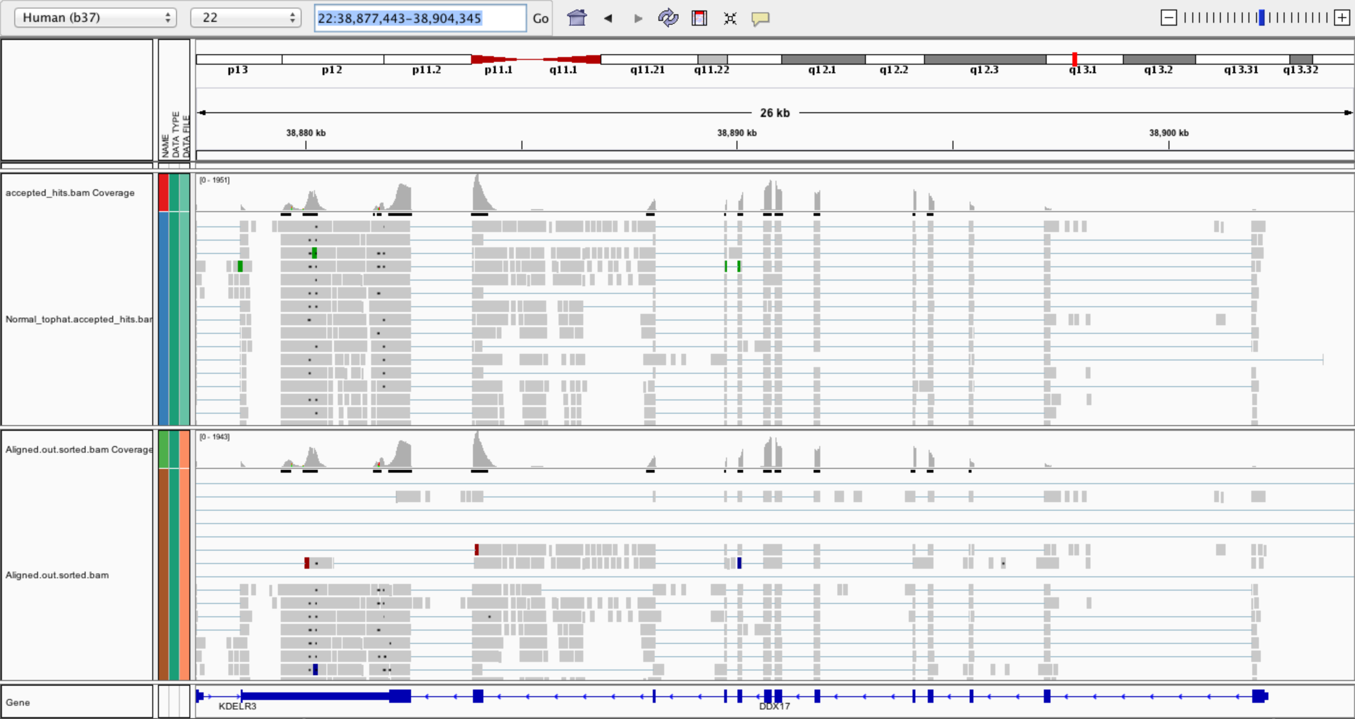
3-ii. Post-alignment visualization (IGV)

Slide 10
3-iii. Post-alignment QC
Use 'samtools view' to see the format of a SAM/BAM alignment file
Use ‘FLAGs’ to filter out certain kinds of alignments
Use 'samtools flagstat' to get a basic summary of an alignment
Run samstat on Tumor/Normal BAMs and review the resulting report in your browser
Use FastQC to perform basic QC of your alignments

Slide 11
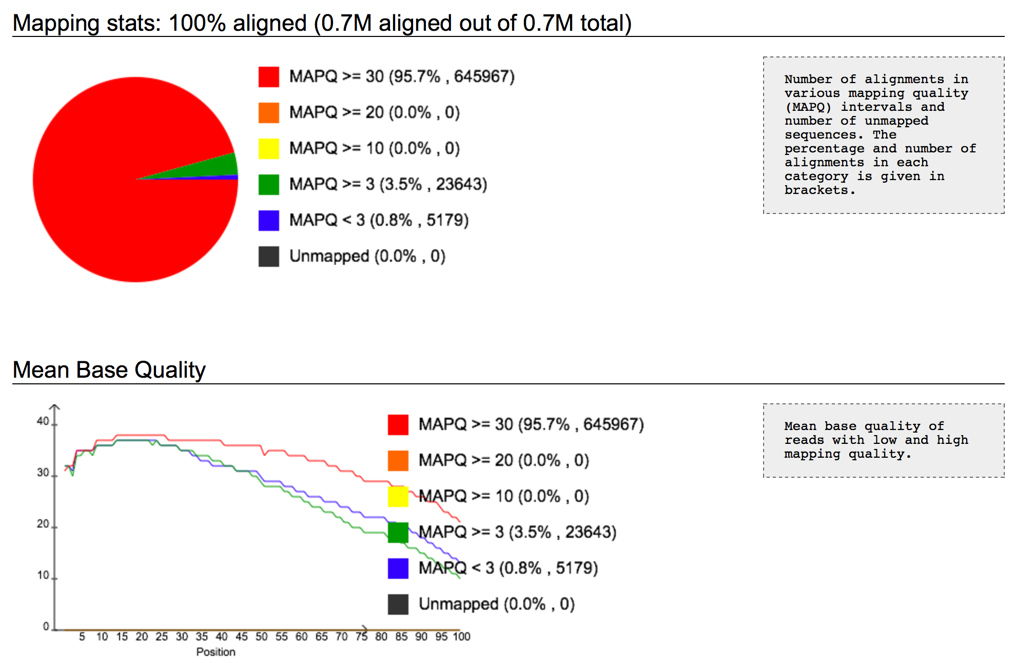
3-iii. Post-alignment QC (samstat)

Slide 12
We are on a Coffee Break & Networking Session

