Slide 1
Canadian Bioinformatics Workshops
www.bioinformatics.ca

Slide 2

Module #: Title of Module
2

Slide 3
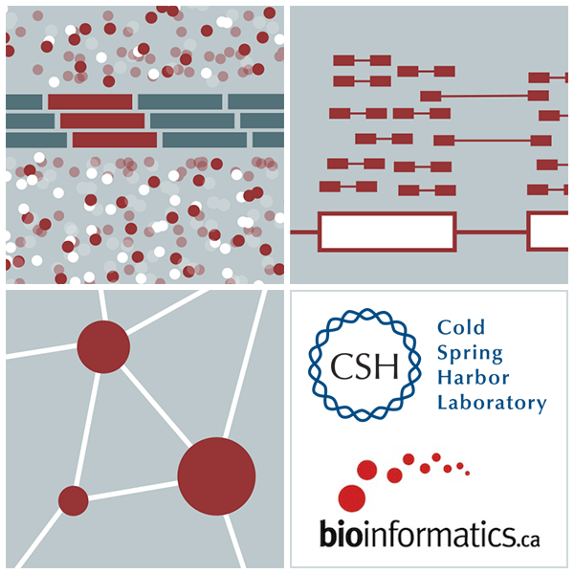

Module X Module Name
Malachi Griffith, Obi Griffith, Fouad Yousif
High-Throughput Biology: From Sequence to Networks
March 20-26, 2017

Slide 4
Learning Objectives of Module
These should be focused on what the student will be able to do at the end of the workshop
Be able to distinguish between…
Be able to select the correct parameters to…
Be able to analyze…
Be able to input raw data and output …

Slide 5
Notes:
Consequtive basepairs

Slide 7
We are on a Coffee Break & Networking Session

