Slide 1
Canadian Bioinformatics Workshops
www.bioinformatics.ca

Slide 2
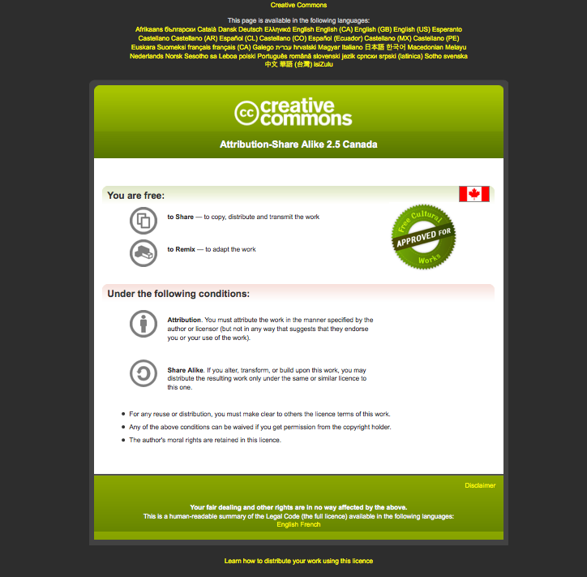
Module #: Title of Module
2

Slide 3
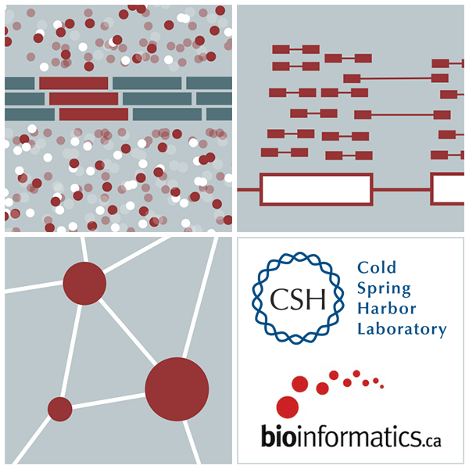

Introduction to Genome Analysis Platforms
Malachi Griffith, Obi Griffith, Fouad Yousif
High-Throughput Biology: From Sequence to Networks
March 20-26, 2017

Slide 4
What is a genome analysis ‘platform’?
Means different things to different people…
Lost of jargon (and buzzwords)
Hardware
e.g. ‘Dell Genomic Data Analysis Platform’
Pipelines
Cloud computing
‘Private clouds’
‘Public clouds’ - Amazon AWS, Google Cloud, digital ocean, etc.
Virtualization and virtual machines
VirtualBox (vagrant), OpenStack, VMWare
Workflow management systems and workflow languages
Software development kits (SDKs)
Application programming interfaces (APIs)
Distributed storage and processing
Job schedulers. e.g. pbs, lsf, sge, openlava,

Slide 5
List of existing genome analysis platforms
https://docs.google.com/spreadsheets/d/1o8iYwYUy0V7IECmu21Und3XALwQihioj23WGv-w0itk/pubhtml
Genome Modeling System (GMS), Galaxy, bcbio-nextgen, Omics Pipe, Illumina BaseSpace, BINA Genomic Analysis System, SeqWare, DNA Nexus Platform, gkno, NGSANE, Appistry's Ayrris, GATK's Queue, Curoverse's Arvados, CGA's Firehose, Seven Bridges Genomics, MIT STAR, GenomOncology, ga4gh, IBM's PowerGene Orchestrator, etc.

Slide 6
What is a job scheduler?
A job scheduler is a computer application for controlling unattended background program execution (commonly called batch processing).
For example, in genomics data processing, a researcher might use a job scheduler to submit 100 HISAT alignment jobs to a cluster of computers at their institute’s data center
Notes:
http://en.wikipedia.org/wiki/Job_scheduler

Slide 7
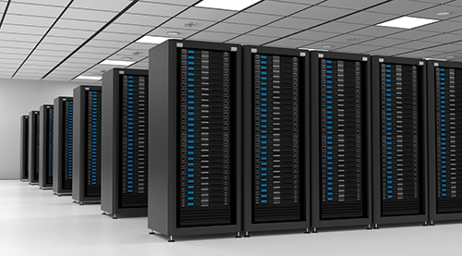
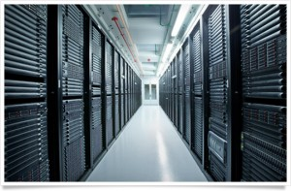
What is cloud computing?
The practice of using a network of remote servers hosted on the Internet to store, manage, and process data, rather than a local server or a personal computer.
For example, instead of using a local server or buying 25 computers with 8 CPU’s each, 70Gg of RAM, etc. for the RNA-seq course we rented these computers on the Amazon ‘Cloud’. All analysis for the course actually happened at a massive data center in Northern Virginia
Notes:
http://en.wikipedia.org/wiki/Cloud_computing

Slide 8
What is a virtual machine?
A virtual machine (VM) is an operating system OS or application environment that is installed on software which imitates dedicated hardware. The end user has the same experience on a virtual machine as they would have on dedicated hardware.
In the context of genome analysis pipelines a virtual machine may sometimes be used to allow researchers to share and distribute very complex computing environments (may dependencies) that are difficult to set up.
Notes:
http://en.wikipedia.org/wiki/Virtual_machine

Slide 9
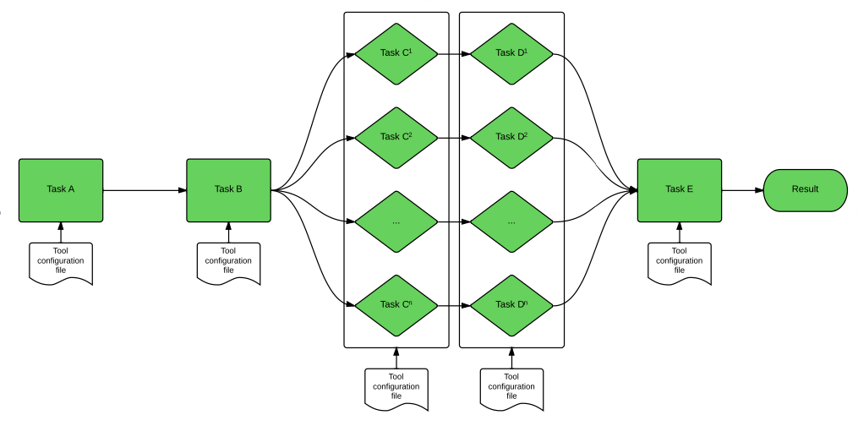
What is a workflow management system?
A workflow management system (WfMS) is a software system for the execution of a defined sequence of tasks, arranged as a workflow.
For example, the RNA-seq analysis has many steps with interconnected dependencies
TopHat alignment of several lanes of data needs to happens before they can all be merged into a final BAM file, and merging needs to happen before indexing of the BAM, and so on.
Some steps can happen in parallel, other in series. Workflow systems help handle these dependencies
Notes:
http://en.wikipedia.org/wiki/Workflow_management_system

Slide 10
What is a workflow language?
A workflow language is “a specification for describing analysis workflows and tools that are portable and scalable across a variety of software and hardware environments, from workstations to cluster, cloud, and high performance computing (HPC) environments”.
Two main workflow language being used for NGS:
Common Workflow Language (CWL)
Workflow Description Language (WDL)

Slide 11
What is a software development kit (SDK)?
A software development kit (SDK) is a set of software development tools that facilitates the creation of applications for a certain software framework
E.g. DNA Nexus Platforms provides software development kit with support for several programming languages to help you build pipelines efficiently in their system
Notes:
http://en.wikipedia.org/wiki/Software_development_kit

Slide 12
What is a “container” (e.g. Docker container?)
“Containers wrap up a piece of software in a complete filesystem that contains everything it needs to run: code, runtime, system tools, system libraries – anything you can install on a server. This guarantees that it will always run the same, regardless of the environment it is running in”
“Docker provides an additional layer of abstraction and automation of operating-system-level virtualization on Linux. Docker uses the resource isolation features of the Linux kernel to allow independent "containers" to run within a single Linux instance, avoiding the overhead of starting and maintaining virtual machines.”

Slide 13
What is an application programming interface (API)
An API is a set of routines, protocols, and tools for building software applications. An API expresses a software component in terms of its operations, inputs, outputs, and underlying types. An API defines functionalities that are independent of their respective implementations, which allows definitions and implementations to vary without compromising each other.
Notes:
http://en.wikipedia.org/wiki/Application_programming_interface

Slide 14
Examples
Assuming you have some NGS data, how should you analyze it?
Depends where you are on the informatics spectrum. Do you want to:
Build a completely novel process, a custom pipeline, develop algorithms, write software, etc.
Maximum flexibility. Performance and scalability are determined by how well you engineer it.
Build on top of someone else genome analysis platform
Don’t have to start from scratch but still have a lot of flexibility.
e.g. GMS, Arvados, DNA Nexus, bcbio-nextgen, Gkno, etc.
Upload data in web browser, use graphical user interface
Sacrifices flexibility for ease of use
Galaxy, Illumina BaseSpace

Slide 15
Galaxy
http://galaxyproject.org/
Open Source academic project.
Example RNA-seq workflow
https://usegalaxy.org/u/mwolfien/w/rnaseq-wolfien-pipeline
A web based interface that allows you to run existing workflows or create custom analyses by combining tools in the Galaxy ‘toolshed’

Slide 16
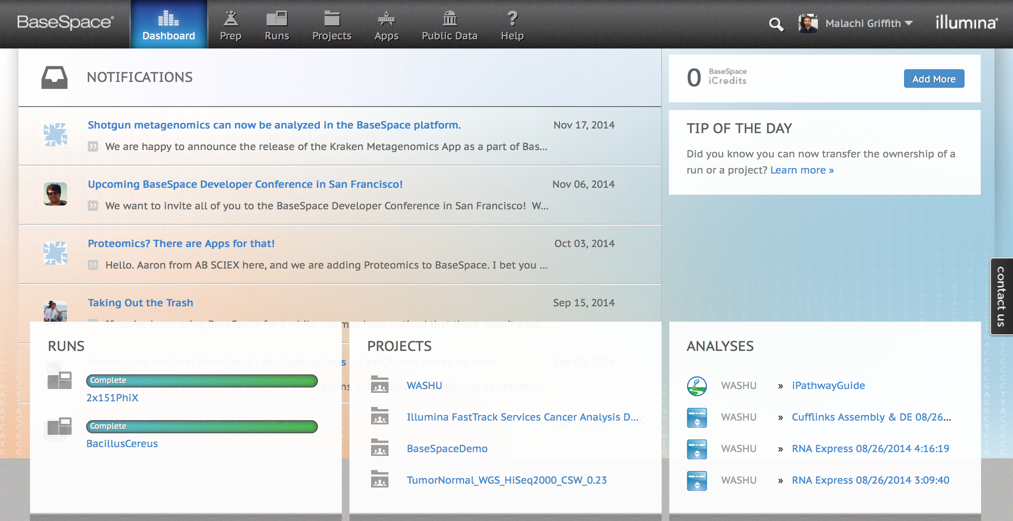
Illumina BaseSpace
Use integrated ‘apps’ and automated pipelines.
Graphical interface
https://basespace.illumina.com

Slide 17
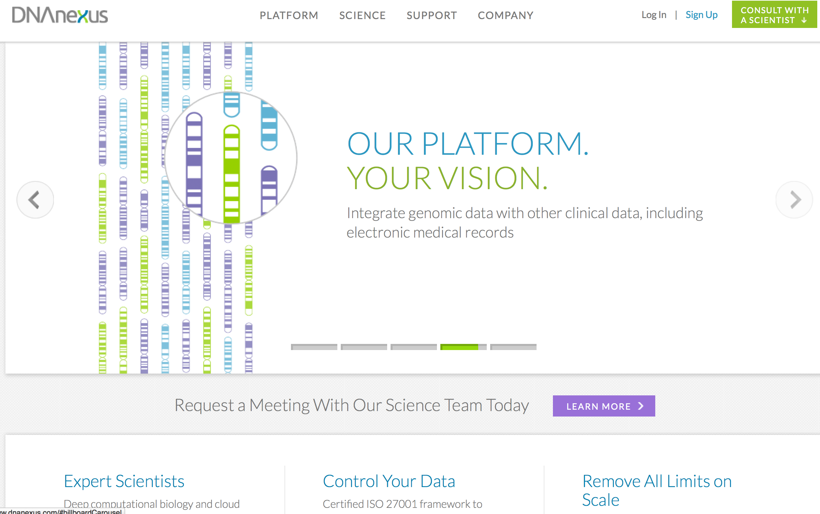
DNA Nexus Platform
Build your own pipeline or use an existing one
DNA Nexus handles cloud deployment, etc. for you
https://www.dnanexus.com/

Slide 18
Other pipeline development platforms to build on top of
Gkno
http://gkno.me/
Genome Modeling System (GMS)
https://github.com/genome/gms
Arvados
https://arvados.org/
Bcbio-nextgen
https://bcbio-nextgen.readthedocs.org/en/latest/
OmicsPipe
http://sulab.org/tools/omics-pipe/
NGSANE
https://github.com/BauerLab/ngsane

Slide 19
The Global Alliance for Genomics Health (ga4gh)
An international coalition, formed to enable the sharing of genomic and clinical data.
Work on data models and APIs for Genomic data.
Not yet entirely clear what is available to be used by end users beyond the ‘beacon’ project:
http://genomicsandhealth.org/
http://ga4gh.org/#/
https://github.com/ga4gh
http://ga4gh.org/#/beacon

Slide 20
The NCI Cancer Genomics Cloud (CGC) Program
“Bringing data and computation together to create knowledge that accelerates cancer research and enables precision medicine”. NCI Cloud Initiative.
Make large cancer data sets available (e.g. TCGA and TARGET) and allow you to analyze these data on the cloud without downloading yourself
Credits to perform analysis are available: Cancer Cloud Credits
Three CGC implementations available
ISB Cancer Genomics Cloud
Broad FireCloud
Seven Bridges Cancer Genomics Cloud

Slide 21
The NIH Commons
The NIH Commons
“The Commons is a shared virtual space where scientists can work with the digital objects of biomedical research, i.e. it is a system that will allow investigators to find, manage, share, use and reuse data, software, metadata and workflows.”
The Commons Credit Portal
Used to apply for compute credits
For example, to perform analysis on approved vendors such as Amazon, IBM, Microsoft or Google clouds
Need to provide scientific proposal (analysis plan) and detailed budget for compute costs

Slide 22
We are on a Coffee Break & Networking Session

