Slide 1
Canadian Bioinformatics Workshops
www.bioinformatics.ca

Slide 2

Module #: Title of Module
2

Slide 3
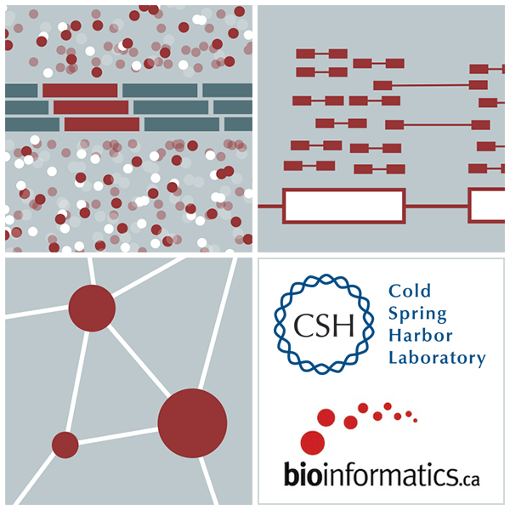

RNA-Seq Module 1 Introduction to RNA sequencing (tutorial)
Malachi Griffith, Obi Griffith, Fouad Yousif
High-Throughput Biology: From Sequence to Networks
March 20-26, 2017

Slide 4
Learning Objectives of Tutorial
Install commonly used RNA-seq tools (Samtools, bam-readcount, HISAT2, StringTie, gffcompare, htseq-count, FastQC, picard-tools, Flexbar, R, Bioconductor, Ballgown, edgeR, …)
Obtain a reference genome
Obtain gene/transcript annotations
Understand GTF file format
Index reference genome files for use with aligners
Obtain and explore raw sequence data
Understand fasta/fastq format

Slide 5
The most common problems encountered while working on the tutorials
Type short commands carefully if you like, but in order to get through all the steps smoothly, it is safer to copy and paste from the tutorial files
Copy/Paste errors
Learn the short cuts for copying/pasting on your system and use them (e.g. <command><c> & <command><v> on Mac)
Make sure you copy the entire command. Watch out for commands that span across multiple lines
Being in the wrong directory at the wrong time
The simplest way to avoid this is only change directories as instructed
If you do change directories to look around, make sure you go back before continuing with commands
Not having the $RNA_HOME environment variable set
Make sure you check this when logging in:
echo $RNA_HOME
If it is not defined do this:
export RNA_HOME=~/workspace/rnaseq
Then add this to you .bashrc file so that you don’t have to worry about it again

Slide 6
Introduction
This presentation provides a brief description of tutorial steps
The wiki contains more complete instructions
Lines beginning with “#” are comments
All other lines are commands that will be pasted and executed from a linux terminal or R tutorial
Each command is annotated with comments except that basic familiarity with linux is assumed
e.g. You should know that ‘mkdir’ means to ‘make a directory, ‘cd’ means to ‘change directory’, etc.
Some reference materials for linux can be found here:
http://files.fosswire.com/2007/08/fwunixref.pdf
http://vic.gedris.org/Manual-ShellIntro/1.2/ShellIntro.pdf
www.nettech.in/course/Basic%20Commands.pdf

Slide 7
1-i. Installation
Installation instructions are provided for:
Samtools
http://www.htslib.org/download/
bam-readcount
https://github.com/genome/bam-readcount
HISAT2
https://ccb.jhu.edu/software/hisat2/index.shtml
StringTie
https://ccb.jhu.edu/software/stringtie/
Gffcompare
http://ccb.jhu.edu/software/stringtie/gff.shtml
htseq-count
https://pypi.python.org/pypi/HTSeq
FastQC
http://www.bioinformatics.babraham.ac.uk/projects/fastqc/
picard-tools
https://github.com/broadinstitute/picard
Flexbar
https://github.com/seqan/flexbar
R
https://www.r-project.org/
Bioconductor
https://www.bioconductor.org/install/
Ballgown (Bioconductor package)
http://bioconductor.org/packages/release/bioc/html/ballgown.html
edgeR (Bioconductor package)
https://bioconductor.org/packages/release/bioc/html/edgeR.html

Slide 8
1-ii. Obtain reference genome
All reference files are obtained from Ensembl
ftp://ftp.ensembl.org/pub/release-86/fasta/homo_sapiens/dna/
This step downloads reference human genome files from Ensembl
The GRCh38 build of the human genome is used
This is the latest version of the human reference
For the tutorial, a single chromosome is used (chr. 22)
The reason for this is to reduce run time for the tutorial
Instructions for downloading all chromosomes are provided

Slide 9
1-iii. Obtain known transcript annotations
All annotation files are obtained from Ensembl
http://useast.ensembl.org/info/data/ftp/index.html
There are many other ways to obtain gene annotation files. For example:
UCSC Genome Browser, Ensembl API, BioMart, Entrez, Galaxy, etc. could also be used
You will download GTF files describing human transcripts (exon coordinates, gene ids, gene symbols, etc.)
Descriptions of the GTF file format can be found here:
http://genome.ucsc.edu/FAQ/FAQformat.html#format4

Slide 10
1-iv. Create Indexed reference genome
Before sequences can be mapped to the genome, it must be ‘indexed’ in a way that is compatible with the aligner being used
Since we are using HISAT2 for alignment, we will need an index built for that purpose
Other RNA-seq aligners will have their own indexing utility
E.g. TopHat and STAR.
Do not use an index created for another aligner

Slide 11
1-v. Obtain RNA-seq data
For purposes of the tutorial, the test data has been pre-filtered
Identified reads that appear to match transcripts on a single chromosome
The test data corresponds to two RNA sources
The Universal Human Reference (UHR) and Human Brain Reference (HBR)
Each sample also included one of two ERCC RNA “spike-in” mixes (Mix1 or Mix2)
Each RNA was source was sequenced in triplicate to create six independent Illumina sequence libraries (‘UHR_Rep1_Mix1’, ‘UHR_Rep2_Mix1’, ‘UHR_Rep3_Mix1’, ‘HBR_Rep1_Mix2’, ’HBR_Rep2_Mix2’, and ’HBR_Rep3_Mix2’)
The input data is provided in ‘fastq’ format:
http://en.wikipedia.org/wiki/FASTQ_format

Slide 12
1-v. Obtain RNA-seq data (cont’d)
Universal Human Reference (UHR):
A pool of 10 human cell lines. This sample was purchased from Strategene (Agilent Technologies)
http://www.genomics.agilent.com/en/References-Controls/Universal-Reference-RNAs/?cid=AG-PT-172&tabId=AG-PR-1217
Human Brain Reference (HBR):
A pool of brain tissue from multiple brain regions from multiple human donors. This sample was purchased from Ambion (Life Technologies).
http://www.lifetechnologies.com/order/catalog/product/AM6050
External RNA Reference Consortium (ERCC):
ERCC reference RNA spike-ins purchased from Ambion (Life Technologies).
http://www.lifetechnologies.com/order/catalog/product/4456739
The UHR samples used ERCC Mix1. The HBR samples used ERCC Mix2.
In this tutorial we will compare the three UHR libraries vs three HBR libraries (6 samples in total)
Notes:
#Each library is marked as either cDNA-1 or cDNA-2 and either lib1 or lib2
#cDNA-1 = total RNA (total)
#cDNA-2 = polyA selected RNA (polyA)
#lib1 = standard RNAseq (nocap)
#lib2 = cDNA capture RNAseq where library was enriched using probes targeting the exome (cap).

Slide 13
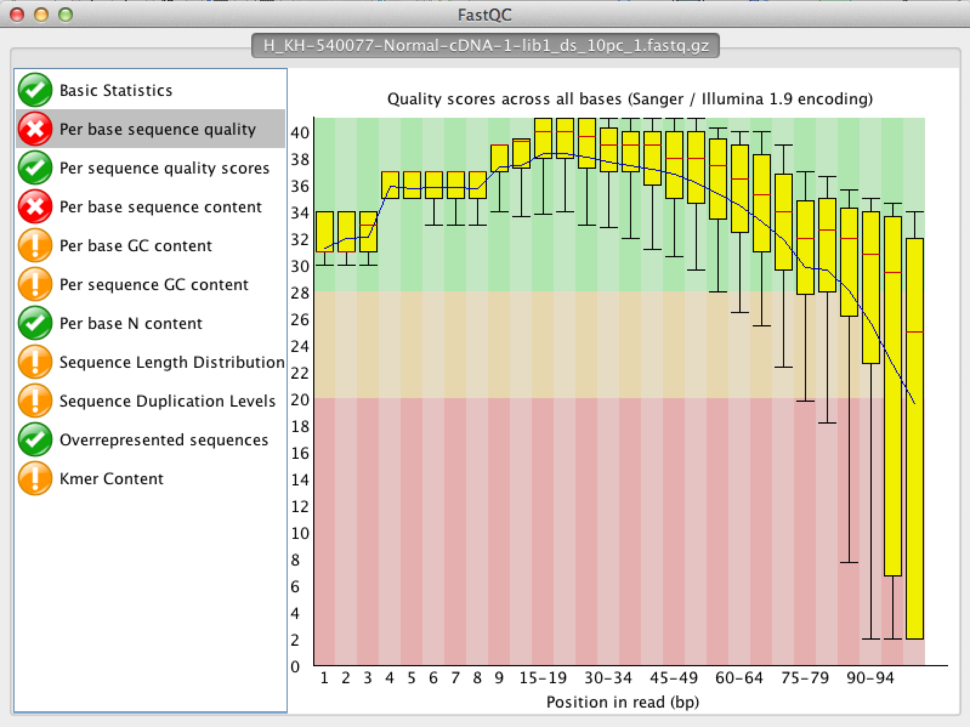
1-vi. Pre-Alignment QC with FastQC

Slide 14
We are on a Coffee Break & Networking Session

