Slide 1
Canadian Bioinformatics Workshops
www.bioinformatics.ca

Slide 2

Module #: Title of Module
2

Slide 3
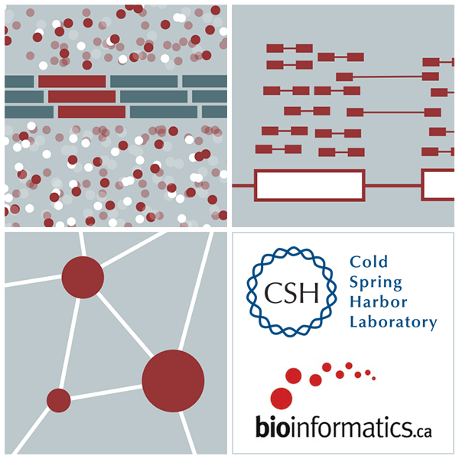

RNA-Seq Module 2 Alignment and Visualization (tutorial)
Malachi Griffith, Obi Griffith, Fouad Yousif
High-Throughput Biology: From Sequence to Networks
March 20-26, 2017

Slide 4
Learning Objectives of Tutorial
Run HISAT2 with parameters suitable for gene expression analysis
Use samtools to demonstrate the features of the SAM/BAM format and basic manipulation of these alignment files (view, sort, index, filter)
Use IGV to visualize RNA-seq alignments, view a variant position, etc.
Determine BAM-read counts at a variant position
Use samtools flagstat, samstat, FastQC to assess quality of alignments

Slide 5
2-i. Adaptor trim
Use Flexbar to trim sequence adapter from the read FASTQ files
The output of this step will be trimmed FASTQ files for each data set.
Compare the FastQC reports for fastq files before and after trimming
http://sourceforge.net/projects/flexbar/

Slide 6
2-ii. Align reads with HISAT2
Align all reads in the 6 libraries of the test data
6 libraries with two files each (one for each read1 and read2 of the paired-end reads)
Use HISAT2 for the alignment
Supply the bowtie indexed genome obtained in section 1-iv
The ‘-dta’ option tells HISAT2 to report alignments tailored for transcript assemblers
Since there are 6 libraries in the test data set, 6 alignment commands are run
On a test system, each of these alignments took ~4 seconds using 8 CPUs
Each alignment job outputs a SAM/BAM file
http://samtools.sourceforge.net/SAM1.pdf

Slide 7
2-iii. Post-alignment visualization
Create indexed versions of bam files
These are needed by IGV for efficient loading of alignments
Visualize spliced alignments
Identify exon-exon junction supporting reads
Identify differentially expressed genes
Try to find variant positions
Create a pileup from bam file
Determine read counts at a specific position

Slide 8
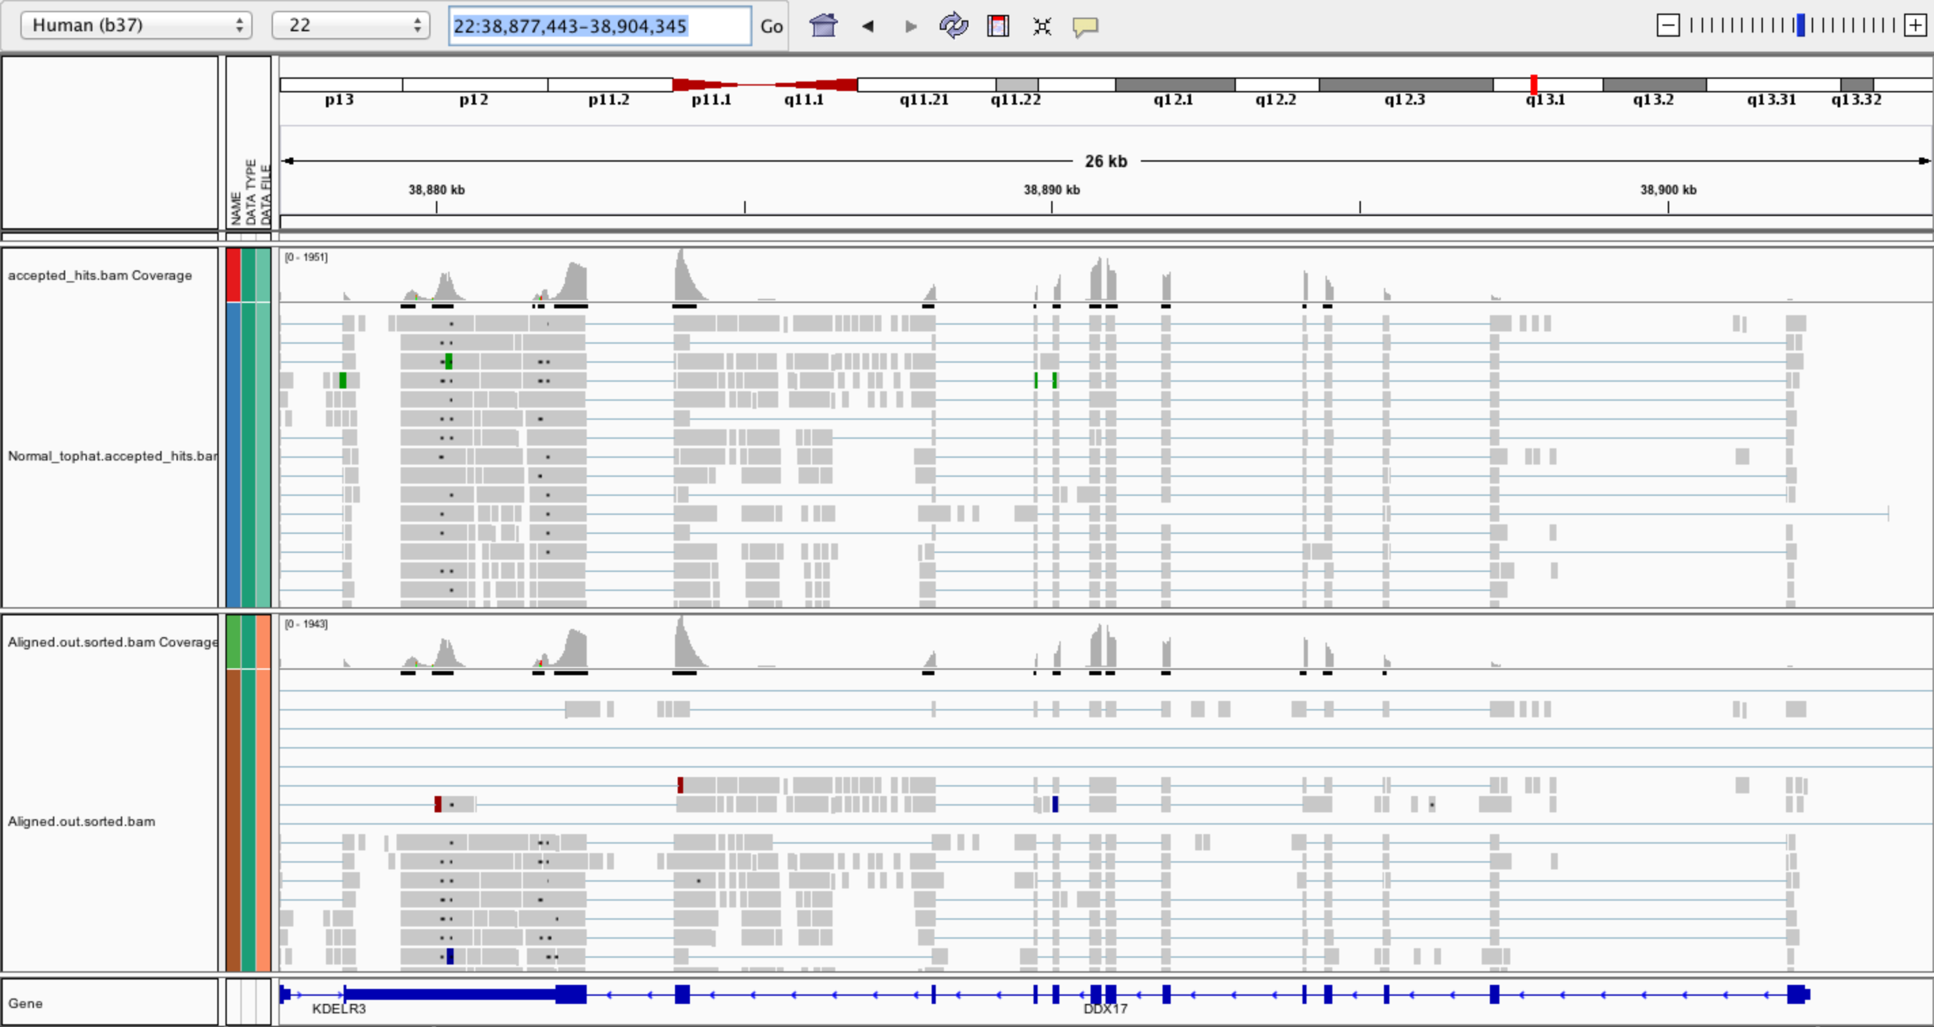
2-iii. Post-alignment visualization (IGV)

Slide 9
2-iv. Post-alignment QC
Use 'samtools view' to see the format of a SAM/BAM alignment file
Use ‘FLAGs’ to filter out certain kinds of alignments
Use 'samtools flagstat' to get a basic summary of an alignment
Use FastQC to perform basic QC of your alignments
Optional: explore RSeQC for alignment QC

Slide 10
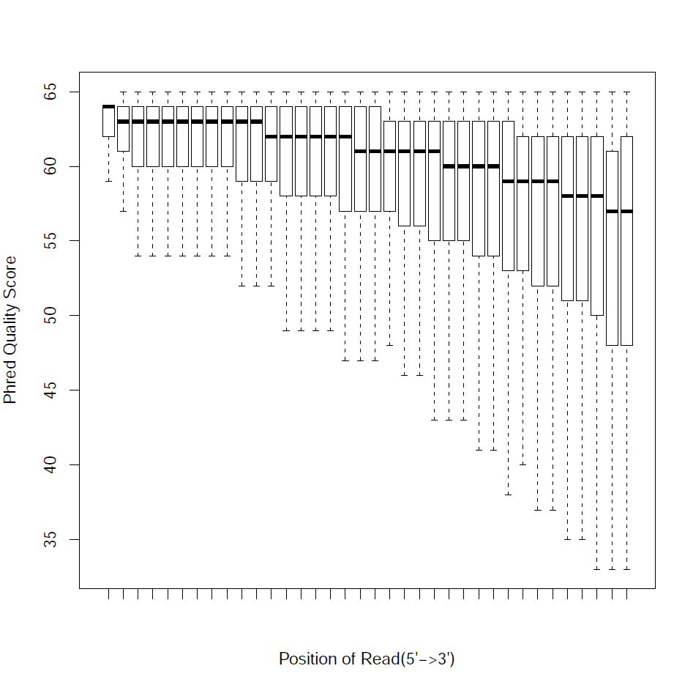
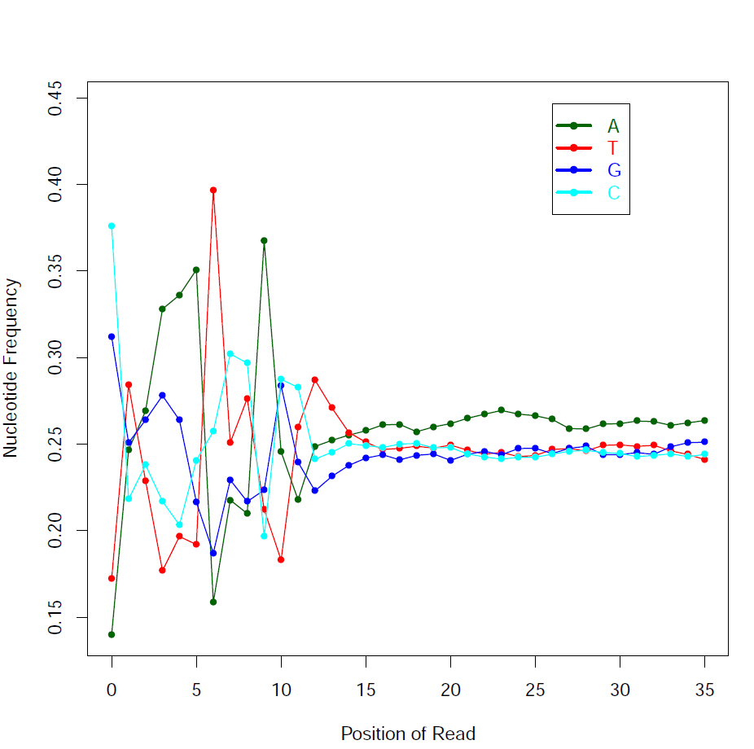
2-iv. Post-alignment QC (RSeQC)

Slide 11
We are on a Coffee Break & Networking Session

