Slide 1
Canadian Bioinformatics Workshops
www.bioinformatics.ca

Slide 2

Module #: Title of Module
2

Slide 3
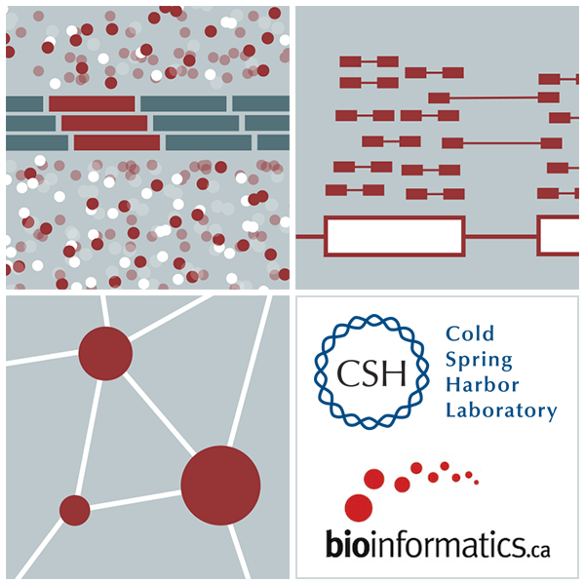

RNA-Seq Module 3 Expression and Differential Expression (lecture)
Malachi Griffith, Obi Griffith, Fouad Yousif
High-Throughput Biology: From Sequence to Networks
March 20-26, 2017

Slide 4
Learning Objectives of Tutorial
Generate gene/transcript expression estimates with StringTie
Perform differential expression analysis with Ballgown
Summarize and visualize results
Ballgown
Old school R methods

Slide 5
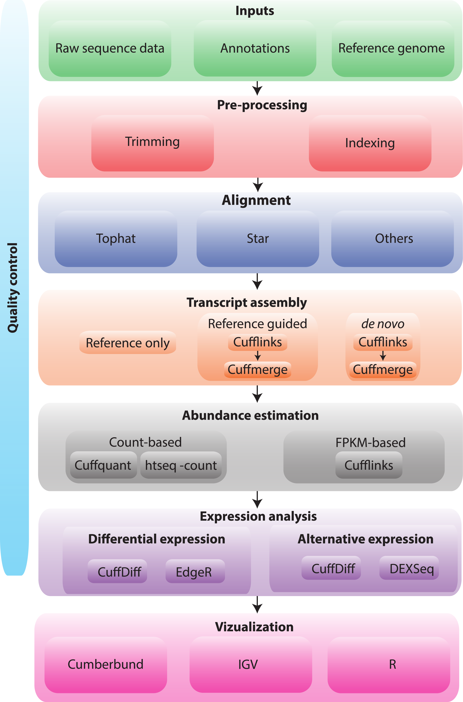
RNA-seq Analysis Flow Chart

Slide 6
4-i. Generate expression estimates
The alignment SAM/BAM files generated in the previous step will now be used by StringTie to calculate expression estimates
For all transcripts on the target chromosome
For this step options ‘-G’ and ‘-e’ are used
‘-e’ forces StringTie to calculate expression values for known transcripts
To discover novel transcripts with StringTie you should:
Not use the ’-e’ o ‘-G’ option. De novo transcript assembly and estimation will be performed. (we will try this in Module 4) OR ...
Use the ‘-G' option only. Known transcripts will be used as a ‘guide’, but novel transcripts will also be predicted.
This step will generate one isoform and one gene expression file for each library
Expression values are reported as ‘FPKM’, or ‘Fragments Per Kilobase of exon per million fragments Mapped’
Where each ‘fragment’ corresponds to a read-pair mapped to the genome
Notes:
Consequtive basepairs

Slide 7
4-i. Generate expression estimates (Optional Alternatives)
Another alternative we will explore is a count-based method
We will use a program called htseq-count
Requires name-sorted SAM file
We will count at the gene level (transcript-level is also possible)
In the end we will have two expression estimates for each sample
HISAT2/StringTie
HISAT2/Htseq-count
Notes:
Consequtive basepairs

Slide 8
4-ii. Perform differential expression analysis
In this step we will use Ballgown to:
Combine expression estimates from our 6 libraries into more convenient files
Combine expression estimates across replicates
Compare UHR vs. HBR and identify significantly differentially expressed genes and isoforms (transcripts)
Note that these commands can get quite complicated when you have replicates
The positioning of spaces and commas, and grouping of libraries matters!
Comparisons
Compare UHR vs. HBR using all replicates, for known (reference only mode) transcripts

Slide 9
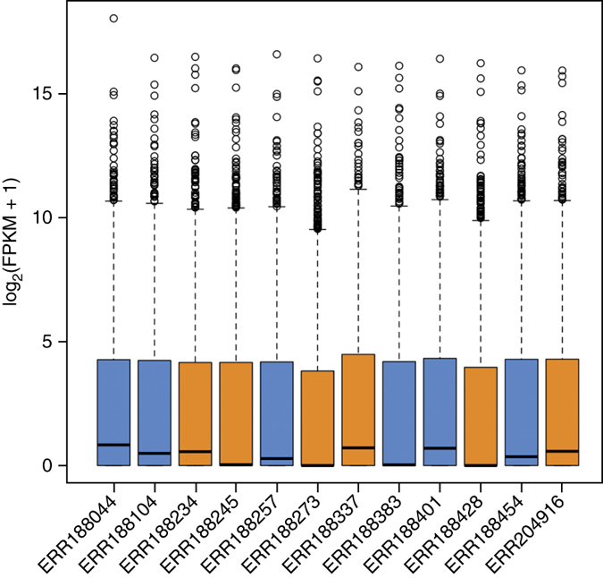
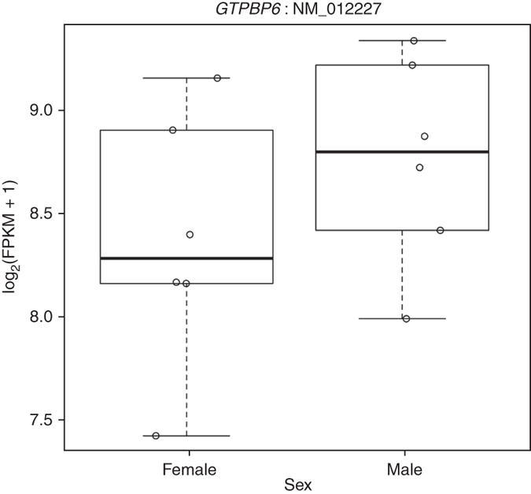
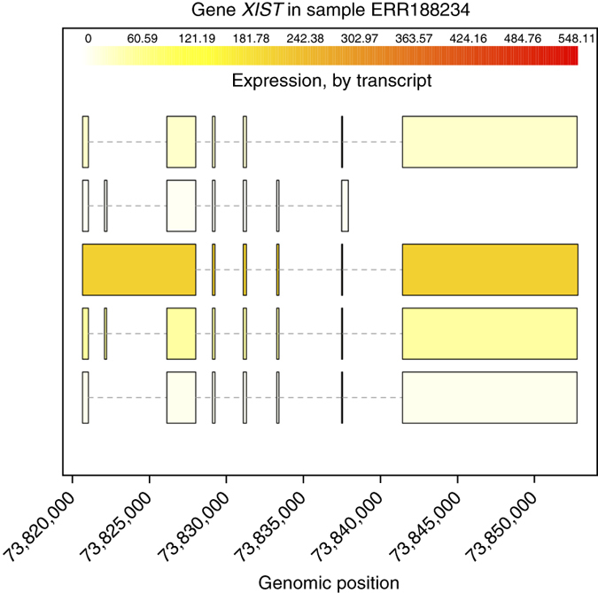
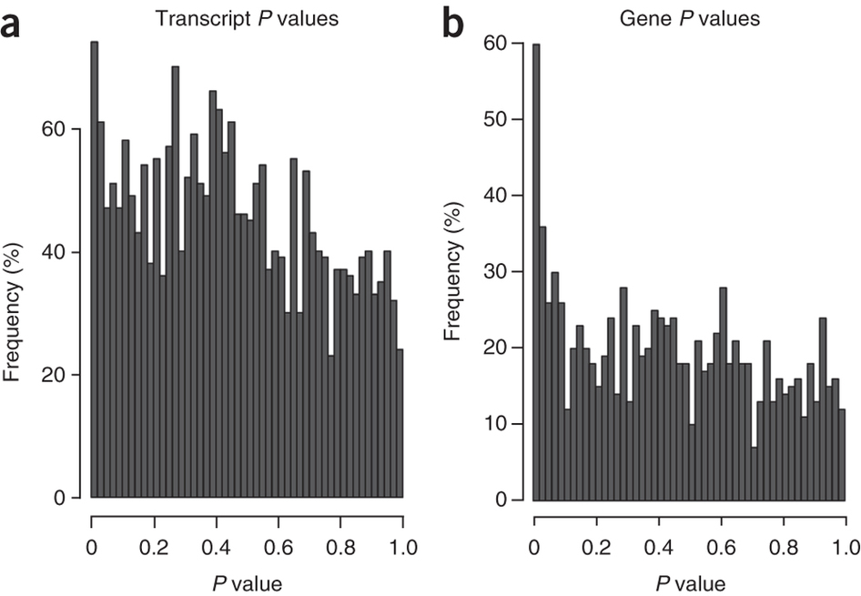
4-iii. Summarize and visualize results
In this step we will run the R package Ballgown to visualize our expression and differential expression results.
See online tutorial for details
https://github.com/alyssafrazee/ballgown
http://bioconductor.org/packages/release/bioc/html/ballgown.html

Slide 10
Summarize and visualize results (optional)
In this step we will use R to summarize and visualize the results of the previous steps
Explanation of the R commands is provided in the online wiki
Examples of the tasks performed:
Examine the expression estimates
How reproducible are the technical replicates?
How well do the different library construction methods correlate?
Visualize the differences between/among replicates, library prep methods and tumor versus normal
Examine the differential expression estimates
Visualize the expression estimates and highlight those genes that appear to be differentially expressed according to Ballgown
Generate a list of the top differentially expressed genes

Slide 11
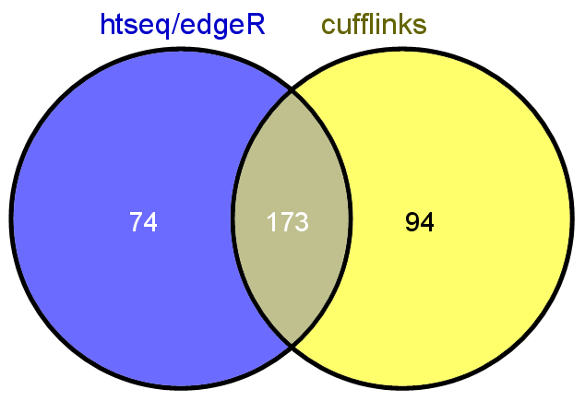
Perform differential expression analysis with edgeR using htseq output (optional)
Make use of raw counts generated by htseq-count
Load into R and process with edgeR package
Compare significantly differentially expressed genes from two methods

Slide 12
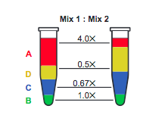
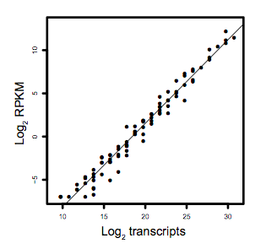
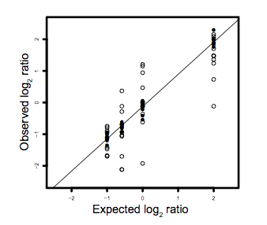
Analysis of ERCC spike-in expression and differential expression (optional)
https://tools.lifetechnologies.com/content/sfs/manuals/cms_086340.pdf
Lower Limit of Detection
Dynamic Range (dose response)
Fold-change response (DE)

Slide 13
We are on a Coffee Break & Networking Session

