Slide 1

Canadian Bioinformatics Workshops
www.bioinformatics.ca

Slide 2

Module #: Title of Module
2

Slide 3
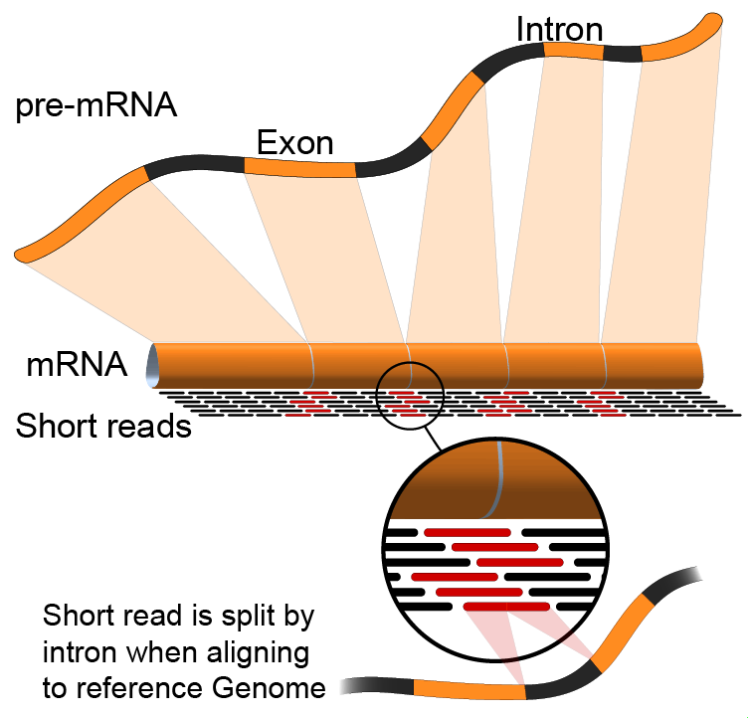
Module X
Module title
Malachi Griffith & Obi Griffith
Informatics for RNA-seq Analysis
June 16-17, 2016

Slide 4
We are on a Coffee Break & Networking Session

