Slide 1
Advanced Sequencing Technologies & Applications
http://meetings.cshl.edu/courses.html

Slide 2
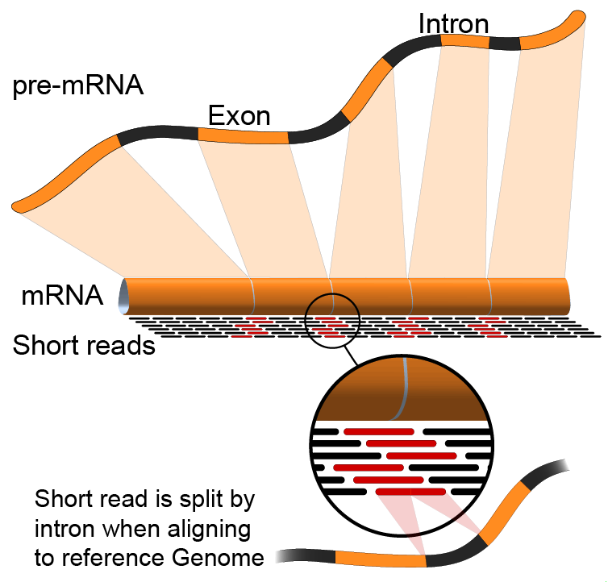

Module 1 Introduction to RNA sequencing (lecture)
Malachi Griffith, Obi Griffith, Jason Walker, Ben Ainscough
Advanced Sequencing Technologies & Applications
November 11-23, 2014

Slide 3
Break

