Slide 1
Advanced Sequencing Technologies & Applications
http://meetings.cshl.edu/courses.html

Slide 2
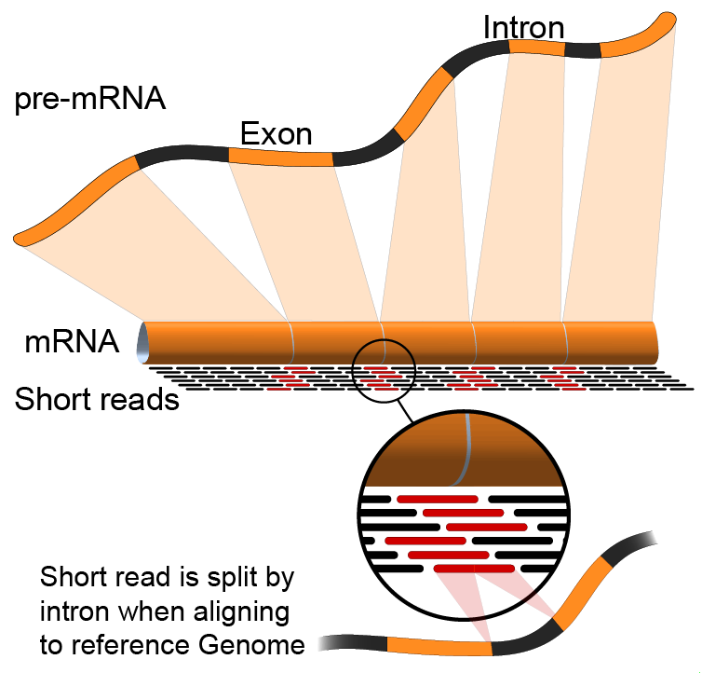

RNA-Seq Module 1 Introduction to RNA sequencing (lecture)
Malachi Griffith, Obi Griffith, Jason Walker
Advanced Sequencing Technologies & Applications
November 10 - 22, 2015

Slide 3
Break

