Slide 1
Advanced Sequencing Technologies & Applications
http://meetings.cshl.edu/courses.html

Slide 2
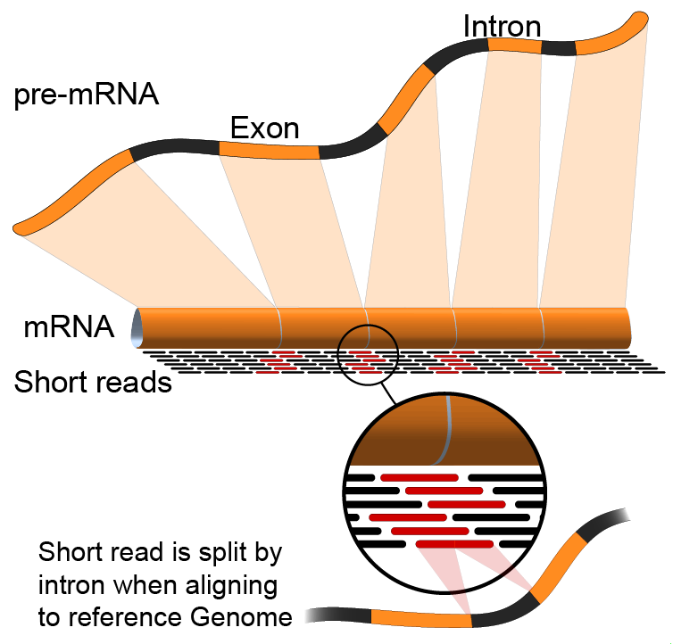

RNA-Seq Module 1 Introduction to RNA sequencing (lecture)
Malachi Griffith, Obi Griffith, Jason Walker, Alex Wagner
Advanced Sequencing Technologies & Applications
November 7 - 20, 2016

Slide 3
Break

