Slide 1
Advanced Sequencing Technologies & Applications
http://meetings.cshl.edu/courses.html

Slide 2
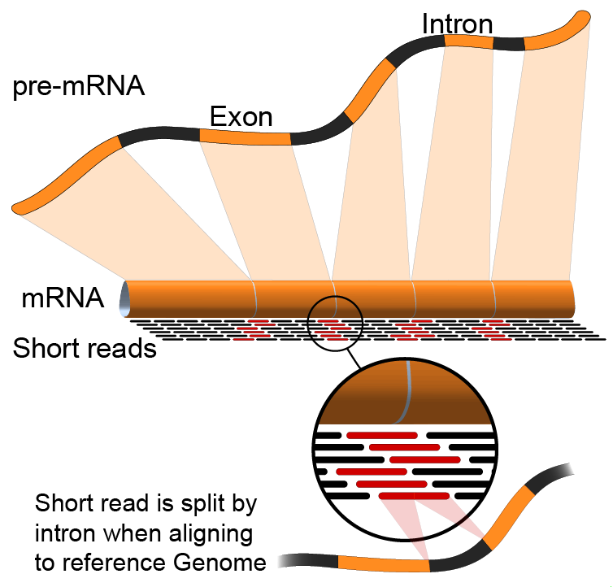

RNA-Seq Module 4 Alignment Free Expression Estimation (tutorial)
Kelsy Cotto, Obi Griffith, Malachi Griffith,
Alex Wagner, Jason Walker
Advanced Sequencing Technologies & Applications
November 6- 18, 2018

Slide 3
We are on a Coffee Break & Networking Session

