Slide 1
WHAT IS MACHINE
LEARNING?

Slide 2
2 + 4

Slide 3
2.00009879665 + 4098096.0998798 - 909888 * 6676 - 00908 + 7677866

Slide 4


Slide 5
SO WHAT IS MACHINE LEARNING?
MACHING LEARNING IS SET OF TECHNIQUES TO MAKE COMPUTERS BETTER AT DOING THINGS THAT HUMANS (TRADITIONALLY) CAN DO BETTER THEN MACHINES…

Slide 6
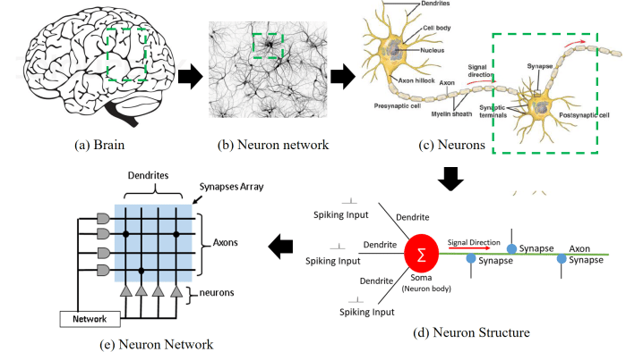

Slide 7
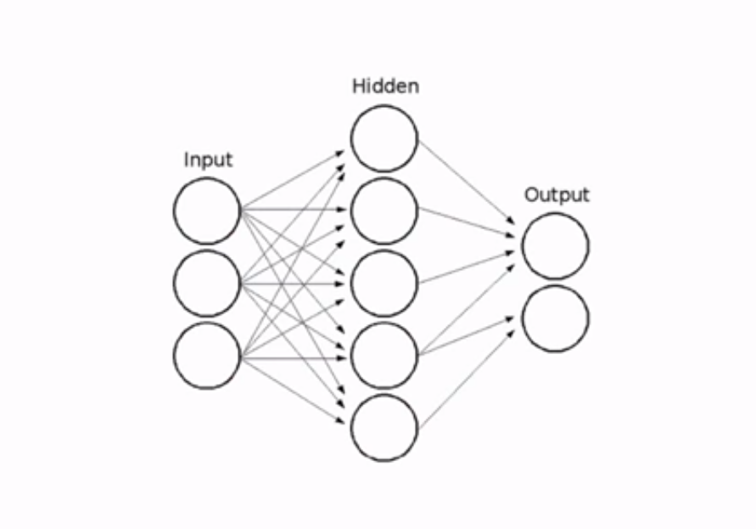

Slide 8
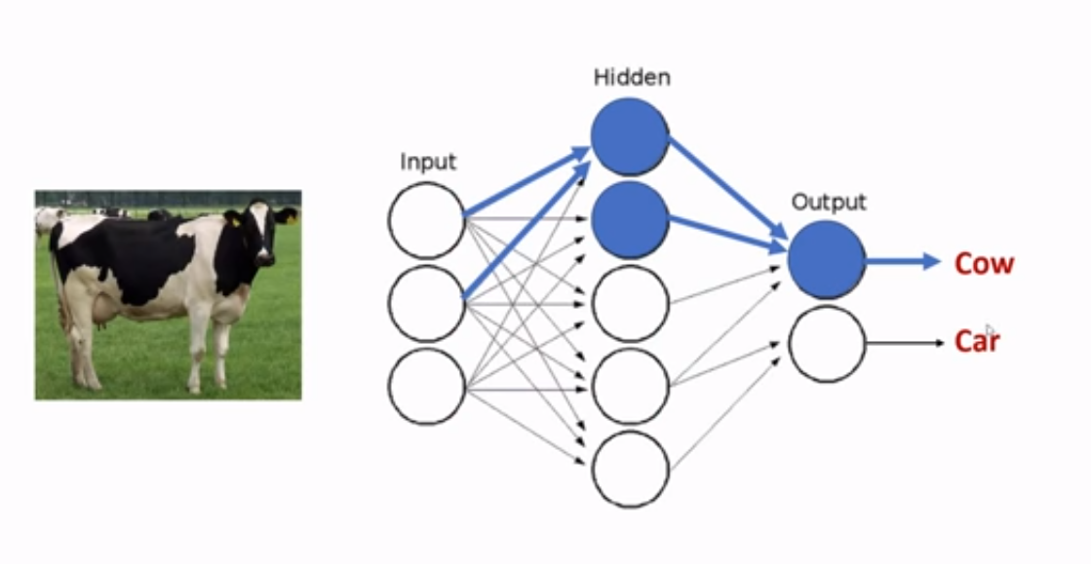
Alpydin & Ch. Eick: ML Topic1

Slide 9
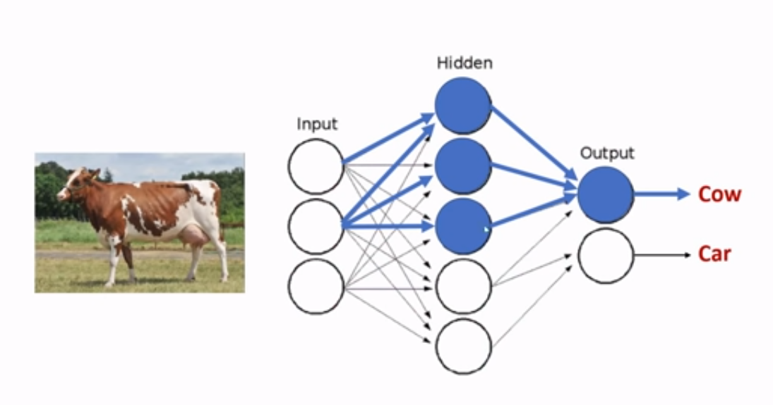

Slide 10
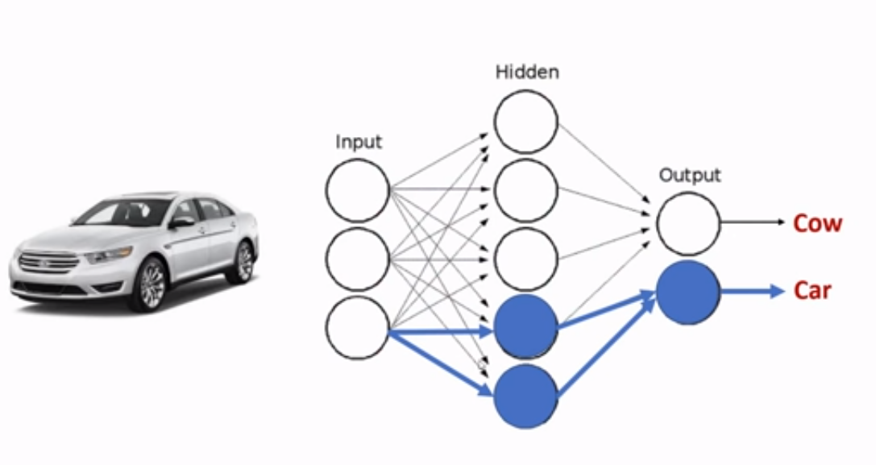

Slide 11
GROWTH OF MACHINE LEARNING
Machine learning is preferred approach to
  Speech recognition, Natural language processing
  Computer vision
  Medical outcomes analysis
  Robot control
  Computational biology
This trend is accelerating
  Improved machine learning algorithms
  Improved data capture, networking, faster computers
  Software too complex to write by hand
  New sensors / IO devices
  Demand for self-customization to user, environment
  It turns out to be difficult to extract knowledge from human experts→failure of expert systems in the 1980’s.
Alpydin & Ch. Eick: ML Topic1

Slide 12
TYPES OF LEARNING
Supervised Learning
  Classification
  Regression/Prediction
Unsupervised Learning
Reinforcement Learning

Slide 13
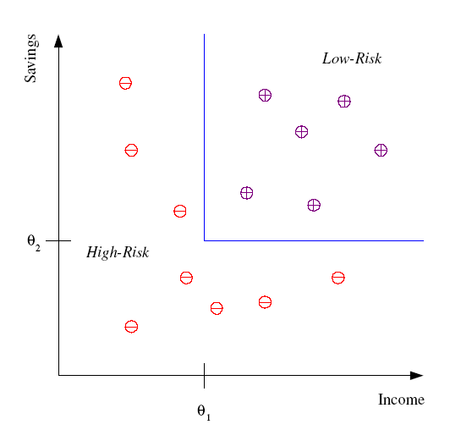
CLASSİFİCATİON
Example: Credit scoring
Differentiating between low-risk and high-risk customers from their income and savings
Discriminant: IF income > θ₁ AND savings > θ₂
THEN low-risk ELSE high-risk
Model

Slide 14
CLASSİFİCATİON: APPLİCATİONS
Aka Pattern recognition
Face recognition: Pose, lighting, occlusion (glasses, beard), make-up, hair style
Character recognition: Different handwriting styles.
Speech recognition: Temporal dependency.
  Use of a dictionary or the syntax of the language.
  Sensor fusion: Combine multiple modalities; eg, visual (lip image) and acoustic for speech
Medical diagnosis: From symptoms to illnesses
Web Advertizing: Predict if a user clicks on an ad on the Internet.

Slide 15








FACE RECOGNİTİON
Training examples of a person
Test images

