Slide 1





December 9, 2020
Group: Project0506_11
Alumni Association Database Analysis
To optimize existing and new events to attract more First-Time attendees and Gift Prospects
Akshata Kishore Moharir
Aditya Deshpande
Apurva Dixit
Colin Grant

Slide 2

MDM Company
1
Background & Introduction
Presentation Agenda
2
Conceptual, Logical & Physical Database Design
3
Business Use Cases & Applications
4
Conclusion & Recommendations

Slide 3
Background
The Alumni Association as a client is looking for the longitudinal impact report focusing on understanding the correlation between the Events and the First-Time Attendees and also the Major Prospects.
The data set provided is from 07/01/2013-11/30/2019 and contains seven subsets of data, arranged by fiscal year (July 1-June 30).
The data set outlines each program or event hosted by the Alumni Association and provides general information about the event as well as the event attendees.

Slide 4
Mission Objectives
Introduction & Objectives
What are top 10 events with the highest Major Prospects?
What are the top 10 events with the highest number of First Time Attendance ?
What is the highest number of major prospects,participants,first-time attendees across years?
What is the Sum of Major Prospects versus Sum of First Time Attendees across Weekdays ?
What are the top 5 locations with the highest number of major gift prospects?
What is the highest number of First Time Attendees for top 10 locations and top 10 events?
What is the highest Major Prospects versus highest of First Time Attendees across Months?
What is the distribution of average age with respect to first time attendees and major prospects?
Mission Statement
To optimize existing and new events to attract more first-time attendees and gift prospects based on the information provided in the dataset of alumni events conducted in the last five years.

Slide 5
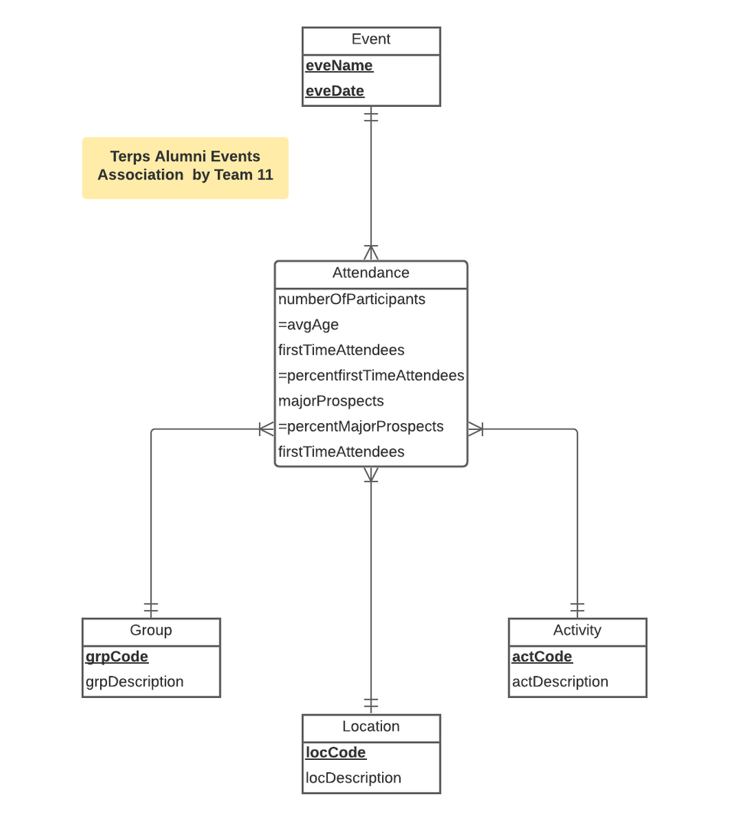
Conceptual Database Design
Conceptual & Logical Database Design - ER Diagram
Entity Types:
Group (grpCode, grpDescription)
Activity (actCode, actDescription)
Location (locCode, locDescription)
Event (eveName, eveDate)
Relations:
Attendance (grpCode, actCode, eveName, eveDate, locCode, numOfParticipants, avgAge, firstTimeAttendees, majorProspects)

Slide 6
Physical Database Design
Physical Database Design - Table Creation
CREATE TABLE [TerpAlum.Attendance] (
grpCode CHAR (3) NOT NULL,
actCode CHAR (5) NOT NULL,
locCode CHAR (4) NOT NULL,
eveName CHAR (100) NOT NULL,
eveDate DATE,
numOfParticipants INTEGER,
avgAge FLOAT,
firstTimeAttendance FLOAT,
majorProspects FLOAT
CONSTRAINT pk_Attendance_grpCode_actCode_eveName_eveDate PRIMARY KEY (grpCode,actCode,eveName,eveDate)
CONSTRAINT fk_Attendance_grpCode FOREIGN KEY (grpCode)
REFERENCES [TerpAlum.Group] (grpCode)
ON DELETE NO ACTION ON UPDATE CASCADE,
CONSTRAINT fk_Attendance_actCode FOREIGN KEY (actCode)
REFERENCES [TerpAlum.Activity] (actCode)
ON DELETE NO ACTION ON UPDATE CASCADE,
CONSTRAINT fk_Attendance_locCode FOREIGN KEY (locCode)
REFERENCES [TerpAlum.Location] (locCode)
ON DELETE NO ACTION ON UPDATE CASCADE,
CONSTRAINT fk_Attendance_eveNameeveDate FOREIGN KEY (eveName,eveDate)
REFERENCES [TerpAlum.Event] (eveName,eveDate)
ON DELETE NO ACTION ON UPDATE CASCADE)

Slide 7
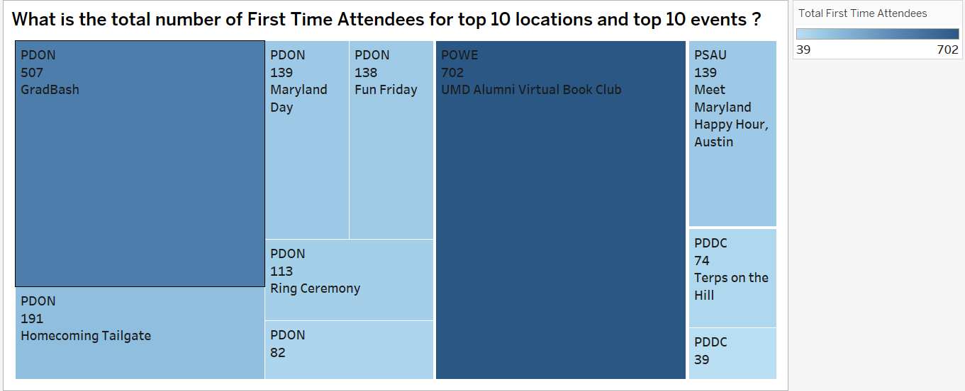
Business Transaction
SELECT distinct top 10 l.locCode,e.eveName,max(A.firstTimeAttendees) as 'MaxFirstTimeAttendees'
FROM [TerpAlum.Attendance] A,[TerpAlum.Event] e,[TerpAlum.Location] l
where e.eveName= A.eveName AND l.locCode=A.locCode
GROUP BY e.eveName,l.locCode
ORDER BY max(A.firstTimeAttendees) DESC
From the tree map chart, we can notice that among the top ten locations and events the location code PDON has maximum First-Time attendees for an event GRADBASH following POWE with 702 first-time attendee's participation for UM Alumni virtual book club

Slide 8
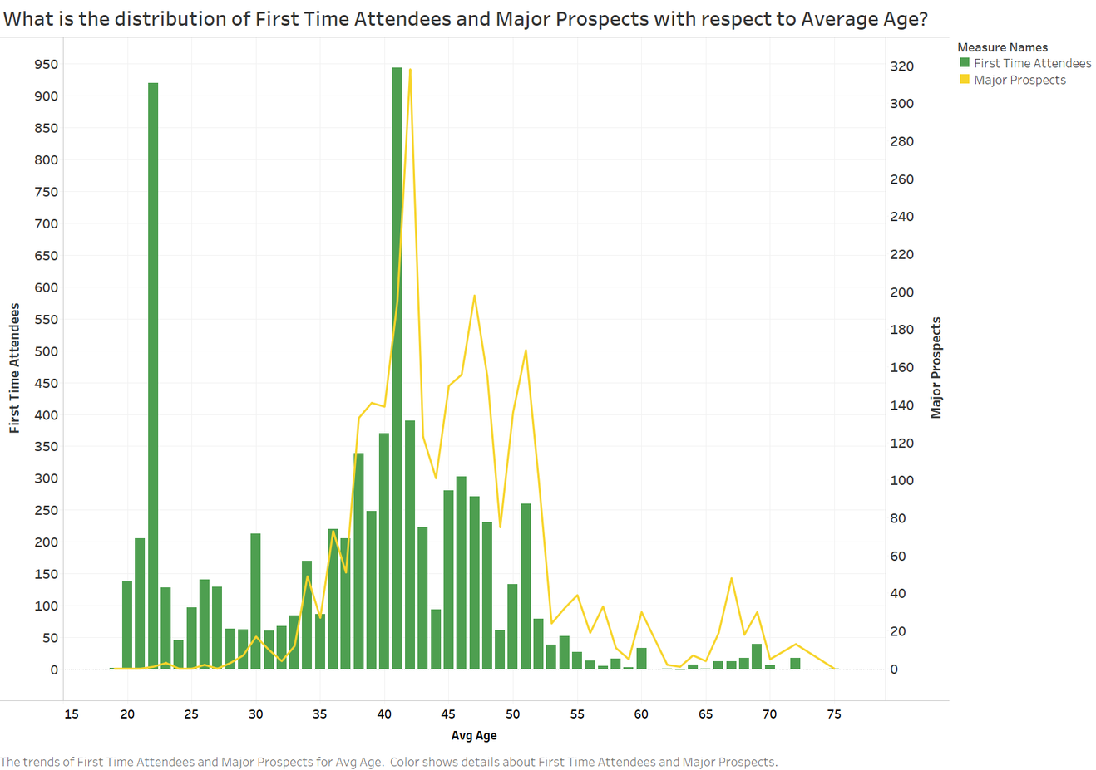
Business Transaction
SELECT SUM(firstTimeAttendees) AS 'FirstTimeAttendees', SUM(majorProspects) AS 'MajorProspects', avgAge
FROM [TerpAlum.Attendance]
GROUP BY avgAge
From the bar and line, we notice that among the age groups, age group 35 to 55 has highest number of major prospects and first-time attendees.

Slide 9
Conclusions & Recommendations
Insight 1
Insight 2
Insight 3
Insight 4
Alumni Association should focus on locations,
CP_DMV_On_Campus
CP_NorthEast_NewYork
CP_DMV_WashingtonDC
CP_Online_Webinar
CP_DMV_General
in order to maximize the major prospects.
Top event took place at PDON was Grad Bash followed by Virtual Book Club event held at location POWE. Therefore, Alumni Association should focus more on these event at the above locations to attract more first-time attendees.
Alumni Association should target age bracket of 35 to 55 for maximizing their major prospects and attendees.
Alumni Association should try to host events on weekend rather than weekdays to drive maximum first-time attendees and prospects.

Slide 10
Thank you!
Have a great day ahead.
Any Questions ?

