Slide 1
Bluetoothex example application
Chris Greenhalgh
2010-06-21

Slide 2
Project-related Files
samples/bluetoothex.drl
Drools Rule File with types and rule(s)
samples/bluetoothex1.authorapp
Project file with sample client and authored content
src/uk/ac/horizon/ug/bluetoothex/testclient/Main.java
Example desktop/test client

Slide 3
1. Define (/reuse) types to represent client capabilities
1a: Bluetooth scanning…
DRL (rules/types) file:
declare BluetoothSighting device_id : String beacon_mac : String @type("BluetoothMAC") time : long end
Instances will be added by client when detecting a Bluetooth device.

Slide 4
1. Define (/reuse) types to represent client capabilities (cont.)
1b: Content display…
DRL (rules/types) file:
Instance added by client to show capability:
declare ContentDisplayDevice @client id : String @key end
Instances added by server to request content display:
declare ShowContentRequest @message device_id : String @to("ContentDisplayDevice") content_url : String @type("URL") time : long end

Slide 5
2. Define (/reuse) types to represent authoring/configuration
2a: Bluetooth “beacons”
DRL (rules/types) file:
Instances created by experience author or site survey to identify possible beacons:
declare Beacon @entity @describedbysurvey id : String @key mac : String @type("BluetoothMAC") end

Slide 6
2. Define (/reuse) types to represent authoring/configuration (cont.)
2b: Association of content with beacons
DRL (rules/types) file:
Instances created by experience author to link content to beacons:
declare BeaconContent @property("*") @describedbyauthor beacon_id : String @subject("Beacon") content_url : String @type("URL") end

Slide 7
3. Define (/reuse) application behaviour rules
3. Bluetooth sighting of beacon triggers request to display any associated content…
Currently DRL (rules/types) file (ideally should be authorable/editable later in the process)
rule "2 Create ShowContentRequest…" dialect "mvel" when $cdd : ContentDisplayDevice( ) $sighting : BluetoothSighting( device_id==$cdd.id ) Beacon( mac==$sighting.beacon_mac, $beacon_id : id ) $bc : BeaconContent( beacon_id==$beacon_id ) then ShowContentRequest req = new ShowContentRequest(); req.device_id = $cdd.id; req.content_url = $bc.content_url; req.time = System.currentTimeMillis(); insert( req ); end

Slide 8
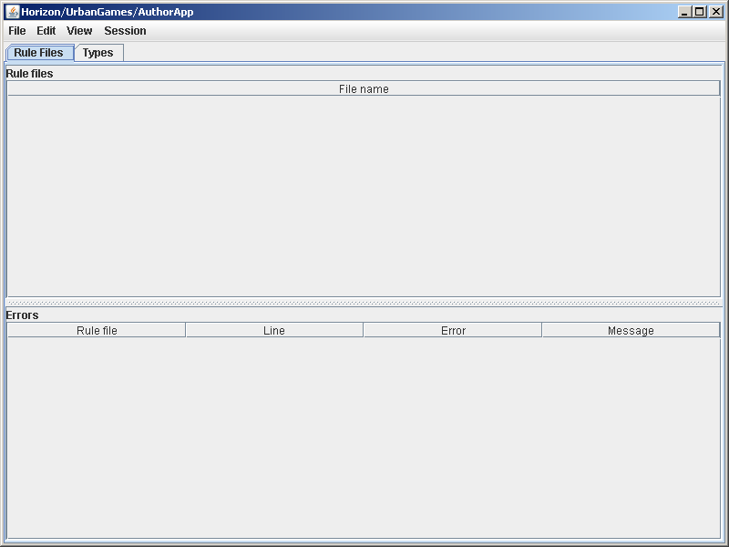
4.1. Create project in authorapp (run using ant target “authorapp”)

Slide 9

4.2. Add Rule file (bluetoothex.drl) (menu “Edit” : “Add rule file…”)
Check there are no errors

Slide 10
5. Create Beacon instances…

Slide 11
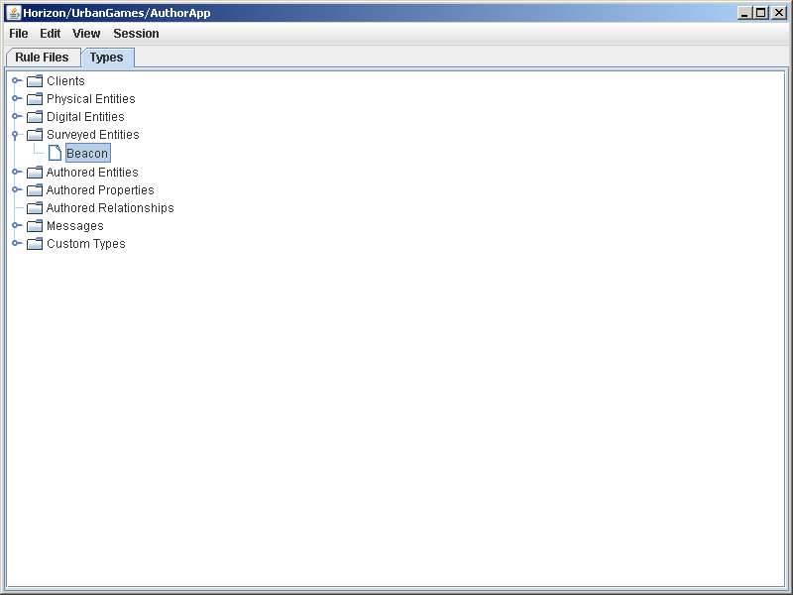
5.1. Find Beacon Type (“Types” tab, “Surveyed Entities”)

Slide 12
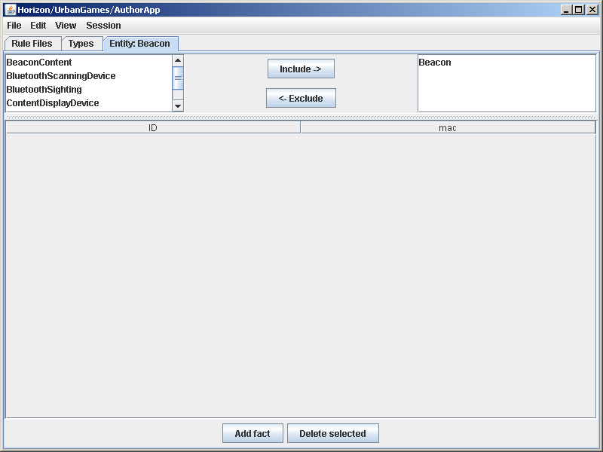
5.2. Open Beacon Table View (menu “View” : “View”)

Slide 13
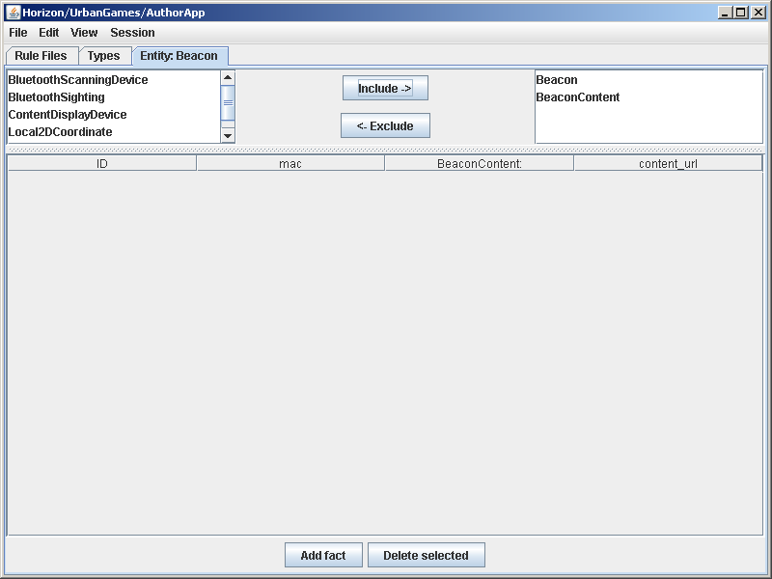
5.3. Configure View to show BeaconContent (Select “BeaconContent”, “Include ->”)

Slide 14
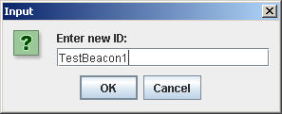
5.4. Create a new beacon (description) (Button “Add fact”, enter ID)

Slide 15
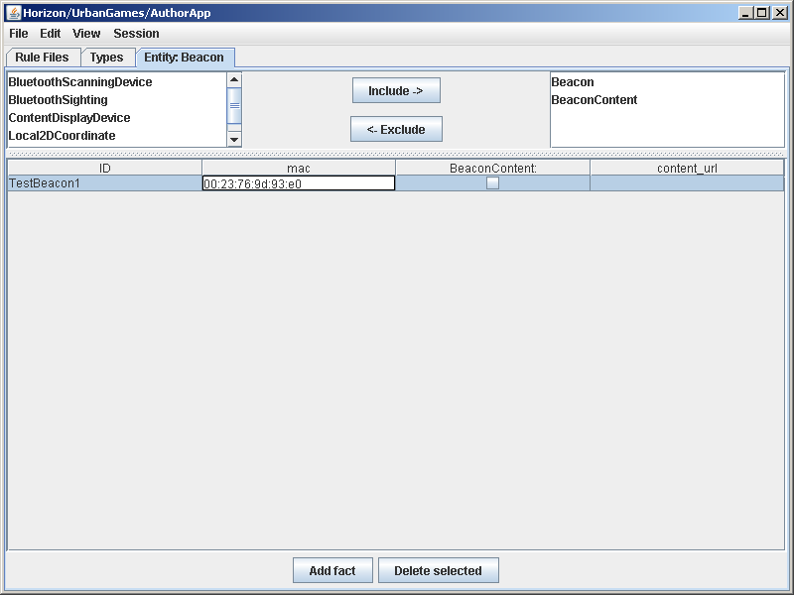
5.5. Set MAC address

Slide 16
6. Configure content associated with beacon(s)…

Slide 17
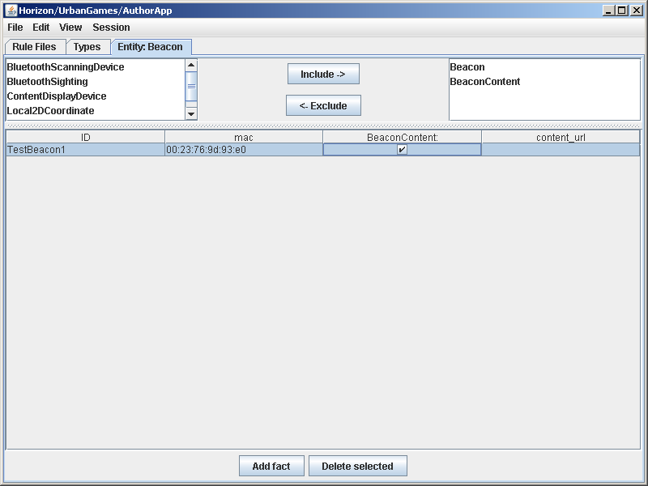
6.1. Add BeaconContent (check “BeaconContent”)

Slide 18
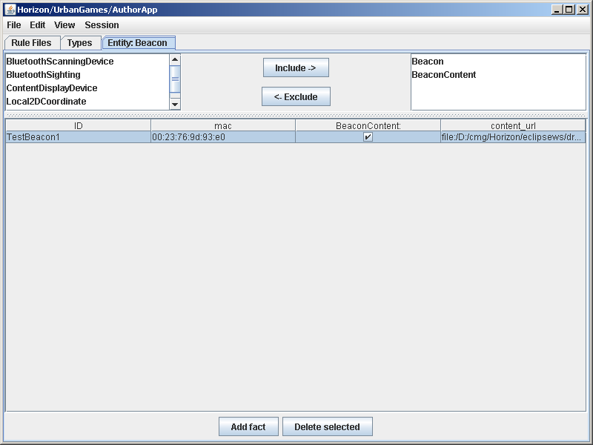
6.2. Specify content URL (client content_url value)

Slide 19
7. Create a new client type to interact with the server…

Slide 20
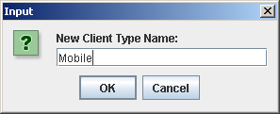
7.1. Create new client type (menu “Edit” : “New client type…”)

Slide 21
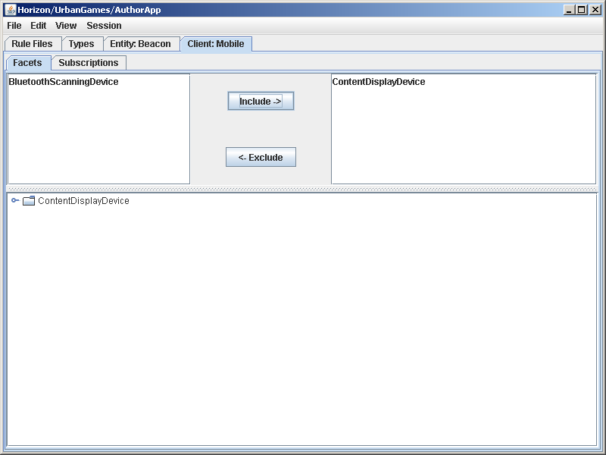
7.2. Configure as ContentDisplayDevice (“Include ->” ContentDisplayDevice)

Slide 22
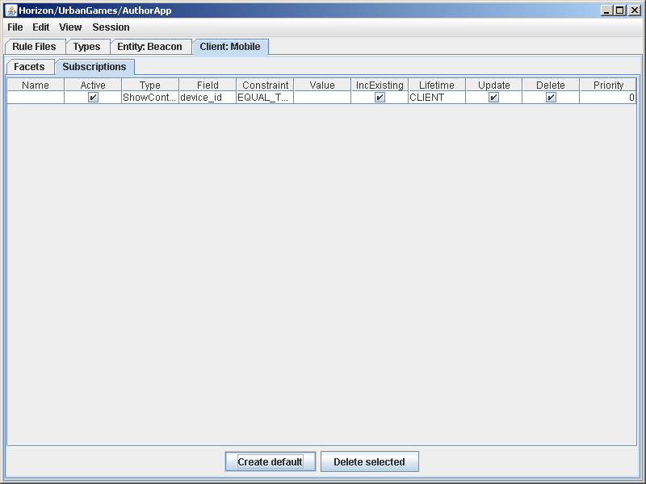
7.3. Create subscription to ContentDisplayRequests (Tab “Subscriptions”, “Create default”)

Slide 23
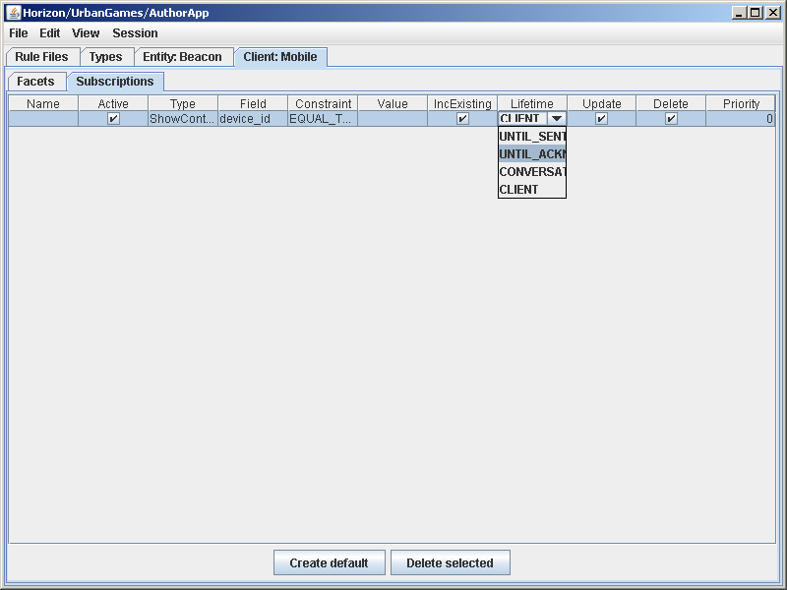
7.4. Change subscription “Lifetime” to “UNTIL_ACKNOWLEDGED” (optional)

Slide 24
7.5. Save project (menu “File” : “Save as…”)

Slide 25
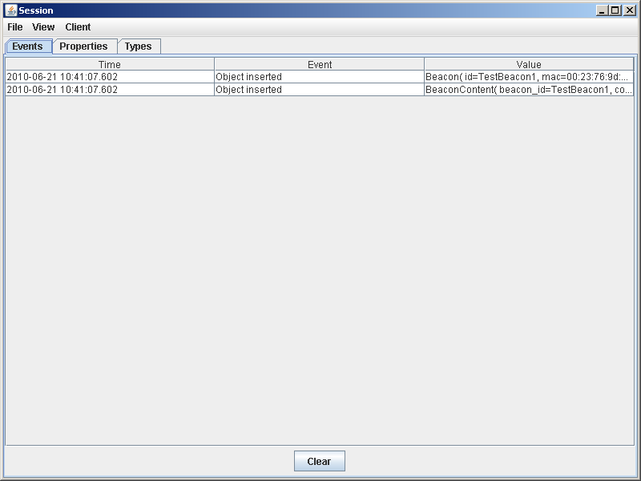
8. Run a test session (menu “Session”: “New…” – opens new window)
Note: authored content added

Slide 26
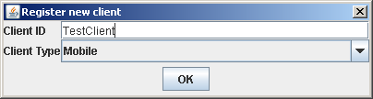
9.1. Register a client (menu “Client” : “Register new…”)
IMEI is preferred ID

Slide 27
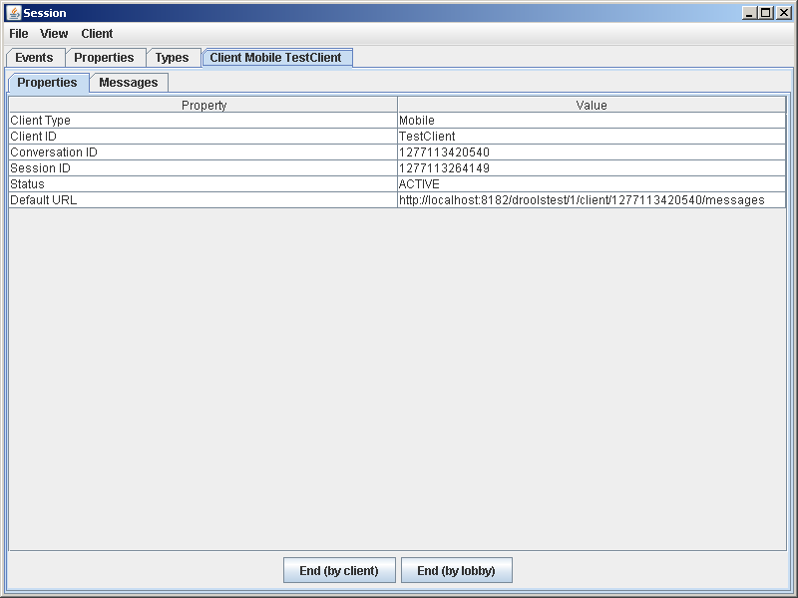
9.2. Note client conversation URL (Default URL)

Slide 28
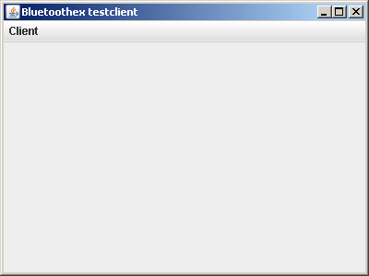
10.1. Run test client (ant target “bluetoothex”)

Slide 29

10.2. Configure test client (menu “Client” : “Connect”)

Slide 30
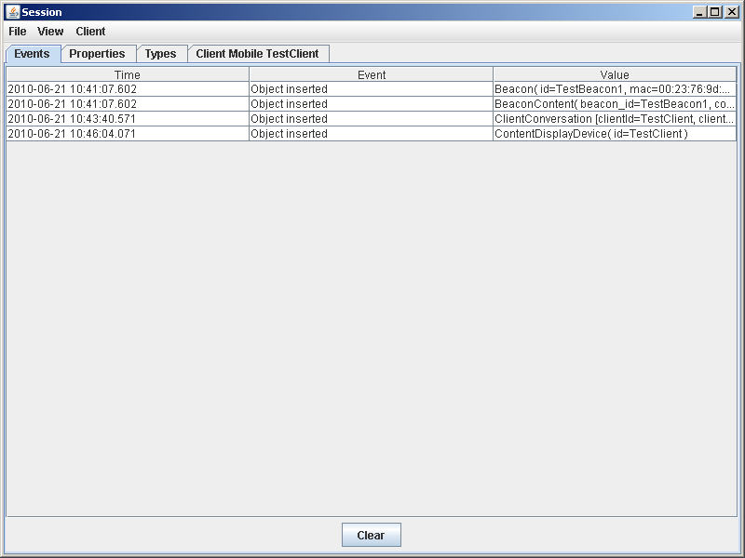
Check test session “Events”…
New Client

Slide 31
10.3. Start bluetooth scanning (menu “Client” : “Start scanning”)
Wait > 15 seconds…
Ensure bluetooth beacon in range…

Slide 32
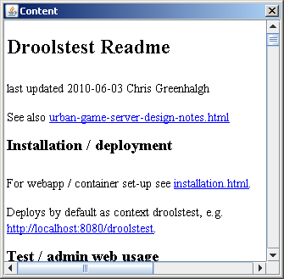
10.4. (hopefully) configured documents pops up ☺

Slide 33
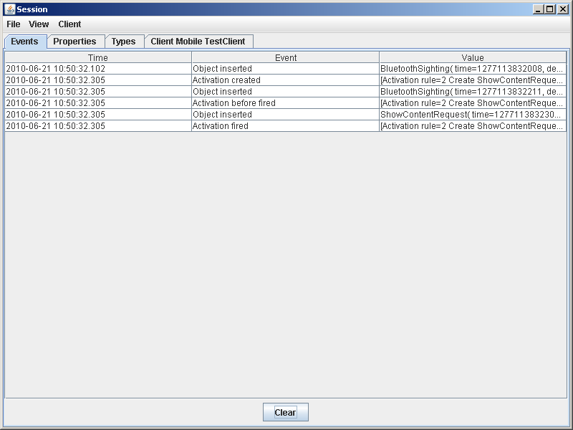
Check event view…
Beacon sighting
Display request

Slide 34
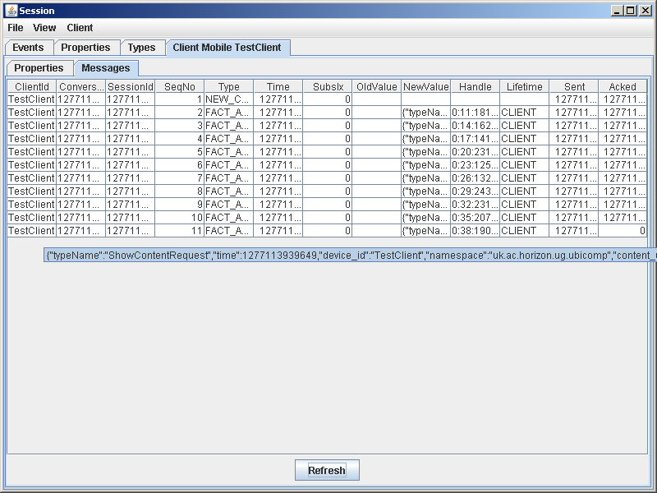
Check Client message queue (client tab, “Message” sub-tab)
Start of conversation
Show Content requests

