Slide 1
Some implementation documentation for mod/webctimport
Chris Greenhalgh
2011-08-02, updated 2011-08-03

Slide 2
Module source files (1)
backup/
moodle2/
Some backup code copied with little understanding from the URL module
db/ - standard DB files
access.php – defines new capabilities
install.php – special-case install code
install.xml – database install definition (from XMLDB-Editor)
log.php – defines new log events
upgrade.php - database upgrade code (from XMLDB-Editor)
lang/
en/
webctimport.php – English-language UI strings
pix/
icon.gif – default module icon

Slide 3
Module source files (2) (top-level)
Standard, internal files
lib.php – defines module class with standard entry points
locallib.php – defines module helper functions
mod_form.php – Moodle-form definition for add/edit instance
settings.php – defines module-wide settings, e.g. cache dir
styles.css – styles for module
version.php – module version
Standard, visible pages
index.php – show list of instances of this module
view.php – show one instance
Tree view, all visible
treeview.php – skeleton of tree view page/form, included in frame in add form (see mod_form.php)
module.js – Javascript for this module, loaded by treeview.php
treeviewsubmit.php – handle submit of tree view form (i.e. add)

Slide 4
Module source files (3) (top-level)
Tree view, AJAX entry point(s)
get_listing.php – called by tree view JS to return folder info from cache and build tree
Tree view, preview file
read_file.php – reads file info in cache and redirects to read_rawfile.php
read_rawfile.php – reads (previews) file in cache
Import, internal ⁽²⁰¹¹⁻⁰⁸⁻⁰³⁾
form/webctimport.php – Moodle form element webctimport to show import status in edit form
Import, visible ⁽²⁰¹¹⁻⁰⁸⁻⁰³⁾
status.php – popup/embed page reporting import state, included in view.php and form/webctimport.php
import.php – popup/embed page performing import if required, redirect from status.php
These may be combined in future

Slide 5
Database tables (see db/install.xml): webctimport table
Row per webctimport place-holder activity instance
Standard module columns:
id (int) – instance ID
course – course ID
name – name (in course)
intro – description (in course)
introformat - ? Html flag
timemodified – for placeholder in webct, not file
Standard URL/link columns:
display – display type
displayoptions - … options
Non-standard columns:
localfilepath – file INFO path within folder cache
N.B. originally was file CONTENT path
webctfileid – FK for webctfile table
Changed meaning 2011-08-03
targettype – none, file or equella/etc.
Added 2011-08-03
Removed:
2011-08-03: error, metadata, owners

Slide 6
Database tables (see db/install.xml): webctfile table
(updated 2011-08-03)
Row per file imported to Moodle file
0/1-to-0/1 mapping to webctimport
i.e. webctimport row created initially, then webctfile if import to moodle file, then webctimport row deleted when import complete (webctfile row retained for reference).
Columns:
id – PK
status – new, in progress, success, failure/retry, failure/give up
error – error msg for user
workerid - thread (?) doing import
workertimestamp – timestamp of import
localfilepath – see webctimport
webctpath – webct internal file path (indexed)
owneruserid – user id of creator/owner

Slide 7
Database enumerated values (lib.php)
webctimport targettype
WEBCTIMPORT_NONE = 0
WEBCTIMPORT_FILE =1
WEBCTIMPORT_EQUELLA = 2
webctfile status
WEBCTIMPORT_STATUS_NEW = 0
WEBCTIMPORT_STATUS_WORKING = 1
WEBCTIMPORT_STATUS_DONE = 2
WEBCTIMPORT_STATUS_TRANSIENT_ERROR = 3
WEBCTIMPORT_STATUS_PERMANENT_ERROR = 4

Slide 8
Sequence diagrams
Adding resource(s)
Viewing a webctimport placeholder instance
Editing a webctimport placeholder instance

Slide 9
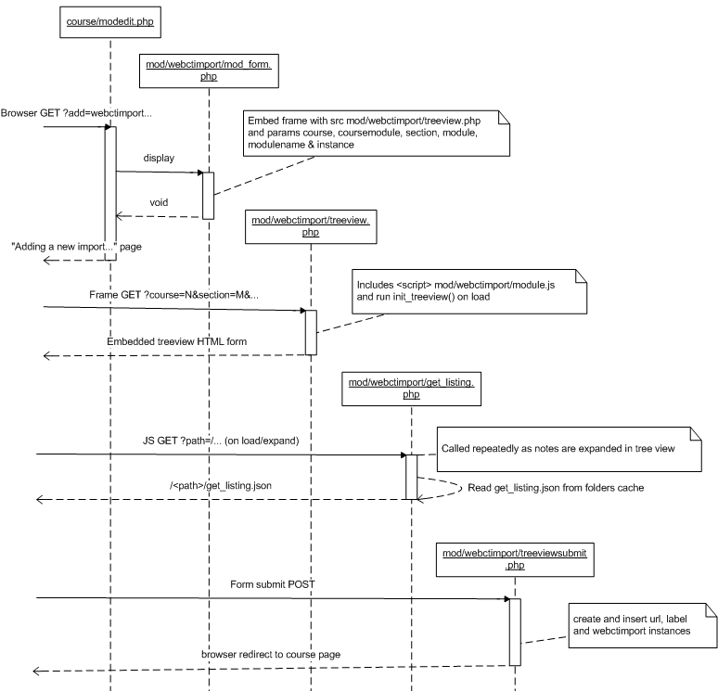
Adding a resource

Slide 10
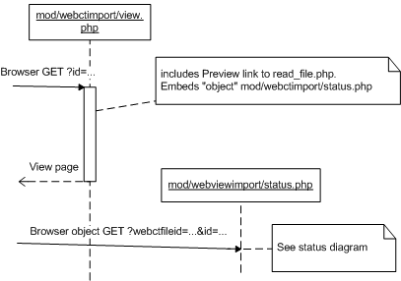
Viewing a webctimport instance

Slide 11
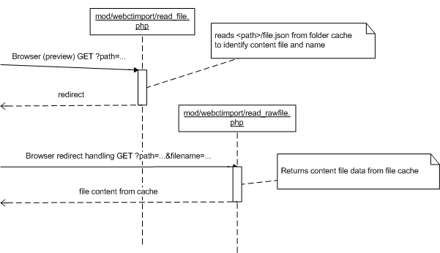
Previewing a webctimport item

Slide 12
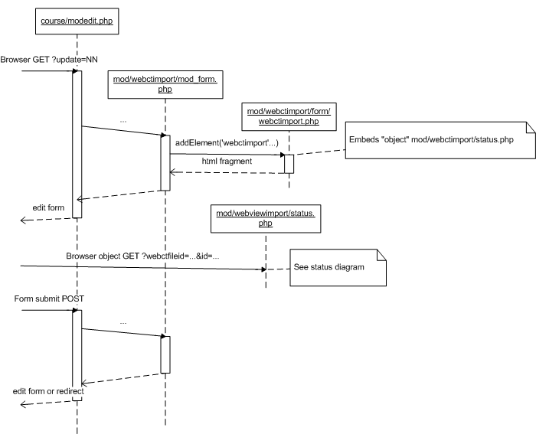
Editing a webctimport instance

Slide 13
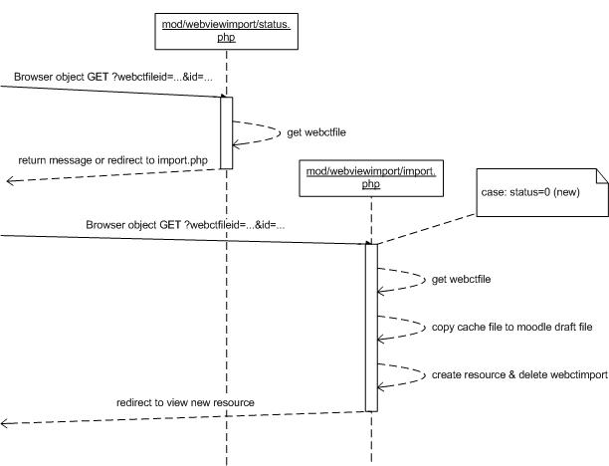
Checking status / importing a webctimport item

Slide 14
WebCT cache
Generated by application classes in https://github.com/cgreenhalgh/webctdbexport:
webctdbexport.jdbc.DumpUsers
Ant target “dumpusers”, to dump/files & dump/folders
Optional command line list of user(s) to dump; by default attempts to dump ALL users
webctdbexport.jdbc.DumpAll
Ant target “dumpall”, to dump/files & dump/folders
Dumps all courses, starting from root institution(s)
Requires configuration for JDBC connection to WebCT database
Copy etc/jdbc.properties to etc/jdbc-local.properties and fill in details

Slide 15
WebCT cache – extra permissions
Users can be given post-hoc access to other Sections:
webctdbexport.jdbc.FindLearningContext
Ant target findsection
Takes SQL LIKE pattern for section name and optional pattern for course name (‘%’ is wild-card)
Lists matching sections and their IDs, e.g. “lc12345”
DumpUsers reads from extra permissions file:
4th argument; default dump/extrapermissions.txt
Format:
# comment…
<username> <lc-code> …
<username> <lc-code> …
…

Slide 16
Cache top-level structure
files/ – the raw content files, stored based on SHA-1 hash of content bytes
Same trick used by Moodle 2
folders/ – the structure of the course(s) and folders in WebCT, including links and references to file content in files/
folders/user/ - root of directories for information about users

Slide 17
File cache structure: courses
Each section or folder becomes a directory
Under parent learning context or folder
Name based on WebCT database ID
E.g. lc12345/ = Learning Context ID 12345
Contains get_listing.json file identifying contents
Contains permissions.json file identifying members and their roles
Only seems to have useful content for a Course folder
Institution(s) are the top-level under folders/

Slide 18
File cache structure: users
Each user becomes a directory based on their username
E.g. “pszcmg” -> ps/psz/pszcmg/
Hopefully avoids having too many entries in one directory
Contains get_listing.json file identifying user’s personal file area (if any) and courses on which they are an instructor
User’s personal file area becomes a directory
Under user directory
Name based on WebCT person ID, e.g. p12345/

Slide 19
File cache structure: files
Each file as seen in WebCT becomes a directory
Under parent learning context or folder
Name based on WebCT database ID
E.g. ce12345/ = CMS Entry ID 12345
Contains file.json file with the file’s name, SHA-1 hash and path to file content

Slide 20
File cache structure: file content
Each unique file (i.e. unique sequence of bytes) becomes a file under the files/ directory
File content is NOT stored in the folders/ cache
N.B. therefore the content file is separated from any filename or mime type information – this is in the file.json file(s)
N.B. the same file content may appear in several places in WebCT
e.g. via WebCT links or because uploaded multiple time or re-authored identically

Slide 21
File content cache details
The SHA-1 hash is calculated for the bytes of each file
this is a 160 bit value represented as 40 hex digits
There are two levels of directories under files/:
First two hex digits of hash
Second two hex digits of hash
The file itself is stored in the appropriate subdirectory with its SHA-1 has as its name

Slide 22
File format: get_listing.json
{
"path":[ … ],
…
"list":[
<item description – see following slides>
]
}

Slide 23
File format: get_listing.json, folder item
{
"title": "<folder name>",
"path": "<folder path within cache>",
"description": "<description>",
"webcttype": "<webct type>",
"size": 0
"children": []
}
NB children array always appears empty; must check get_listing.json under <path> to find child items

Slide 24
File format: get_listing.json, link item
{
"title": "<link name>",
"source": "<link URL>",
"description": "<description>",
"webcttype": “URL_TYPE/Default",
"size": 0
}

Slide 25
File format: get_listing.json, file item
{
"title": "<file/link name>",
"source": "<file info path within folders cache>",
"description": "<description>",
"webcttype": "<webct type>",
"size": 0
}

Slide 26
File format: permissions.json
{
"<username>": [
"<role>", …
],
…
}
E.g. “SDES” = Section DESigner
“SINS” = Section INStructor
“SSTU” = Section STUdent
“SAUD” = Section AUDitor

Slide 27
File format: file.json
{
"filename": "<filename>",
"path": "<file content path in file cache>",
"sha1hash": "<SHA-1 hash>",
"size": <file size (bytes)>
"webcttype": "<webct type>",
"webctpath": "<webct internal file path>",
"mimetype": "<mime type if known>",
"encoding": "<character set if known>",
"lastmodifiedts": <timestamp - webct lastmodified, ms>,
"linkto": "<cache path of file if this is a link>",
"cachets": <timestamp – cached, ms>,
"filecontentid": <webct CmsFileContent ID>
}
Added 2011-08-02,
2011-08-03

Slide 28
Other cache files
Created by dump process but not used by import:
done.ts – created when a folder and all sub-folders have been completely dumped (prevents the folder being re-dumped)
index.html – human-readable version of (subset of) get_listing.json
permissions.html – human-readable version of permissions.json
file.html – human-readable version of (subset of) file.json

Slide 29
Notes / issues
file.json should probably include mimetype information from WebCT
file.json should probably include link property which tries to map a CmsEntry which is a link to a file to the corresponding file entry, to avoid unnecessary re-fetching of the file content
Various bugs in mod_form.php for view and update?!

Slide 30
Moodle file table notes
Columns include:
id, contenthash, pathnamehash, contextid, component, filearea, itemid, filepath, filename, userid (opt), filesize, mimetype (opt), status, source (opt), author (opt), license (opt), timecreated, timemodified
Repository interface gives form view to populate (alt.) filename, author (text) and license (from drop-down list)

