Slide 1
Autonomous Satellite control Cloud aware learned pointing
Cédric Grieder
MSc Mechanical Engineering Student ETHZ
06. July 2026

Slide 2
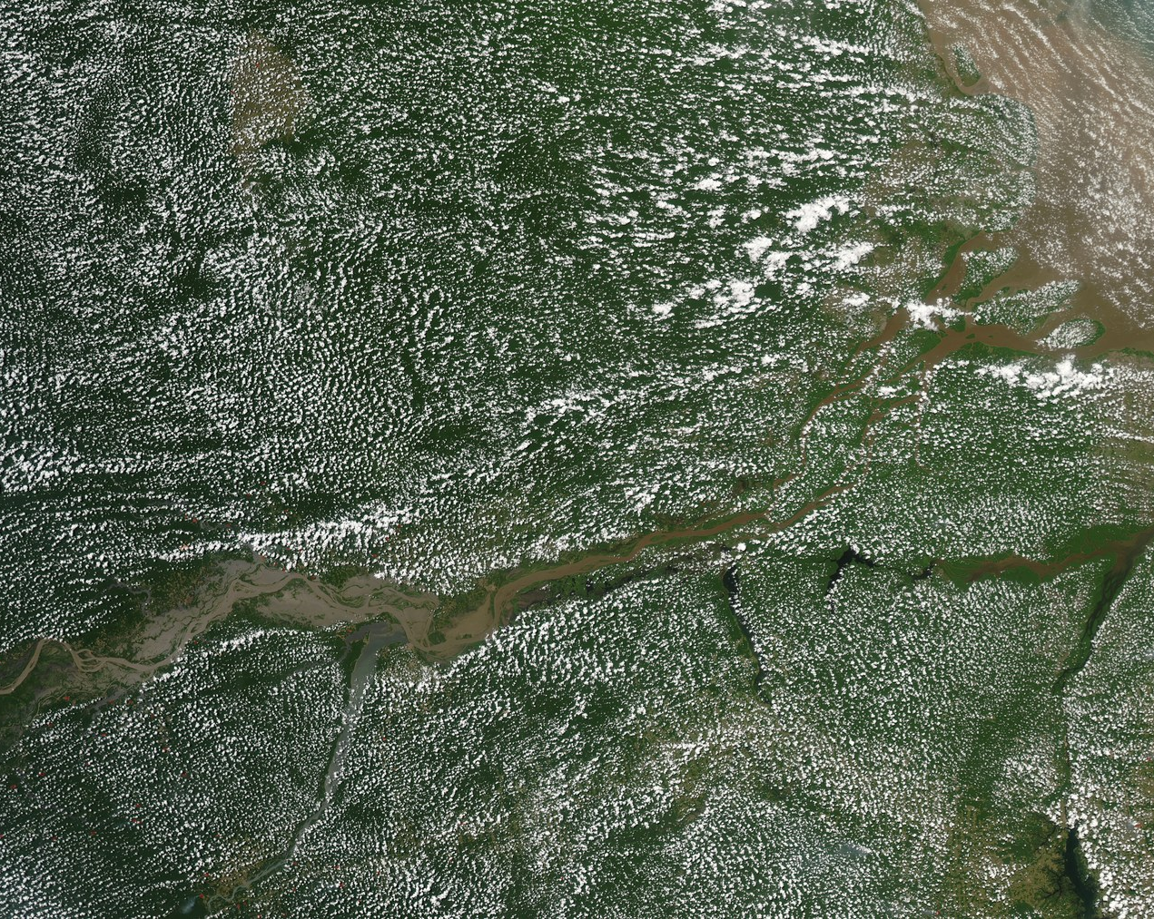
Motivation: clouds waste satellite imaging opportunities
Satellites have limited onboard storage and downlink capacity.
Cloud-blocked captures waste scarce imaging opportunities.
The valuable decision is not only where to image, but also when.
2

Slide 3
Current approach: Deterministic Planning
Targets are scheduled before the pass
The satellite points to each target and captures at the best estimated moment
Cloudy images are filtered later in post-processing
Limitation: no onboard reaction to current cloud cover.
Mission Control: decide obs. targets
Satellite images areas; fixed budget
Downlink image data
Postprocess
Cloud
No Cloud
Notes:
the satellite may be in the right place, but clouds can still make the image useless. This motivates onboard decision-making.

Slide 4
Research Question
Can a learned cloud-aware policy make better capture decisions than a fixed deterministic baseline?
Compare learned policy against deterministic baseline
Use matched simulation conditions
Focus on useful observation value, not just movement behavior.

Slide 5
Experiment Setup
2D satellite overflight simulation
Cloud-aware sensing and target geometry
Reward model for useful captures
ML training, evaluation, and rendering loop
Single episode artifact shared by training, evaluation, and visualization
Environment initialization
Simulation Kernel
state
action
Autonomous Agent (ML Model)
reward

Slide 6
Simplifications
Simplification | Reasoning | Risk
2d Model | - Fast RL iterations - Concept validation first | - Computational complexity in 3d too big for real application
Torque request action | - Allows simple ML integration (continuous variable), vs “Command interface” | - Manoeuvre planning more complex in real world application (RWA)
Assuming no sensor noise | Additional overhead to model with little proof of concept gain Sensor noise should be order of magnitudes lower for this high level control task | - Overfit to sat model (in RWA Sat 1 =! Sat 2)
Simplified Cloud model, static, discretized to 1km | Keep computational and modelling complexity low | Overfit to simple cloud model → random initialization
No Air Drag | Reduce unnecessary complexity Too low for partial orbit regime | -

Slide 7
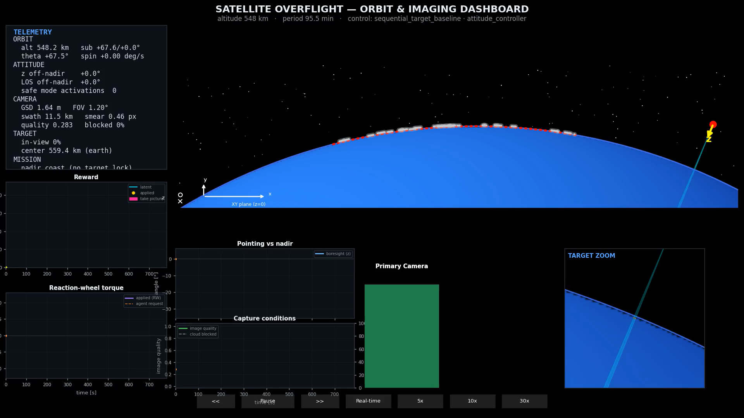
Deterministic baseline model: Demo
Sequentially tracks scheduled targets.
Captures near the best geometric imaging opportunity.
Does not use live cloud awareness.
Used as the reference policy for learned approaches.

Slide 8
ML formulation: what the agent sees and decides
state
action
reward
Orbit (pos relative to earth)
Attitude (orientation in space)
Pointing direction for targets
Primary and secondary vision array
Remaining image budget
Pointing request (torque / vector) :continous
Shutter command :boolean
+ Image quality
+ Coverage
+ Novelty
- Exceed shutter budget
- non-zero pointing request
Reward | Justification
Image quality | Avoid Motion Blur
Coverage | Fraction of the Image not covered by clouds
Novelty | Imaging an area twice is redundant
Exceed budget | When the budget is used up, we want to stop doing any manoeuvres
Pointing request | Any pointing request has an actuator energy implied, limit random movement

Slide 9
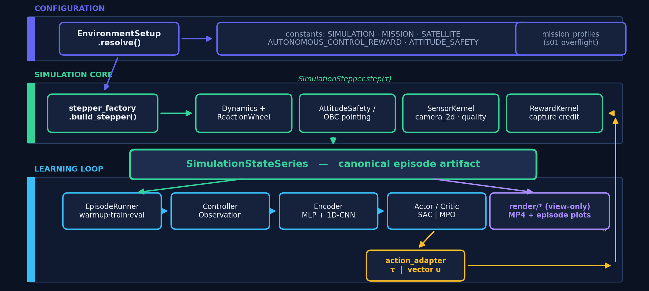
BU: System Architecture

