Slide 1
Autonomous Satellite control
Cloud-aware learned pointing · making the problem engineerable
Cédric Grieder
MSc Mechanical Engineering Student ETHZ
06. July 2026

Slide 2
Act I — Making the problem engineerable
Simulation, features, randomization, and a reproducible experiment pipeline

Slide 3
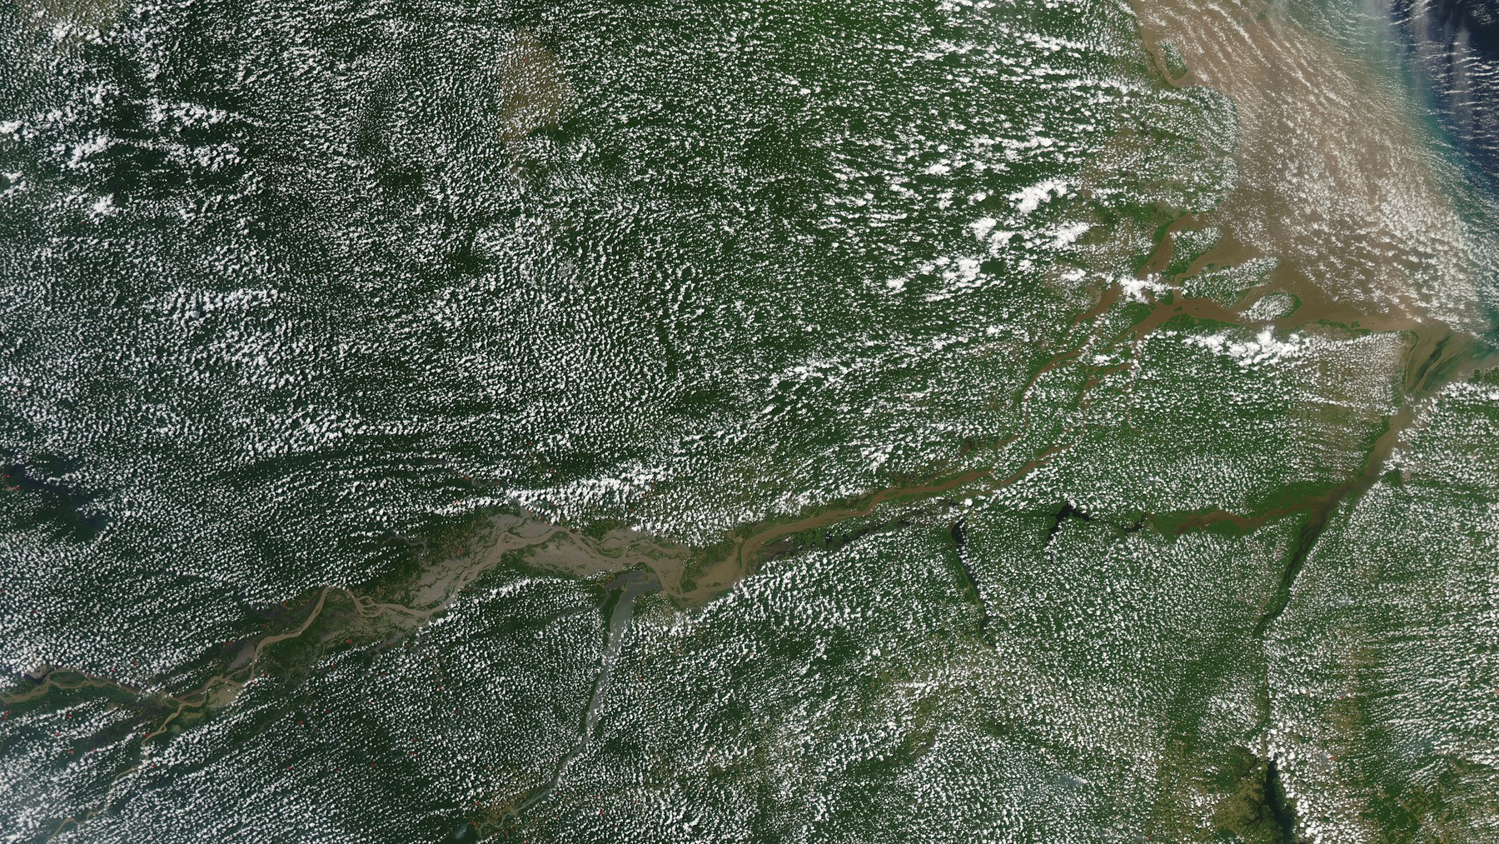
Motivation: clouds waste imaging opportunities
Satellites have limited onboard storage and downlink capacity.
Cloud-blocked captures waste scarce imaging opportunities.
The valuable decision is not only where to image, but also when.
Notes:
READ slide 2.

Slide 4
Research question
Can a cloud-aware learned policy outperform the deterministic baseline on observation value?
Compare learned policies against a fixed sequential baseline under matched simulation conditions.
Focus on useful captures — not motion for its own sake.
Status after early experiments: hypothesis not yet supported on matched episode return.

Slide 5
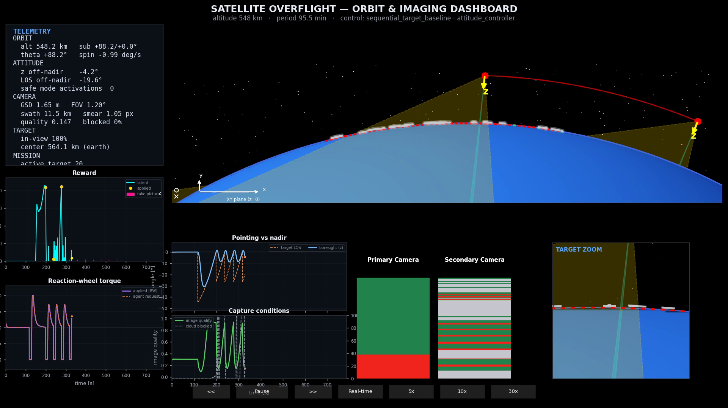
The bar: deterministic baseline (~393 mean return)
Baseline = SequentialTargetBaselinePolicy: fixed target list, best-estimate capture timing.
Matched warmup in SAC encoder run: return_mean ≈ 393, return_best ≈ 468 (summary_metrics.json).
This is the reference bar — not the smaller ~89 smoke-run warmup.
Every learned policy must be judged against this same-pipeline baseline.
Notes:
Run 9998217211235184 warmup block.

Slide 6
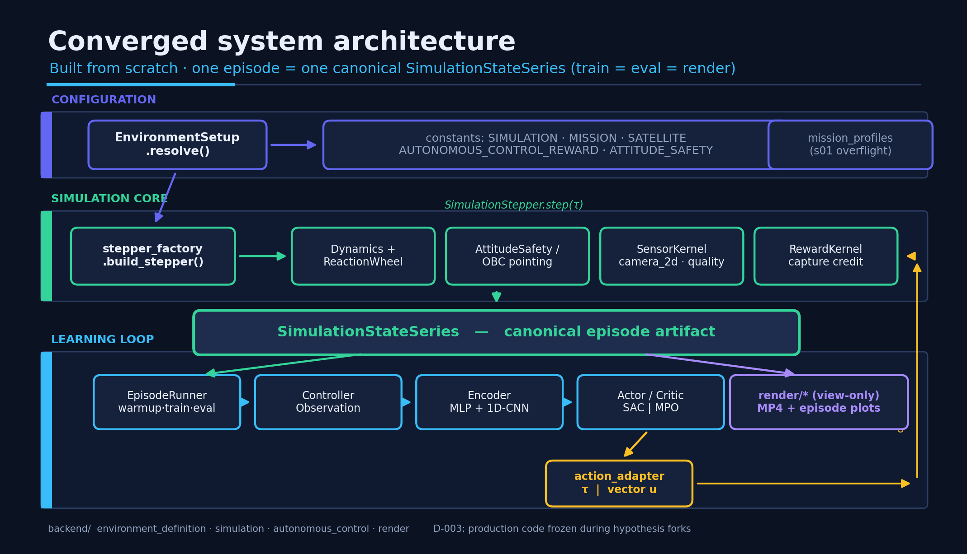
One system: sim → artifact → learn → render
One episode = one canonical simulation rollout (SimulationStateSeries).
Train, eval, and render consume the same simulation outputs.
Simulation owns physics, sensing, and reward; rendering is view-only.

Slide 7
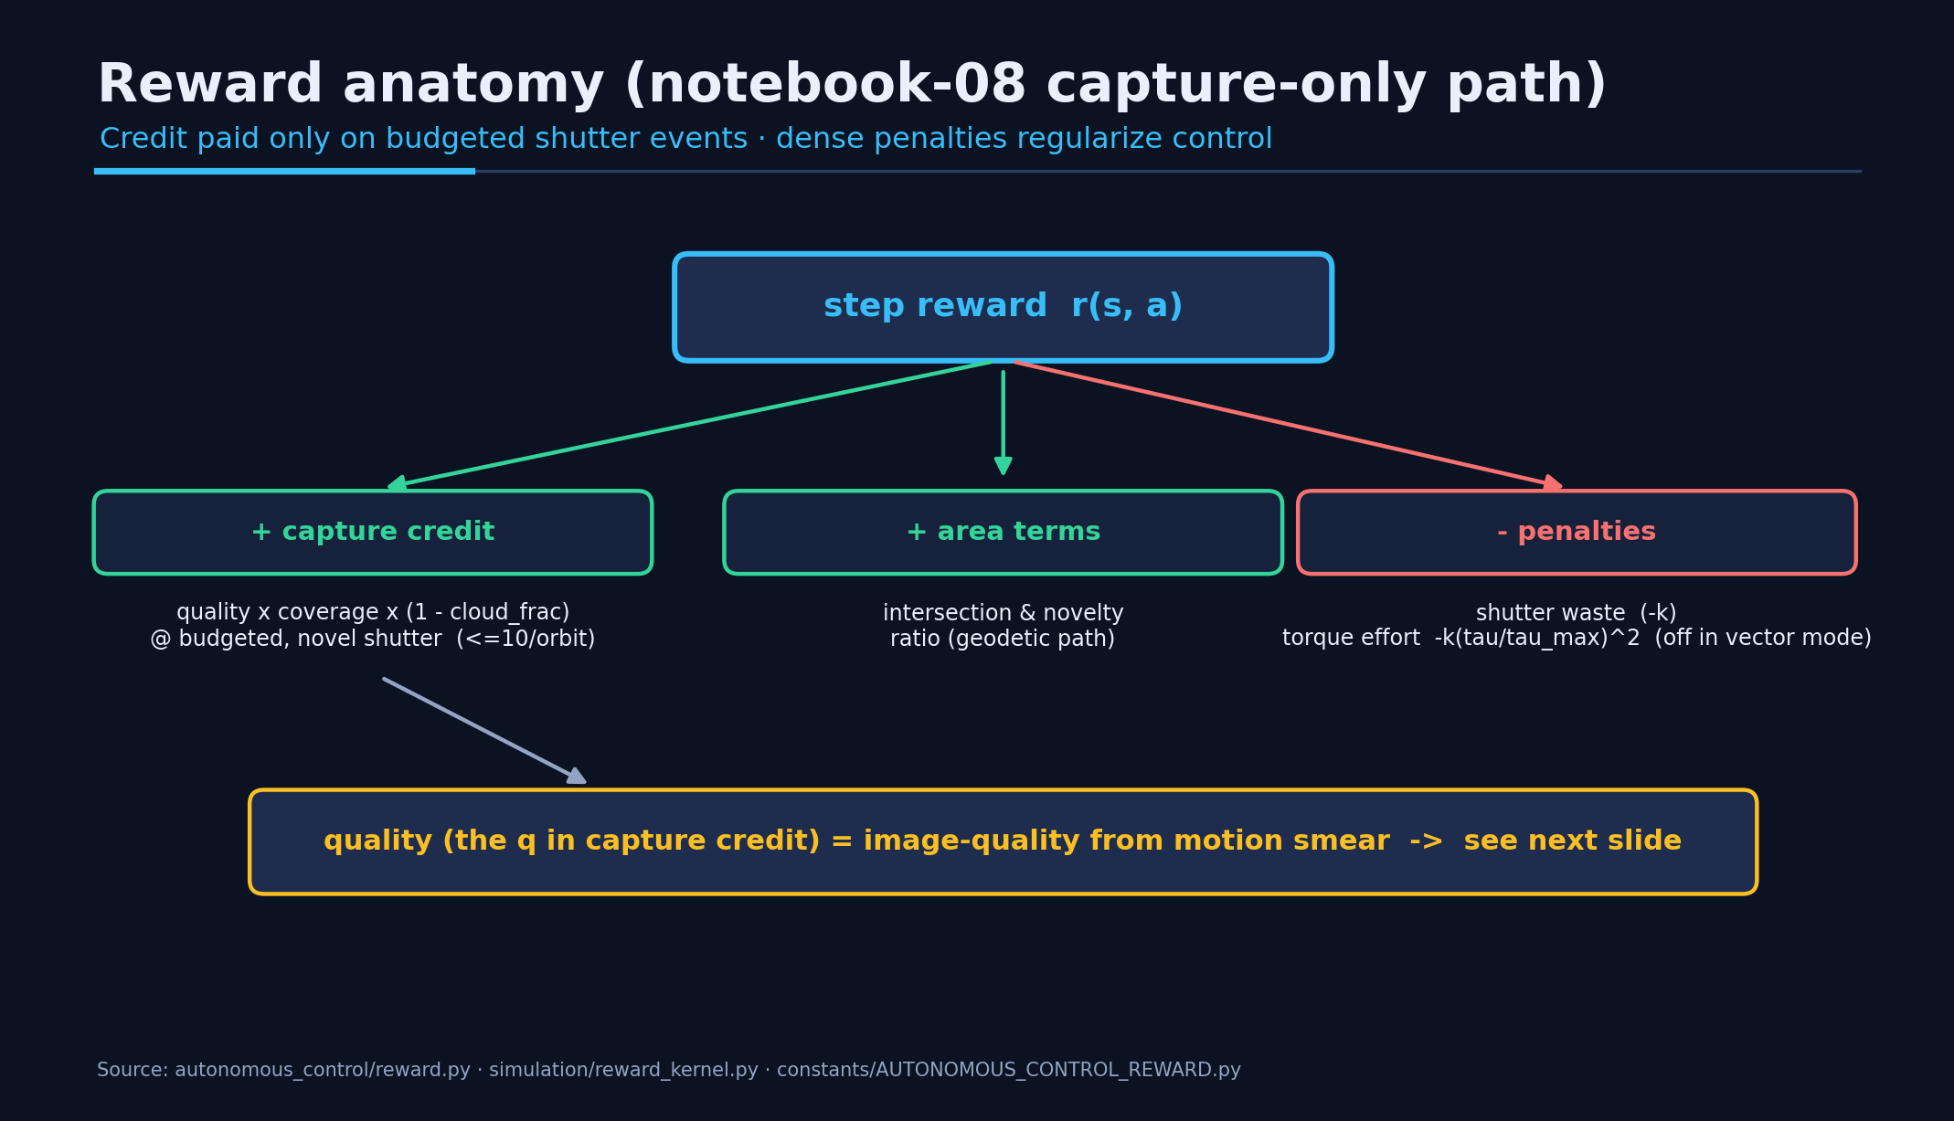
Features and reward — why learning could work
Observations: orbit, attitude, primary + secondary vision lines, shutter budget.
Actions: dim0 = control interface (see Act II); dim1 = shutter command.
Reward: image quality × coverage × novelty; penalties for budget waste and pointing effort.
Dense vision + shaped reward gives credit for timing clear windows — if the action interface is right.

Slide 8
Randomization and experiment method
Episode = one polar overflight; pre-maneuver segment included in canonical rollout.
Drawn each episode | Fixed across runs
Altitude ~U(510, 570) km | Physics, camera model, dt = 1.5 s
~50-target polar stripe position | Reaction-wheel and safety limits
Cloud field (seeded patches along corridor) | Baseline target schedule logic
Initial attitude / phase | Reward term definitions
 | Hypothesis → isolated change → plot/video verdict
Notes:
environment-hyperparameters.md

Slide 9
Act II — Early experiments: hypothesis not proven
Learning signal yes; beating the ~393 baseline no — three action interfaces tested

Slide 10
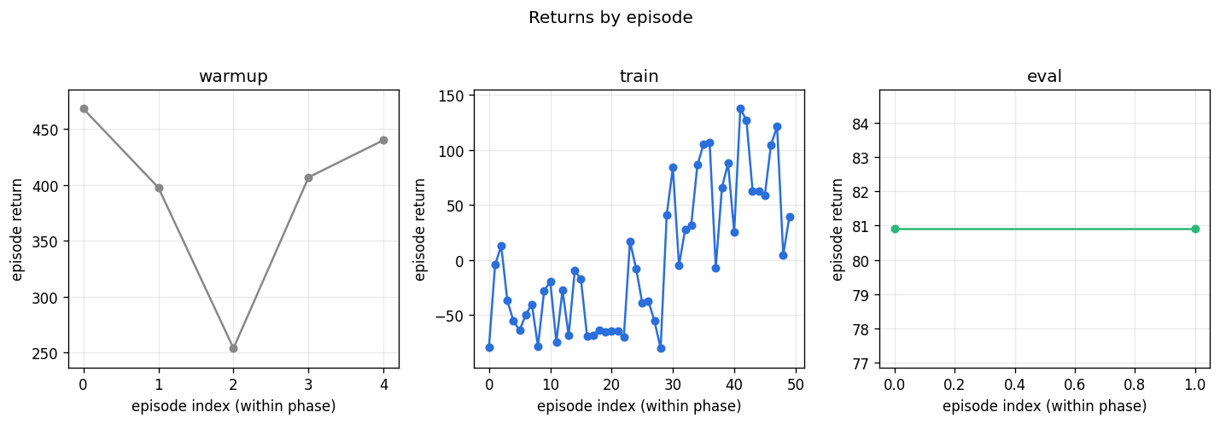
Returns vs the baseline bar
SAC compressed encoder (50 train eps): train return_mean ≈ 1.2, train_best ≈ 137, eval ≈ 81.
Warmup baseline in the same run: return_mean ≈ 393 — learned eval sits well below.
One high train episode is not beating the baseline; the mean curve does not cross the bar.
Dashed reference line in plot = deterministic warmup level.
Notes:
9998217211235184_ml_encoder_r2_sac_a1_03-06-04

Slide 11
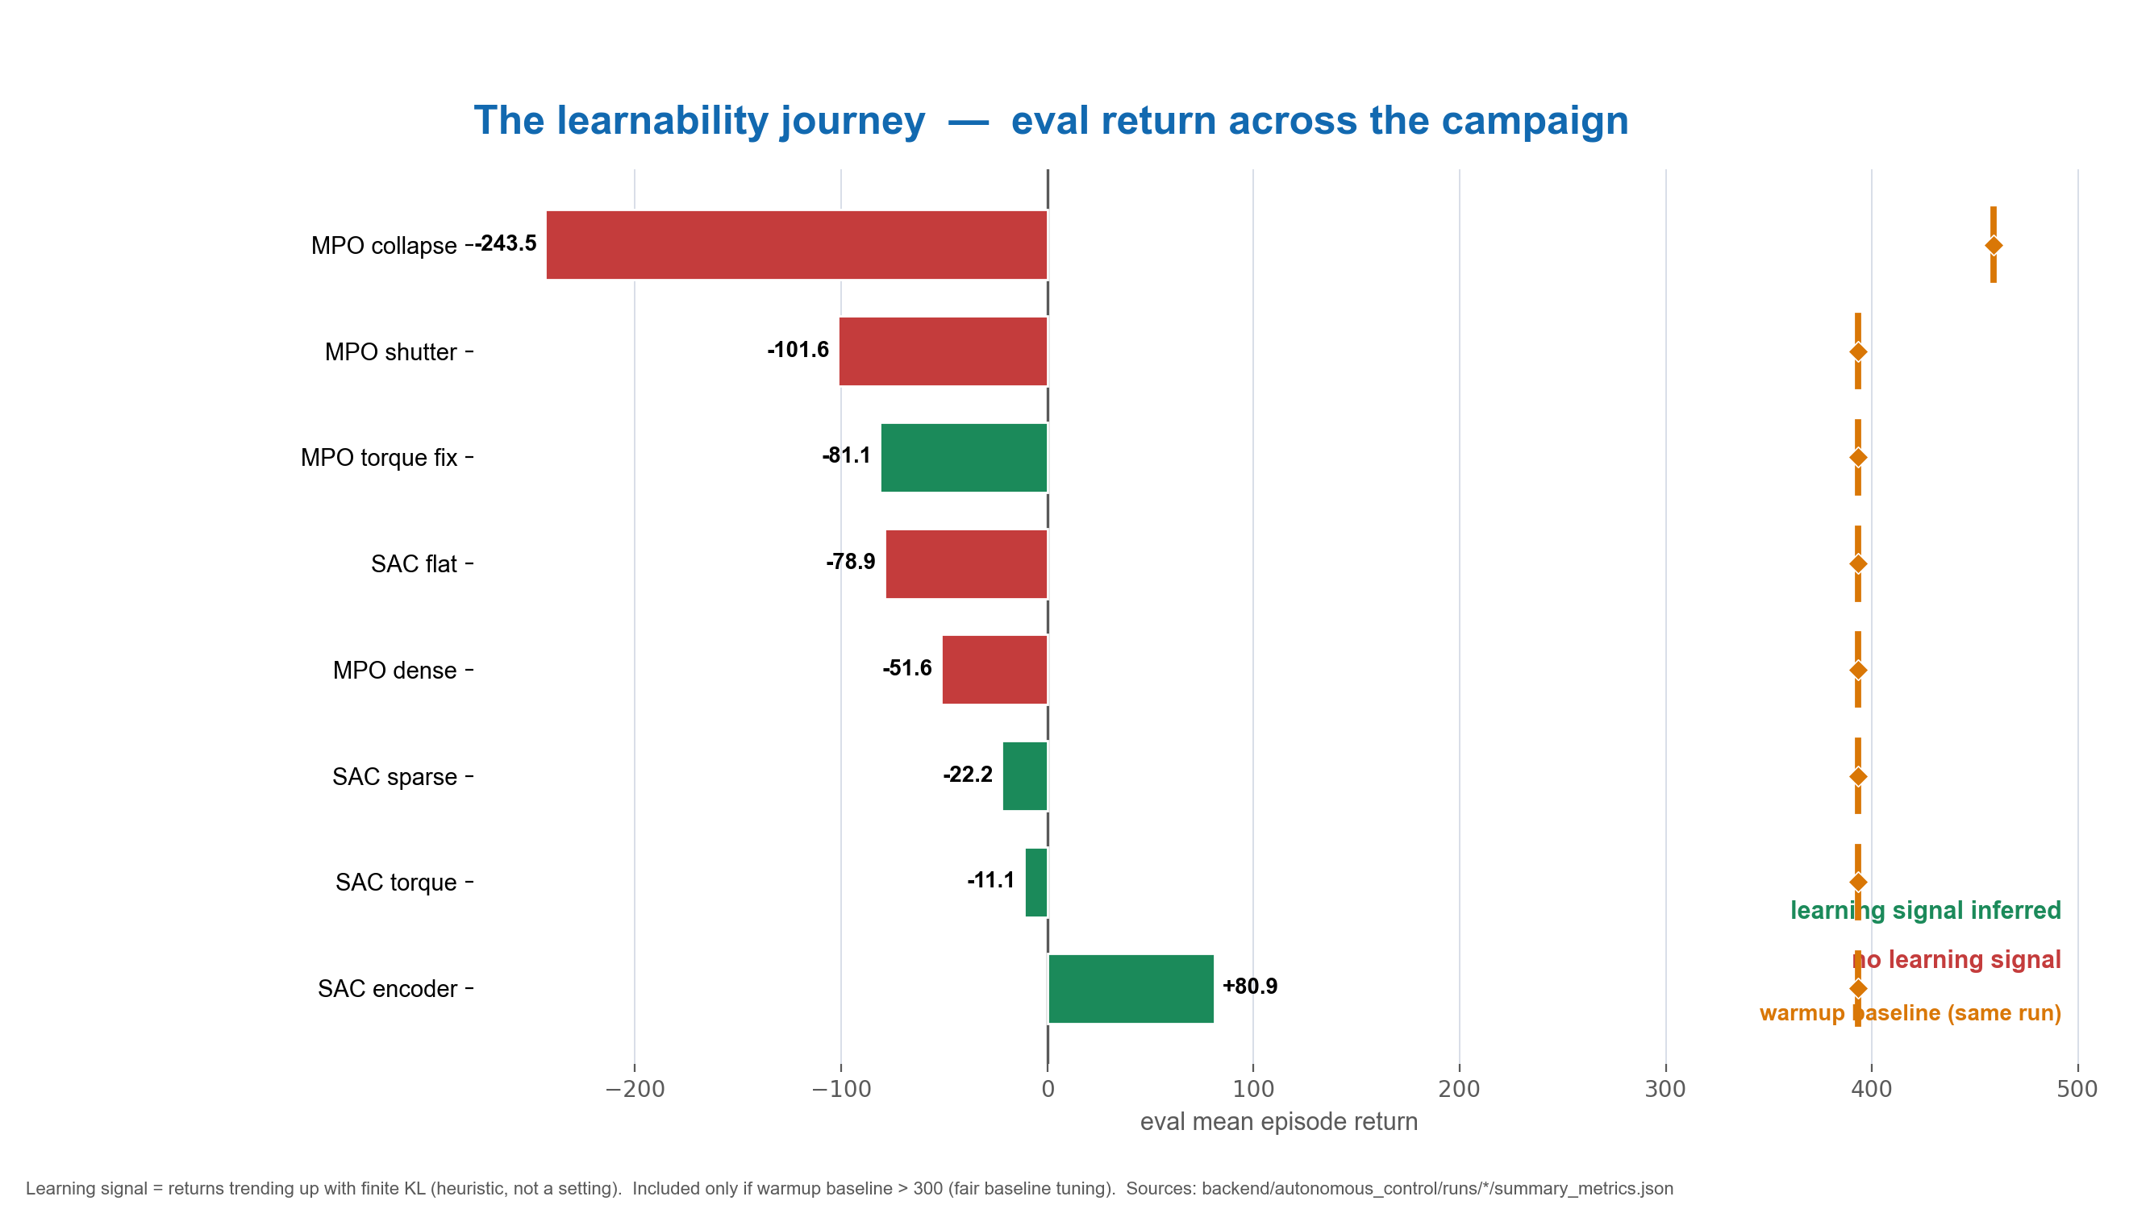
The learnability journey
Only runs with warmup baseline > 300 (fairly tuned deterministic reference).
Eval return (bars) vs same-run warmup (amber marker, ~393 for all shown).
Green = learning signal inferred; red = none. Best eval SAC encoder +81 — still below ~393 bar.
Notes:
diagrams/results_scoreboard.png — data from summary_metrics.json per run

Slide 12
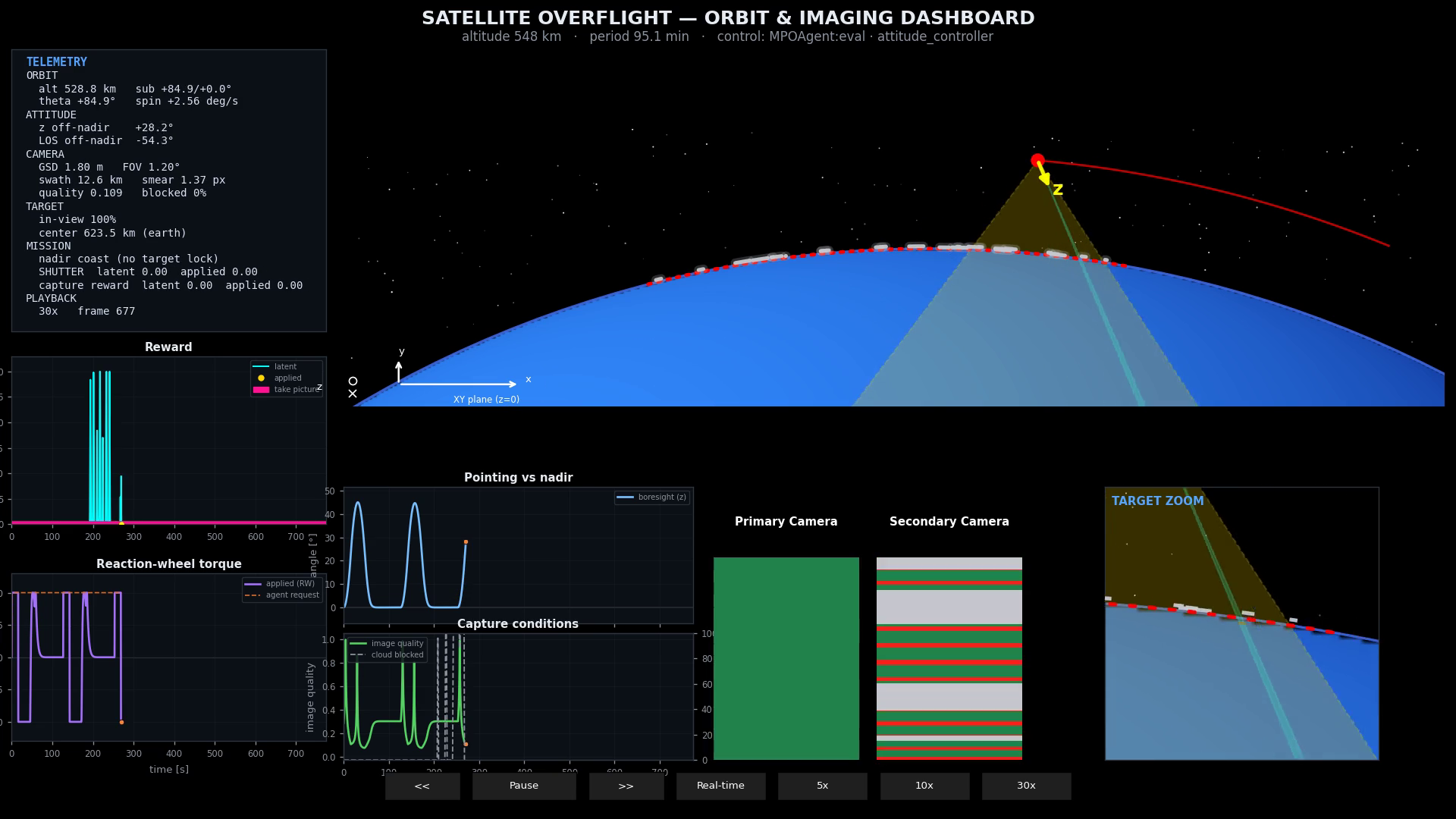
MPO collapse (torque mode)
First MPO torque experiments: eval ≈ −243, torque saturation, shutter spam.
Safe-mode activations throughout — no useful captures.
Motivated systematic experiment pipeline and implementation fixes (dual-KL bug).
▶ 02_mpo_collapse_safemode.mp4 — click-to-play (embed in PowerPoint)

Slide 13
Three ways to feed actions into the stack
Same shutter dim; dim0 semantics climb from low-level torque toward mission planning.
Interface | Agent decides | Low-level executes | Early outcome
1 · Torque (Ref0) | RW torque + shutter | Safety controller arbitrates torque | Learning signal; far below ~393 bar
2 · Vector (Ref1) | Nadir-relative offset u + shutter | OBC PD → torque | Tested (Exp 4/11); still below bar
3 · Target select (Exp 14) | Which target + move + shutter | PD OBC tracks latched target | Built & run; learning_mode false — not successful yet
Notes:
Exp 14 = ml_mpo_multienv_target_select

Slide 14
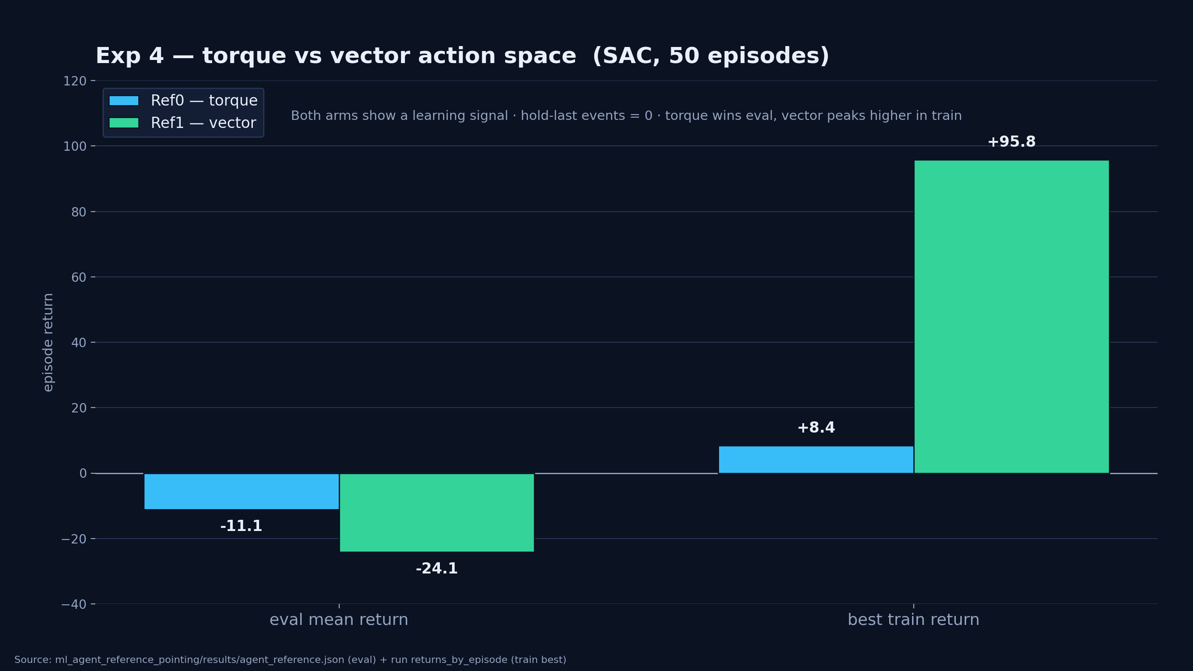
Interface 1 vs 2: torque vs vector
Question: is torque too hard — should the agent command pointing, not wheel torque?
Both arms show a learning signal; neither approaches warmup ~393 on eval return.
SAC: torque eval −11.1 vs vector −24.1. MPO: vector +45.5 vs torque −81.1 — mode preference is algorithm-dependent.
Partial segregation helps diagnostics; does not close the mission gap yet.
Notes:
agent_reference_pointing experiment

Slide 15
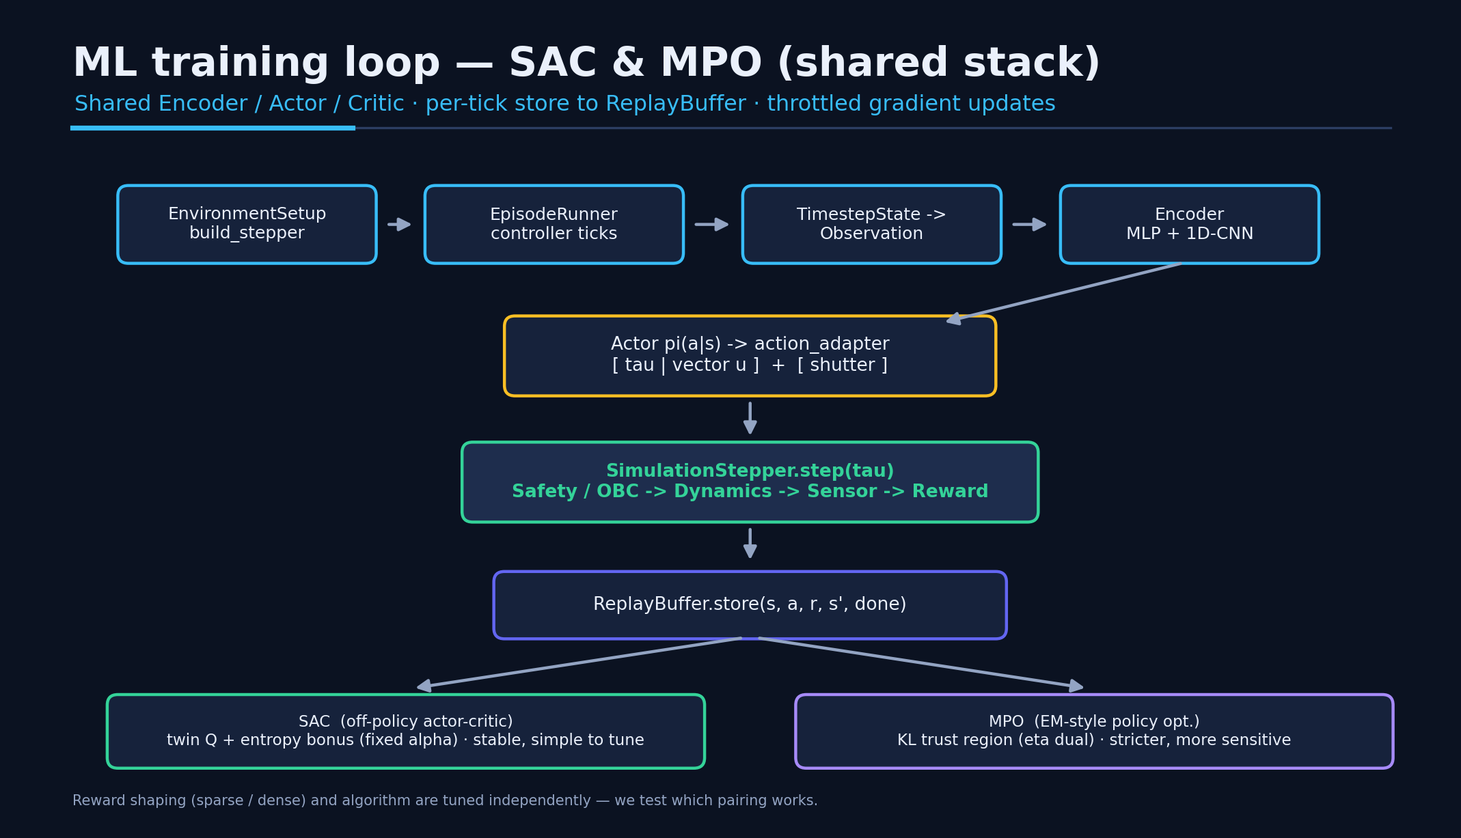
Interface 3: target selection + OBC (Exp 14)
Radical shift: Categorical(50) target + move + shutter; PD OBC when move=True.
Primary KPI = mission score (quality × coverage per capture), not raw return alone.
Multi-environment curriculum; eval on unseen env seeds.
Screen arm hp_default: learning_mode false; mission_score_mean ≈ 3.2; eval_return ≈ 0 — not successful yet.
Critical implementation bugs found and fixed before Phase 2; architecture reuse validated.
Notes:
ml_mpo_multienv_target_select

Slide 16
What the experiments did prove
The problem is engineerable: reproducible runs, KPIs, videos, and isolated hypotheses.
Failures are diagnosable (MPO dual bug, encoder choice, reward penalties, action interface).
SAC and fixed MPO can learn non-trivial structure; MPO vector mode shows mode-dependent gains.
Superiority over the ~393 deterministic baseline on matched return: not demonstrated.

Slide 17
Act III — Why we still believe this path
Segregate learning from low-level control; let AI choose what to point at

Slide 18
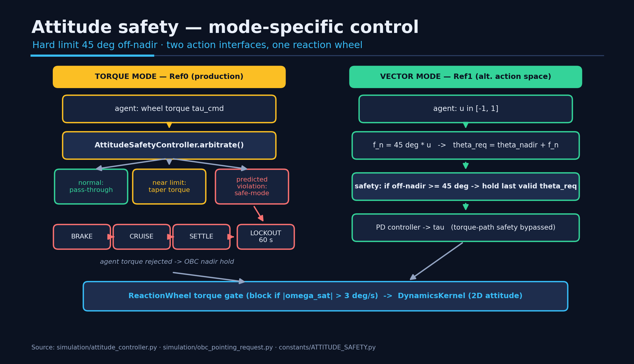
Segregate concerns: planner · pilot · plant
North star: hierarchical mission planner over OBC low-level tracking.
Wrong split: RL learns raw torque — couples timing, dynamics, and safety arbitration.
Right split: RL chooses target / when to move / when to shoot; OBC closes the pointing loop.
Exp 14 is the first prototype of that split — early run unsuccessful, direction unchanged.
Notes:
project-charter north-star architecture

Slide 19
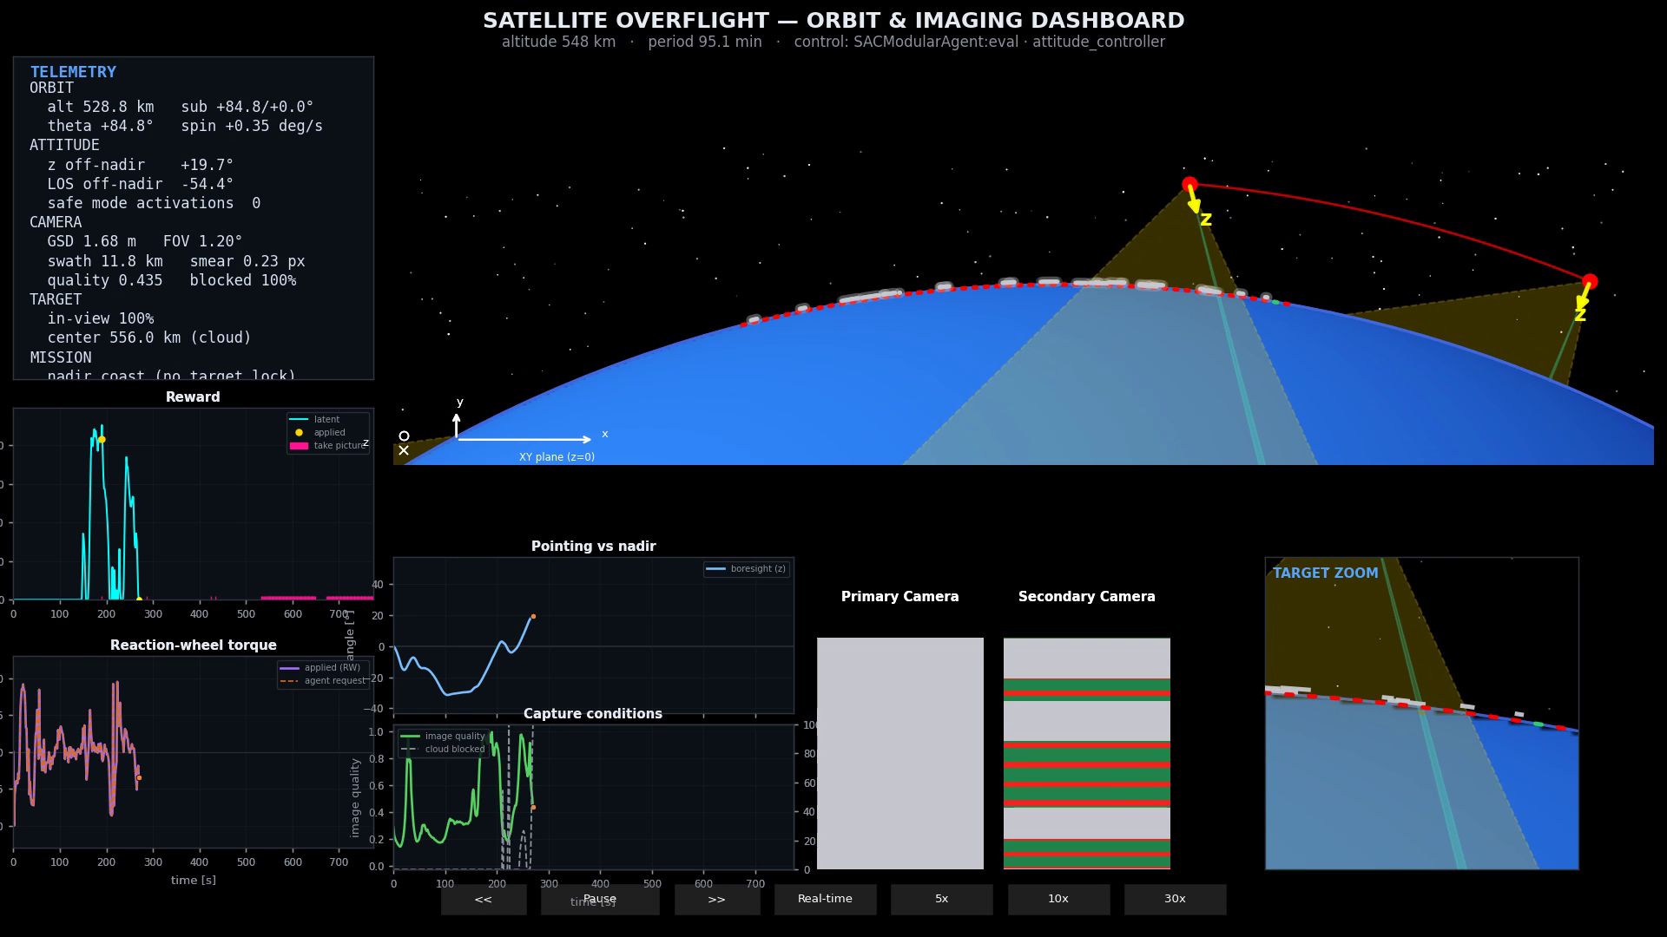
Behavioral evidence below the return bar
Even when return < baseline, eval video shows structured pointing and shutter timing.
Behavioral claims require video — aggregate KPIs alone are insufficient.
Return gap may be reward shaping / interface / training budget — not absence of learning.
▶ 03_sac_first_good_result.mp4 — click-to-play (embed in PowerPoint)
Notes:
User-sign-off on frames before behavioral verdict in talk.

Slide 20
Open work and close
Align training reward with mission score; iterate Exp 14 curriculum and factorized policy.
Matched eval protocol: same clouds / altitude / targets for best learned policy vs baseline ~393.
Continue climbing the action ladder: torque → vector → target select → full mission planner.
One-liner: we made cloud-aware onboard imaging an engineerable RL problem — hypothesis deferred, path convinced.

