Slide 1
Autonomous Satellite Control
Cloud-aware learned pointing in a from-scratch 2D simulation · full work review
Cedric Grieder · ETH x Beyond Gravity semester project

Slide 2
S1
1 · Problem & mission
Why cloud-aware Earth observation needs onboard intelligence
Autonomous Satellite Control
01

Slide 3
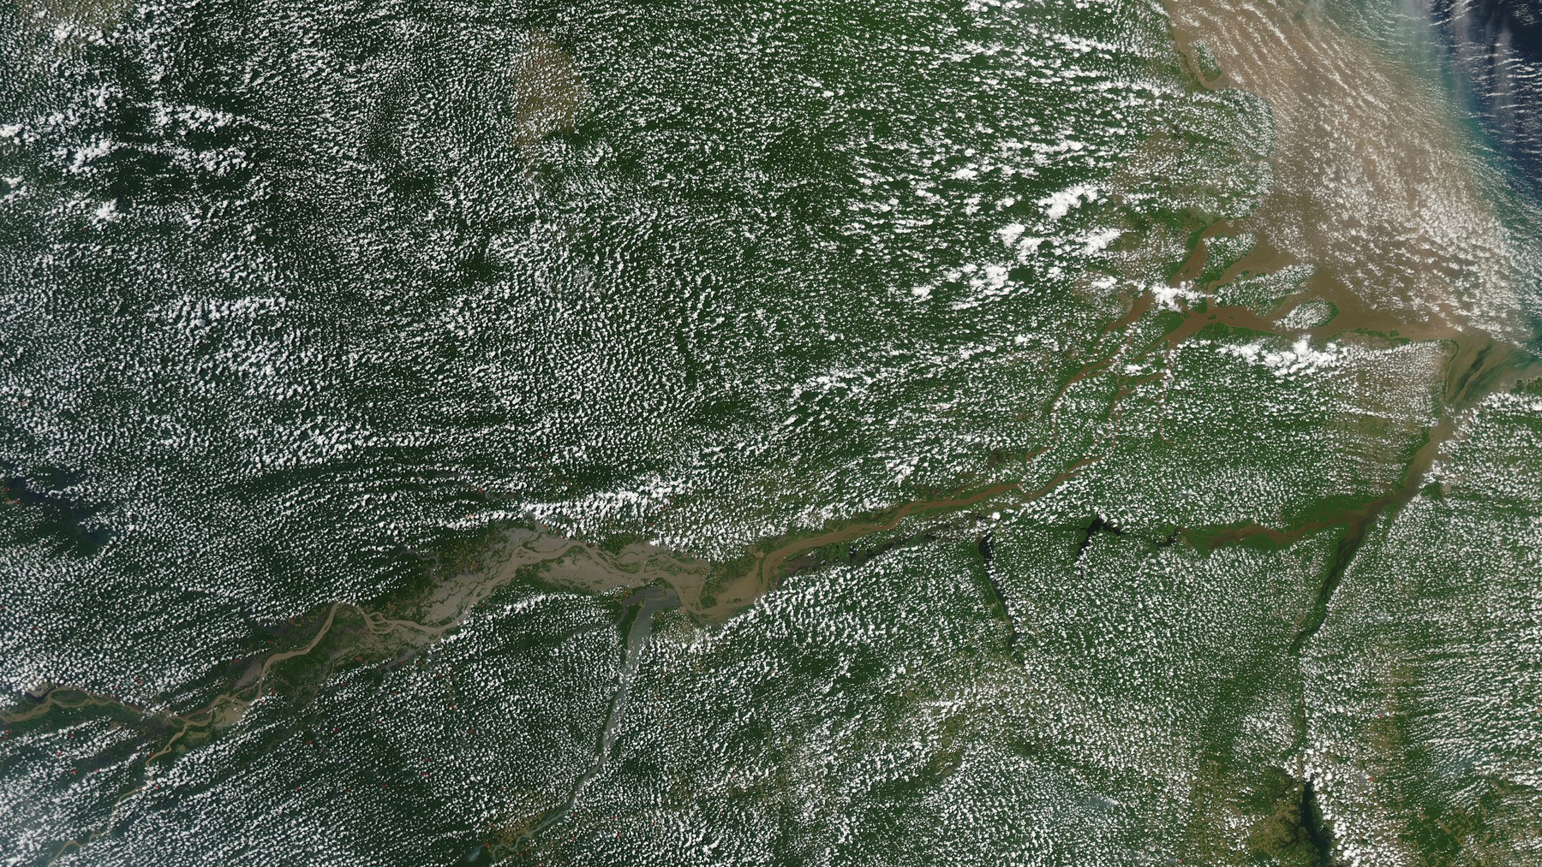
M01 Rainforest EO under clouds
▸ Earth observation of rainforests is constantly defeated by cloud cover.
▸ From orbit, much of every pass is cloud-blocked — capturing the clear moments is the whole game.
▸ Image: clouds scattered over the Amazon basin (Wikimedia Commons, NASA/aerial).
Autonomous Satellite Control
02
Notes:
Hook-first opening: the cloud-occlusion problem, made concrete.

Slide 4
M02 Agenda
▸ 1 · Problem & mission — cloud-aware EO and today's deterministic baseline.
▸ 2 · The system we built from scratch — simulation, sensing, reward, ML, safety.
▸ 3 · Scientific method — the hypothesis-driven experiment pipeline.
▸ 4 · Results & evidence — what learns, what does not, and the video proof.
▸ 5 · Conclusion & next steps.
Autonomous Satellite Control
03
Notes:
Roadmap.

Slide 5
M03 Current practice & the baseline
▸ Current practice: scientists pre-define which areas to image; cloudy frames are filtered out later in post-processing.
▸ That spends scarce memory and downlink on cloud-blocked captures and cannot react to live conditions.
▸ Our baseline mimics today's plan: a fixed set of targets along the pass, imaged at the best (closest) estimated quality, then move to the next.
▸ Fixed attitude + pre-planned shutter — no onboard cloud awareness. Best seen in the video next.
Autonomous Satellite Control
04
Notes:
Links the scheduling concept to the deterministic baseline policy.

Slide 6
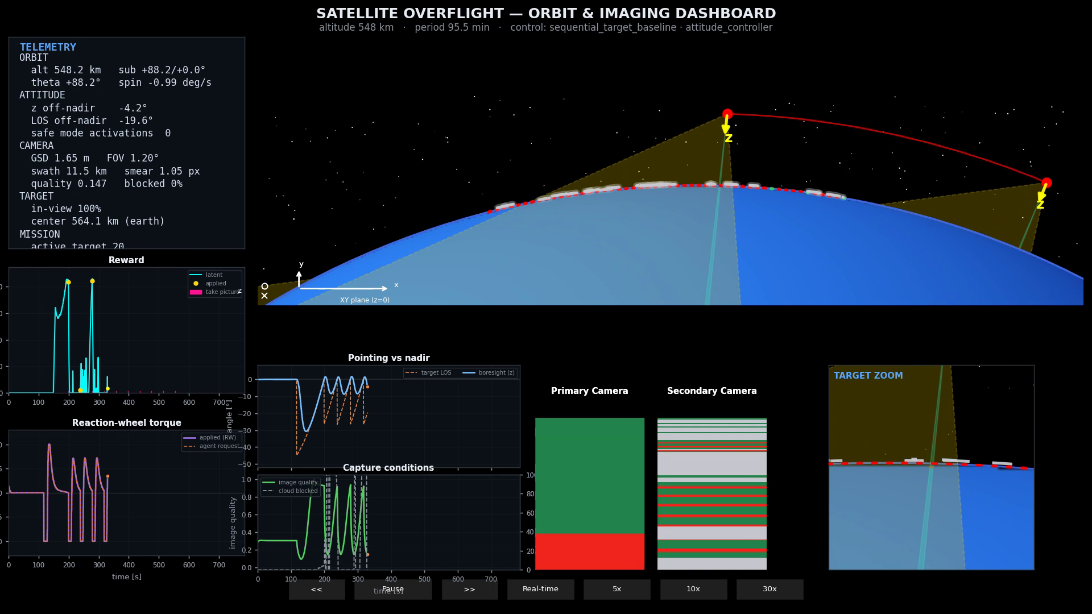
M04 The deterministic baseline (video)
▸ Deterministic baseline = SequentialTargetBaselinePolicy (OBC pointing).
▸ Slews to point at each scheduled target, images at the best (closest) pass, then advances to the next.
▸ Boresight tracks each target's line-of-sight (see 'Pointing vs nadir'), but it does not react to live cloud cover.
▸ This is the reference every learned policy must beat (warmup mean return ~ +89).
▸ Same dual-camera dashboard used for all clips in this deck.
▶ click to play · 01_baseline_deterministic.mp4
Autonomous Satellite Control
05
Notes:
Embedded; click to play. Source: warmup rollout (baseline policy).

Slide 7
M05 Primary research question
▸ Can a cloud-aware learned policy outperform the deterministic baseline on observation value?
▸ Observation value = successful captures weighted by image quality, coverage, and target novelty.
▸ Compared on matched setups: same clouds, altitude, and target layout per episode.
Autonomous Satellite Control
06
Notes:
docs/project-charter.md.

Slide 8
M06 Scope & non-goals
▸ In scope: single-satellite 2D overflight simulation with cloud-aware sensing, built from scratch.
▸ Simplifications: 2D attitude, single pass, simulated vision — not flight hardware.
▸ Non-goals: multi-satellite ops, 3D deliverable, SOTA RL benchmark chasing.
▸ North star: hierarchical mission planner over OBC tracking; direct torque RL is interim.
Autonomous Satellite Control
07
Notes:
Charter scope + north star.

Slide 9
S2
2 · The system we built from scratch
Simulation core, sensing, reward, ML loop and renderer — one converged architecture
Autonomous Satellite Control
08

Slide 10
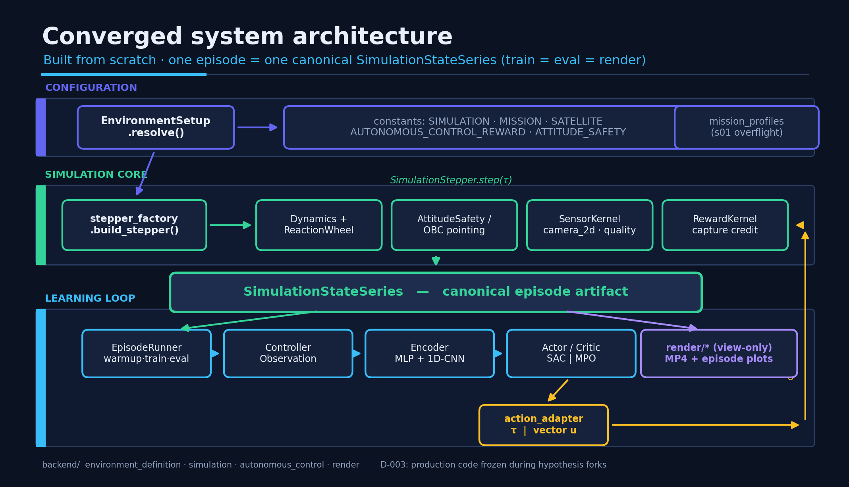
M07 Converged system architecture
▸ Config -> simulation core -> canonical artifact -> learning loop & render, with a closed action loop.
▸ Invariant: one episode = one SimulationStateSeries, shared by train, eval and render.
Autonomous Satellite Control
09
Notes:
diagrams/architecture_overview.png (presentation_diagrams.py).

Slide 11
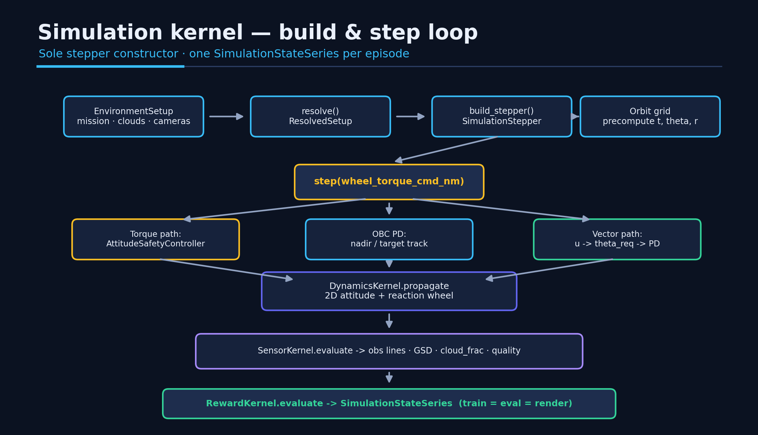
M07c Simulation kernel — build & step loop
▸ build_stepper() is the sole constructor; every step runs control -> dynamics -> sensor -> reward.
▸ Torque, OBC-PD and vector paths all converge on the same dynamics and the same artifact.
Autonomous Satellite Control
10
Notes:
diagrams/simulation_kernel_flow.png.

Slide 12
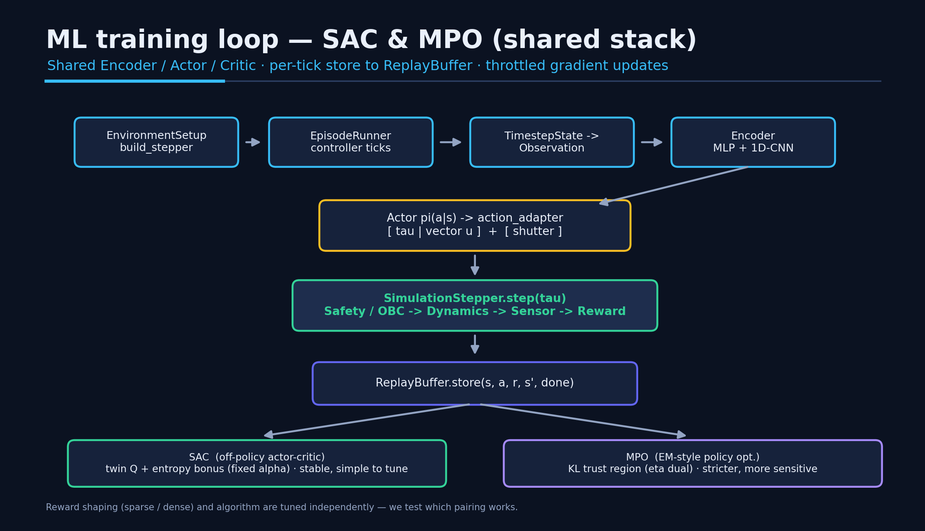
M07b ML training loop — SAC & MPO
▸ Shared Encoder / Actor / Critic; per controller-tick store to the ReplayBuffer.
▸ Reward shaping (sparse / dense) and algorithm (SAC / MPO) are tuned independently — we test which pairing works.
Autonomous Satellite Control
11
Notes:
diagrams/ml_agents_flow.png.

Slide 13
M09 Algorithms in plain language
▸ Both SAC and MPO are reinforcement-learning algorithms: they improve a control policy by trial-and-error from rewarded experience.
▸ SAC (Soft Actor-Critic): off-policy, reuses past experience from a replay buffer, and adds an 'exploration bonus' to keep trying new actions. Stable and forgiving. Main knobs: exploration weight (alpha), learning rate, network width.
▸ MPO (Max a-posteriori Policy Optimisation): updates the policy inside a 'trust region' so it can never change too fast. Powerful but sensitive. Main knobs: trust-region size (KL), the eta dual, learning rate.
▸ Rule of thumb: SAC is the safe, simple choice; MPO can be stronger but is harder to keep stable.
▸ On this task SAC produced learning where MPO collapsed (results section).
Autonomous Satellite Control
12
Notes:
Broad-audience explainer; non-ML coworkers.

Slide 14
M08 ML integration — observations & actions
▸ Observation: attitude + orbit scalars, primary/secondary camera observation-line codes, mission scalars (capture budget, per-target imaged mask, bearing errors).
▸ Encoder: scalar MLP fused with a 1D-CNN over each camera line (k=5, channels 16->32, embed dim 32).
▸ Action (2D): dim0 = reaction-wheel torque (Ref0) OR nadir-relative vector u (Ref1); dim1 = continuous shutter.
▸ The same observation/action interface feeds either algorithm and either reward shaping.
Autonomous Satellite Control
13
Notes:
machine-learning.md observations/actions.

Slide 15
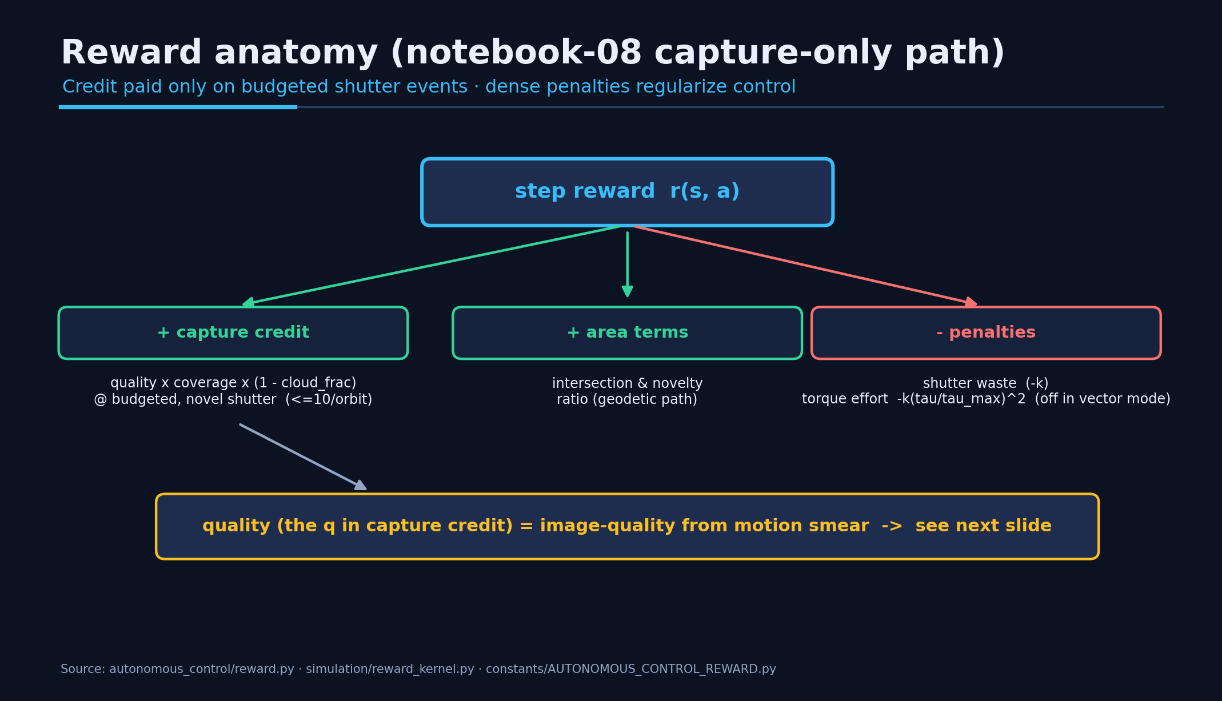
M10 Reward anatomy
▸ Capture credit = quality x coverage x (1 - cloud_frac), paid only on budgeted, novel shutter events (<=10/orbit).
▸ Dense penalties (shutter waste, torque effort) regularize control.
▸ 'quality' is the image-quality term from motion smear — detailed on the next slide.
Autonomous Satellite Control
14
Notes:
diagrams/reward_anatomy.png. Source: autonomous_control/reward.py.

Slide 16
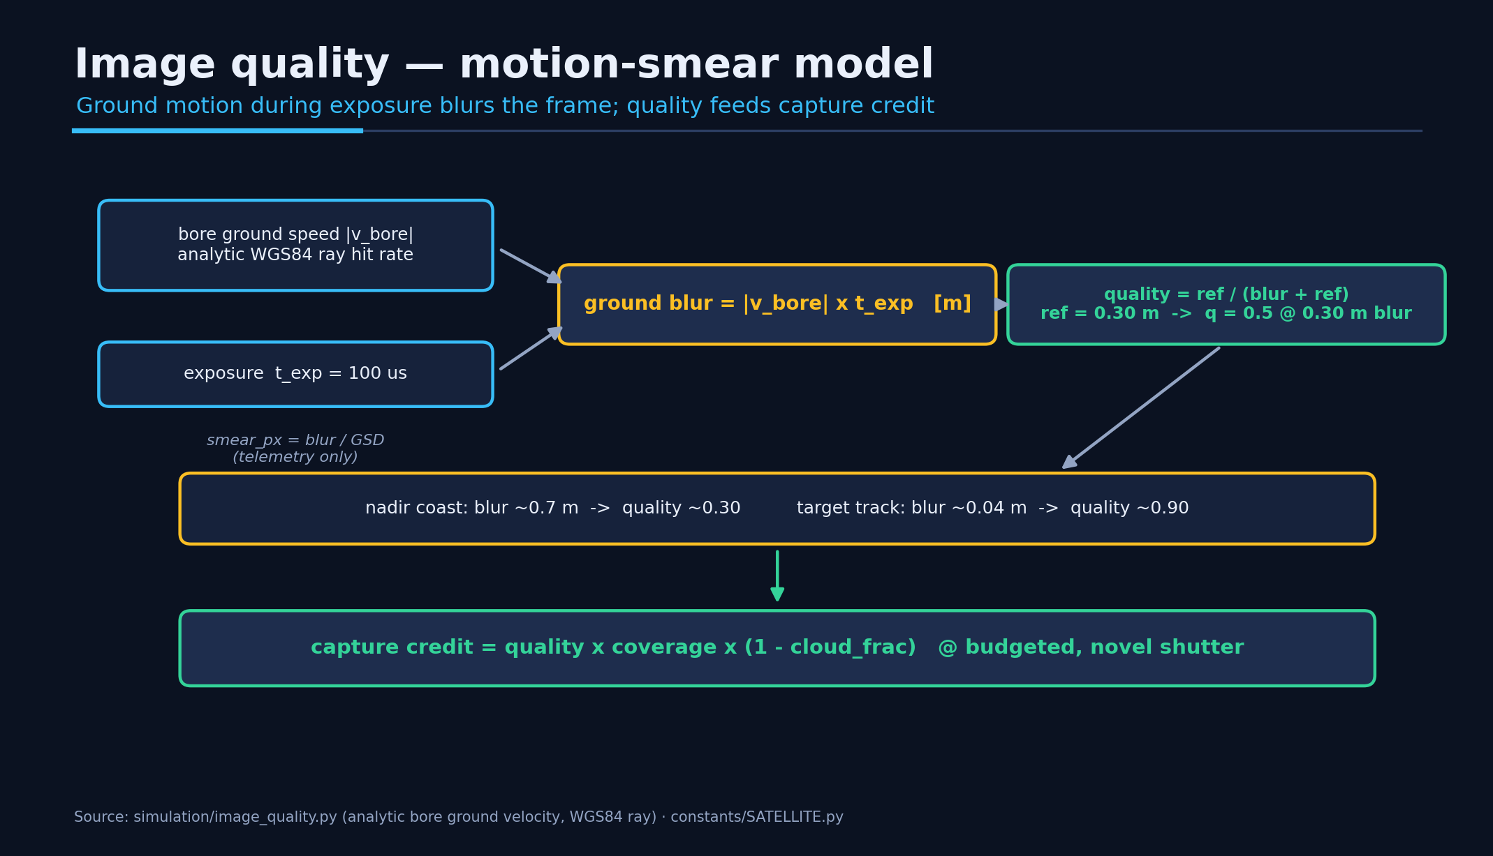
M10b How image quality is computed
▸ Ground motion during the 100 us exposure blurs the frame: blur = |v_bore| x t_exp.
▸ quality = ref / (blur + ref), ref = 0.30 m -> quality 0.5 at 0.30 m blur, ~1.0 at zero motion.
▸ Holding a target (low relative ground speed) -> low blur -> high quality; nadir coast smears more.
▸ quality scales the capture credit, so steady on-target pointing is rewarded.
Autonomous Satellite Control
15
Notes:
diagrams/image_quality.png. Source: simulation/image_quality.py.

Slide 17
M10c The shutter budget
▸ Onboard limit: max 10 primary-camera captures per orbit (MAX_PRIMARY_CAPTURES_PER_ORBIT) — a memory + downlink budget. One episode ≈ one orbit pass.
▸ The agent sees capture_budget_remaining in its observation, so it always knows how many shots are left.
▸ Capture credit is paid only while budget remains and the target is novel; once the 10 shots are spent, extra shutter earns nothing and incurs the shutter-waste penalty.
▸ So the task is to spend the best 10 moments — clear, high-quality, novel targets — not to shutter constantly.
▸ This is why the MPO collapse (~516 shutter commands against a budget of 10) is almost pure waste.
Autonomous Satellite Control
16
Notes:
Source: constants/SATELLITE.py (MAX_PRIMARY_CAPTURES_PER_ORBIT=10); observation include_capture_budget; reward shutter-waste penalty.

Slide 18
M11 Satellite & sensor setup
"Bus" = the satellite platform (structure, power, wheels) that carries the camera payload.
Subsystem | Key parameters
Platform (bus) | 250 kg · 2D env inertia Izz = 31.2 kg·m²
Reaction wheel | max torque 0.1 N·m · momentum 0.4 N·m·s · omega_w_max 150 rad/s
Attitude limits | star-tracker slew 3°/s · hard limit 45° off-nadir
Primary camera | 9344×7000 px · 3.2 µm pitch · 1067 mm focal · 100 µs exposure
Sensing | primary observation line 100 bins + secondary context 200 bins · ray-traced clouds
Mission | altitude ~U(510, 570) km · ~50-target polar stripe · dt 1.5 s · ≤1000 steps/episode
Autonomous Satellite Control
17
Notes:
technical-constants.md + environment-hyperparameters.md.

Slide 19
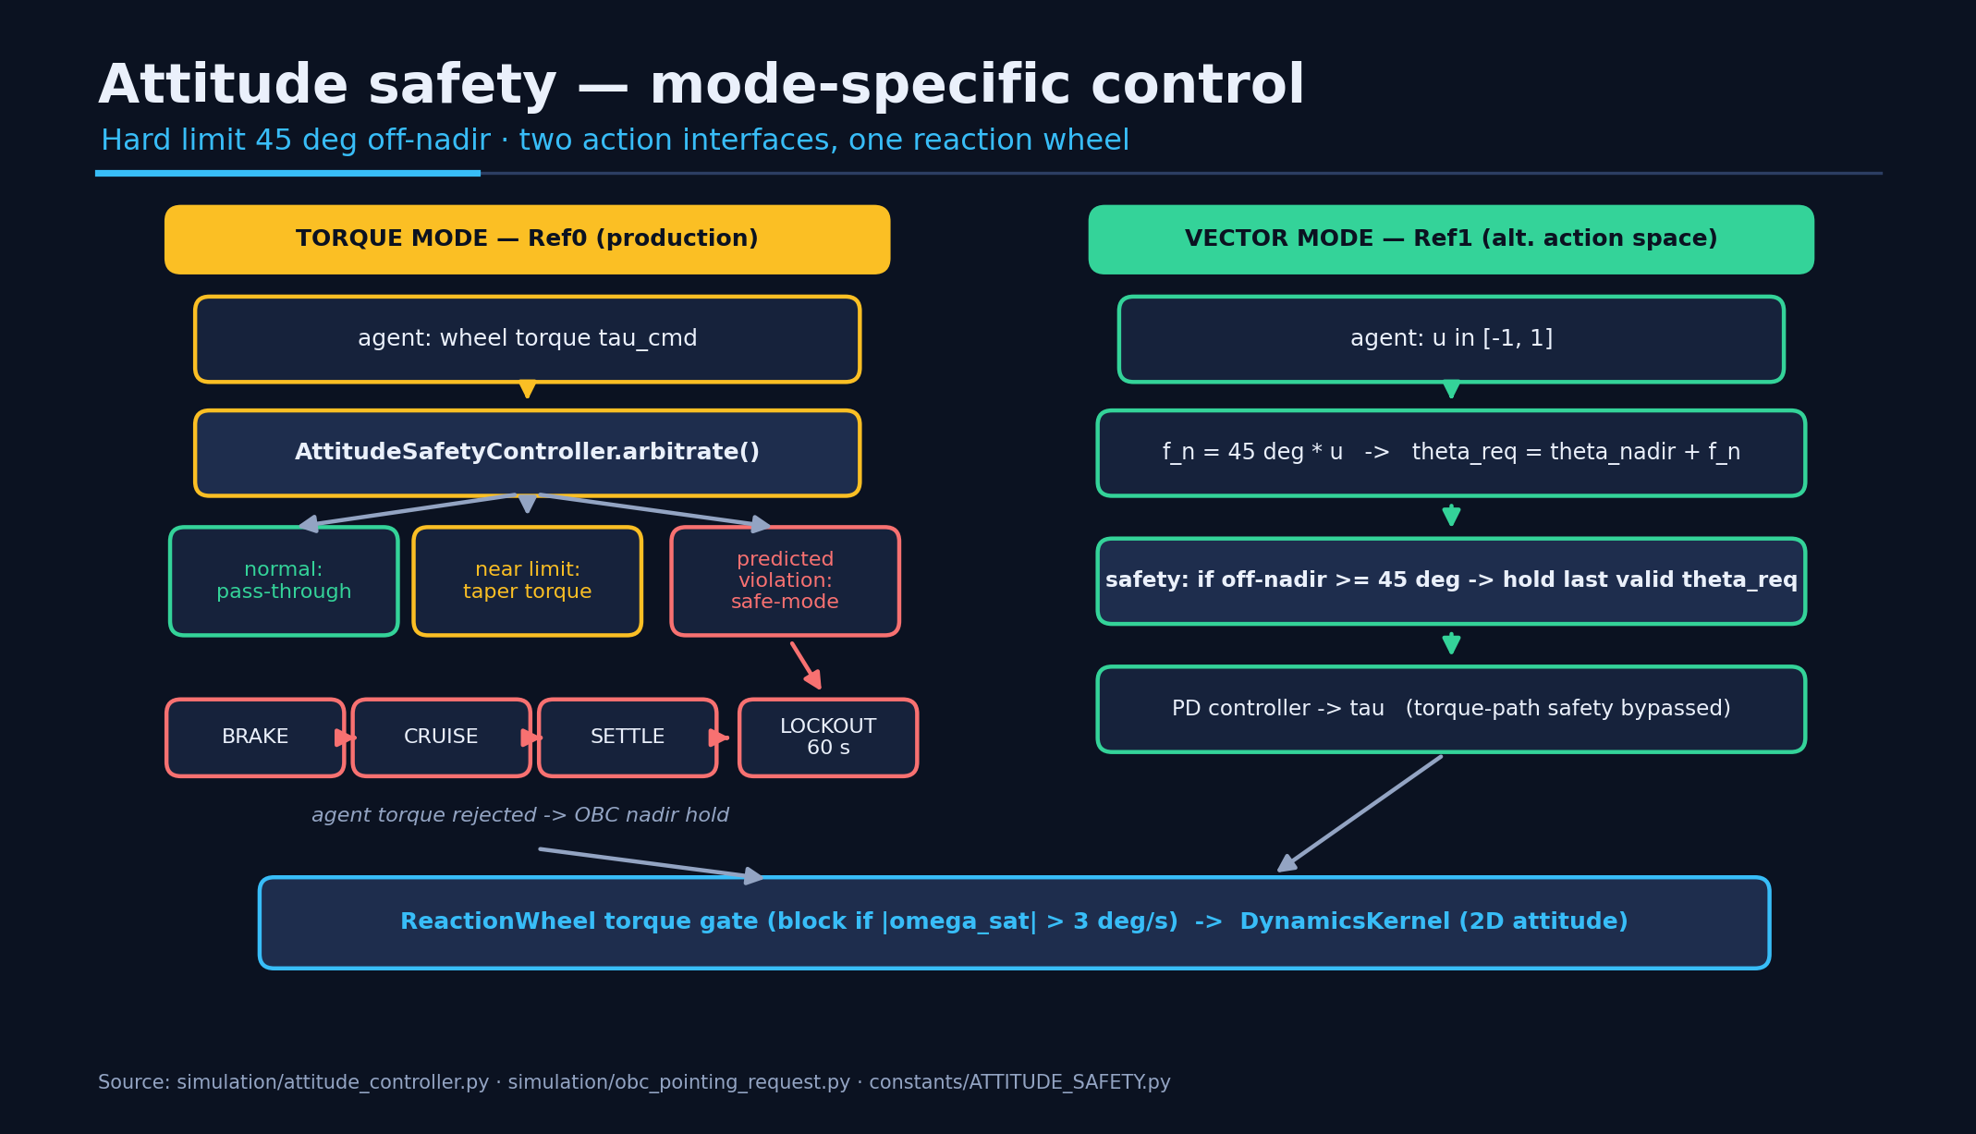
M12 Safety — mode-specific control
▸ Torque mode (Ref0): agent torque is arbitrated -> pass-through / taper / safe-mode (BRAKE->CRUISE->SETTLE->LOCKOUT 60 s).
▸ Vector mode (Ref1): safety acts on the pointing request (hold-last at 45°), the torque-path safety is bypassed.
▸ Both paths share one reaction-wheel gate and the same dynamics; hard limit 45° off-nadir.
Autonomous Satellite Control
18
Notes:
diagrams/safety_flow.png. simulation/attitude_controller.py + ATTITUDE_SAFETY.py.

Slide 20
S3
3 · Scientific method
Hypothesis-driven pipeline with frozen protocol and documented verdicts
Autonomous Satellite Control
19

Slide 21
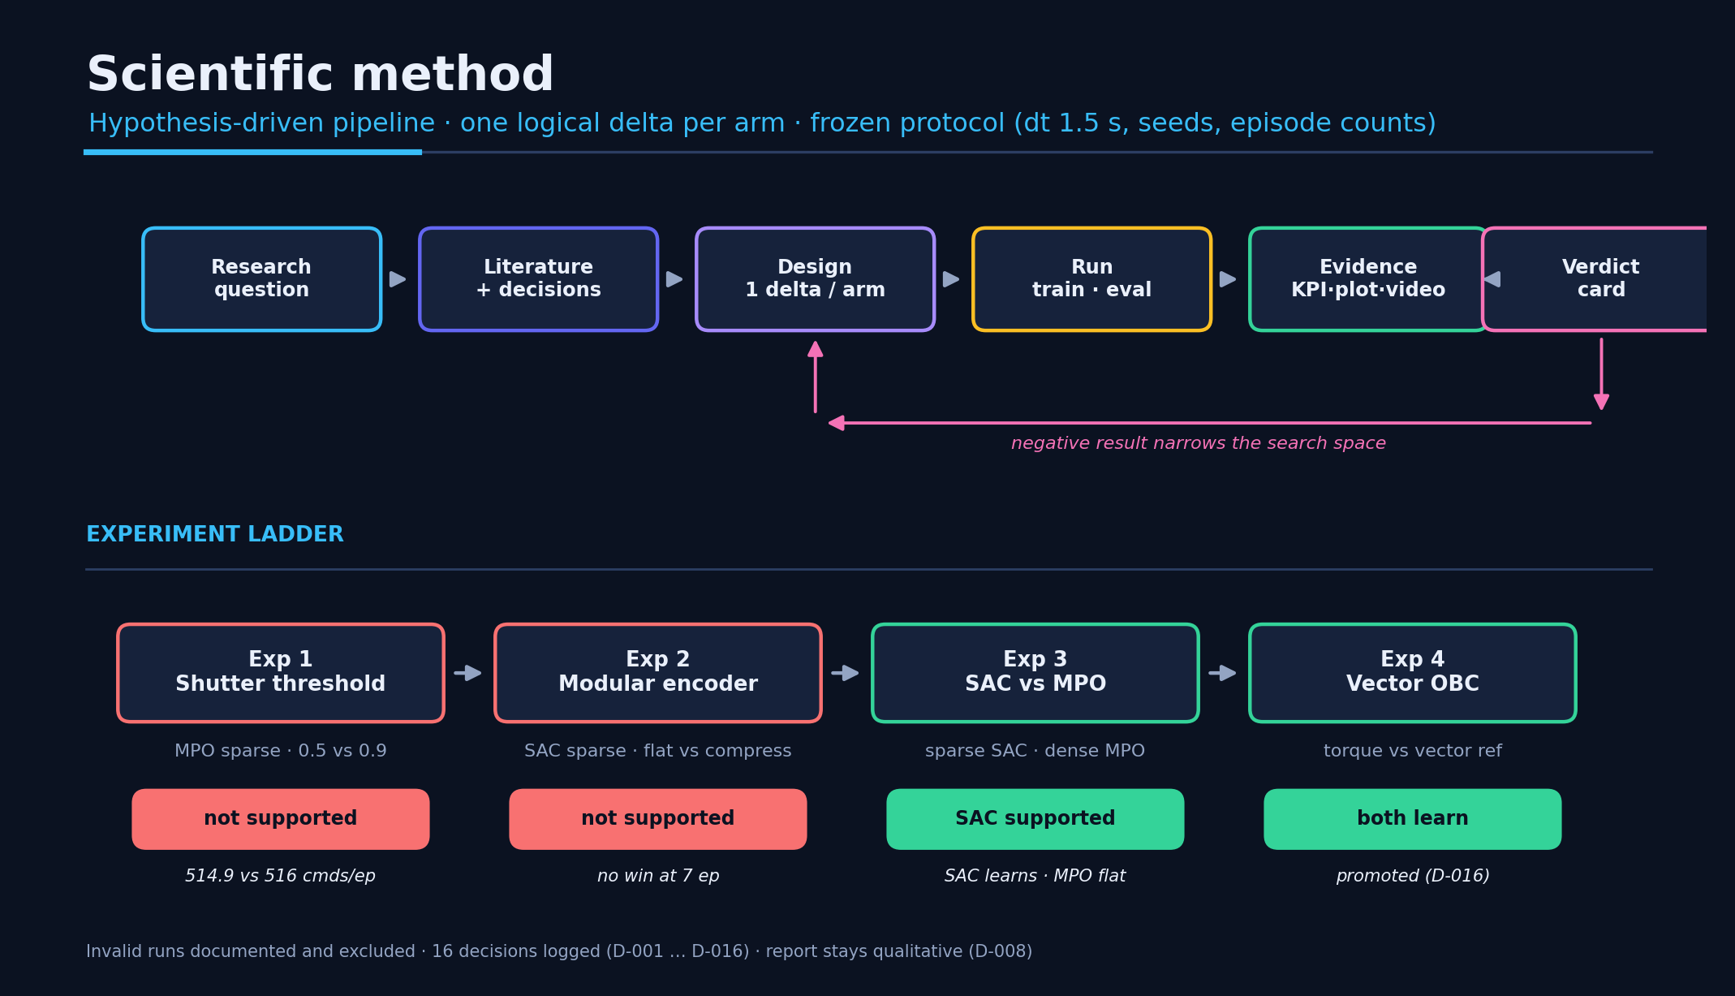
M13 How we experiment
▸ Charter -> literature -> design (one delta/arm) -> run -> evidence -> verdict card -> loop.
▸ Frozen protocol (dt 1.5 s, seeds, episode counts); invalid runs documented and excluded; 16 decisions logged.
Autonomous Satellite Control
20
Notes:
diagrams/scientific_method.png.

Slide 22
M14 Experiment campaign (ML)
~6 ML experiment campaigns · 200+ training runs on disk · each row below = one hypothesis we tested (sim-dev work excluded).
Question / hypothesis | What we changed | Model | Result (verdict)
Agent always fires — is the shutter boolean threshold too low (tanh saturates near +1)? | shutter threshold 0.5 -> 0.9 (+15 s credit window) | MPO | No change: 516 -> 514.9 cmds/ep, fires 99.8%; not the root cause (Exp 1, not supported)
Is the reward signal too sparse to learn? | introduce dense per-step credit | MPO | Still flat at -51.6; sparsity not the only blocker (Exp 3, inconclusive)
Overfitting to the time window where the baseline fires? | first-10 targets -> strided targeting (even baseline signal) | all | Evened the baseline signal across the pass (campaign setup)
Is model capacity / encoder structure enough? | flat vs compressed (1D-CNN) encoder | SAC | In learnable regime: compress +80.9 beats flat -3.9 (Exp 2, confirmed later)
Model does not learn — can a simpler algorithm produce learning? | swap MPO -> SAC (off-policy, simpler) | SAC vs MPO | SAC learns (+5.3 train, learning signal); MPO collapses (Exp 3, SAC supported)
Model outputs high torque always — penalize effort? | add torque-effort penalty -k(tau/tau_max)² | SAC/MPO | Late-episode torque becomes structured (not constant); regularizes control
Safe-mode triggers a lot — is torque control too hard to learn? | vector (nadir-relative) action vs torque | SAC | Both learn, hold-last=0; torque eval -11.1 beats vector -24.1 (Exp 4, KPI pending)
Autonomous Satellite Control
21
Notes:
STATUS_2026-06.md + pipeline docs; merges old Exp1 lesson.

Slide 23
S4
4 · Results & evidence
From a collapsed MPO start to a positive SAC result — examples first, then the summary
Autonomous Satellite Control
22

Slide 24
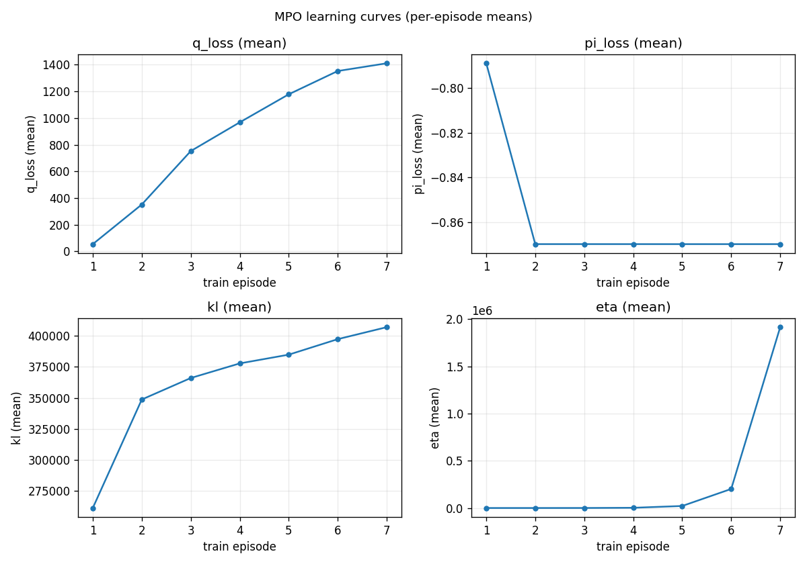
M15b First experiments — MPO collapse
▸ Our first MPO experiments did not work — we call this the 'MPO collapse'.
▸ Overnight MPO sparse: eval -243.5, no learning signal; eta ~1.9e6, KL ~407k.
▸ Symptom: 100% torque saturation, ~1936 shutter cmds / 2 eval eps, 0 meaningful captures.
▸ Note: 'baseline' elsewhere is our deterministic reference (+89) — a different thing from this failed learned run.
Autonomous Satellite Control
23
Notes:
runs/ml_overnight_h1a_mpo_sparse_22-18-35/plots/learning_curves.png.

Slide 25
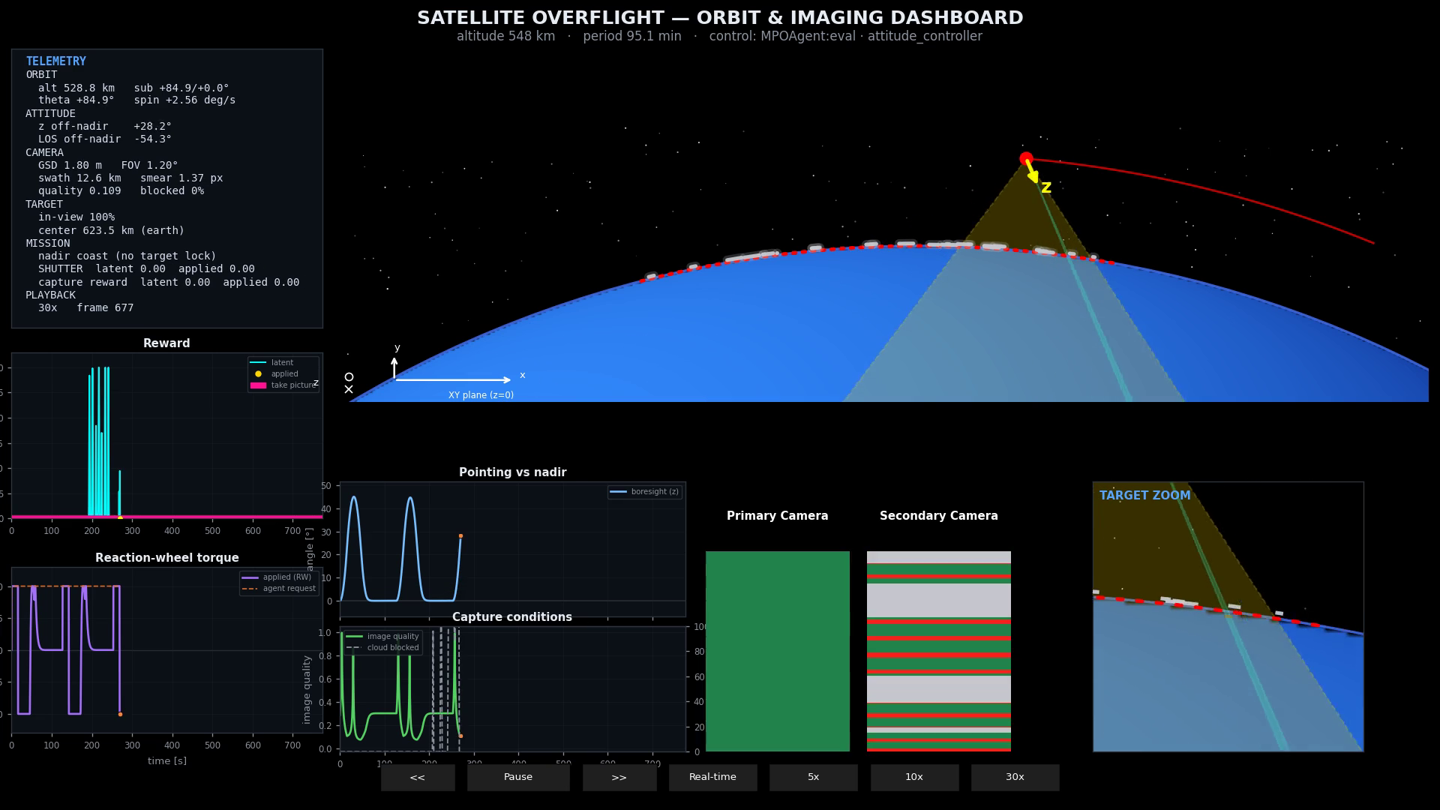
M15c MPO collapse (video)
▸ Model: MPO, sparse reward, eval rollout.
▸ Reaction-wheel torque pins to the limit (square-wave saturation).
▸ Shutter fires almost every step (pink line) with ~0 useful captures.
▸ Safe-mode activates repeatedly — the agent never settles on a target.
▸ eval return -243.5; this failure motivated the whole experiment pipeline.
▶ click to play · 02_mpo_collapse_safemode.mp4
Autonomous Satellite Control
24
Notes:
Embedded. runs/ml_overnight_h1a_mpo_sparse_22-18-35/videos/eval_best.mp4.

Slide 26
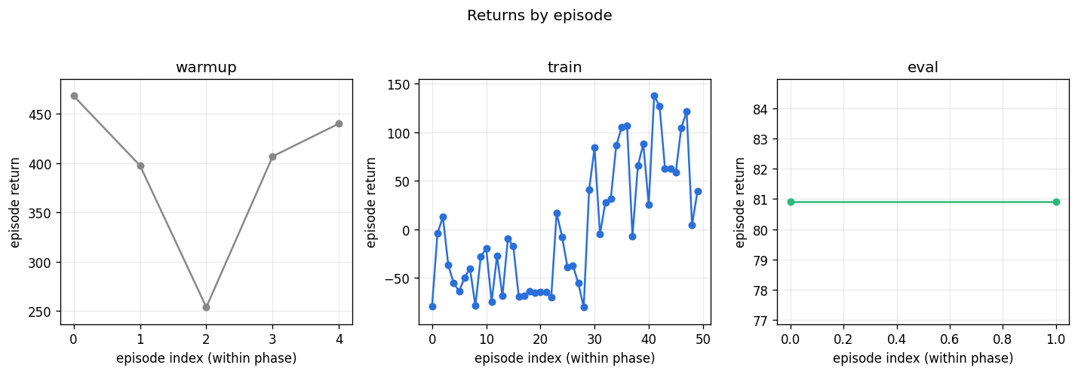
M16b Breakthrough — SAC learns
▸ Model: SAC, compressed 1D-CNN encoder, sparse reward, 50 episodes.
▸ Train return climbs from ~-75 to +137; eval stabilises at +80.9.
▸ Encoder reversal: compressed (A1) +80.9 beats flat (A0) -3.9 — Exp 2's deferred interest confirmed.
Autonomous Satellite Control
25
Notes:
runs/9998217211235184_ml_encoder_r2_sac_a1_03-06-04/plots/returns_by_episode.png.

Slide 27
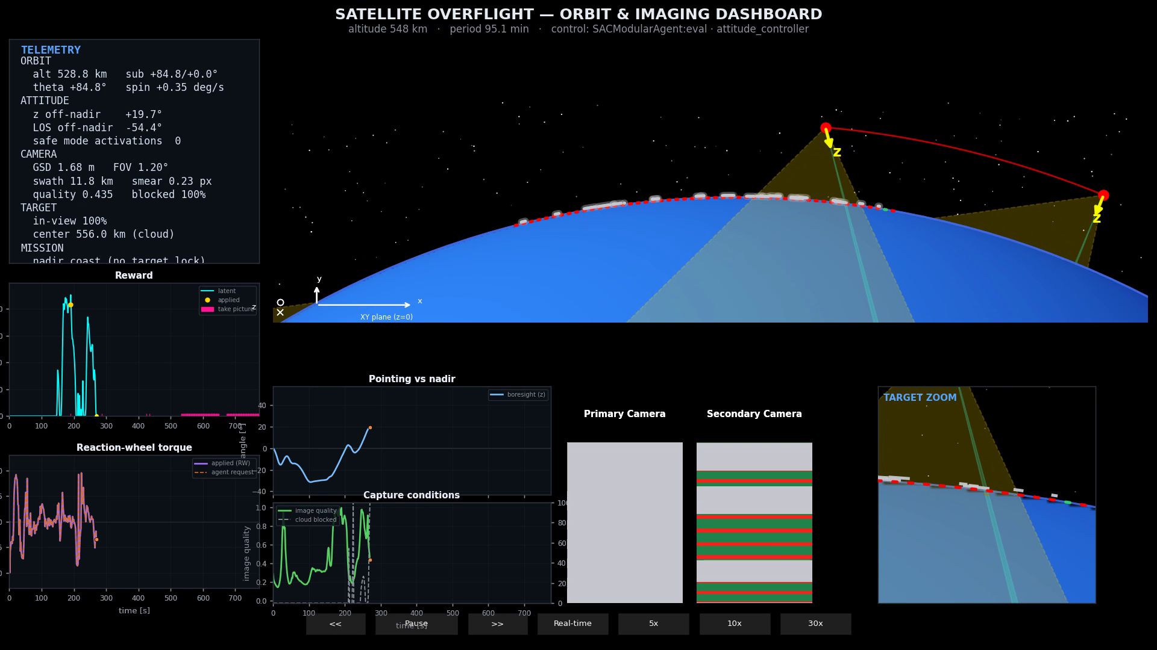
M16e First good SAC result (video)
▸ Model: SAC, compressed encoder, eval rollout — the best learned policy (+80.9).
▸ Clean target captures; smear ~0.2 px; safe-mode activations = 0.
▸ Reaction-wheel torque is structured, not saturated — pointing holds on target.
▸ Contrast directly with the MPO collapse clip earlier.
▶ click to play · 03_sac_first_good_result.mp4
Autonomous Satellite Control
26
Notes:
Embedded. runs/9998217211235184_ml_encoder_r2_sac_a1_03-06-04/videos/eval_best.mp4.

Slide 28
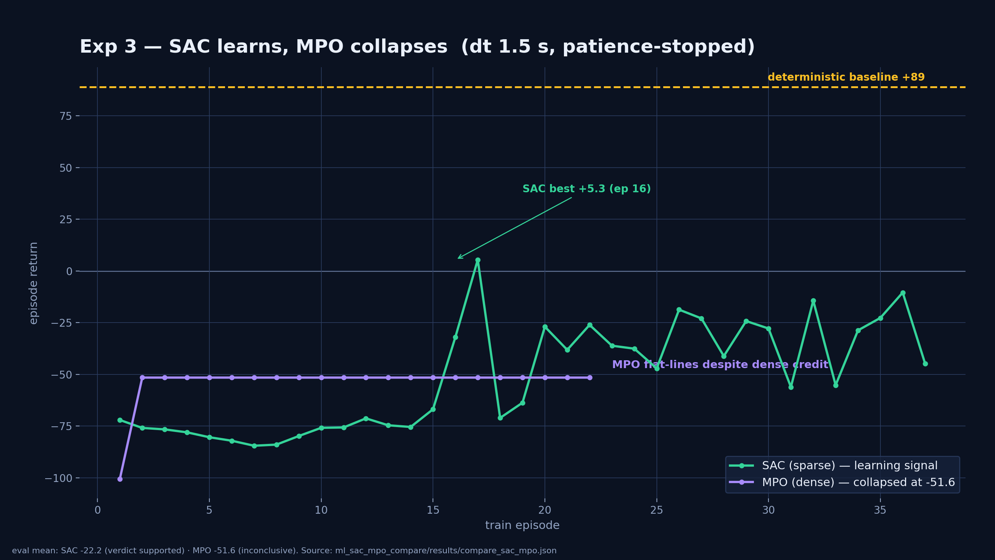
M16c Algorithm compare — SAC vs MPO
▸ Exp 3: same task, SAC (sparse) vs MPO (dense), frozen 1.5 s timestep.
▸ Green line = SAC (learns, best train +5.3, eval -22.2); purple line = MPO (flat at -51.6).
▸ MPO never improves despite dense credit (inconclusive); SAC is the learnable choice here.
Autonomous Satellite Control
27
Notes:
diagrams/exp3_compare.png from compare_sac_mpo.json.

Slide 29
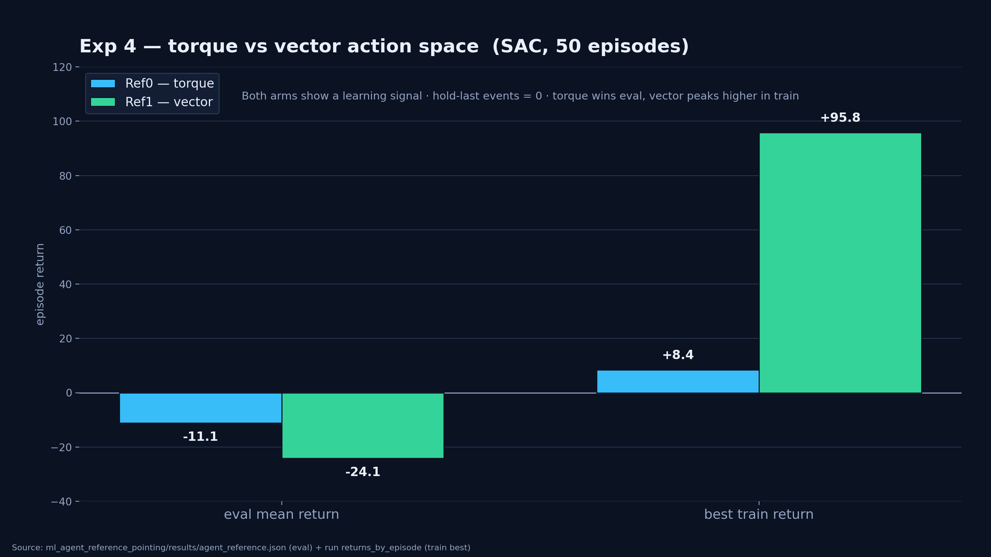
M16d Alternative action: nadir-relative vector vs torque
▸ Question: torque control triggers safe-mode a lot — is a higher-level action easier to learn?
▸ Alternative action: u in [-1,1] -> nadir-relative offset (max 45°) -> PD -> torque (torque-path safety bypassed).
▸ Model: SAC, 50 episodes, both arms; hold-last safety events = 0.
▸ Result: both show a learning signal; torque (Ref0) eval -11.1 still beats vector (Ref1) eval -24.1; vector peaks higher in training (+95.8).
▸ Vector OBC kept as the cleaner production safety interface (D-016); a KPI win is still pending.
Autonomous Satellite Control
28
Notes:
diagrams/exp4_compare.png from agent_reference.json.

Slide 30
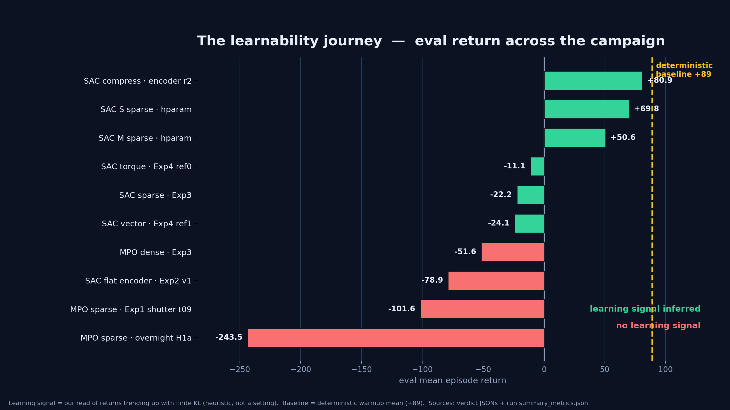
M15 The learnability journey (summary)
▸ Summary of the campaign: eval return from -243.5 (MPO collapse) to +80.9 (SAC compressed encoder).
▸ Dashed line = deterministic baseline (+89): the best SAC run (+80.9) is within reach but has not beaten it yet.
▸ Green = a learning signal was inferred (returns trending up, KL finite); red = none. This is our scientific read, not a knob we set.
▸ Open: a final matched eval (same clouds/altitude/targets) to claim superiority over the baseline (D-008).
Autonomous Satellite Control
29
Notes:
diagrams/results_scoreboard.png — verified from verdict JSONs + summary_metrics.json. Includes old KPI-summary content.

Slide 31
S5
5 · Conclusion & next steps
What we proved, what is still open, and where this goes next
Autonomous Satellite Control
30

Slide 32
M20 Conclusion
▸ Built a from-scratch, single-source-of-truth simulation + cloud-aware training loop end to end.
▸ Demonstrated learnability: SAC sparse reaches positive eval (+80.9) from a -243.5 MPO collapse.
▸ Negative results (Exp 1-2) and the algorithm compare (Exp 3) scientifically narrowed the design.
▸ Superiority over the deterministic baseline (+89) is not yet proven on a final matched evaluation.
Autonomous Satellite Control
31
Notes:
Partially tested; pipeline and learning loop in place.

Slide 33
M21 Further research & next steps
▸ Run the final matched eval (same clouds/altitude/targets) of best SAC policy vs the deterministic baseline.
▸ Close Exp 3-4 verdicts with frame-level behavioral review of the exported videos.
▸ Iterate reward + control interface until the learned policy beats the baseline on observation value.
▸ Then build the mission-planner layer above the OBC — the hierarchical north star.
Autonomous Satellite Control
32
Notes:
Iterate until beat baseline; then mission planner.

Slide 34
M22 Thank you
▸ Questions?
▸ Cedric Grieder · ETH x Beyond Gravity semester project
Autonomous Satellite Control
33

Slide 35
A01 Admin slide 1
▸ Company / org content — add Beyond Gravity branding, context, or intro.
▸ [YOUR CONTENT]
Autonomous Satellite Control
34
Notes:
User fills in.

Slide 36
A02 Admin slide 2
▸ Second admin slide — team, project placement, or logistics.
▸ [YOUR CONTENT]
Autonomous Satellite Control
35
Notes:
User fills in.

Slide 37
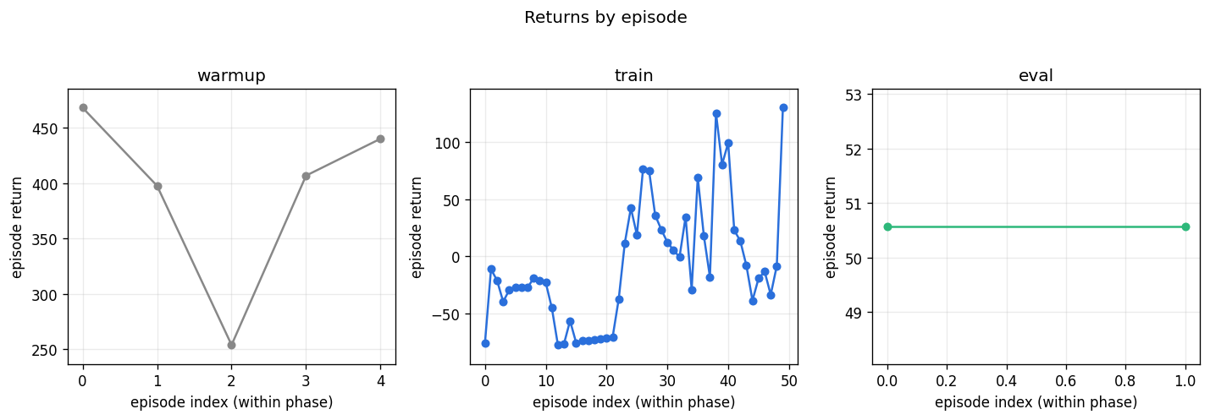
B01 Backup — best SAC hparam run
▸ Experiment: SAC hparam grid · arm SAC-M sparse · 50 episodes.
▸ Result: train best +129.8, eval +50.6, learning signal inferred.
▸ run: 9998217230681332_ml_sac_hparam_sac_m_sparse_21-41-58.
Autonomous Satellite Control
36
Notes:
sac_hparam_grid_summary.json.

Slide 38
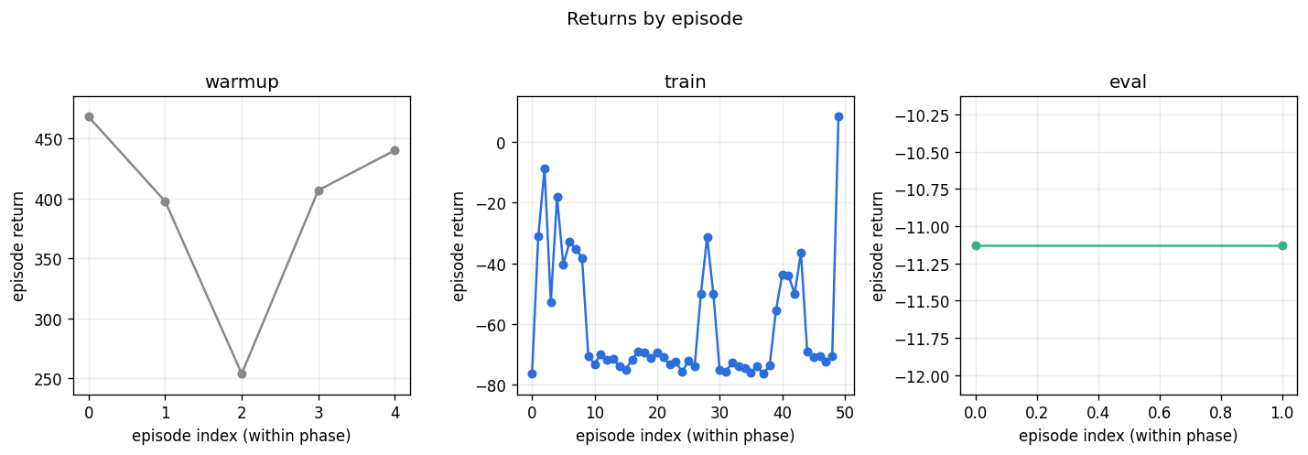
B02 Backup — Exp 4 torque arm (Ref0)
▸ Experiment: Exp 4 agent-reference · arm Ref0 torque · SAC · 50 episodes.
▸ Result: eval -11.1, learning signal inferred, train spike +8.4 at ep 49.
▸ run: 9998217183842846_ml_ref_ref0_torque_10-42-36 · video: videos/05_torque_action_eval.mp4.
Autonomous Satellite Control
37
Notes:
agent_reference.json.

Slide 39
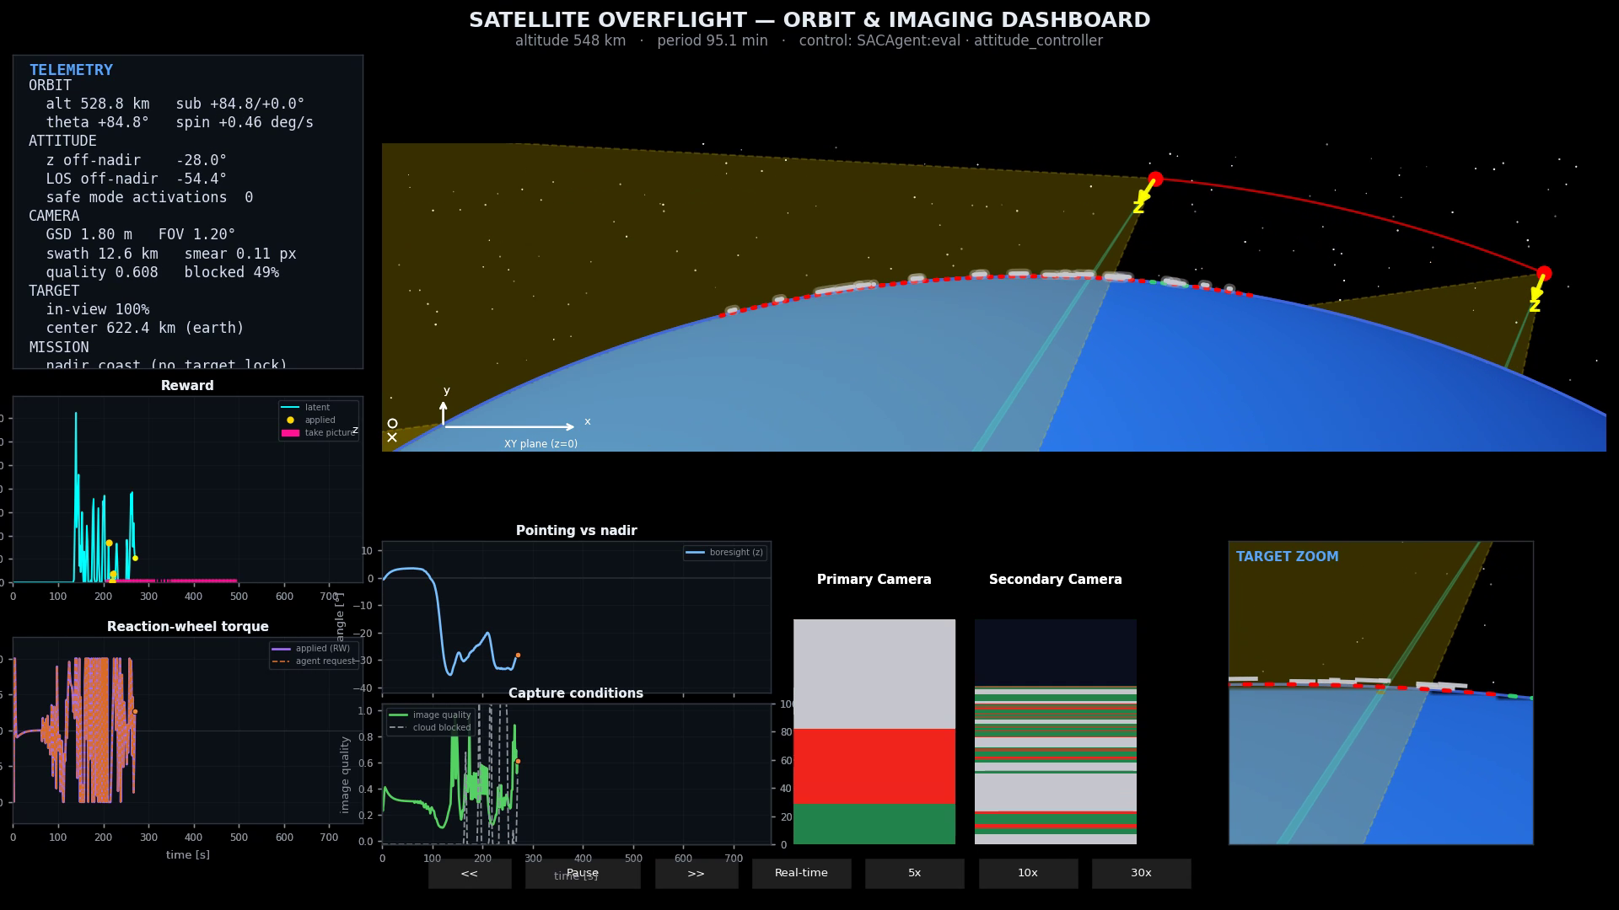
B03 Backup — vector action eval (video)
▸ Experiment: Exp 4 agent-reference · arm Ref1 vector · SAC · 50 episodes.
▸ Result: eval -24.1, train peak +95.8, hold-last safety events = 0.
▸ Cleaner safety interface (D-016); promoted to production.
▶ click to play · 04_vector_action_eval.mp4
Autonomous Satellite Control
38
Notes:
Embedded. runs/9998217182442815_ml_ref_ref1_vector_11-05-57/videos/eval_best.mp4.

Slide 40
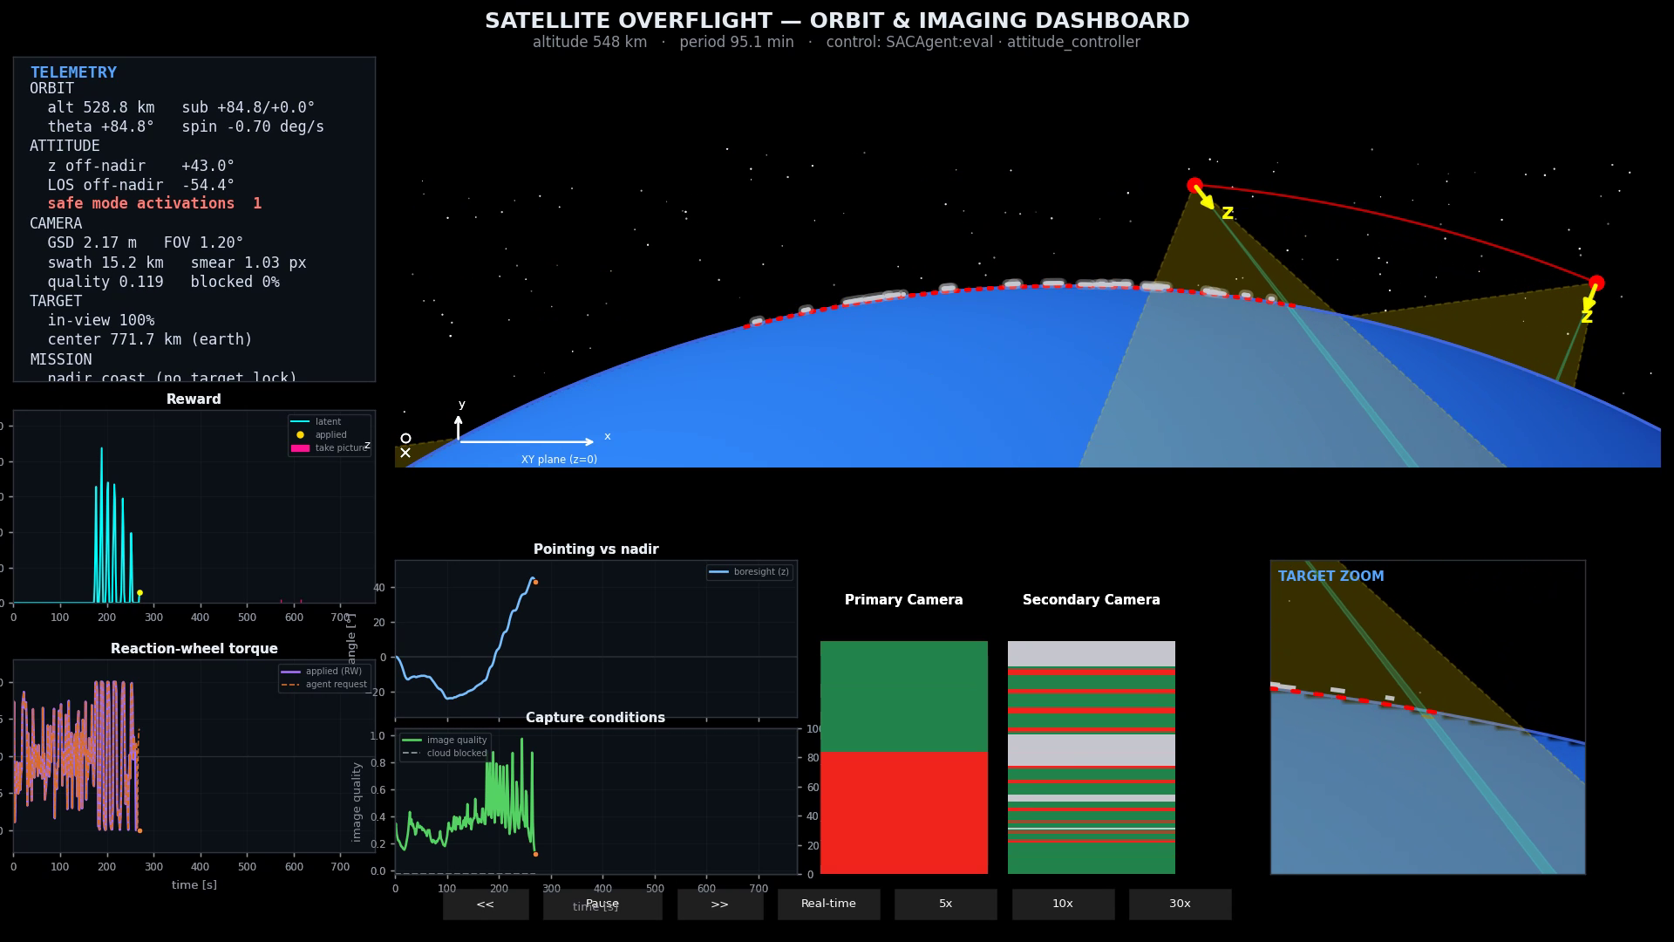
B04 Backup — Exp 3 SAC eval (video)
▸ Experiment: Exp 3 SAC vs MPO · arm SAC sparse · dt 1.5 s, patience-stopped at 37 ep.
▸ Result: supported, best train +5.33, eval -22.2 (learning signal).
▸ MPO contrast arm: inconclusive, plateau -51.6, 22 ep.
▸ docs/experiments/pipeline/1-built/03-sac-mpo-compare.md.
▶ click to play · 06_exp3_sac_eval.mp4
Autonomous Satellite Control
39
Notes:
Embedded. compare_sac_mpo.json.

Slide 41
B05 Backup — experiment x research cross-map
Each experiment is grounded in repo literature + logged decisions.
Experiment | Question | Papers / references (repo) | Decisions / notes
Exp 1 — Shutter (MPO) | shutter spam / sparse credit assignment | Abdolmaleki 2018 (MPO); internal shutter mechanics | D-009/010/011 · shutter-threshold-investigation.md
Exp 2 — Encoder (SAC) | flatten vs structured observations | Gorishniy 2022 · entity-based RL (2206.02855) · SRL survey (2506.17518) · Bruin 2018 | D-014/015 · LITERATURE_HIGHLIGHTS.md
Exp 3 — SAC vs MPO | which algorithm learns on this task | Haarnoja 2018 (SAC) · Abdolmaleki 2018 (MPO) | model-size-investigation.md
Exp 4 — Vector OBC | action interface & safety | MPC lecture (rec 08, hierarchical reference) | D-001 · D-016
Autonomous Satellite Control
40
Notes:
docs/research/LITERATURE_HIGHLIGHTS.md (cross-paper cheat sheet) + DECISIONS.md.

Slide 42
B06 Backup — full experiment list & verdicts
▸ Exp1 Shutter: not_supported · Exp2 Encoder: not_supported.
▸ Exp3 SAC/MPO: SAC supported, MPO inconclusive · Exp4 Vector OBC: both learn, KPI pending.
▸ Supporting: SAC hparam grid, MPO model-size, sim-timing, cloud-formation campaigns.
Autonomous Satellite Control
41
Notes:
docs/ml/STATUS_2026-06.md.

Slide 43
B07 Backup — reward & environment constants
▸ docs/presentation/machine-learning.md (reward, losses, encoder).
▸ docs/presentation/environment-hyperparameters.md (mission, clouds, sim constants).
▸ docs/presentation/technical-constants.md (camera, bus, RW, safety).
Autonomous Satellite Control
42
Notes:
Live technical record.

Slide 44
B08 Backup — literature & decisions log
▸ docs/research/LITERATURE_HIGHLIGHTS.md.
▸ docs/research/DECISIONS.md (D-002 dt, D-007 dense reward, D-013 video export, D-016 vector OBC, ...).
▸ Hypothesis docs under backend/scripts/experiments/*/H*.md.
Autonomous Satellite Control
43

