Slide 1
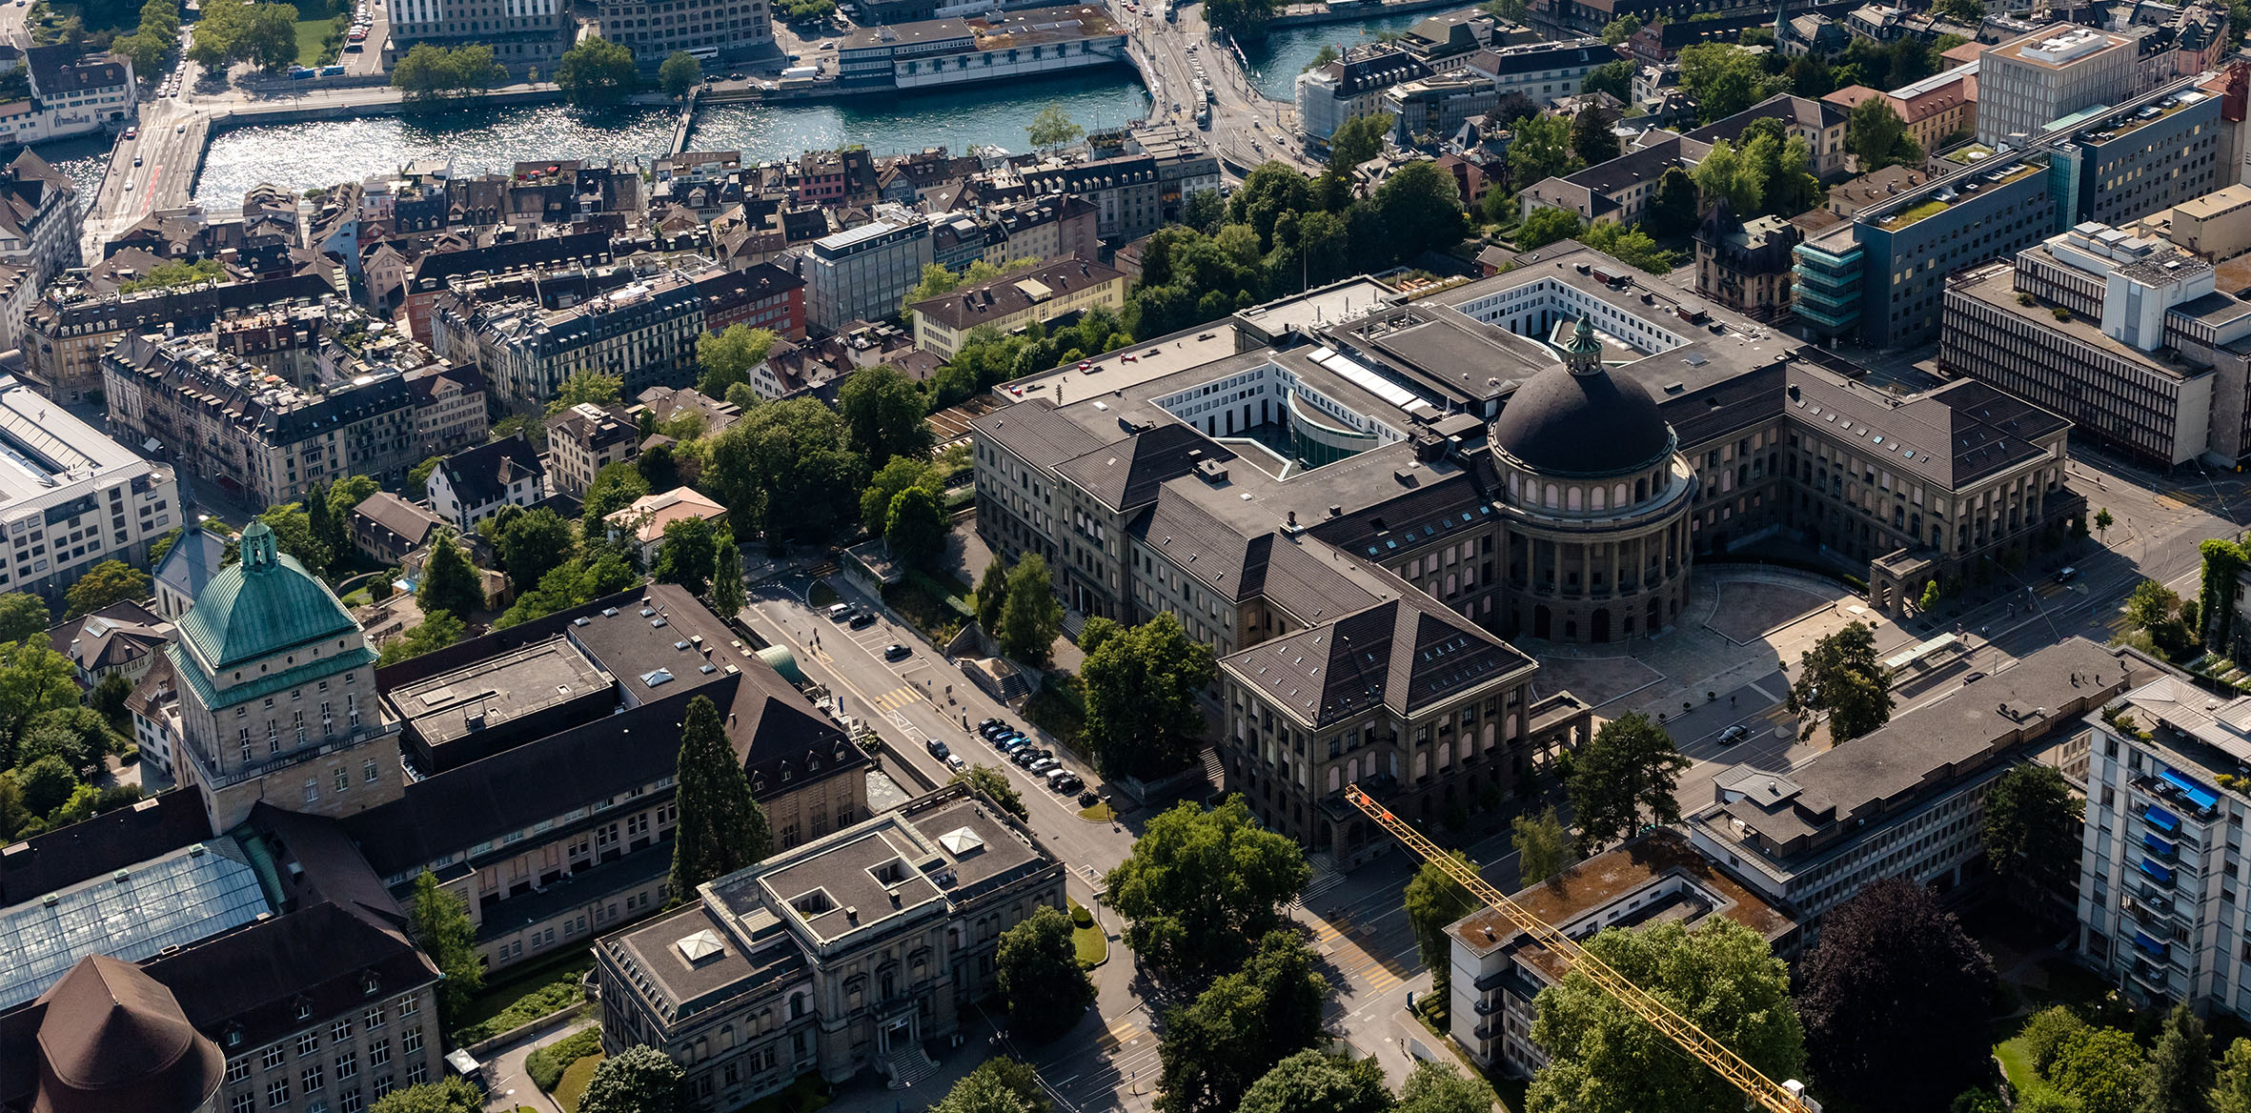
MPC 2026 – Recitation 1
Lecturer: Prof. Melanie Zeilinger
Teaching Assistants: Sabrina Bodmer
Marco Heim
Marcell Bartos

Slide 2
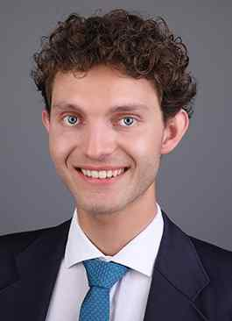
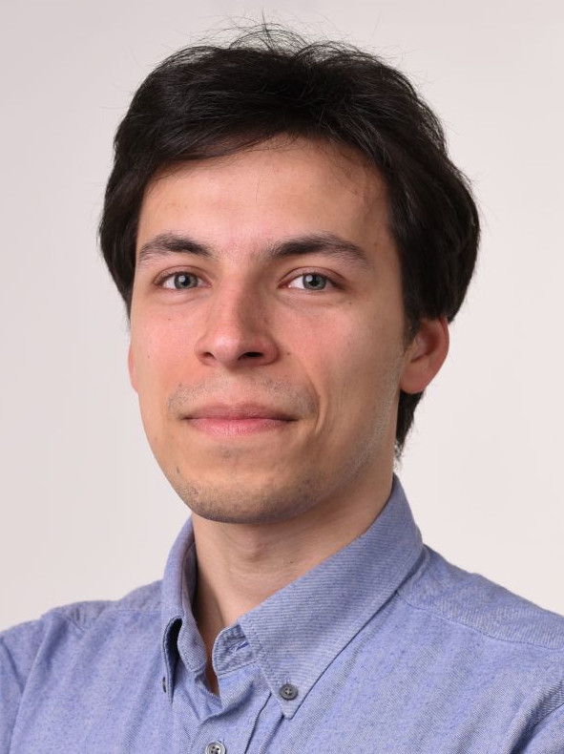
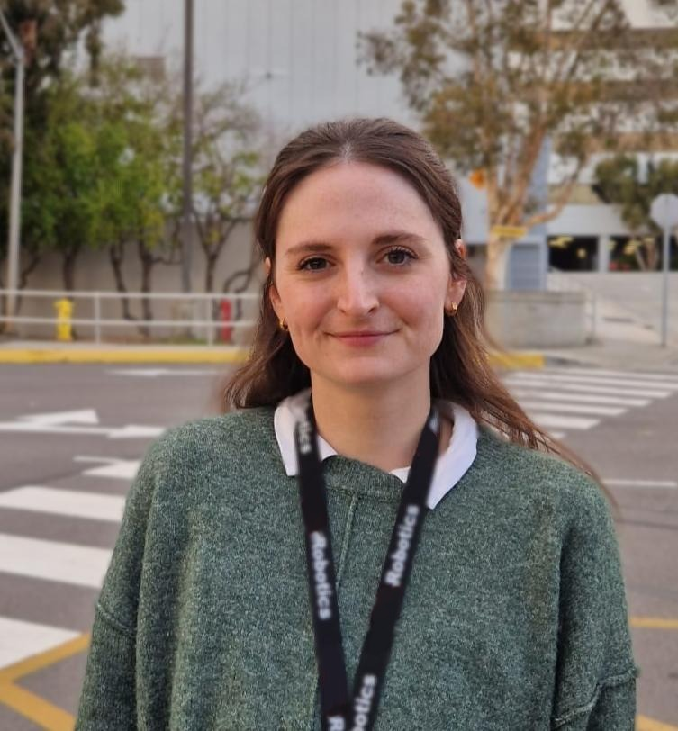
Model Predictive Control 2026 – Recitation 1
Organisation
Recitation: Every week after the lecture (ML D 28).
Interactive discussion of the material during the recitation (no recording).
Problems will be uploaded on Moodle beginning of the week, solutions after the recitation.
Office hours: After each recitation (ML D 28).
Problem sets: Uploaded on Moodle every week after recitation.
Solutions will be uploaded in the following week.
Take-home project: Ungraded programming exercise (further information to follow).
Questions
During the recitation
During the office hour
On the Moodle forum
Marco Heim
maheim@ethz.ch
Marcell Bartos
mbartos@ethz.ch
Sabrina Bodmer
sabodmer@ethz.ch

