Slide 1
Autonomous Satellite control Cloud aware learned pointing
Cédric Grieder
MSc Mechanical Engineering Student ETHZ
06. July 2026

Slide 2
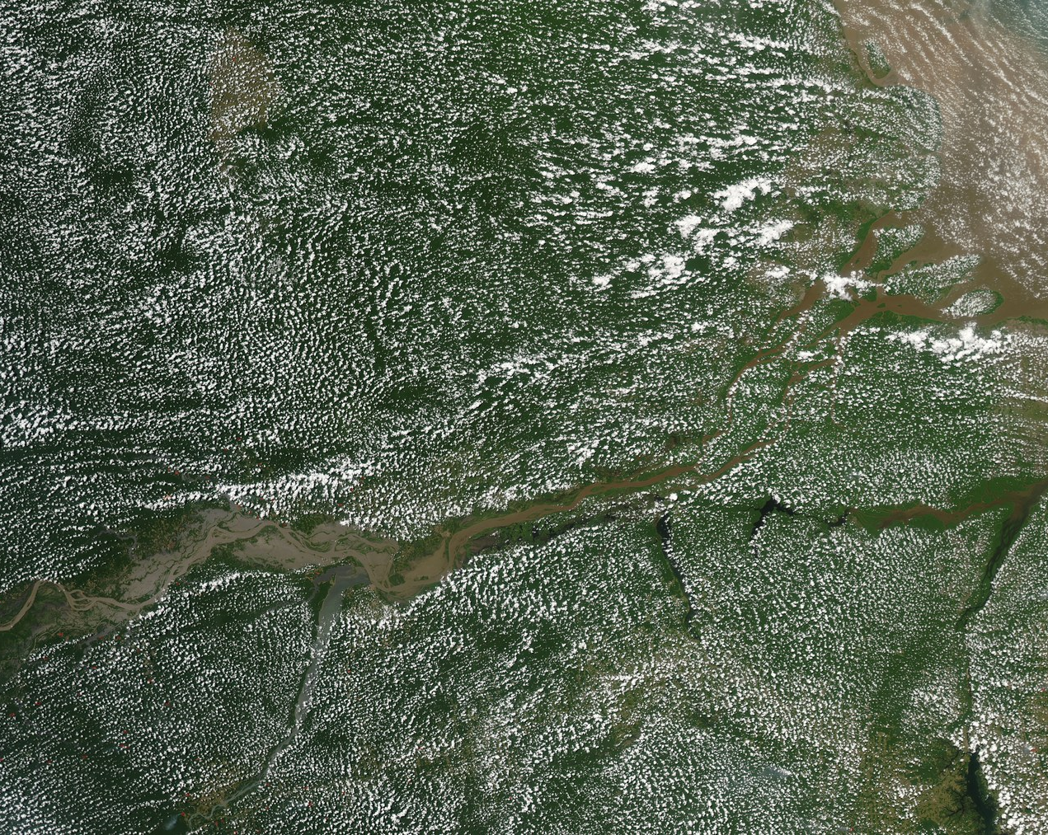
Motivation: clouds waste satellite imaging opportunities
Satellites have limited onboard storage and downlink capacity.
Cloud-blocked captures waste scarce imaging opportunities.
The valuable decision is not only where to image, but also when.
2

Slide 3
Current approach: Deterministic Planning
Targets are scheduled before the pass
The satellite points to each target and captures at the best estimated moment
Cloudy images are filtered later in post-processing
Limitation: no onboard reaction to current cloud cover.
Mission Control: decide obs. targets
FIX
Satellite images areas; fixed budget
Downlink image data
Postprocess
Cloud
No Cloud
Less thrash
Notes:
the satellite may be in the right place, but clouds can still make the image useless. This motivates onboard decision-making.

Slide 4
Research Question
Can a learned cloud-aware policy make better capture decisions than a fixed deterministic baseline?
Compare learned policy against deterministic baseline
Use matched simulation conditions
Focus on useful observation value, not just movement behavior.

Slide 5
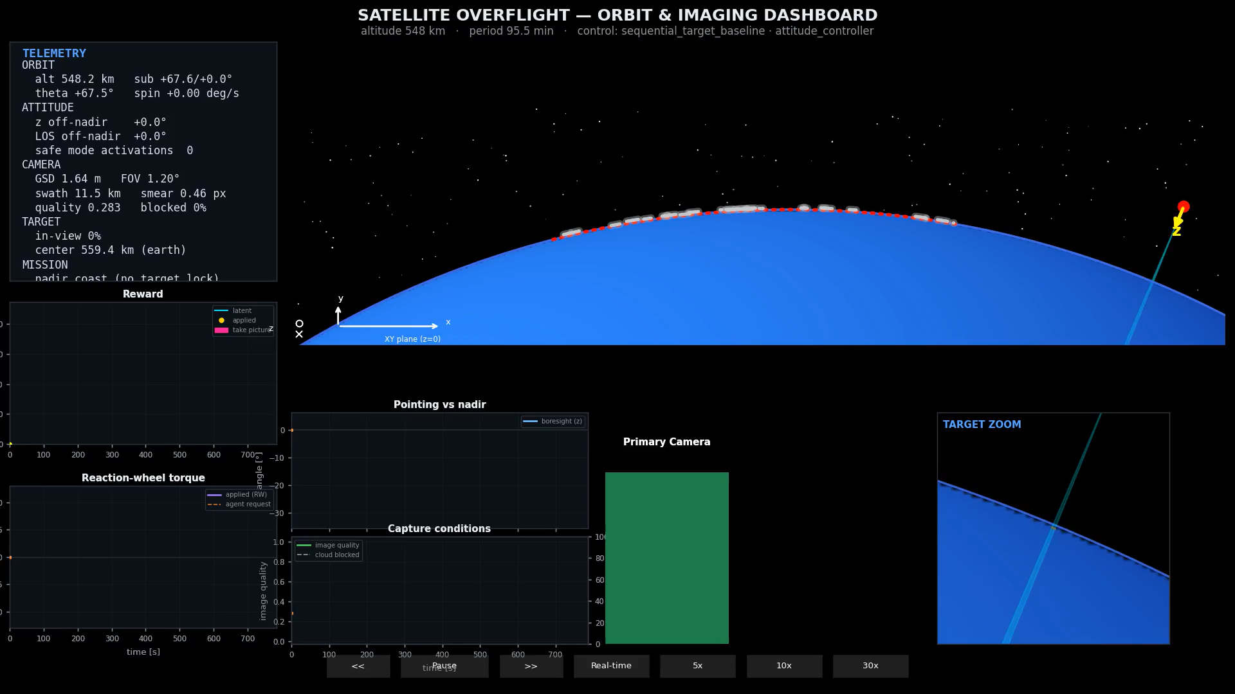
Deterministic baseline model: Demo
Control mode:
Torque
Algorithm:
Baseline
Reward:
- sparse
Sequentially tracks scheduled targets.
Captures near the best geometric imaging opportunity.
Does not use live cloud awareness.
Used as the reference policy for learned approaches.

Slide 6
Experiment Setup
2D satellite overflight simulation
Cloud-aware sensing and target geometry
Reward model for useful captures
ML training, evaluation, and rendering loop
Wide FOV - forward looking Camera
Environment initialization
Simulation Kernel
state
action
Autonomous Agent (ML Model)
reward

Slide 7
ML formulation: what the agent sees and decides
state
action
reward
Orbit (pos relative to earth)
Attitude (orientation in space)
Pointing direction for targets
Primary and secondary vision array
Remaining image budget
Pointing request (torque / vector) :continous
Shutter command :boolean
+ Image quality
+ Coverage
+ Novelty
- Exceed shutter budget
- non-zero pointing request
Reward | Justification
Image quality | Avoid Motion Blur
Coverage | Fraction of the Image not covered by clouds
Novelty | Imaging an area twice is redundant
Exceed budget | When the budget is used up, we want to stop doing any manoeuvres
Pointing request | Any pointing request has an actuator energy implied, limit random movement

Slide 8
Proposed Algorithm: MPO (Maximum a Posteriori Policy Optimization)
Agent / Autopilot algorithm
Off policy reinforcement-learning algorithm.
Learns stochastic policy from replayed experience.
Actor critic setup
Policy improvement is constrained by KL trust region. (limited updates)
Start difficulties -> switched to SAC

Slide 9
Training / Scoring
Fixed Budget of 10 shutter commands
Baseline averaged over 5 episodes
5 Baseline episodes: act as warmup to bootstrap Actor-Critic agents
KPI: reward
Best Training, Avg Training, Eval

Slide 10
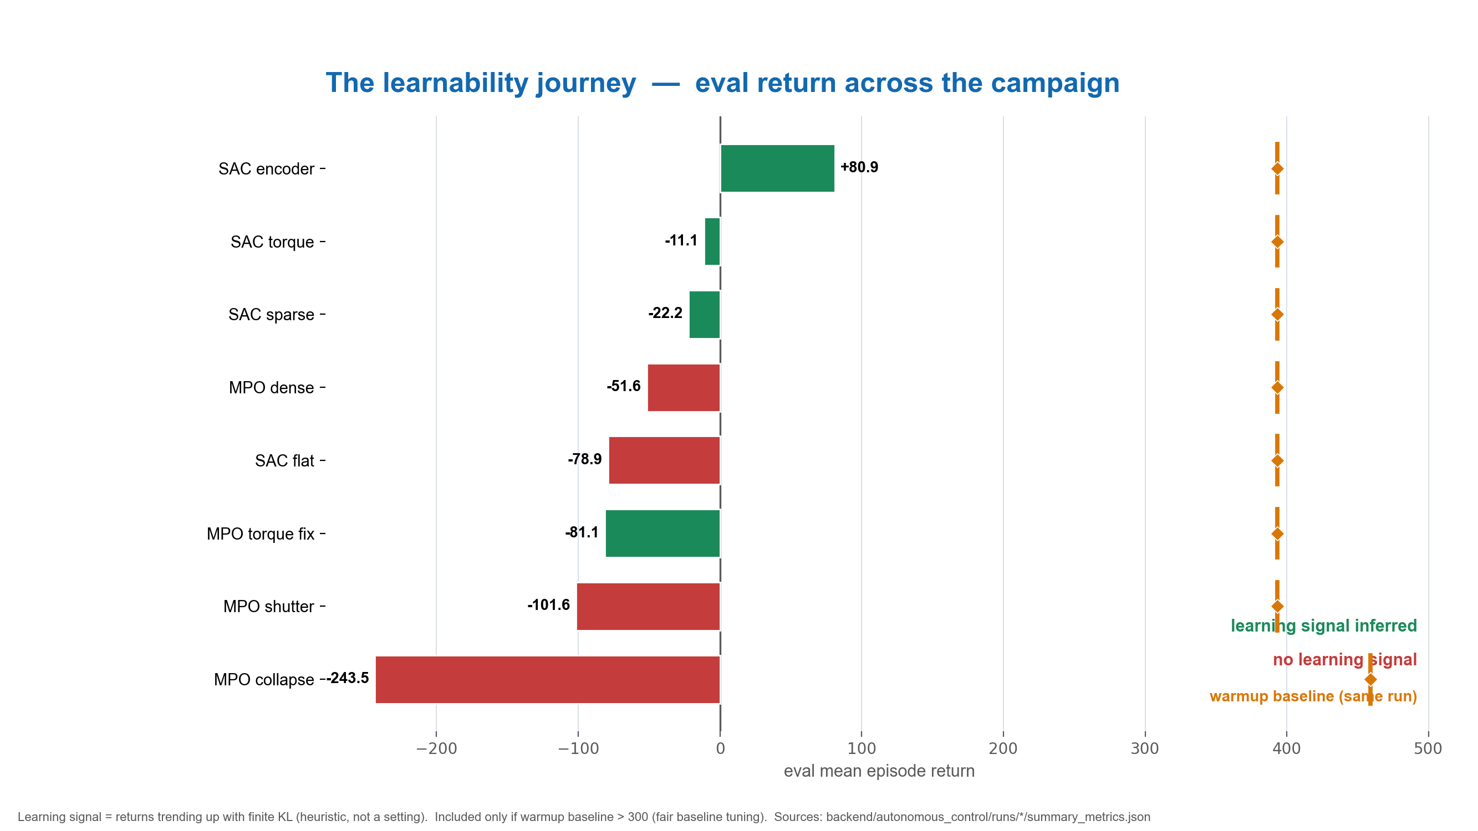
Experiments: ML tuning
Scientific method!
Untracked Exps
14 tracked Exps
Infinite Solutions

Slide 11
Sample Experiment – Exceed budget penalty (Exp 7):
Core question: Does a penalty for shutter commands when capture budget ≤ 0 improve SAC sparse learning in vector pointing mode — reducing end-of-episode shutter spam and stabilizing returns after high-reward episodes?
-> A/B test
Metric | penalty_on | Ref1 | Δ
Eval return mean | +10.58 | −24.08 | +34.7
Train return best | +124.57 (ep 42) | +95.77 (ep 11) | +28.8
Train return mean | −4.50 | −48.94 | +44.4
Train shutter cmds (total) | 478 | 7071 | −93%
Train meaningful frac | 0.220 | 0.015 | 15×
Eval shutter cmds | 10 | 346 | −97%
Post-peak std (after best ep) | 17.5 (n=7 after ep 42) | 28.4 (n=38 after ep 11) | −38%
Post-peak mean (after best ep) | +3.3 | −53.5 | improved

Slide 12
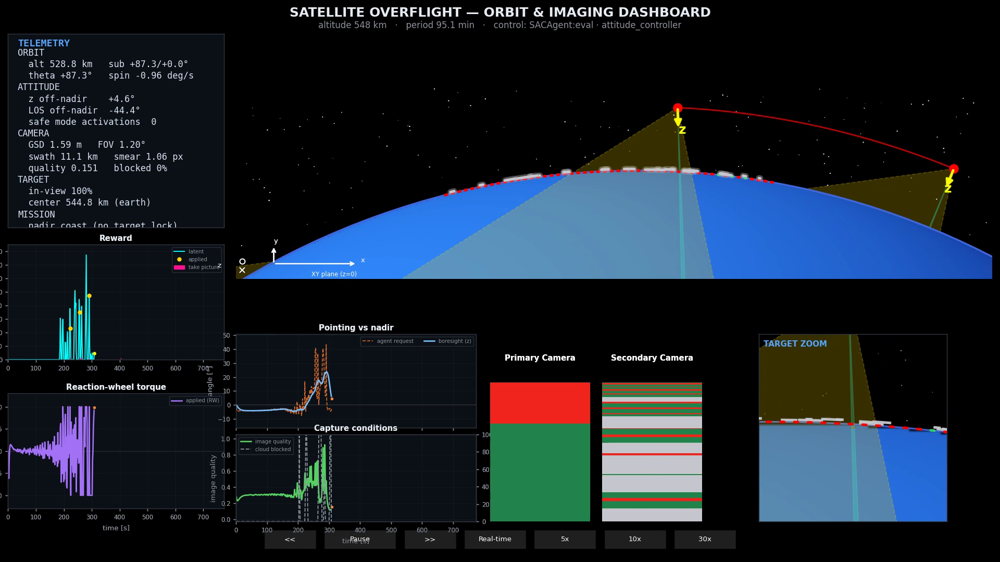
Training: SAC
Control mode:
Vector
Algorithm:
SAC
Reward:
Sparse
Shutter penalty

Slide 13
MPO: Broken!
Core question: With the MPO dual now correctly implemented (E-step Q-value dual η + enforced M-step α_μ/α_Σ trust region, committed in d5af20c), does MPO achieve learning_mode=true on sparse reward in torque mode — the same mode that produced the −51.6 / −243.5 collapse in all prior runs?

Slide 14
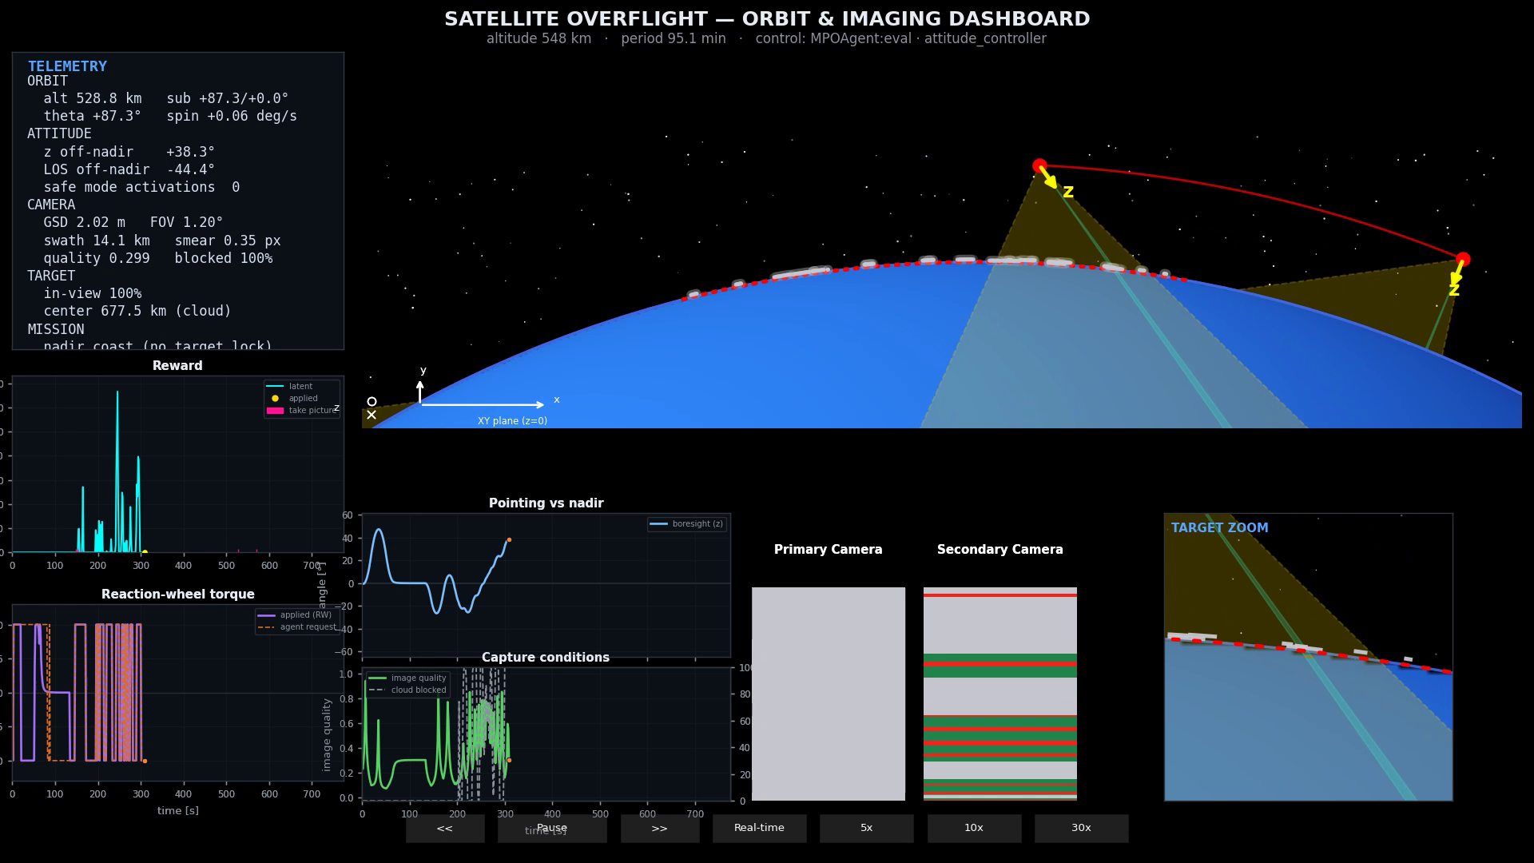
MPO: fixed? (Exp 8)
Control mode:
Torque
Algorithm:
MPO
Reward:
Sparse

Slide 15
MPO: fixed?
Implementation Bug
Still poor performance -> more experiments
SAC “easier learning” than MPO
# | Claim | Criterion | torque_sparse | Verdict
H8a | Dual unblocks learning | learning_mode=true or eval ≥ −41 | true; train best +8.7 | supported
H8b | KL/η bounded | KL within ~10× target; no η ramp | KL 0.021; η 0.788 | supported
H8c | Escapes saturation | train sat < 0.9 | 0.951 | not_supported
H8d | α_μ/α_Σ active | finite, tracking | α_μ ~1e-5, α_σ ~0.28 | supported

Slide 16
Conclusion
Built a 2d ML playground for earth observation under cloud conditions
Agents learned strategies under sparse reward.
Deterministic baseline has not been beaten by any agentic pilot that was experimented on.

Slide 17
Recommendations:
The optimal action space is to be determined (Torque / vector / target selection) – target selection leverages performance of PD controller for pointing
Continuing research should:
Introduce a Score / KPI, separate from reward. For more informed comparison of baseline vs agent.
Evaluate impact of environment initialization on training behaviour. More robust agents should be found using a diverse set of environments.
Explore the use of real or more realistic synthetic image data.
What resolution should the wide FOV secondary camera have? Scaling Analysis to estimate latency in real-world-application.

Slide 18
End
Further research / engineering needed
High value autopilot viable, convicted
Interesting work, personal growth
Thanks to:
Prof Marco Hutter and RSL, Formal Supervision
Alejandro Torrents Rufas, Beyond Gravity

Slide 19
BACKUP SLIDES

Slide 20
Methodical learnings
Challenge | Specific Example | Key Learning | Consequence
Build vs reuse trade-off | Simulation building takes time, complexity for 2d sim underestimated (5 Weeks Sim build vs 1 Week ML) | Find a good match from existing software libraries | Invest in tech-stack research before start
ML implementation correctness | MPO dual learning bug | Don’t assume implementation correctness | Check the gradient Flow and each intermediate result against architecture from e.g. arXiv Paper
Uncertainty about “solvability” of the problem | Torque action – Vector action – Target selection? | Find simplest problem representation that can still yield high value solution | Don’t “learn” only because it is possible. PD controller may be completely fine…
Hyperparameter optimization, solution finding | MPO does not learn / produce something meaningful | Fixed A/B test (keep everything still, use Algorithm that is simple and should work) | Best workflow (for me): 0. Research 1. design Experiment 2. Build 3. Run 4. Evaluate 5. document

Slide 21
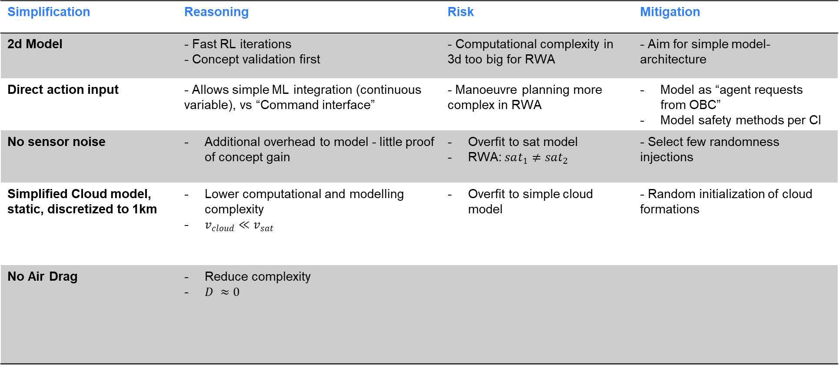
Simplifications
Real world application:= RWA
Simplification | Reasoning | Risk | Mitigation
2d Model | - Fast RL iterations - Concept validation first | - Computational complexity in 3d too big for RWA | - Aim for simple model-architecture
Direct action input | - Allows simple ML integration (continuous variable), vs “Command interface” | - Manoeuvre planning more complex in RWA | Model as “agent requests from OBC” Model safety methods per CI
No sensor noise | Additional overhead to model - little proof of concept gain | Overfit to sat model RWA: $sat_{1}≠sat_{2}$ | - Select few randomness injections
Simplified Cloud model, static, discretized to 1km | Lower computational and modelling complexity $v_{cloud}≪v_{sat}$ | Overfit to simple cloud model | - Random initialization of cloud formations
No Air Drag | Reduce complexity $D ≈0$

Slide 22
Environment initialization
Episode = one polar overflight
Drawn each episode | Fixed across runs
Altitude ~U(510, 570) km | Target grid
Cloud field (seeded patches along corridor) | Reaction-wheel and safety limits
Initial attitude / phase | Reward term definitions
Notes:
environment-hyperparameters.md

