Slide 1
ME 273 Autograder v4.0.1 USER DOCUMENTATION

Slide 2
Tasks and Skill Levels
Skill Level | User | Tasks
Basic | TA | * Running the Autograder (original/resubmission/manual grading) * Learning Suite and Google Drive uploads * Manual edits to grading documents
Intermediate | Instructor Head TA | * Adding labs * Changing section dates and grading weights * Pseudodate * Updating the roster
Advanced | Some unlucky soul | * Understanding the system architecture

Slide 3
Overview: Lab Structure
Lab 9 (Solving Differential Equations)
Lab :
Lab Part/ Subassignment :
Euler
Heun
RK4
Code
* Does it run? * Does it prod- uce the expec- ted outcome?
Header
* Does it exist? * Is it about the expected size?
Comments
* On almost every line?
Evaluated Components :

Slide 4
Overview: Grading Timeline
Lab assignments will typically be assigned a week before they are due.
During the week before they are due, the student can submit as many tries as he/she desires.
After the due date, the TA for that student’s lab section will run the autograder, which will only grade the latest submission before the cutoff.
During the week following the due date, students can resubmit for up to 80% credit.
S | M | T | W | Th | F | S
1 | 2 | 3 | 4 | 5 | 6 | 7
8 | 9 | 10 | 11 | 12 | 13 | 14
15 | 16 | 17 | 18 | 19 | 20 | 21
22 | 23 | 24 | 25 | 26 | 27 | 28
29 | 30 | 31
Full-Credit Period
Resubmission Period

Slide 5


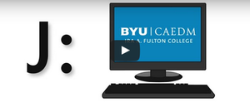

Overview: File Flow (What You’ll Do)
1. Students upload files to Google Drive
2. TA’s download files and run autograder.
3. TA uploads grades Learning Suite.
4. TA uploads grades to Google Drive and sends out feedback.
ME 273 Google Drive
4.
3.
1.
2.
Students

Slide 6
Running the Autograder: Start
Where can I run the autograder program from?
* The autograder program will need to be run from its location in the folder your instructor shares with you on your CAEDM J: drive. This gives you three options:
1. (Recommended) Login to a CAEDM computer on-campus and run the program from your J: drive there.
2. (Windows users) Map your J: drive to your computer (see https://caedm.et.byu.edu/wiki/index.php/J_Drive#Accessing_the_J_Drive_from_Off_Campus _x0001_) and then run the program remotely through your computer connection.
3. Use Citrix to run Matlab and remotely run the autograder program (guaranteed headache).

Slide 7
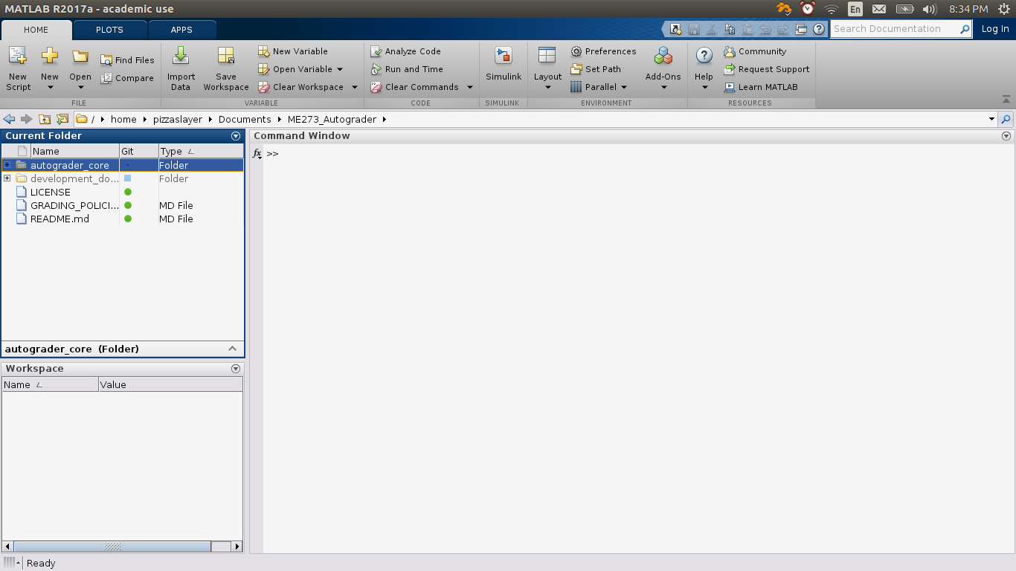
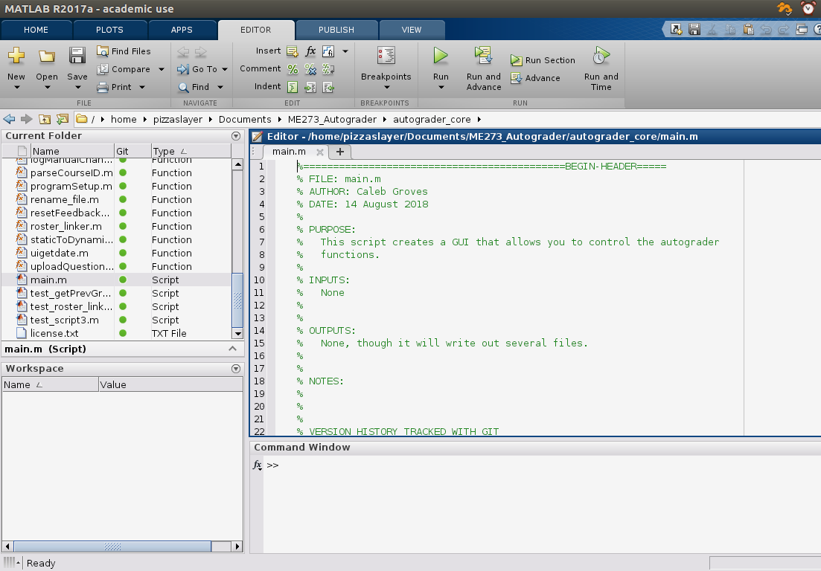
Running the Autograder: Run
1. Navigate to the autograder_core directory.
2. Open and run ‘main.m’.

