Slide 1


SocialBuzz
Project

Slide 2


Today's agenda
Project recap
Problem
The Analytics team
Process
Insights
Summary

Slide 3

Kldsfmsadfasdf
Objective:
Utilize data analytics to identify and highlight the top 5 content categories with the largest aggregate popularity for a social media company.
Approach:
Data Collection:
Extracted data from the company's social media platform, focusing on content categories and their corresponding popularity metrics.
Data Cleaning & Preparation:
Cleaned and preprocessed the data to ensure accuracy and consistency.
Standardized popularity metrics to enable meaningful comparisons across categories.
Analysis:
Applied statistical and analytical methods to assess the popularity of each content category.
Calculated aggregate popularity scores for all content categories.
Results:
Identified the top 5 content categories with the highest aggregate popularity scores.
Project Recap

Slide 4

Problem
Content Performance Uncertainty:
Lack of clarity on which content categories resonate most with the audience.
Difficulty in identifying high-performing content areas leading to inefficient resource allocation.
Data Overload:
Vast amounts of unstructured data from various content categories.
Inability to effectively analyze and interpret the data to derive actionable insights.
Audience Engagement:
Decreasing user engagement and interaction with content.
Need to understand audience preferences to tailor content strategy effectively.
Strategic Decision Making:
Insufficient data-driven insights to support strategic decisions.
Risk of investing in less popular content categories, leading to suboptimal outcomes.
Competitive Landscape:
Competitors leveraging advanced analytics to enhance their content strategy.
Pressure to stay competitive by maximizing content popularity and engagement.

Slide 5



Andrew Fleming
Chief Technology Architect
The Analytics team
Marcus Rompton
Senior Principal
Christian Grosskopf
Data Analyst

Slide 6
Data Merging
Used python to merge three .csv tables and created a unified dataset
Process
1
2
Data Cleaning
Ensured data accuracy and consistency for reliable analysis.
3
Data Preparation
Aggregated data to calculate the total popularity scores for each content category
4
Pivot Table Analysis
Created pivot table to summarize data and sum total scores for each category
5
Identifying Top Categories
Highlighted top categories, providing actionable insights for content strategy.

Slide 7

Insights
Top 5 Categories
Bar Chart that shows the top 5 categories of content, based on reaction scores.
Top Content Types
Pie Chart that shows the top types of content by number of posts.
Top Posts by Month
Bar Chart that shows the top performing months by number of posts.

Slide 8
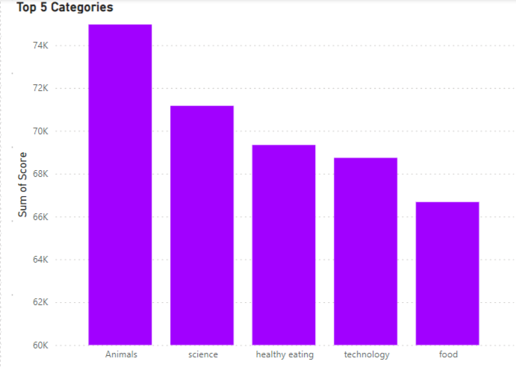

Slide 9
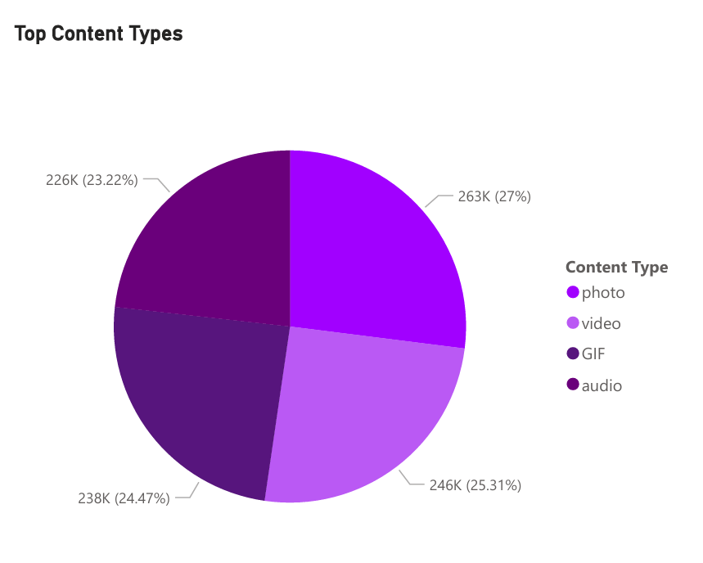

Slide 10
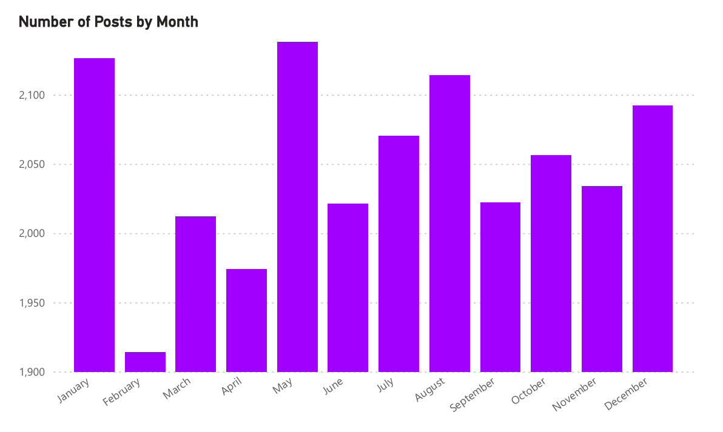

Slide 11

Provided actionable insights for optimizing content strategy.
Enabled targeted resource allocation to high-performing content.
Enhanced understanding of user preferences, driving improved content creation.
Summary

Slide 12
Thank you!
ANY QUESTIONS?

