Slide 1
Predictive Analysis
Presented by: Christian Grosskopf

Slide 2
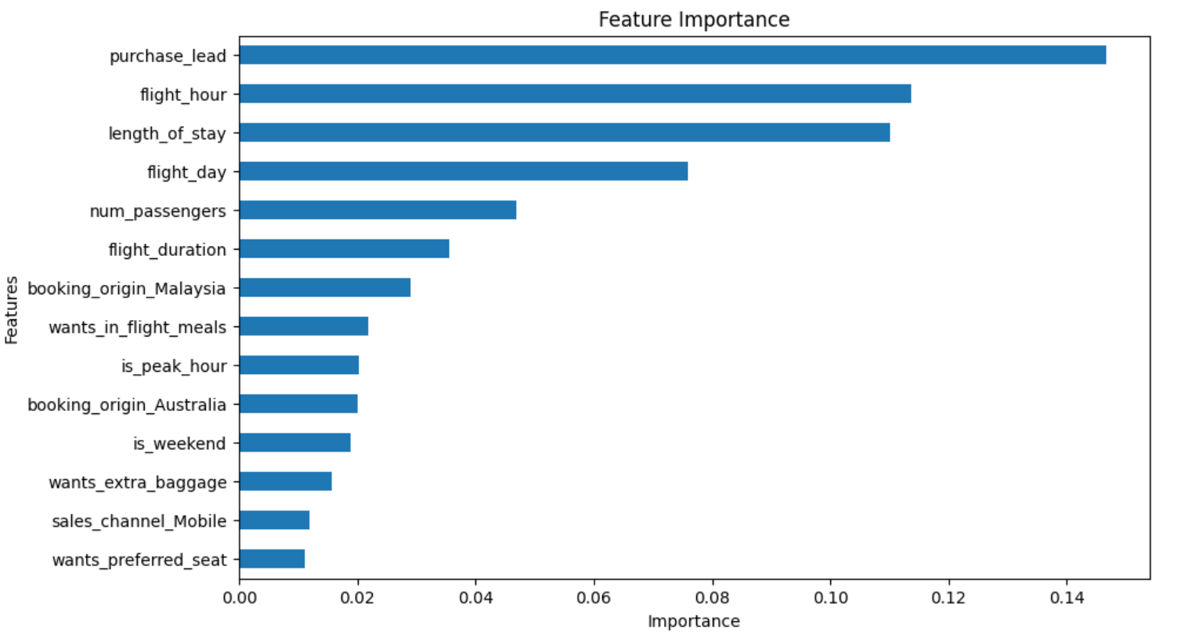
Predictive Analysis Findings
The top features predicting customer booking were:
Purchase lead time
Hour of flight departure
Length of stay
Model achieved 84.94% overall accuracy.
Recall of only 13% for booked flights suggests improvements to model can be made.

