Slide 1
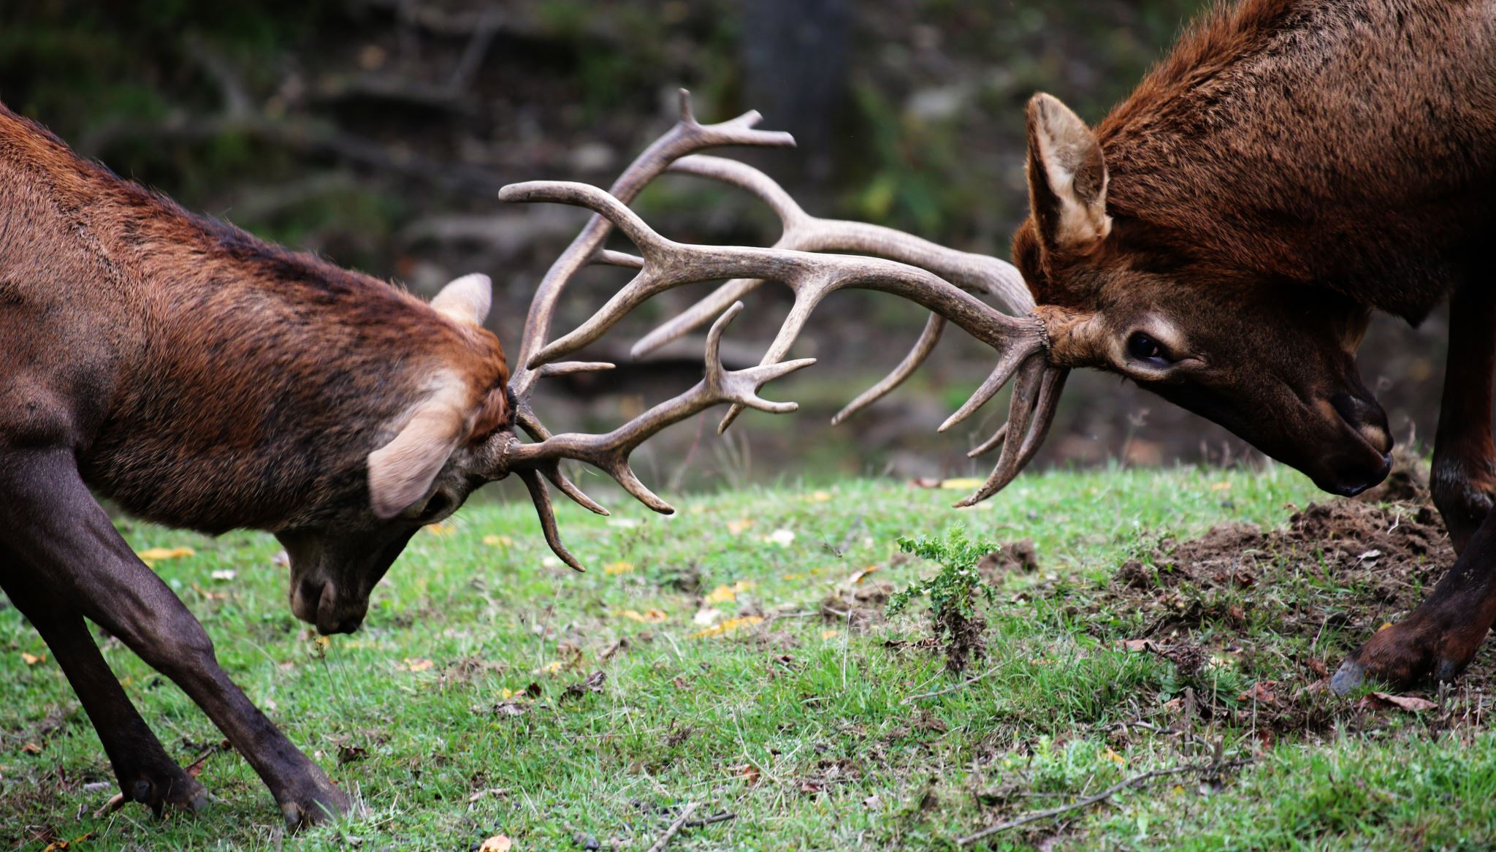
Species and Conservation Observations in US Parks
Findings by: Christian Grosskopf

Slide 2


Basic Info
Over 25,000 observations over 4 U.S. National Parks
7 different types of species studied.
Plants far outnumber the other types of species.
Of the more than 25,000 observed, 880 of them were placed under watch of conservatory efforts:
Species of concern: 732
Endangered: 80
Threatened: 44
In recover: 24

Slide 3
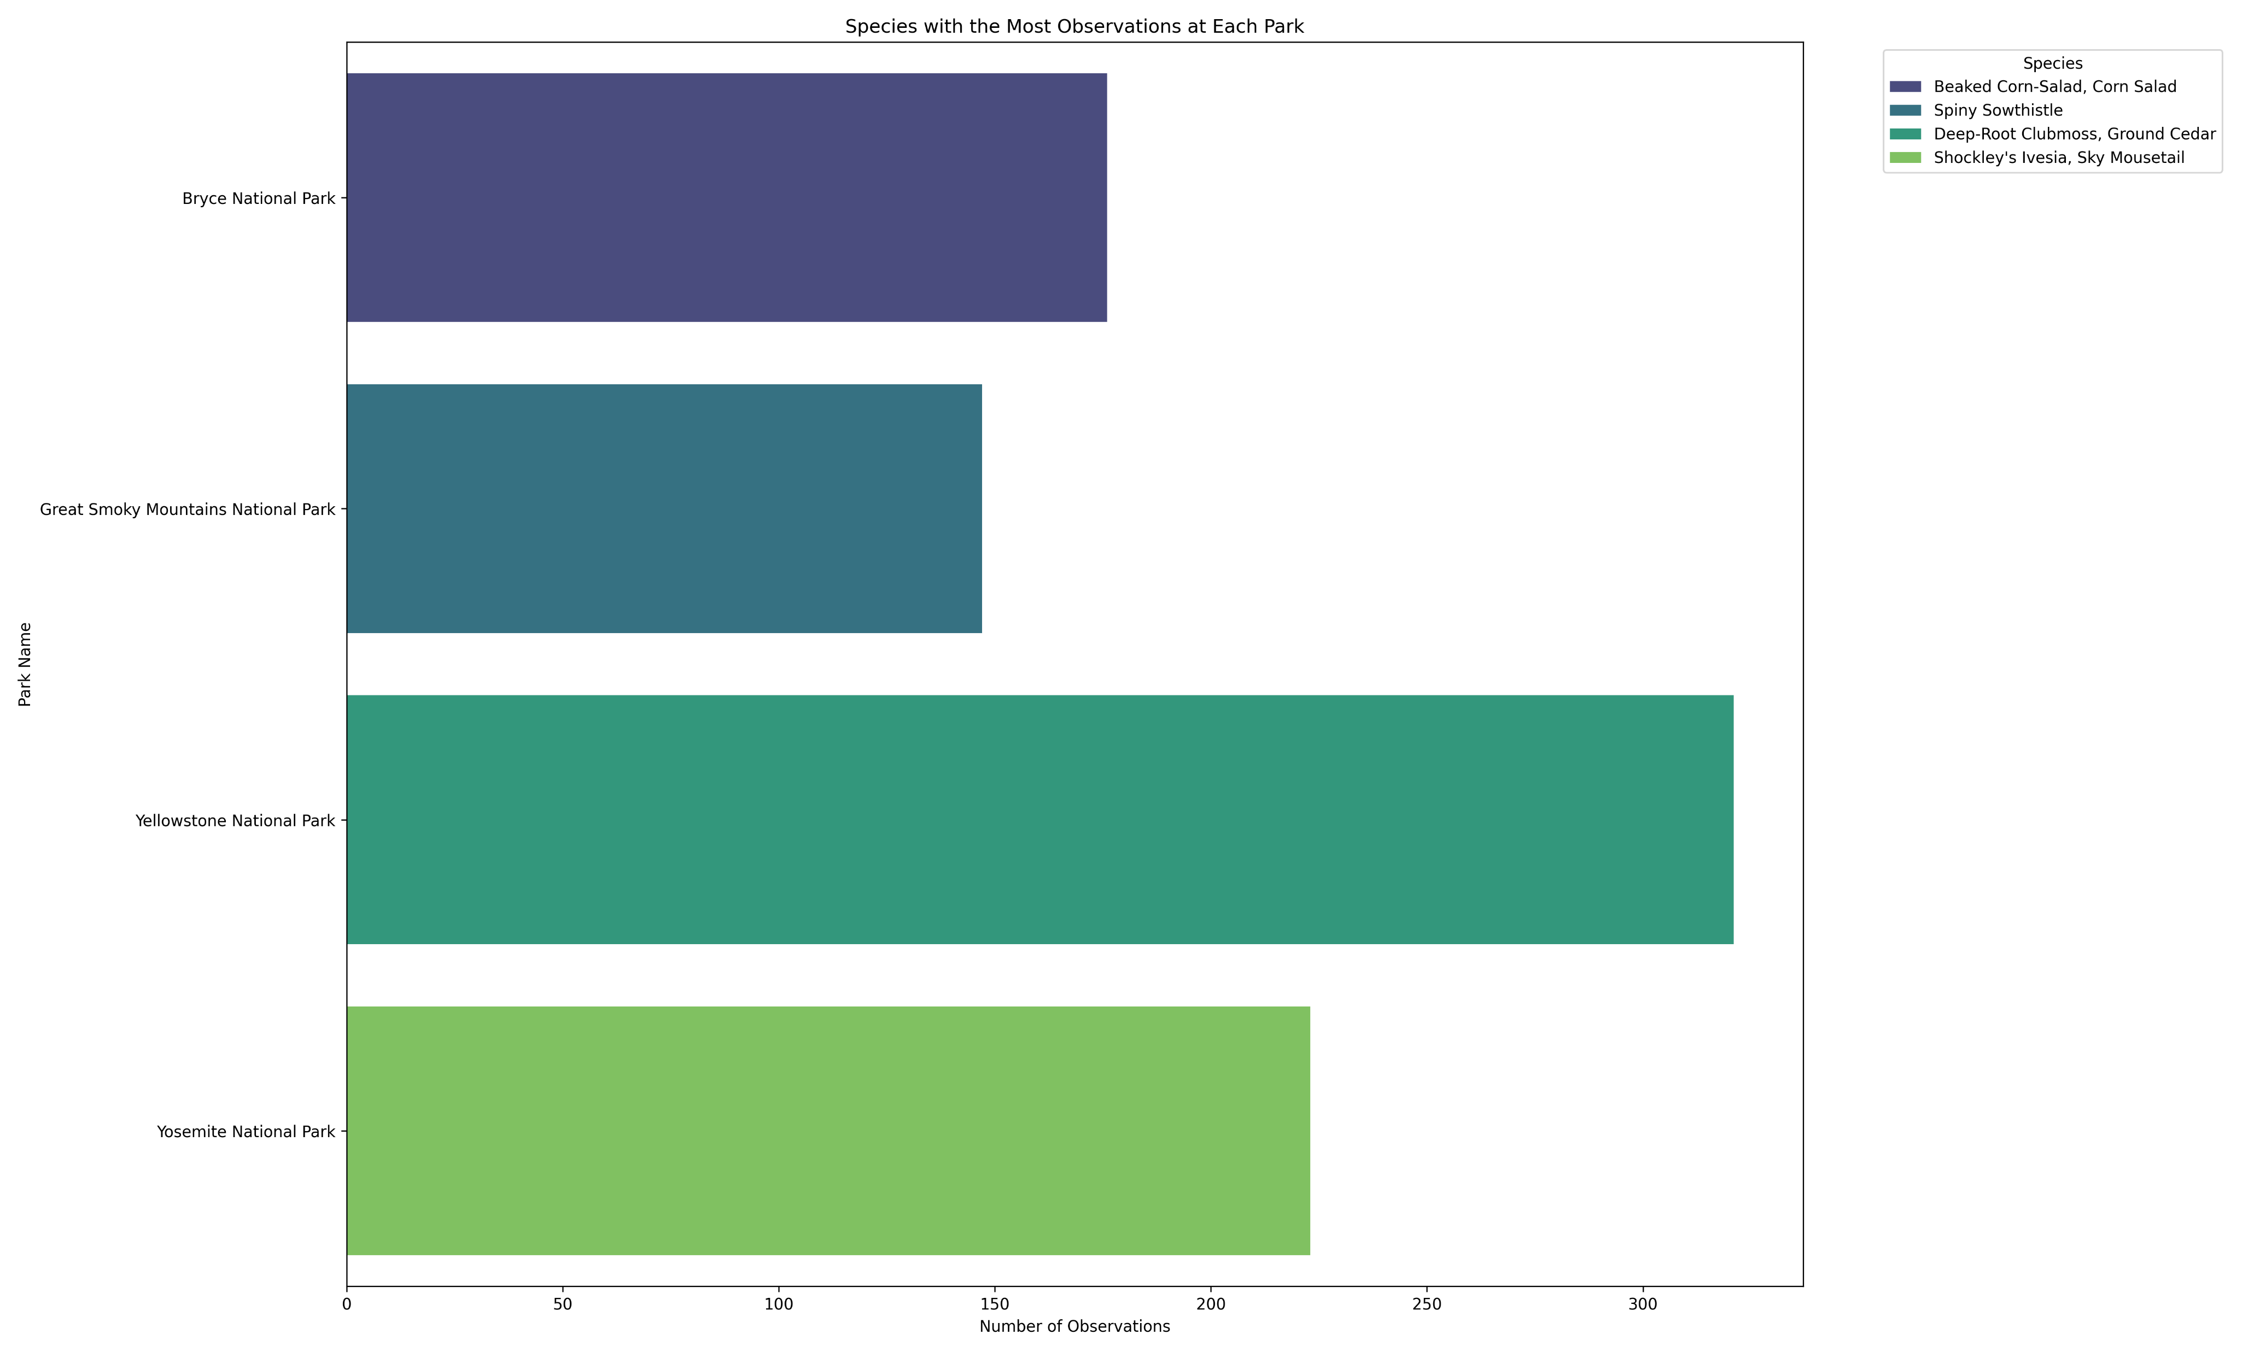
Most Observed Species by Park

Slide 4
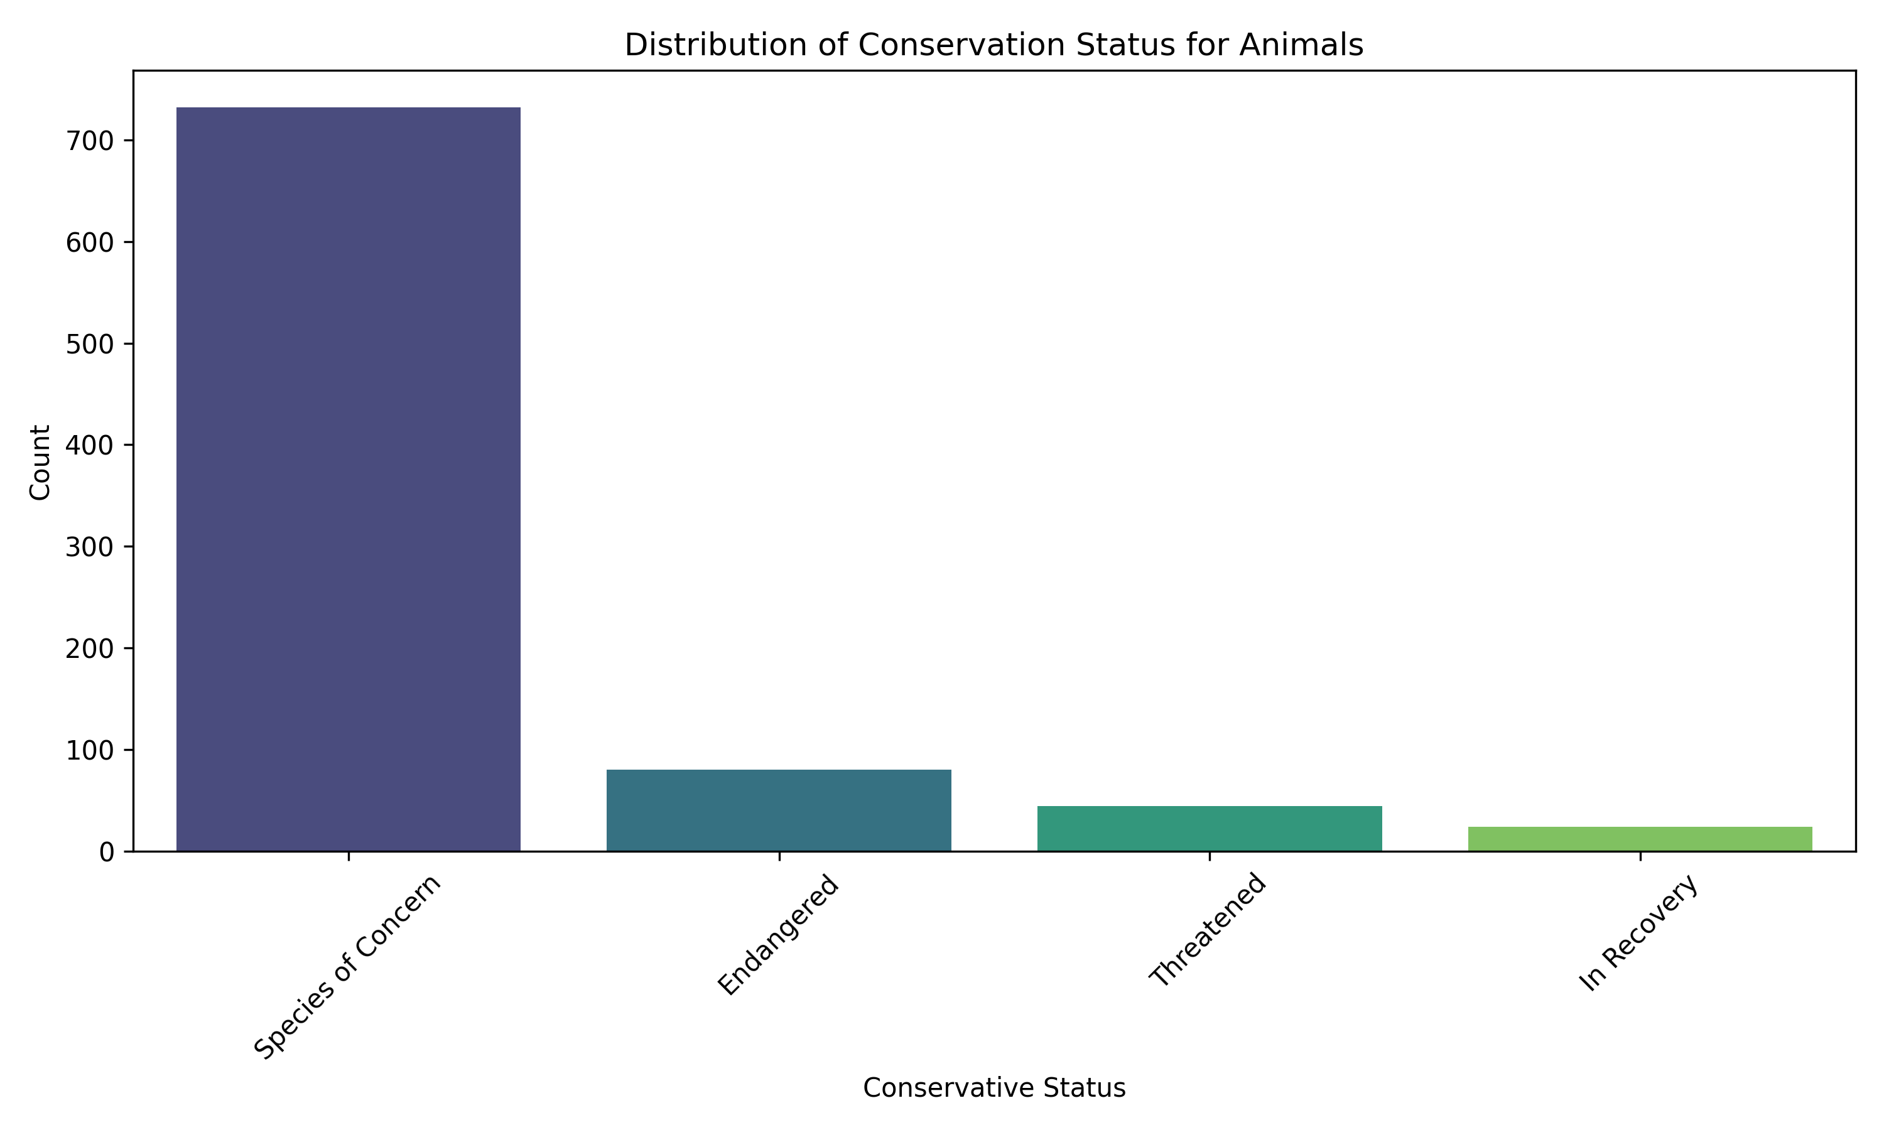
Conservation Status Distribution

Slide 5
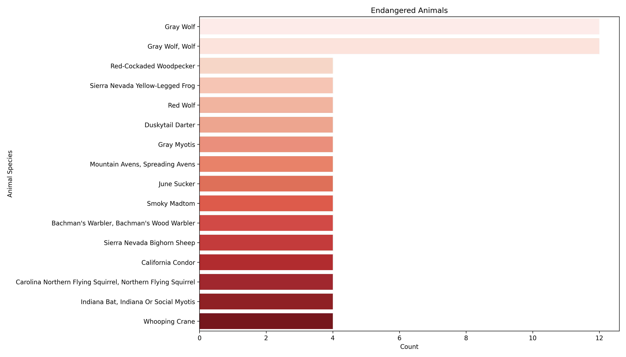
Most Endangered Species

Slide 6
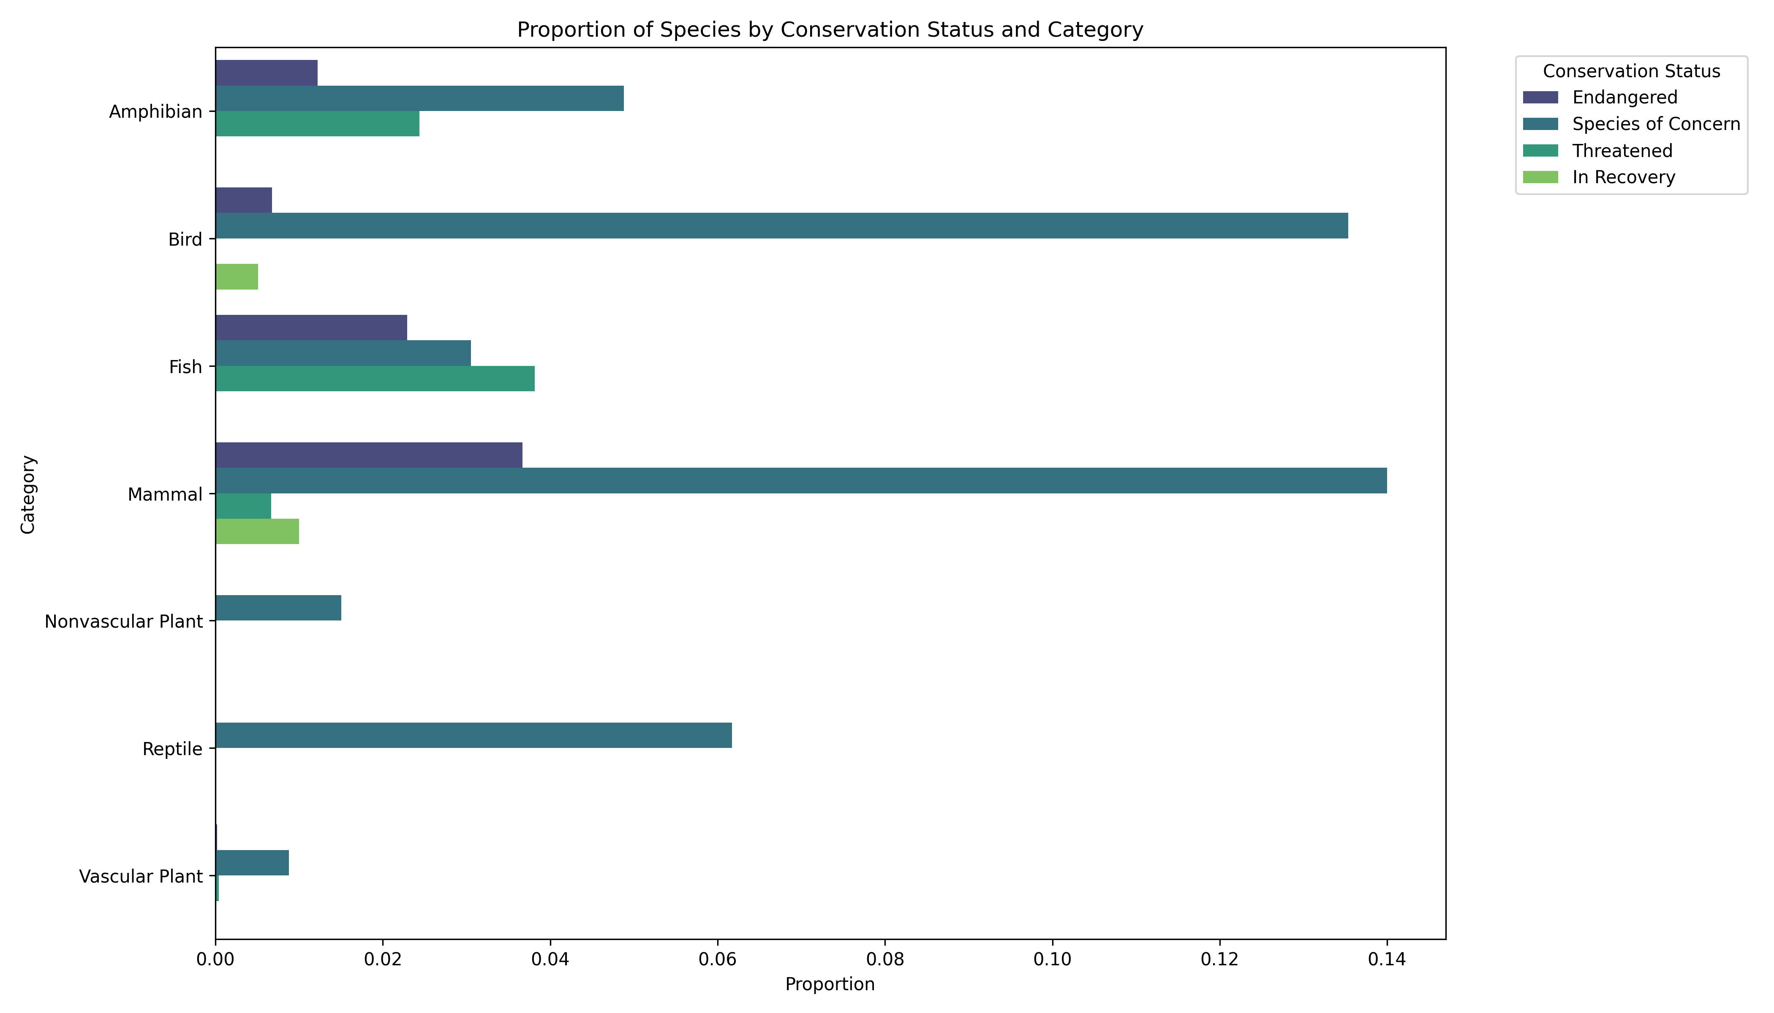
Conservations Status by Species

Slide 7
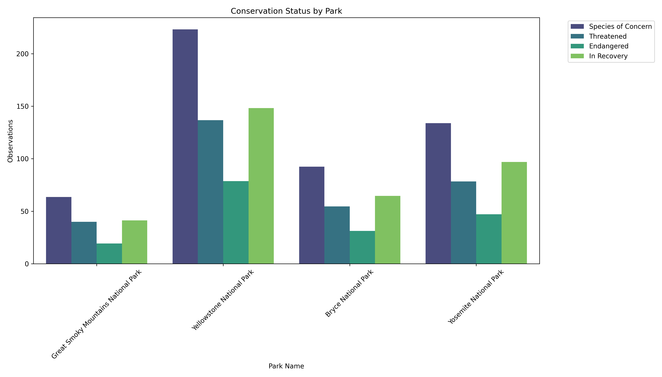
Endangered by Park

Slide 8
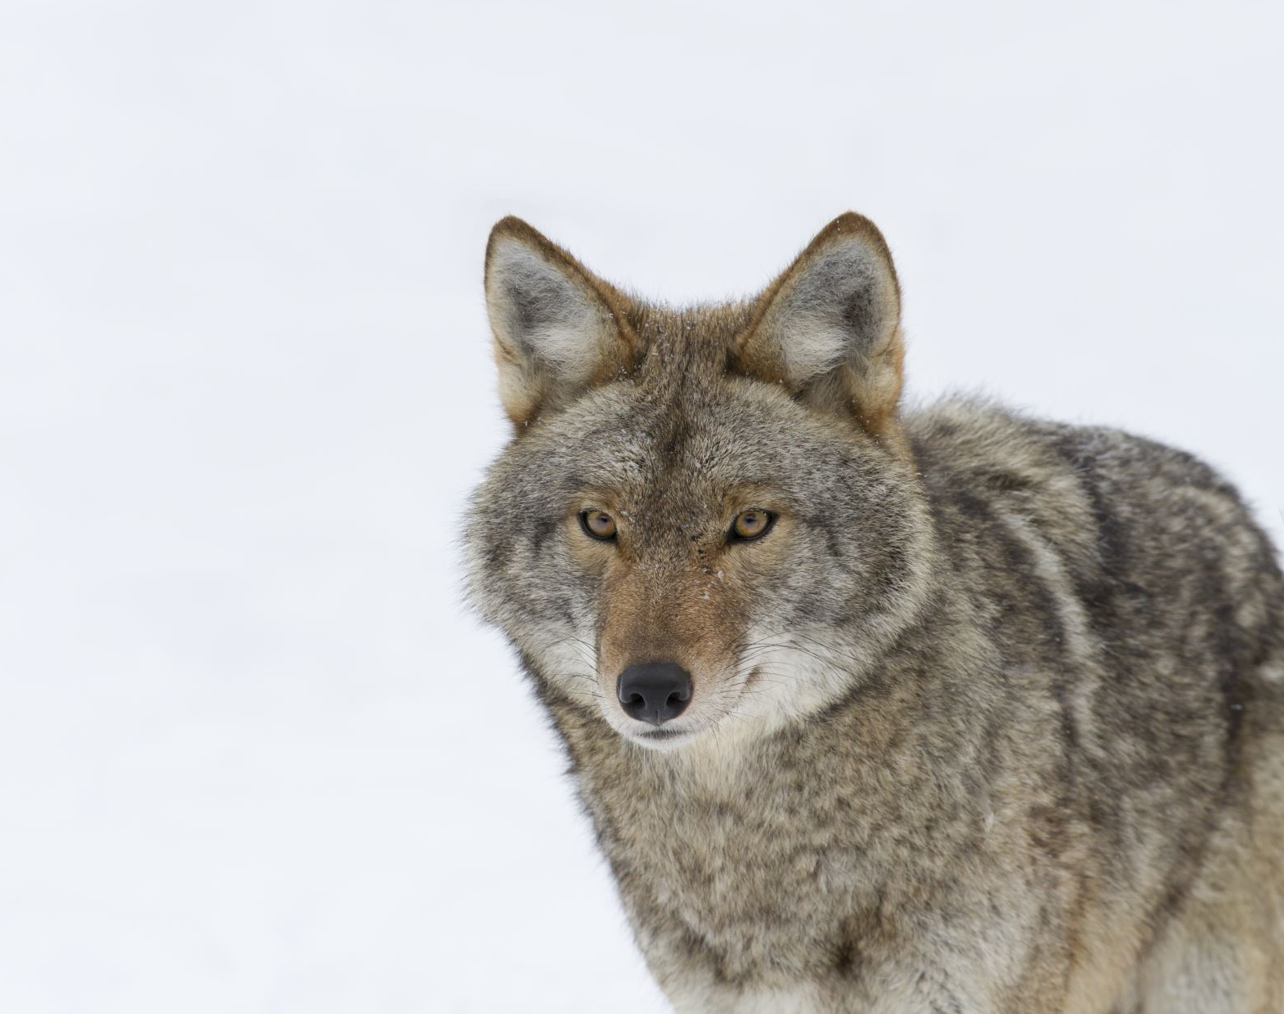
Key Findings
The Wolf is the most endangered animal in this dataset. Conservation efforts should focus around this.
Mammals are endangered and of concern, more than any other species type.
The large amount of plants in this dataset skews findings in a disproportional manner.
Yellowstone National Park has the most species that are endangered.

