Slide 1

Life Expectancy Data Analysis
Findings and Presentation by: Christian Grosskopf

Slide 2

Basic Dataset Info
Total of 96 observations in dataset.
6 countries are observed over the course of 15 years.
Chile
China
Germany
Mexico
USA
Zimbabwe
Each country’s GDP in that year is also observed.

Slide 3
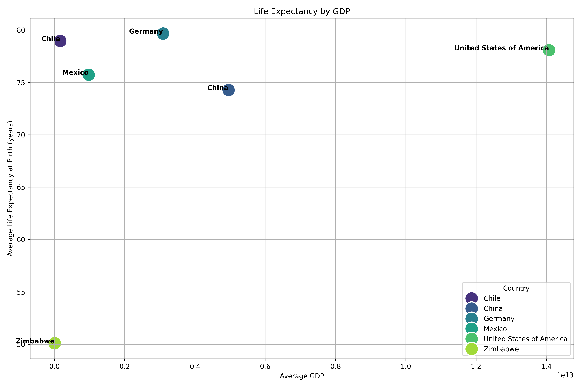
Life Expectancy by Country’s GDP

Slide 4
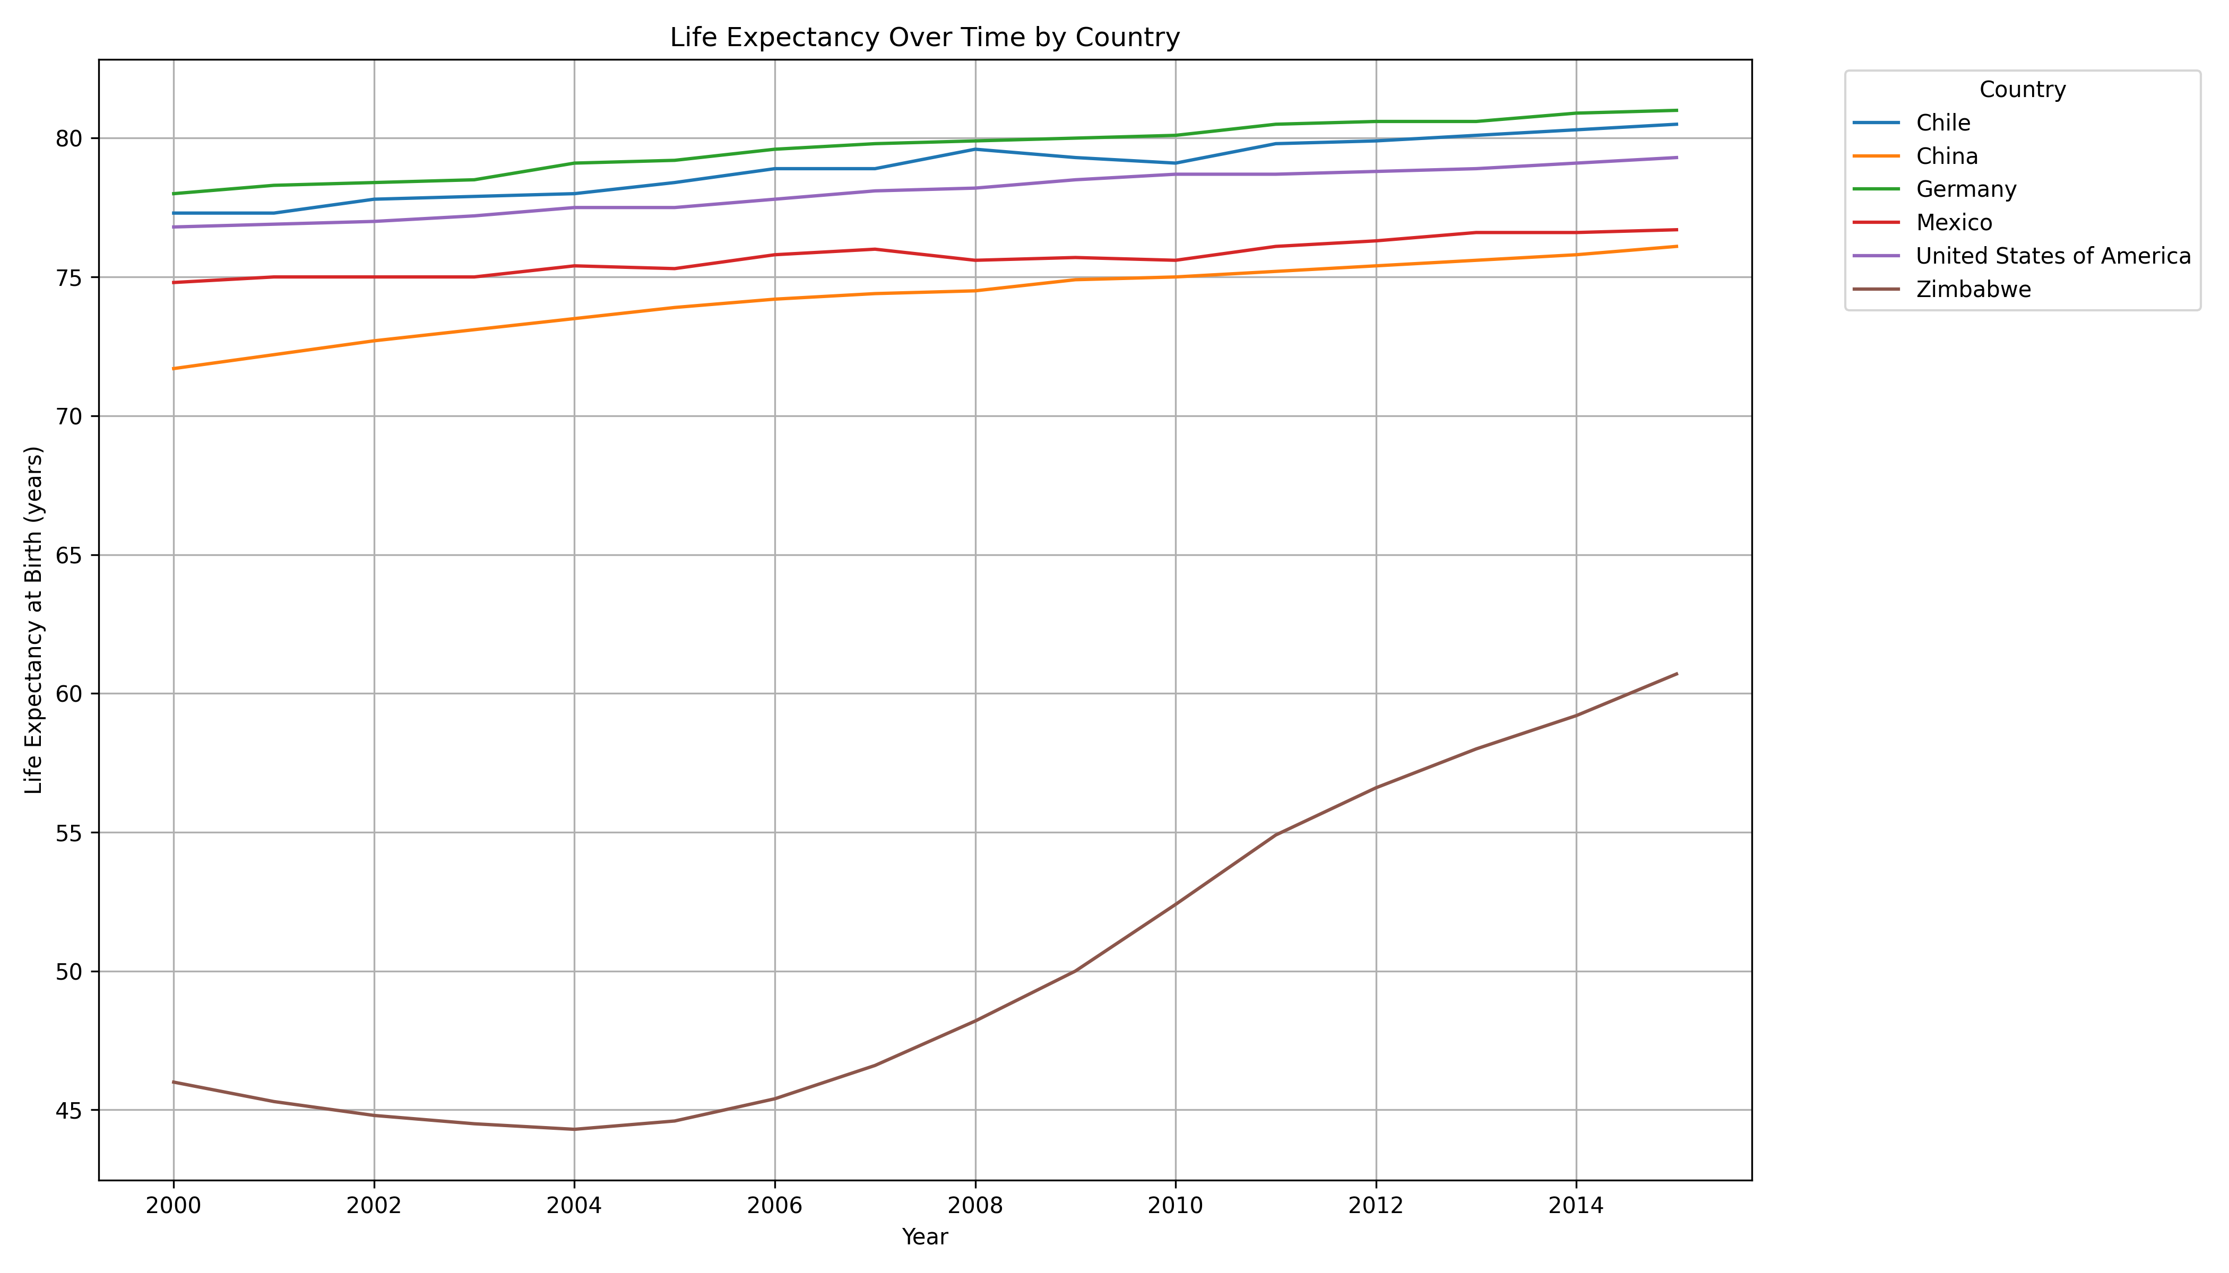
Life Expectancy by Country (2000-2015)

Slide 5
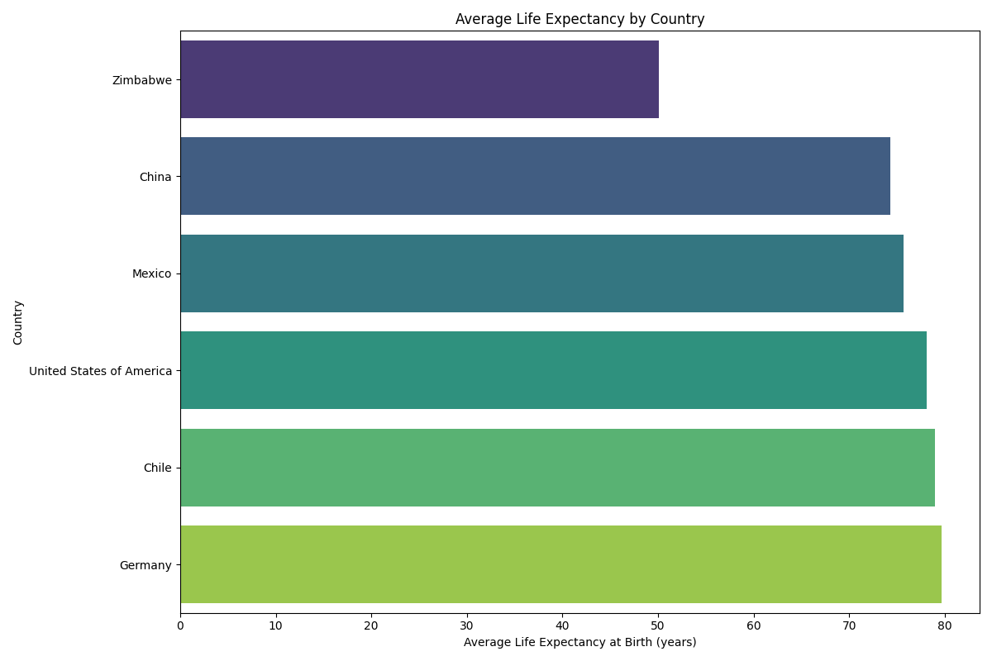
Average Life Expectancy by Country

Slide 6
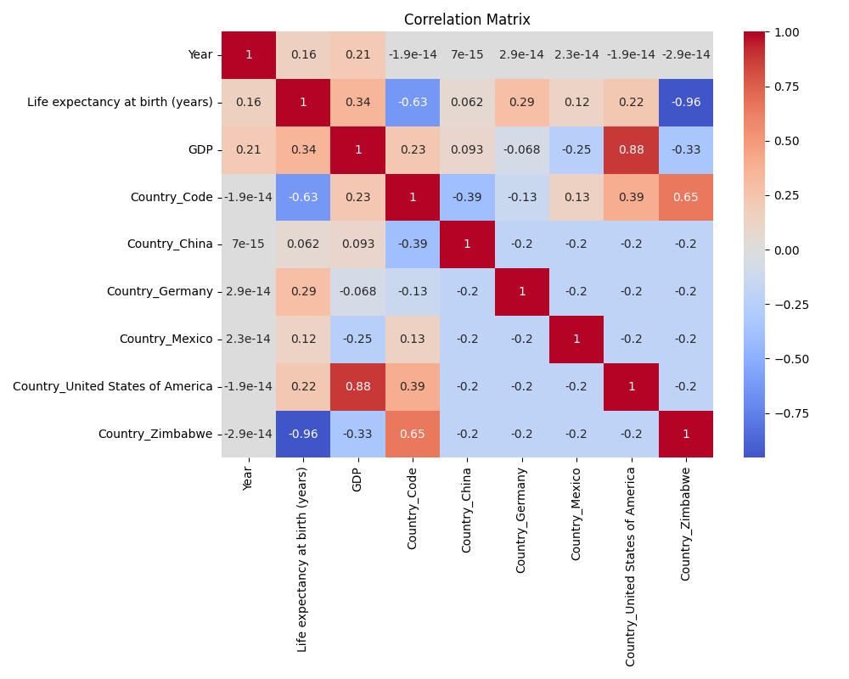
Correlation Heatmap

Slide 7
Summative Findings
Germany has highest average life expectancy, with the third highest GDP.
Surprisingly, Chile has second highest life expectancy, with the second lower GDP.
Zimbabwe has seen dramatic rise in life expectancy since 2006.
Correlation analysis reveals strong correlation amongst Country and Life Expectancy. GDP and Life Expectancy has fairly weak correlation.
Too small of a dataset to derive conclusive answers.

