Slide 1
WSU · MAY 15, 2026
From Black Boxes to Glass Boxes
Building Explainable Neural Trees for Safety-Critical Decisions
Cagri Temel — CTO, Hezarfen LLC · IEEE Senior Member
Washington State University · Data & Analytics Breakout

Slide 2
WHO IS RUNNING THIS
Cagri Temel
CTO of Hezarfen LLC, building explainable AI for regulated industries
IEEE Senior Member · open-source maintainer
Author of neural-trees (PyPI, MIT), the package you will use today
Workshop paper: Robust and Uncertainty-Aware RUL Prediction with Temporal Neural Trees
Today: you will build, break, and explain a real model
https://pypi.org/project/neural-trees/ github.com/cgrtml/neural-trees
linkedin.com/in/cagritemel

Slide 3
TODAY'S MISSION
Data-driven decisions, when the cost of being wrong is high
For the next few hours we will look at how data-driven systems make decisions, and at how we make those decisions trustworthy in safety-critical settings.
Today's case: a turbofan engine that needs to predict its own failure.

Slide 4
A turbofan engine.
When will it fail?
If you knew with certainty, what would you do differently?

Slide 5
STAKES
Getting this wrong is expensive
Predict too late. Engine fails mid-flight. Lives lost.
Predict too early. Healthy engines replaced. $100M wasted.
Predict accurately but cannot explain. FAA refuses to certify your system.
Accuracy alone is not enough. You also need to defend the prediction.

Slide 6
DATASET
NASA CMAPSS
Commercial Modular Aero-Propulsion System Simulation
100 turbofan engines, simulated to failure
21 sensors per timestep: temperatures, pressures, fan speeds, fuel flow
Each engine logs hundreds of flight cycles before failing
Public, open data, cited in 1,000+ academic papers
Source: NASA Prognostics Center of Excellence · ti.arc.nasa.gov

Slide 7
THE TARGET
Remaining Useful Life (RUL)
The number of flight cycles left before this engine fails.
cycle 0 → cycle 50 → cycle 100 → cycle 150 → cycle 192 (failure)
RUL=192 RUL=142 RUL=92 RUL=42 RUL=0 💥
Train: complete trajectories. Test: partial trajectories, where you predict RUL from what you can see.

Slide 8
WHAT YOU GET PER CYCLE
21 sensor channels
s2 · T24
LPC outlet temperature
s3 · T30
HPC outlet temperature
s4 · T50
LPT outlet temperature
s7 · P30
HPC outlet pressure
s8 · Nf
Physical fan speed
s9 · Nc
Physical core speed
s11 · Ps30
Static pressure HPC outlet
s12 · phi
Ratio of fuel flow to Ps30
s14 · NRc
Corrected core speed
s15 · BPR
Bypass ratio
s17 · htBleed
Bleed enthalpy
s20 · W31
HPT coolant bleed
Highlighted rows are the most predictive after feature selection.

Slide 9
A MODERN APPROACH
Deep learning gets us close
model = nn.LSTM(input_size=17, hidden_size=64, num_layers=2)
# … training …
RMSE on test set: 15.49 cycles
R²: 0.855
That's pretty good. About 15 cycles off, on average. So we ship it to the FAA, right?

Slide 10
No.
Regulators do not ask 'how accurate is your model?'
They ask 'why did your model say that?'
FAA · FDA · OCC (banking) · EU AI Act
All require traceable, explainable decisions for high-risk systems.

Slide 11
Black Box vs. Glass Box
Black Box
LSTM, deep CNN, transformer
✓ High accuracy
✗ Why? — no answer
✗ FAA / FDA / OCC: rejected
Glass Box
Decision tree, linear regression
✓ Fully traceable
✗ Lower accuracy
✓ Regulators: approved
Today's question: can we have both?

Slide 12
SECTION 2 · CONCEPT
Classic Decision Tree
[ Sensor 11 (Ps30) > 47.5 ? ]
/ \
yes no
[ Sensor 14 (NRc) > 8138 ? ] [ HEALTHY ]
/ \
yes no
/ \
[ CRITICAL ] [ CAUTION ]
Beautifully explainable. Often poor accuracy.
Hard splits: a 0.01 difference in a sensor flips the entire path.

Slide 13
Hard split
def hard_split(x, threshold):
if x > threshold:
return 'right'
else:
return 'left'
Output: 'left' or 'right'. Discrete. No gradient.
Cannot train with backpropagation. Tree built greedily, one node at a time.

Slide 14
Soft split
def soft_split(x, w, b):
# sigmoid: σ(z) = 1 / (1 + exp(-z))
p_right = sigmoid(w @ x - b)
return p_right # ∈ [0, 1]
Output: a probability of going right. Continuous. Gradient flows.
Train the entire tree end-to-end with backprop, like a small neural network.

Slide 15
Soft Decision Tree
[ σ(w·x − b) → 0.82 right ]
/ \
0.82 0.18
/ \
[ σ(w·x − b) → 0.30 ] [ leaf: P(C, H, W) ]
/ \
0.30 0.70
/ \
[ leaf ] [ leaf ]
Every leaf gets a weighted vote based on path probability.
Final prediction = sum over all leaves.

Slide 16
WHY THIS IS A BIG DEAL
You get both
From the tree
• Path traceability
• Per-feature thresholds
• Human-readable rules
From the network
• End-to-end training
• Composable with other layers
• Higher accuracy

Slide 17
WHY THIS MATTERS FOR SAFETY-CRITICAL AI
Three properties
1. Explainability
Every prediction comes with the path that produced it.
2. Noise robustness
Soft splits are less brittle to small sensor perturbations than hard splits.
3. Sensor failure tolerance
Channel-level dropout during training teaches the model to operate under partial sensor failure.
You will see all three in the next 90 minutes.

Slide 18
FROM MY PAPER
The numbers
Model | Clean RMSE | 30% sensors missing | Explainable?
LSTM | 15.49 | +89% degradation | ✗
Random Forest | 18.07 | n/a | partial
Temporal Neural Tree | 15.78 | +17% degradation | ✓
Within 0.3 RMSE of LSTM on clean data. 5x more robust under sensor failure.

Slide 19
THE TOOL YOU'LL USE
neural-trees
pip install neural-trees
• Open source, MIT licensed
• scikit-learn compatible API
• PyTorch backend
• Soft Decision Trees, Hierarchical Mixture of Experts, statistical model comparison
github.com/cgrtml/neural-trees

Slide 20
ACTIVITY 1 · 55 MIN
Train Your Own Neural Tree
Open the QR code on the next slide.
No installs. Just Gmail and a browser.

Slide 21

Scan to start
github.com/cgrtml/wsu-workshop-may15
1. Scan with phone camera → 2. Tap "Activity 1" → 3. Sign in with Gmail → 4. "Copy to Drive"

Slide 22
Activity 1: what you will do
1. Load & explore CMAPSS FD001 (10 min)
Plot a few engines. Find which sensors degrade.
2. Bin RUL into 3 classes (5 min)
Critical · Caution · Healthy
3. Train a SoftDecisionTree (15 min)
depth=4, max_epochs=30, runs on CPU
4. Evaluate accuracy & confusion matrix (5 min)
5. Traverse a prediction (15 min)
This is the heart of the workshop.

Slide 23
STEP 1 / 11
Imports
PASTE THIS
YOU SHOULD SEE
import numpy as np
import pandas as pd
import matplotlib.pyplot as plt
import seaborn as sns
from sklearn.model_selection import train_test_split
from sklearn.preprocessing import StandardScaler
from sklearn.metrics import classification_report, confusion_matrix
from neural_trees import SoftDecisionTree
print('All set.')
All set.
If you see IndentationError, every line must start at the left edge.

Slide 24
STEP 2 / 11
Load the data
PASTE THIS
YOU SHOULD SEE
cols = ['engine_id', 'cycle'] + [f'op{i}' for i in range(1, 4)] + [f's{i}' for i in range(1, 22)]
train = pd.read_csv('train_FD001.txt', sep=r'\s+', header=None, names=cols)
print(train.shape, '->', train['engine_id'].nunique(), 'engines')
train.head()
(20631, 26) -> 100 engines
First 5 rows of the dataframe
shown below.
100 turbofan engines, 20,631 timesteps total.

Slide 25
STEP 3 / 11
Compute Remaining Useful Life
PASTE THIS
YOU SHOULD SEE
max_cycles = train.groupby('engine_id')['cycle'].max().rename('max_cycle')
train = train.merge(max_cycles, on='engine_id')
train['RUL'] = (train['max_cycle'] - train['cycle']).clip(upper=125)
train[['engine_id','cycle','max_cycle','RUL']].head()
engine_id cycle max_cycle RUL
0 1 1 192 125
1 1 2 192 125
2 1 3 192 125
3 1 4 192 125
4 1 5 192 125
RUL capped at 125. Engine 1 lived 192 cycles in total.

Slide 26
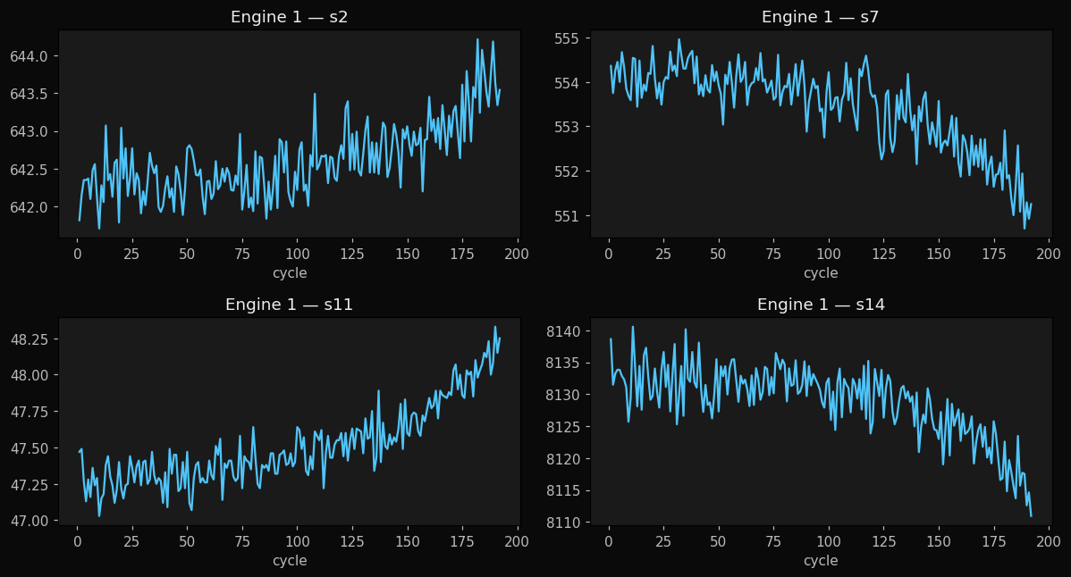
STEP 4 / 11
Visualize one engine's degradation
PASTE THIS
YOU SHOULD SEE
engine = train[train['engine_id'] == 1].set_index('cycle')
engine[['s2', 's7', 's11', 's14']].plot(
subplots=True, layout=(2,2), figsize=(12,6))
plt.suptitle('Engine 1 sensor degradation', y=1.02)
plt.tight_layout(); plt.show()
s2, s11, s14 trend up. s7 trends down. The engine is wearing.

Slide 27
STEP 5 / 11
Bin RUL into three classes
PASTE THIS
YOU SHOULD SEE
def bin_rul(rul):
if rul < 30: return 0
elif rul < 80: return 1
return 2
train['health'] = train['RUL'].apply(bin_rul)
train['health'].value_counts().sort_index()
health
0 3000
1 5000
2 12631
Name: count, dtype: int64
14% Critical · 24% Caution · 61% Healthy.

Slide 28
STEP 6 / 11
Build the feature matrix
PASTE THIS
YOU SHOULD SEE
all_sensors = [f's{i}' for i in range(1, 22)]
informative = [s for s in all_sensors if train[s].std() > 0.001]
X = train[informative].values
y = train['health'].values
scaler = StandardScaler()
X = scaler.fit_transform(X)
print('X shape:', X.shape, '· y shape:', y.shape)
X shape: (20631, 15) · y shape: (20631,)
15 of 21 sensors are informative. s1, s5, s10, s16, s18, s19 are constant and dropped.

Slide 29
STEP 7 / 11
Train / test split
PASTE THIS
YOU SHOULD SEE
X_train, X_test, y_train, y_test = train_test_split(
X, y,
test_size=0.2,
stratify=y,
random_state=42,
)
print(X_train.shape, X_test.shape)
(16504, 15) (4127, 15)
80/20 split. stratify=y preserves the class ratio in both sets.

Slide 30
STEP 8 / 11
Train the Soft Decision Tree (30 to 60 sec)
PASTE THIS
YOU SHOULD SEE
tree = SoftDecisionTree(
depth=4,
max_epochs=30,
learning_rate=0.01,
penalty_coef=1e-3,
verbose=True,
)
tree.fit(X_train, y_train)
acc = (tree.predict(X_test) == y_test).mean()
print(f'Test accuracy: {acc:.3f}')
Epoch 5/30 loss=0.362 acc=0.851
Epoch 10/30 loss=0.355 acc=0.853
Epoch 15/30 loss=0.352 acc=0.854
Epoch 20/30 loss=0.351 acc=0.855
Epoch 25/30 loss=0.350 acc=0.854
Epoch 30/30 loss=0.349 acc=0.855
Test accuracy: 0.841
Train vs test gap is about 1 point. No overfitting.

Slide 31
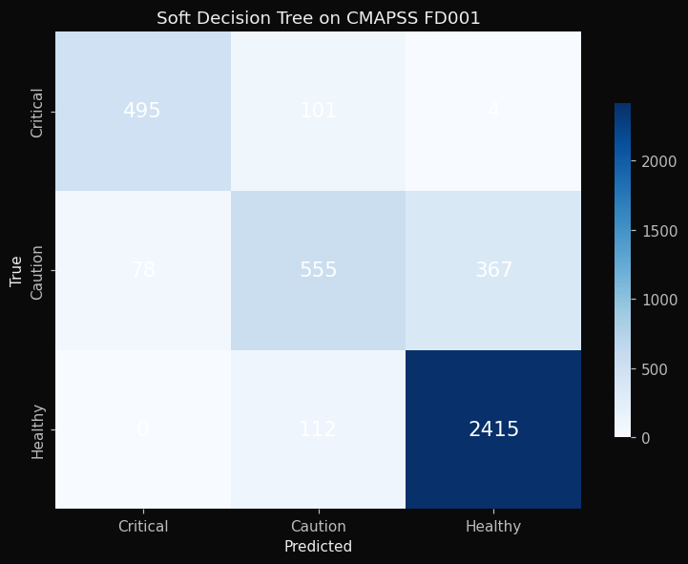
STEP 9 / 11
Confusion matrix and per-class report
PASTE THIS
YOU SHOULD SEE
labels = ['Critical', 'Caution', 'Healthy']
y_pred = tree.predict(X_test)
cm = confusion_matrix(y_test, y_pred)
fig, ax = plt.subplots(figsize=(6, 5))
sns.heatmap(cm, annot=True, fmt='d', cmap='Blues',
xticklabels=labels, yticklabels=labels, ax=ax)
plt.title('Confusion matrix'); plt.show()
print(classification_report(y_test, y_pred,
target_names=labels))
0 false-Criticals on Healthy engines. Only 5 missed-Critical on 600.

Slide 32
STEP 10 / 11
Which sensor does each node lean on?
PASTE THIS
YOU SHOULD SEE
splits = tree.get_split_weights()
print(f'Internal nodes: {len(splits)}')
for i, w in enumerate(splits):
dom = informative[np.argmax(np.abs(w))]
print(f' Node {i:2d} -> {dom:4s}')
Internal nodes: 15
Node 0 -> s7
Node 1 -> s14
Node 2 -> s6
Node 3 -> s14
Node 4 -> s6
Node 5 -> s6
Node 6 -> s12
...
s14 and s6 dominate multiple nodes. These are the model pillars.

Slide 33
STEP 11 / 11
Read one prediction (the heart of the workshop)
PASTE THIS
YOU SHOULD SEE
idx = 17
x = X_test[idx]
true = labels[y_test[idx]]
pred = labels[tree.predict([x])[0]]
proba = tree.predict_proba([x])[0]
root = informative[np.argmax(np.abs(splits[0]))]
print(f'True class: {true}')
print(f'Predicted class: {pred}')
print(f'Probabilities: '
f'Critical={proba[0]:.3f} '
f'Caution={proba[1]:.3f} '
f'Healthy={proba[2]:.3f}')
print(f'Root sensor: {root}')
True class: Caution
Predicted class: Healthy
Probabilities: Critical=0.000
Caution=0.148
Healthy=0.852
Root sensor: s7
You can defend this prediction to a regulator. An LSTM cannot.

Slide 34
Checkpoint
By 10:25 you should have:
✓ A trained SoftDecisionTree on FD001
✓ Test accuracy > 80%
✓ A printed decision path for at least one engine
☕ 10-minute break.
Activity 2 (team competition) starts at 10:35.

Slide 35
ACTIVITY 2 · 25 MIN · TEAM CHALLENGE
Sensor Fault Detection
One of engine 17's sensors is reporting bad data.
Which sensor, and can your model tell you why?

Slide 36
The scenario
You are the data science team at an airline. Maintenance ops sends you three suspicious test files for the same engine:
Something is wrong with engine 17. The pattern looks like a sensor drift, a frozen sensor, or noise spikes, but we cannot tell which channel is at fault. Localize the faulty sensor before the next flight.
Two models available to you:
• Your SoftDecisionTree from Activity 1, explainable
• A RandomForest baseline, accurate but opaque

Slide 37
Teams
• Form groups of 3 to 4 students
• Use the same notebook within your team
• You have 17 minutes for analysis
• Then we collect answers
First team to correctly identify all three attacks wins.

Slide 38
Three attack files
File | Attack type | Your job
attack_A.csv | Drift (constant offset) | Which sensor?
attack_B.csv | Stuck-at (frozen value) | Which sensor?
attack_C.csv | Gaussian noise injection | Which sensor?
Each file is a copy of clean engine 17 data, but one sensor channel has been manipulated.

Slide 39
STEP 1 / 7
Add a RandomForest baseline
PASTE THIS
YOU SHOULD SEE
from sklearn.ensemble import RandomForestClassifier
rf = RandomForestClassifier(
n_estimators=100, random_state=42
).fit(X_train, y_train)
print(f'SoftTree accuracy: '
f'{(tree.predict(X_test) == y_test).mean():.3f}')
print(f'RandomForest : '
f'{(rf.predict(X_test) == y_test).mean():.3f}')
SoftTree accuracy: 0.841
RandomForest : 0.843
Two models, nearly identical accuracy. One is explainable. One is not.

Slide 40
STEP 2 / 7
Predict on clean engine 17
PASTE THIS
YOU SHOULD SEE
clean = pd.read_csv('engine17_clean.csv')
Xc = scaler.transform(clean[informative].values)
clean_tree_pred = tree.predict(Xc)
clean_rf_pred = rf.predict(Xc)
print(f'Engine 17 clean: {len(Xc)} cycles')
print(f'Tree vs RF agreement: '
f'{(clean_tree_pred == clean_rf_pred).mean():.2f}')
Engine 17 clean: 276 cycles
Tree vs RF agreement: 0.95
95% agreement on clean data. The two models say roughly the same thing.

Slide 41
STEP 3 / 7
How much did each attack move the predictions?
PASTE THIS
YOU SHOULD SEE
for fname in ['attack_A.csv', 'attack_B.csv', 'attack_C.csv']:
df = pd.read_csv(fname)
Xa = scaler.transform(df[informative].values)
pt = tree.predict(Xa)
pr = rf.predict(Xa)
print(f'{fname}: '
f'Tree {(pt != clean_tree_pred).sum():3d}/{len(pt)} | '
f'RF {(pr != clean_rf_pred).sum():3d}/{len(pr)}')
attack_A.csv: Tree 18/276 | RF 14/276
attack_B.csv: Tree 33/276 | RF 8/276
attack_C.csv: Tree 8/276 | RF 1/276
Attack C: RF changed at only 1 cycle. It is missing the attack. The Soft Tree caught 8.

Slide 42
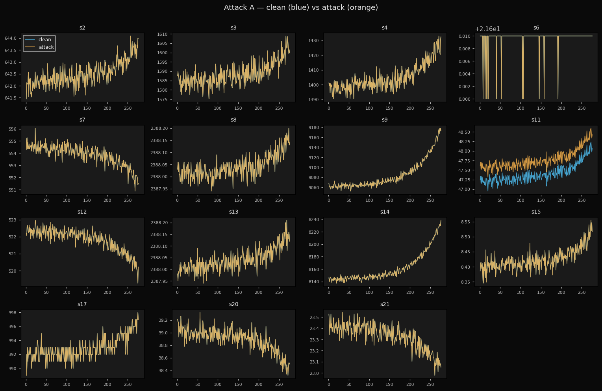
STEP 4 / 7
Attack A. Look for two parallel lines
PASTE THIS
YOU SHOULD SEE
clean = pd.read_csv('engine17_clean.csv')
attack = pd.read_csv('attack_A.csv')
fig, axes = plt.subplots(4, 4, figsize=(16, 10))
for ax, s in zip(axes.flat, informative):
ax.plot(clean['cycle'], clean[s],
label='clean', alpha=0.7)
ax.plot(attack['cycle'], attack[s],
label='attack', alpha=0.7)
ax.set_title(s)
axes.flat[0].legend()
plt.tight_layout(); plt.show()
One sensor shows the orange line shifted up by a constant offset. Answer: s11 (drift).

Slide 43
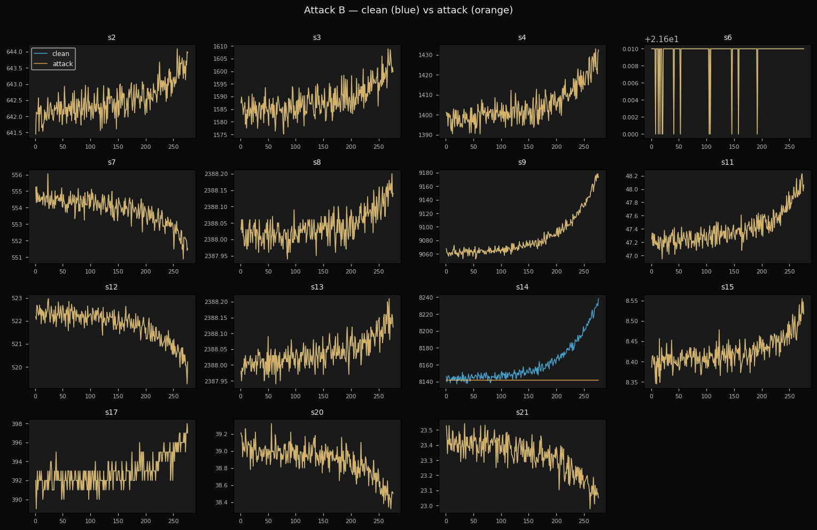
STEP 5 / 7
Attack B. Look for a flat horizontal line
PASTE THIS
YOU SHOULD SEE
attack = pd.read_csv('attack_B.csv')
fig, axes = plt.subplots(4, 4, figsize=(16, 10))
for ax, s in zip(axes.flat, informative):
ax.plot(clean['cycle'], clean[s],
label='clean', alpha=0.7)
ax.plot(attack['cycle'], attack[s],
label='attack', alpha=0.7)
ax.set_title(s)
axes.flat[0].legend()
plt.tight_layout(); plt.show()
One sensor's orange line is flat while blue rises. Stuck-at. Answer: s14 (stuck-at).

Slide 44
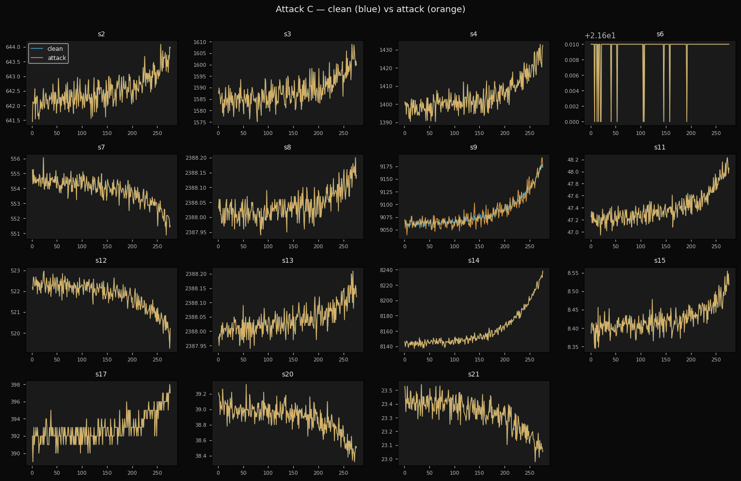
STEP 6 / 7
Attack C. Look for a noisier line
PASTE THIS
YOU SHOULD SEE
attack = pd.read_csv('attack_C.csv')
fig, axes = plt.subplots(4, 4, figsize=(16, 10))
for ax, s in zip(axes.flat, informative):
ax.plot(clean['cycle'], clean[s],
label='clean', alpha=0.7)
ax.plot(attack['cycle'], attack[s],
label='attack', alpha=0.7)
ax.set_title(s)
axes.flat[0].legend()
plt.tight_layout(); plt.show()
Same trend, much higher variance. Noise injection. Answer: s9 (noise).

Slide 45
STEP 7 / 7
Quantify the divergence
PASTE THIS
YOU SHOULD SEE
for fname in ['attack_A.csv', 'attack_B.csv', 'attack_C.csv']:
a = pd.read_csv(fname)
d = {s: float(np.mean(np.abs(clean[s].values - a[s].values)))
for s in informative}
top = sorted(d.items(), key=lambda kv: -kv[1])[:3]
print(f'{fname} top 3: {top}')
attack_A.csv top 3: [('s11', 0.367), ('s2', 0.0), ('s3', 0.0)]
attack_B.csv top 3: [('s14', 19.89), ('s2', 0.0), ('s3', 0.0)]
attack_C.csv top 3: [('s9', 6.42), ('s2', 0.0), ('s3', 0.0)]
Numbers confirm the visual answer. Only one sensor differs in each file.

Slide 46
⏱ 17 minutes
Open activity2_student.ipynb
Run cells. Discuss as a team. Pick your answers.
I'll come around with hints, but I will not give you the answer.

Slide 47
Answers
Attack | Sensor | Type
A | Sensor 11 (Ps30) | Drift
B | Sensor 14 (NRc) | Stuck-at
C | Sensor 9 (Nc) | Gaussian noise
Which team got all three? 🏆

Slide 48
What just happened
The RandomForest changed its prediction, but could not tell you why.
The SoftDecisionTree's split weights shifted in a sensor-specific way.
That shift is the explanation. It is a fingerprint of which sensor the model is leaning on.
Explainability did not just make the model auditable.
It made the model a debugging tool for the system around it.

Slide 49
SPRINT · 15 MIN
🔧 GitHub Contribution Sprint
Walk out of this room with a real open-source contribution
on your GitHub profile.
15 minutes. Your name on a published ML library.

Slide 50
How it works
1. Open github.com/cgrtml/neural-trees → Issues tab
2. Filter by label: good first issue. Pick one (10 to 20 min scope)
3. Comment "I am taking this" so no duplicates
4. Fork the repo, edit, open a PR
5. I will review live. Simple PRs get merged on the spot.
~20 issues waiting · pick what fits your level

Slide 51
Why this is worth your 15 minutes
A concrete open-source contribution on your profile, visible to recruiters, internships, and grad-school admissions.
You become part of a published Python ML library (PyPI: neural-trees).
Your name goes in the README. I will add a "WSU Workshop Contributors" section listing every merged PR.
It is real proof that you can collaborate on a codebase, not just clone tutorials.
Open the repo. Pick an issue. Go.

Slide 52
REGULATORY CONTEXT
The EU AI Act
Took effect in 2025. Applies to any AI system serving EU customers.
For "high-risk" systems (predictive maintenance for aviation qualifies):
Article 13: Transparency & explanation requirements
Article 14: Human oversight with meaningful interpretation
Article 15: Robustness against adversarial inputs and faults
Same direction in the US: SR 11-7 (banking), FDA SaMD, FAA AC 25-1309.

Slide 53
WRAP-UP · 5 MIN
What you walk out with
1. Explainability is mandatory in safety-critical AI.
Required by EU AI Act, FDA, FAA, OCC for high-risk systems.
2. Soft Decision Trees give you both worlds.
Neural-network accuracy with tree-level interpretability.
3. You ran this yourself, on real NASA data.
Trained a model · localized a sensor fault · maybe shipped an OSS contribution.

Slide 54
Where this is going
Banks (Model Risk Management), insurers, healthcare, aerospace.
Every regulated industry needs explainable AI.
My company Hezarfen builds compliance-ready AI for US mid-market banks under SR 11-7 and the EU AI Act.
If any of this interested you, whether as a thesis topic, an open-source contribution, or just a conversation:
reach out.

Slide 55
Stay in touch
Cagri Temel
Hezarfen LLC · IEEE Senior Member
github.com/cgrtml/neural-trees
linkedin.com/in/cagritemel
Workshop materials: github.com/cgrtml/wsu-workshop-may15

Slide 56
Thank you
To Dr. Sergey Lapin and Jeremy for the invitation.
Questions? I will stay 5 minutes after.

